Slide 1
Software Stack
Session 7
INST 346

Slide 2
Software Stack
Application Program (“App”)
API
Runtime environment
Operating System
BIOS
Hardware drivers
Microcode

Slide 3
System Architecture
Keyboard
Mouse
Sound
Card
Video
Card
Input
Controller
System Bus
Front Side Bus
Hard
Drive
RAM
CD/
DVD
L2
USB Port
CPU
L1
Cache
ROM
Motherboard

Slide 4
Some Operating Systems
Windows
Unix
Linux
Android
macOS
iOS

Slide 5
Operating System Functions
Processor scheduling
Single core, multi-core
Disk management
Formatting, file allocation, virtual memory, defragmentation, encryption, compression, …
Access control
Passwords, permission levels, file sharing, …
Configuration management
Parameter selection
Updates (OS, drivers, BIOS, microcode)

Slide 7
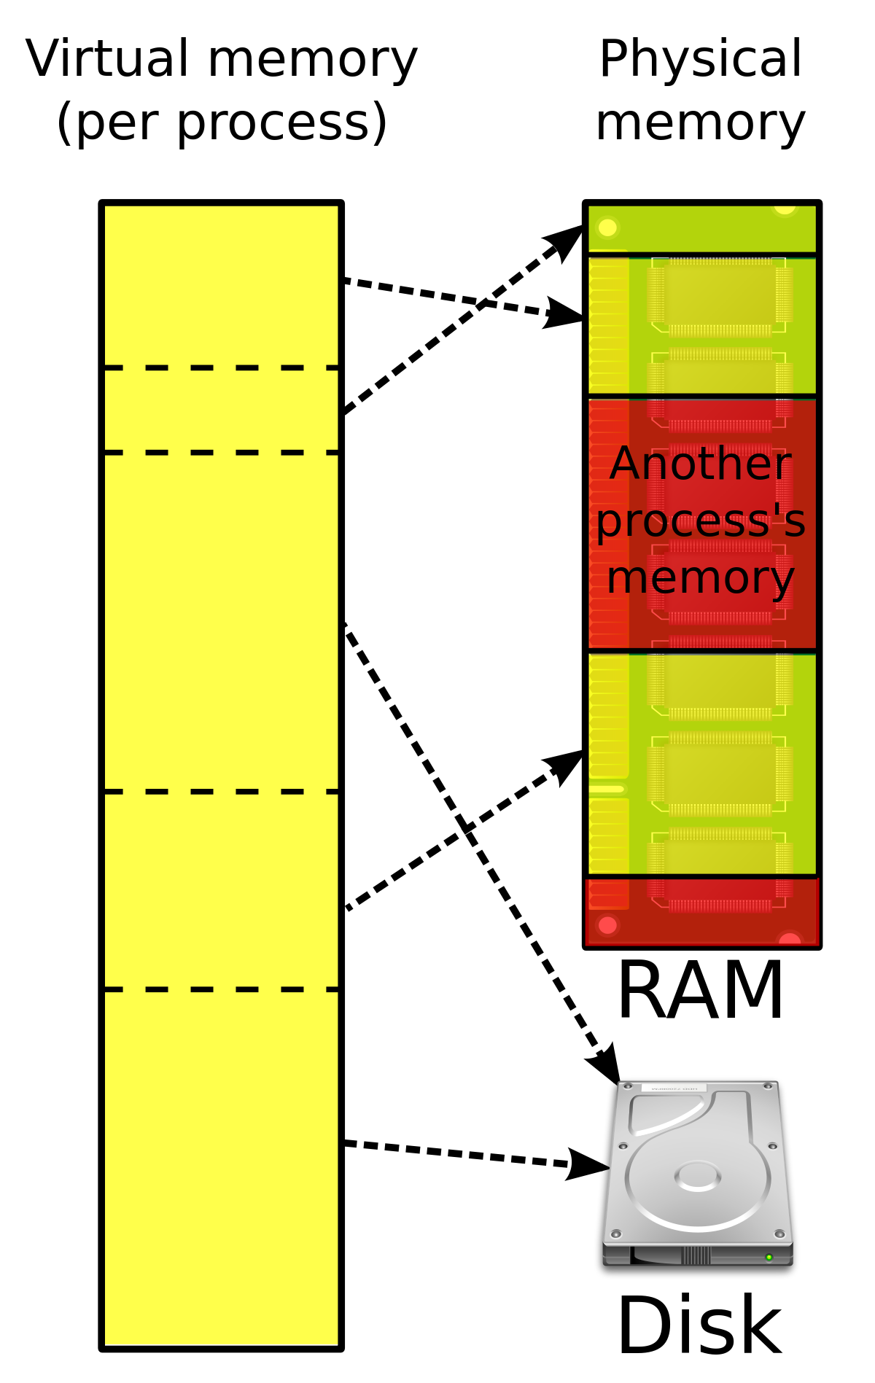

Slide 8
BIOS
Power-On Self Test (POST)
Boot processing
Runs the drivers
Loads the operating system
Boot priority (removable device first)
(originally) Low-level device control
Now managed by specialized device “drivers”

Slide 9
Software Stack
Application Program (“App”)
API
Runtime environment
Operating System
BIOS
Hardware drivers
Microcode

Slide 10
Before You Go
On a sheet of paper, answer the following (ungraded) question (no names, please):
What was the muddiest point in today’s class?

