Slide 1
Backup and Recovery
Session 6
INST 346

Slide 2
Agenda
Introducing Mike
Finishing audio compression
Backups
Analysis Teams

Slide 3
Basic Audio Coding
Sample at twice the highest frequency
8 bits or 16 bits per sample
Speech (0-4 kHz) requires 8 kB/s
Standard telephone channel (1-byte samples)
Music (0-22 kHz) requires 172 kB/s
Standard for CD-quality audio (2-byte samples)
Sampler

Slide 4
Risks
Accidental alteration or deletion
Malicious alteration or deletion
Storage device failure
System failure
Catastrophe

Slide 5
Strategies
Change log
Staged deletion
Redundant storage
Redundant systems
Redundant sites

Slide 6
Tape Backup
LTO-8 cartridges
12 TB uncompressed (~30TB compressed)
9.25 hour full-tape write time
Optionally encrypted
Mountable as a “disk-like” file system for recovery

Slide 7
Music Compression
Opportunity:
The human ear cannot hear all frequencies at once
Approach:
Don’t represent “masked” frequencies
Standard: MPEG-1 Layer 3 (.mp3)

Slide 8
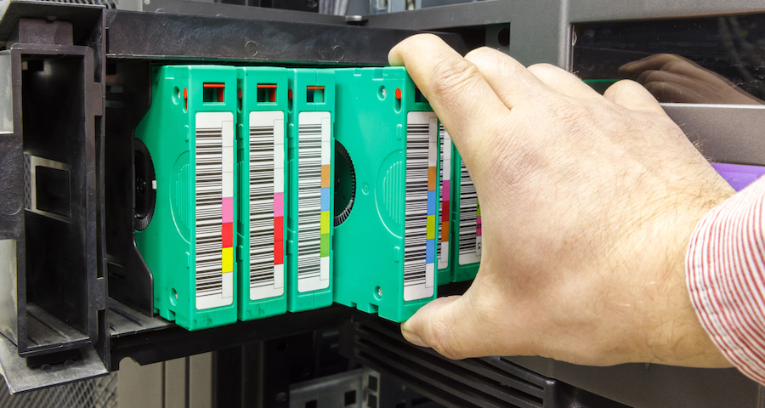
Tape Handling

Slide 9
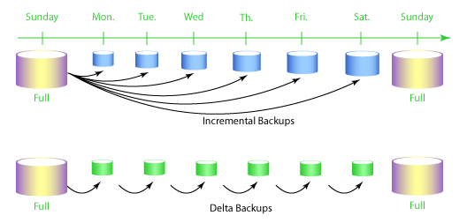
Backup Strategies

Slide 10
Some Considerations
Tape reliability
Tape reuse
Disclosure risk
Decorrelated risk

Slide 11
Analysis Teams: Goal
Relate what we are learning to recent events
Gain some team experience
Gain some research experience

Slide 12
Analysis Team: Process
Five people per team (maybe 4)
One “seed reading”
Meet briefly with me one week prior
Divvy up the research task
Do additional research to fill out the picture
Centralize creation of presentation materials
Choose one to three speakers
Practice a 10 minute in-class talk
Maximum of 5 points
Usually all members will get the same score

Slide 13
Audience: Process
No preparation required
Make notes on key reactions
Online or paper
Upload your notes to ELMS discussion forum by the end of the same day
0.5 points each for substantive comments on six of 10 presentations (other than your own)
Team and everyone who has commented will see your comments

Slide 14
Analysis Team 1
Analysis Team members are listed in ELMS

Slide 15
Before You Go!
On a sheet of paper (no names), answer the following question:
What was the muddiest point in today’s class?

