Slide 1

File Types
Session 5
INST 346

Slide 2
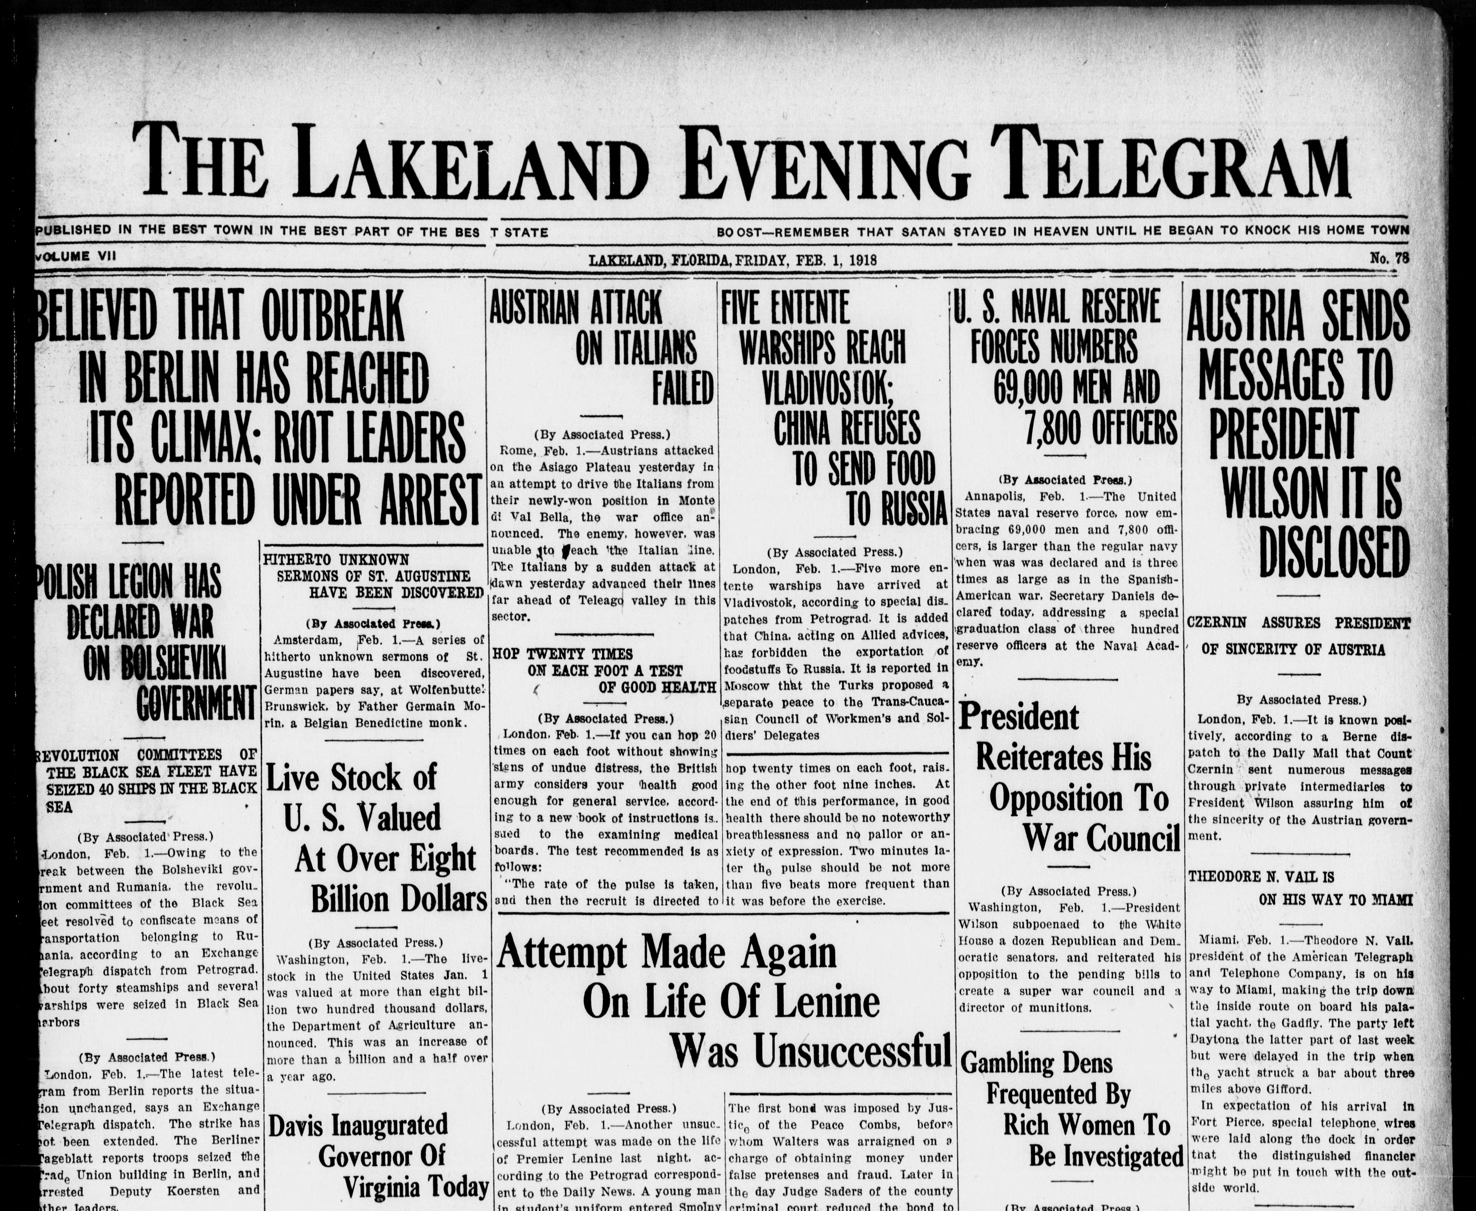

Slide 3
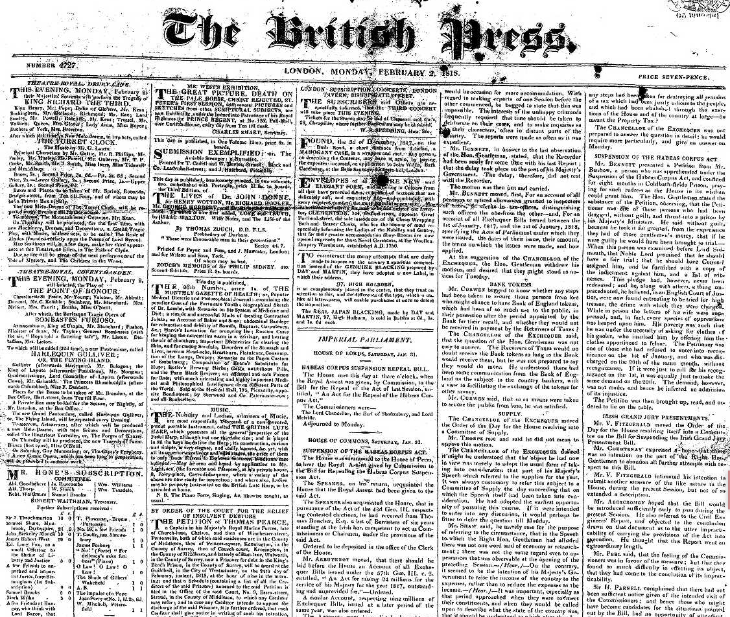

Slide 4
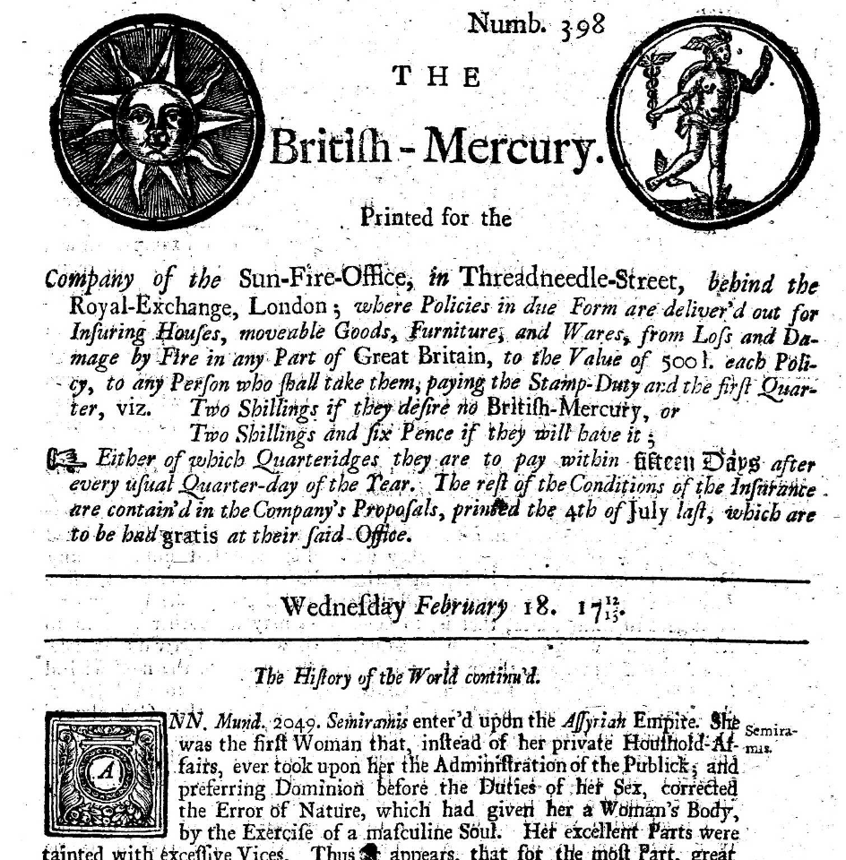

Slide 5
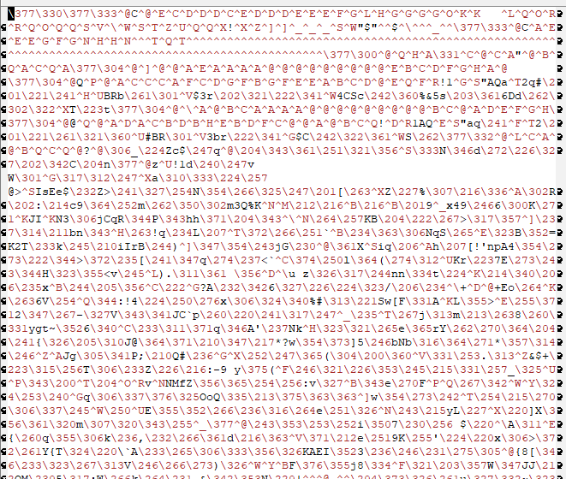

Slide 6
Agenda
Some examples of file types
  Text
  Images
  Video
  Audio

Slide 7
ASCII
| 0 NUL | 32 SPACE | 64 @ | 96 ` |
| 1 SOH | 33 ! | 65 A | 97 a |
| 2 STX | 34 " | 66 B | 98 b |
| 3 ETX | 35 # | 67 C | 99 c |
| 4 EOT | 36 $ | 68 D | 100 d |
| 5 ENQ | 37 % | 69 E | 101 e |
| 6 ACK | 38 & | 70 F | 102 f |
| 7 BEL | 39 ' | 71 G | 103 g |
| 8 BS | 40 ( | 72 H | 104 h |
| 9 HT | 41 ) | 73 I | 105 i |
| 10 LF | 42 * | 74 J | 106 j |
| 11 VT | 43 + | 75 K | 107 k |
| 12 FF | 44 , | 76 L | 108 l |
| 13 CR | 45 - | 77 M | 109 m |
| 14 SO | 46 . | 78 N | 110 n |
| 15 SI | 47 / | 79 O | 111 o |
Widely used in the U.S.
  American Standard Code for Information Interchange
  ANSI X3.4-1968
| 16 DLE | 48 0 | 80 P | 112 p |
| 17 DC1 | 49 1 | 81 Q | 113 q |
| 18 DC2 | 50 2 | 82 R | 114 r |
| 19 DC3 | 51 3 | 83 S | 115 s |
| 20 DC4 | 52 4 | 84 T | 116 t |
| 21 NAK | 53 5 | 85 U | 117 u |
| 22 SYN | 54 6 | 86 V | 118 v |
| 23 ETB | 55 7 | 87 W | 119 w |
| 24 CAN | 56 8 | 88 X | 120 x |
| 25 EM | 57 9 | 89 Y | 121 y |
| 26 SUB | 58 : | 90 Z | 122 z |
| 27 ESC | 59 ; | 91 [ | 123 { |
| 28 FS | 60 < | 92 \ | 124 | |
| 29 GS | 61 = | 93 ] | 125 } |
| 30 RS | 62 > | 94 ^ | 126 ~ |
| 31 US | 64 ? | 95 _ | 127 DEL |
Notes:
7

Slide 8
The Latin-1 Character Set
ISO 8859-1 8-bit characters for Western Europe
  French, Spanish, Catalan, Galician, Basque, Portuguese, Italian, Albanian, Afrikaans, Dutch, German, Danish, Swedish, Norwegian, Finnish, Faroese, Icelandic, Irish, Scottish, and English
Printable Characters, 7-bit ASCII
Additional Defined Characters, ISO 8859-1
Notes:
8

Slide 9
Other ISO-8859 Character Sets
-2
-6
-3
-7
-4
-8
-5
-9
Notes:
9

Slide 10
East Asian Character Sets
More than 256 characters are needed
  Two-byte encoding schemes (e.g., EUC) are used
Several countries have unique character sets
  GB in Peoples Republic of China, BIG5 in Taiwan, JIS in Japan, KS in Korea, TCVN in Vietnam
Many characters appear in several languages
  Research Libraries Group developed EACC
    Unified “CJK” character set for USMARC records
Notes:
10

Slide 11
Unicode
Single code for all the world’s characters
  ISO Standard 10646
Separates “code space” from “encoding”
  Code space extends Latin-1
    The first 256 positions are identical
  UTF-7 encoding will pass through email
    Uses only the 64 printable ASCII characters
  UTF-8 encoding is designed for disk file systems
Notes:
11

Slide 12
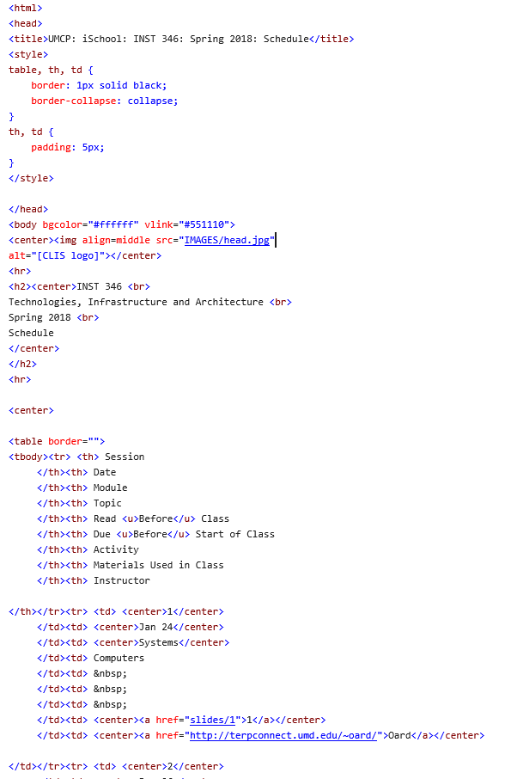

Slide 13
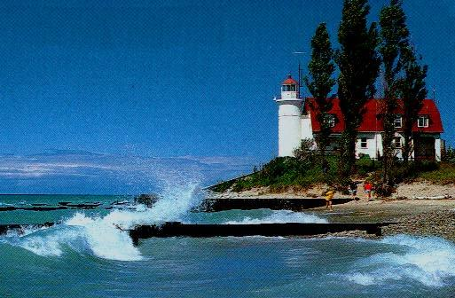

Slide 14
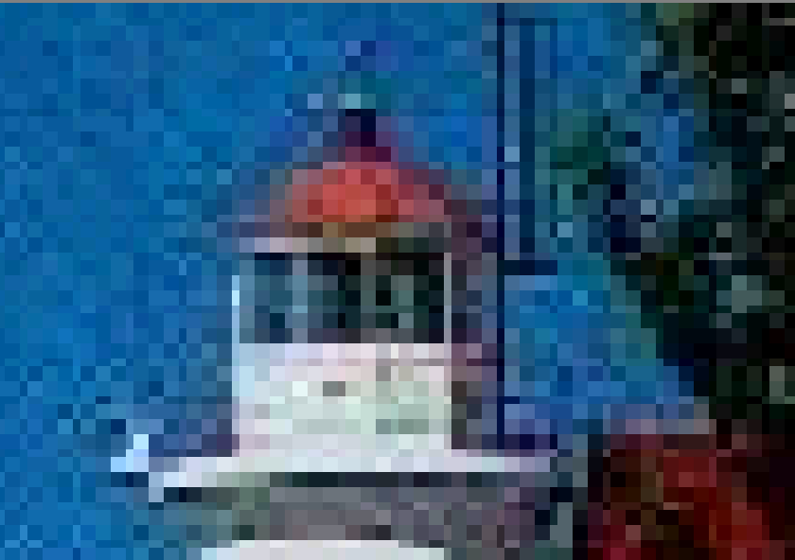

Slide 15
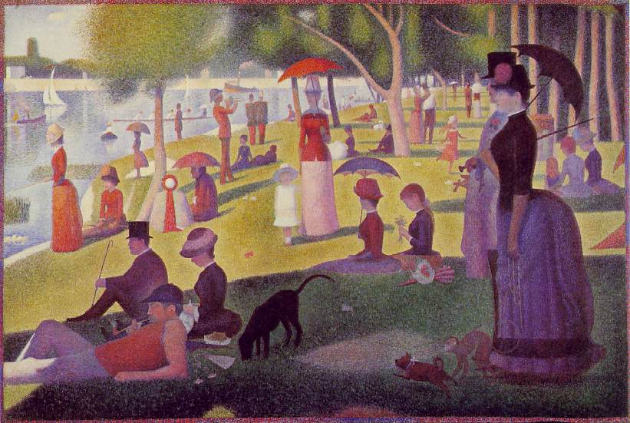
Nothing new…
Georges Seurat, A Sunday Afternoon on the Island of La Grande Jatte

Slide 16
Visual Perception
Closely spaced dots appear solid
  But irregularities in diagonal lines can stand out
Any color can be produced from just three
  Red, Blue and Green: “additive” primary colors
High frame rates produce apparent motion
  Smooth motion requires about 24 frames/sec
Visual acuity varies markedly across features
  Discontinuities easily seen, absolutes less crucial
Notes:
http://www.yorku.ca/eye/thejoy.htm, radiating lines, brightness & color, kanizsa illusion
http://www.aber.ac.uk/media/Modules/MC10220/visper01.html (two images at the bottom)
visper03

Slide 17
Basic Image Coding
Raster of picture elements (pixels)
  Each pixel has a “color”
    Binary - black/white (1 bit)
    Grayscale (8 bits)
    Color (3 colors, 8 bits each)
      Red, green, blue
Screen
  A 1024x768 image requires 2.4 MB
    So a picture is worth 400,000 words!

Slide 18
Compression
Goal: reduce redundancy
  Send the same information using fewer bits
Originally developed for fax transmission
  Send high quality documents in short calls
Two basic strategies:
  Lossless: can reconstruct exactly
  Lossy: can’t reconstruct, but looks the same

Slide 19
Palette Selection
Opportunity:
  No picture uses all 16 million colors
  Human eye does not see small differences
Approach:
  Select a palette of 256 colors
  Indicate which palette entry to use for each pixel
  Look up each color in the palette
“The rain in Spain falls mainly in the plain”
→ [*=ain,^=in] “The r* ^ Sp* falls m*ly ^ the pl*”
…
…

Slide 20
Run-Length Encoding
Opportunity:
  Large regions of a single color are common
Approach:
  Record # of consecutive pixels for each color
An example of lossless encoding
Sheep go baaaaaaaaaa and cows go moooooooooo
→ Sheep go ba<10> and cows go mo<10>
Notes:
Run Length Encoding (RLE)
Pixels are organized into lines
Most pixels are the same as the one before
That can be coded in 1 bit (1/24 the space)
Smaller files take less time to transmit

Slide 21
GIF
Palette selection, then lossless compression
Opportunity:
  Common colors are sent more often
Approach:
  Use fewer bits to represent common colors
    1 Blue 75% 75x1= 75 75x2=150
    01 White 20% 20x2= 40 20x2= 40
    001 Red 5% 5x3= 15 5x2= 10
    130 200
Notes:
Graphic Interchange Format (GIF)
(.GIF file extension) There have been raging debates about the pronunciation. The designers of GIF say it is correctly pronounced to sound like Jiff. But that seems counter-intuitive, and up in my hills, we say it sounding like Gift (without the t).
GIF was developed by CompuServe to show images online (in 1987 for 8 bit video boards, before JPG and 24 bit color was in use). GIF uses indexed color, which is limited to a palette of only 256 colors (next page). GIF was a great match for the old 8 bit 256 color video boards, but is inappropriate for today's 24 bit photo images.
GIF files do NOT store the image's scaled resolution ppi number, so scaling is necessary every time one is printed. This is of no importance for screen or web images. GIF file format was designed for CompuServe screens, and screens don't use ppi for any purpose. Our printers didn't print images in 1987, so it was useless information, and CompuServe simply didn't bother to store the printing resolution in GIF files.
GIF is still an excellent format for graphics, and this is its purpose today, especially on the web. Graphic images (like logos or dialog boxes) use few colors. Being limited to 256 colors is not important for a 3 color logo. A 16 color GIF is a very small file, much smaller, and more clear than any JPG, and ideal for graphics on the web.
Graphics generally use solid colors instead of graduated shades, which limits their color count drastically, which is ideal for GIF's indexed color. GIF uses lossless LZW compression for relatively small file size, as compared to uncompressed data. GIF files offer optimum compression (smallest files) for solid color graphics, because objects of one exact color compress very efficiently in LZW. The LZW compression is lossless, but of course the conversion to only 256 colors may be a great loss. JPG is much better for 24 bit photographic images on the web. For those continuous tone images, the JPG file is also very much smaller (although lossy). But for graphics, GIF files will be smaller, and better quality, and (assuming no dithering) pure and clear without JPG artifacts.
If GIF is used for continuous tone photo images, the limited color can be poor, and the 256 color file is quite large as compared to JPG compression, even though it is 8 bit data instead of 24 bits. Photos might typically contain 100,000 different color values, so the image quality of photos is normally rather poor when limited to 256 colors. 24 bit JPG is a much better choice today. The GIF format may not even be offered as a save choice until you have reduced the image to 256 colors or less.
So for graphic art or screen captures or line art, GIF is the format of choice for graphic images on the web. Images like a company logo or screen shots of a dialog box should be reduced to 16 colors if possible and saved as a GIF for smallest size on the web. A complex graphics image that may look bad at 16 colors might look very good at say 48 colors (or it may require 256 colors if photo-like). But often 16 colors is fine for graphics, with the significance that the fewer number of colors, the smaller the file, which is extremely important for web pages.
GIF optionally offers transparent backgrounds, where one palette color is declared transparent, so that the background can show through it. The GIF File - Save As dialog box usually has an Option Button to specify which one GIF palette index color is to be transparent.
Interlacing is an option that quickly shows the entire image in low quality, and the quality sharpens as the file download completes. Good for web images, but it makes the file slightly larger.
GIF files use a palette of indexed colors, and if you thought 24 bit RGB color was kinda complicated, then you ain't seen nuthin' yet (next page).
For GIF files, a 24 bit RGB image requires conversion to indexed color. More specifically, this means conversion to 256 colors, or less. Indexed Color can only have 256 colors maximum. There are however selections of different ways to convert to 256 colors.

Slide 22
JPEG
Opportunity:
  Eye sees sharp lines better than subtle shading
Approach:
  Retain detail only for the most important parts
  Accomplished with Discrete Cosine Transform
    Allows user-selectable fidelity
Results:
  Typical compression 20:1
Notes:
Jpeg vs gif
http://hotwired.lycos.com/webmonkey/geektalk/97/30/index3a.html?tw=design
JPEG is designed to exploit known limitations of the human eye, notably the fact that small color changes are perceived less accurately than small changes in brightness. Thus, JPEG is intended for compressing images that will be looked at by humans. If you plan to machine-analyze your images, the small errors introduced by JPEG may be a problem for you, even if they are invisible to the eye.
JPEG is that it stores full color information: 24 bits/pixel (16 million colors). GIF, the other image format widely used on the net, can only store 8 bits/pixel (256 or fewer colors).
What is color quantization? Many people don't have full-color (24 bit per pixel) display hardware. Inexpensive display hardware stores 8 bits per pixel, so it can display at most 256 distinct colors at a time. To display a full-color image, the computer must choose an appropriate set of representative colors and map the image into these colors. This process is called "color quantization". (This is something of a misnomer; "color selection" or "color reduction" would be a better term. But we're stuck with the standard usage.)
Making a good color quantization method is a black art, and no single algorithm is best for all images.
http://www.faqs.org/faqs/jpeg-faq/part1/

Slide 23
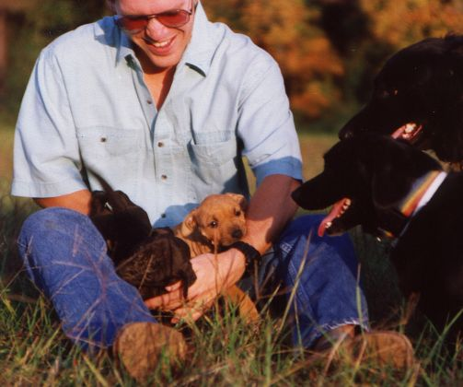
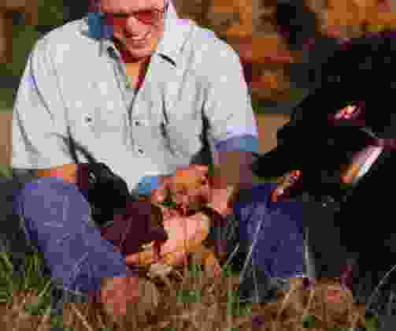
Variable Compression in JPEG
37 kB (20%)
4 kB (95%)
Notes:
http://www.ece.purdue.edu/~ace/jpeg-tut/jpgimag1.html

Slide 24
Video Data Rates
“NTSC” Quality Computer Display
  640 X 480 pixel image
  3 bytes per pixel (red, green, blue)
  30 Frames per Second
Storage
  3 minutes would require 4.74 GB (a full DVD!)
Required transfer rate
  26.4 MB/second
  Near the bandwidth of many disk drives

Slide 25
Video Compression
Opportunity:
  One frame looks very much like the next
Approach:
  Record only the pixels that change
Standards:
  MPEG-2: HDTV and DVD
  MPEG-4: Web video (streaming)

Slide 26
MPEG Encoding
I₁
I₁+P₁
I₁+P₁+P₂
I₂
• • •
• • •
updates
  I frames provide complete image
  P frames provide series of updates to most recent I frame
P₁
P₂

Slide 27
Basic Audio Coding
Sample at twice the highest frequency
  8 bits or 16 bits per sample
Speech (0-4 kHz) requires 8 kB/s
  Standard telephone channel (1-byte samples)
Music (0-22 kHz) requires 172 kB/s
  Standard for CD-quality audio (2-byte samples)
Sampler

Slide 28
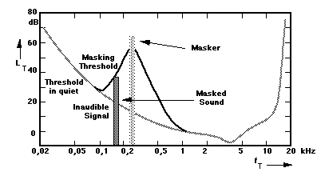
Music Compression
Opportunity:
  The human ear cannot hear all frequencies at once
Approach:
  Don’t represent “masked” frequencies
Standard: MPEG-1 Layer 3 (.mp3)

Slide 29
Agenda
Some examples of file types
  Text
  Images
  Video
  Audio
Key storylines
  Compression
  More than the content
    Context
    Layout

Slide 30
Before You Go!
On a sheet of paper (no names), answer the following question:
What was the muddiest point in today’s class?

