Slide 1

Information Governance
Session 40
INST 346
Technologies, Infrastructure and Architecture

Slide 2
Goals for Today
Information Governance
Records Management
Risk Management
E-Discovery

Slide 3
Information Governance is
the activities and technologies
that people employ to maximize the value of their information while minimizing associated risks and costs.
Information Governance Institute, 2018

Slide 4
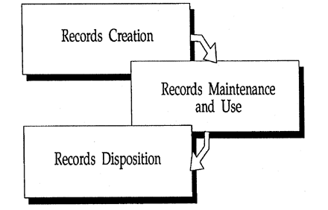
NARA Records Life Cycle
National Archives and Records Administration (2000)

Slide 5
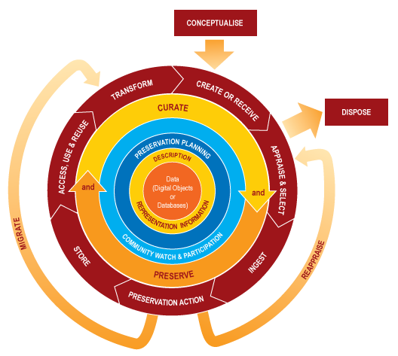
DCC Digital Curation Life Cycle

Slide 6
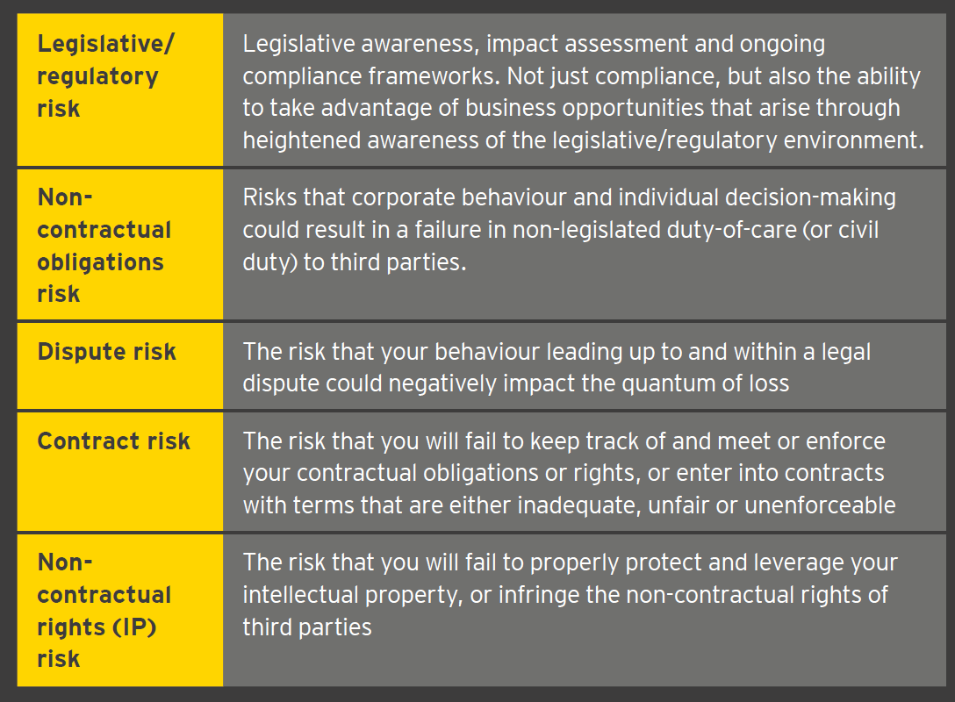
(Legal) Risk Management

Slide 7
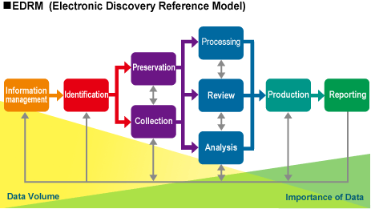
E-Discovery

Slide 8
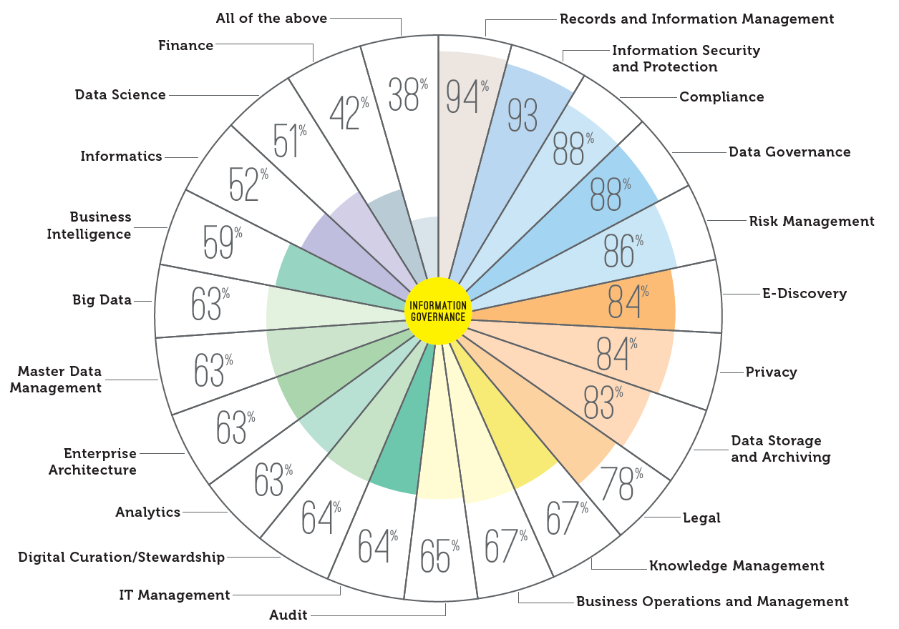
Information Governance

Slide 9
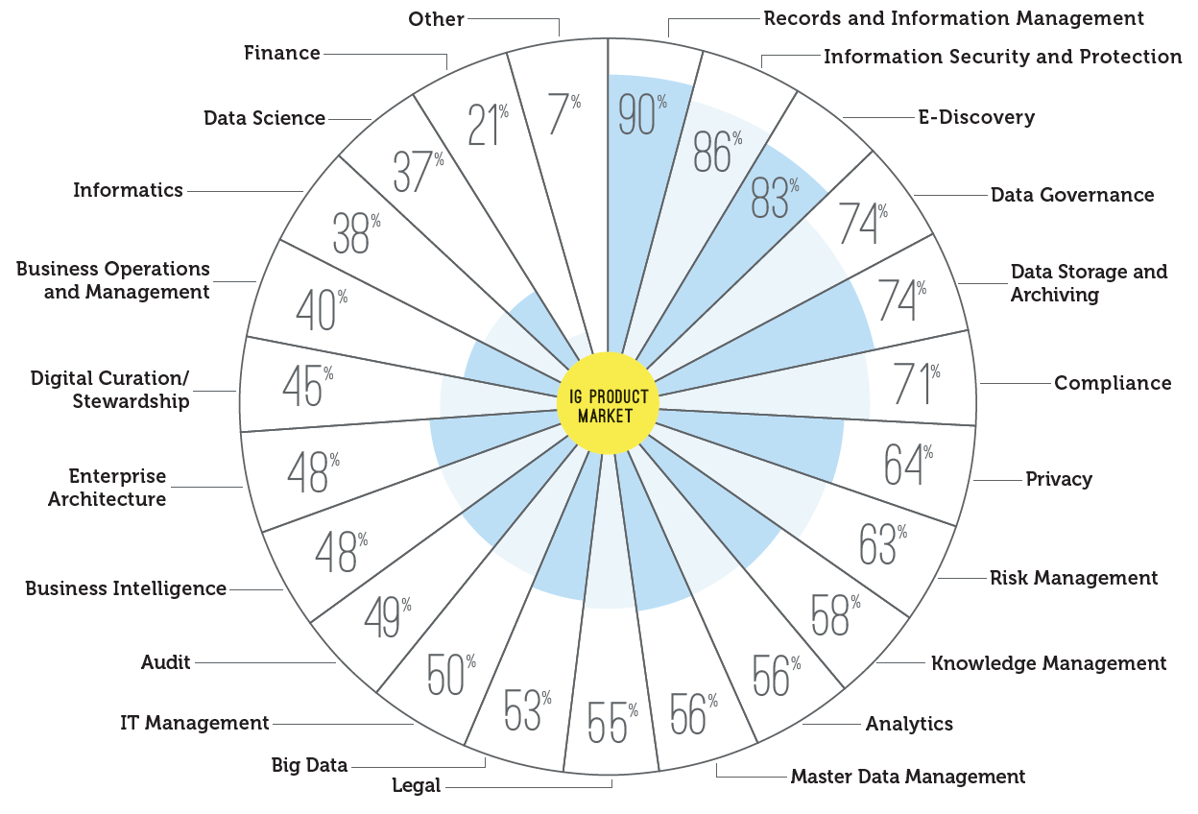
IG Technologies

Slide 10
