Slide 1
Storage
Session 4
INST 346

Slide 2
Agenda
Hard Disks
Optical Disks
Solid State Disks
Magnetic Tape

Slide 3
“Rotating” Memory
Fixed magnetic disk (“hard drive”)
May be partitioned into multiple volumes
In Windows, referred to as C:, D:, E:, …
In Unix, referred to as /software, /homes, /mail, …
Removable magnetic disk
Floppy disk, zip drives, …
Removal optical disk
CDROM, DVD, CD-R, CD-RW, DVD+RW, …

Slide 4
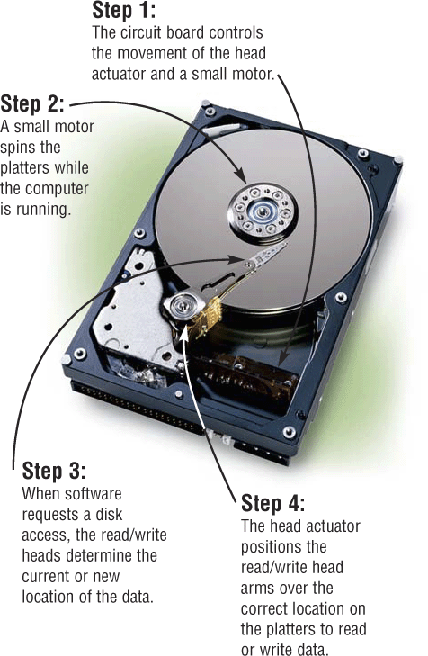
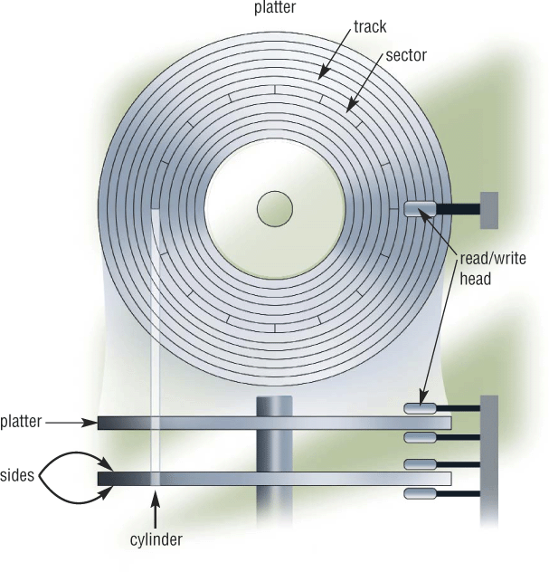
Magnetic (“Hard”) Disks
Extracted From Shelly Cashman Vermatt’s Discovering Computers 2004

Slide 5
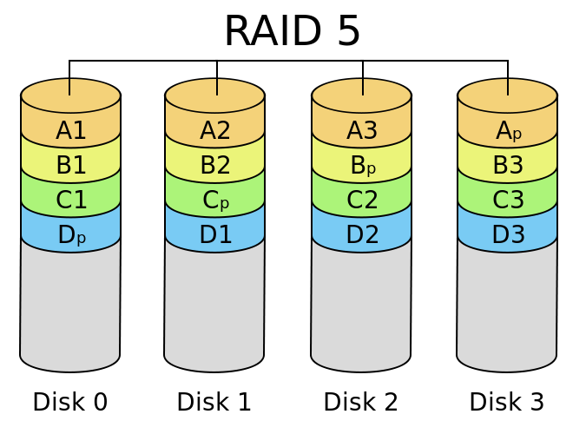

Slide 6
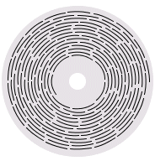
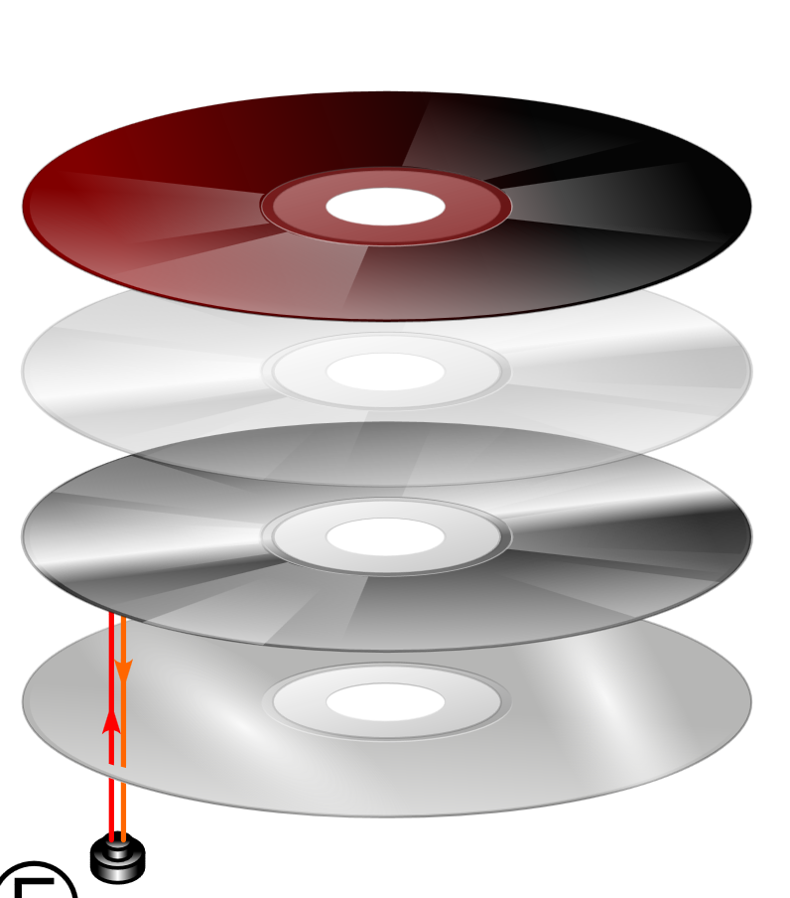
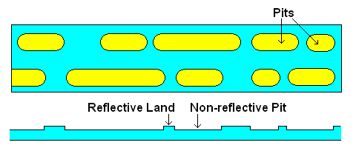
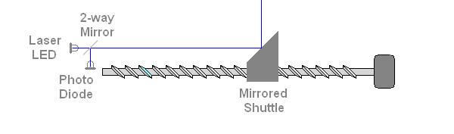
Optical Disc

Slide 7
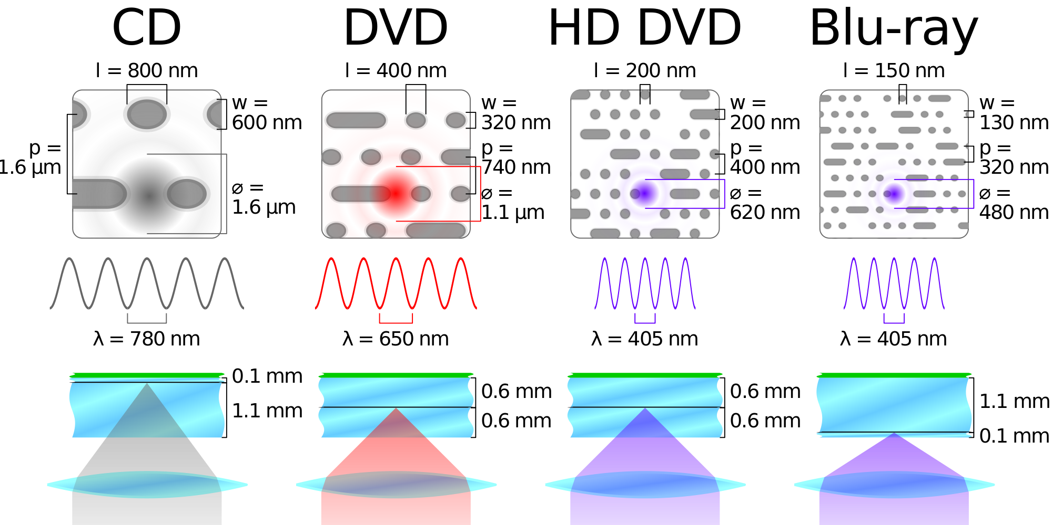
Optical Disk Technologies
near infared
red
violet

Slide 8
Solid-State “Drives”
“Flash memory”
Used in solid state drives and memory sticks
Much faster “random access” than rotating disk
About 10,000 times faster
Substantially more expensive
About 5 times more per bit
Limited data retention time
About 10 years (1-2 years for older drives)
Limited number of lifetime write operations
About 5,000 writes per location
Seamless shuffling is used for “wear leveling”

Slide 9
Magnetic Tape
Tapes store data sequentially
Fast transfer, but no practical “random access”
Used only for low-use storage
Disaster recovery, offline storage

Slide 10
System Architecture
Keyboard
Mouse
Sound
Card
Video
Card
Input
Controller
System Bus
Front Side Bus
Hard
Drive
CD/
DVD
L2
RAM
USB Port
CPU
L1
Cache
Motherboard

Slide 11
The Storage Hierarchy
Type | Speed | Size | Cost
Registers | ~300 ps | 256 B | Very expensive
Cache | ~1 ns | 4 MB | Expensive
RAM | ~10 ns | 1 GB | Cheap
Hard drive | ~10 ms | 100 GB | Very cheap

Slide 12
Frequency
Unit | Abbreviation | Cycles per second
hertz | Hz | 1
kilohertz | KHz | 10³ = 1,000
megahertz | MHz | 10⁶ = 1,000,000
gigahertz | GHz | 10⁹ = 1,000,000,000
Time
Unit | Abbreviation | Duration (seconds)
second | sec/s | 1
millisecond | ms | 10⁻³ = 1/1,000
microsecond | μs | 10⁻⁶ = 1/1,000,000
nanosecond | ns | 10⁻⁹ = 1/1,000,000,000
picosecond | ps | 10⁻¹² = 1/1,000,000,000,000
femtosecond | fs | 10⁻¹⁵ = 1/1,000,000,000,000,000

Slide 13
Units of Size
Unit | Abbreviation | Size (bytes)
bit | b | 1/8
byte | B | 1
kilobyte | KB | 2¹⁰ = 1024
megabyte | MB | 2²⁰ = 1,048,576
gigabyte | GB | 2³⁰ = 1,073,741,824
terabyte | TB | 2⁴⁰ = 1,099,511,627,776
petabyte | PB | 2⁵⁰ = 1,125,899,906,842,624

Slide 14
Before You Go
On a sheet of paper, answer the following (ungraded) question (no names, please):
What was the muddiest point in today’s class?

