Slide 1
Blockchain
Session 39
INST 346
Technologies, Infrastructure and Architecture

Slide 2
Goals for Today
Ledger
Hashchain
Blockchain
Distributed blockchain ledger
Bitcoin
Adoption

Slide 3
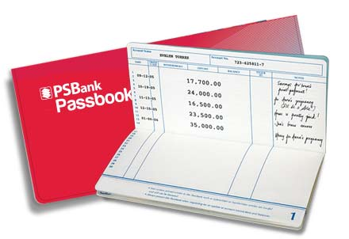
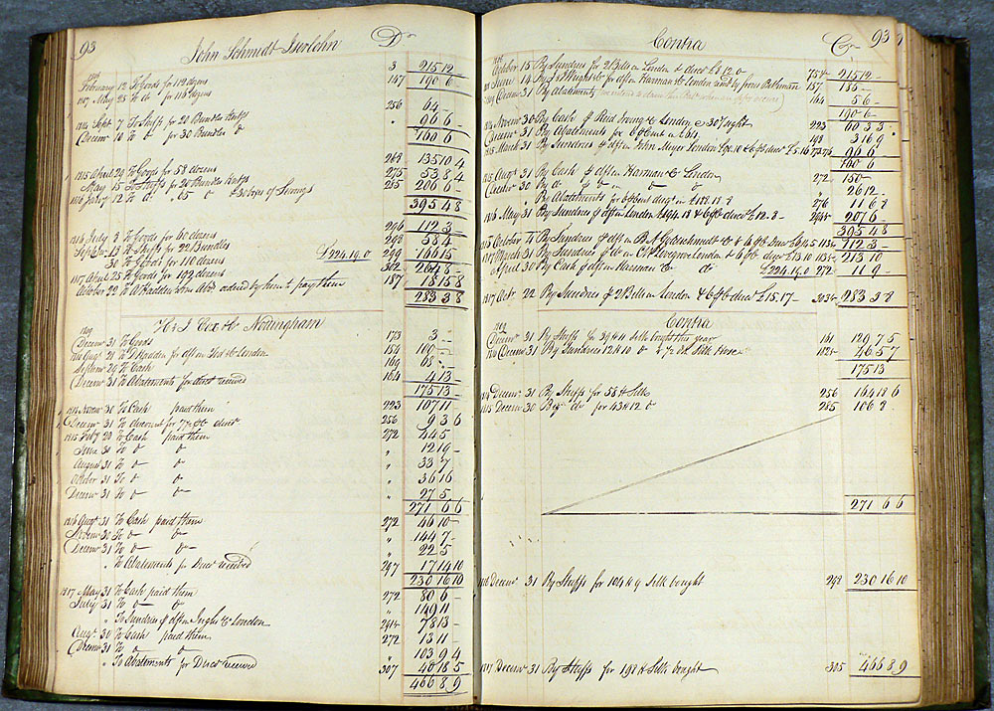
Ledgers

Slide 4
Hashchain

Slide 5
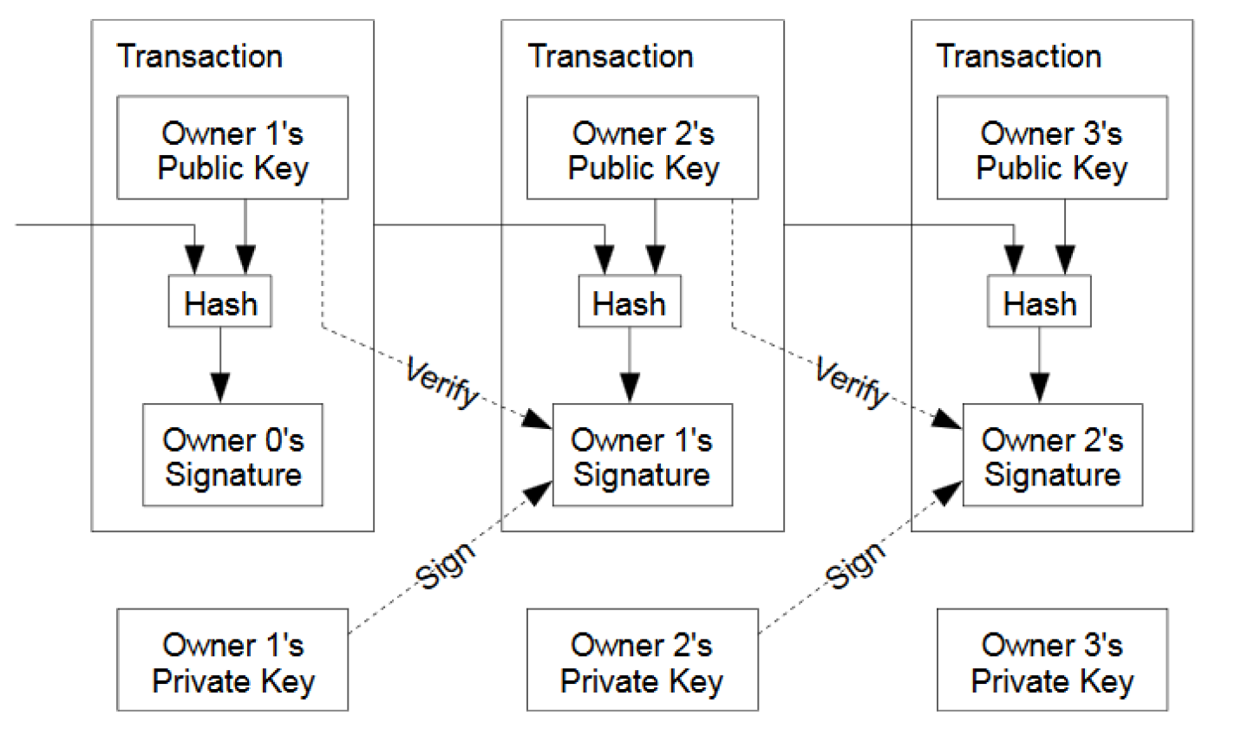
Signed Hashchain

Slide 6
Blockchain

Slide 7
Block Linking
{
"size" : 43560,
"version" : 2,
"previousblockhash" :
"00000000000000027e7ba6fe7bad39faf3b5a83daed765f05f7d1b71a1632249",
"merkleroot" :
"5e049f4030e0ab2debb92378f53c0a6e09548aea083f3ab25e1d94ea1155e29d",
"time" : 1388185038,
"difficulty" : 1180923195.25802612,
"nonce" : 4215469401,
"tx" : [
"257e7497fb8bc68421eb2c7b699dbab234831600e7352f0d9e6522c7cf3f6c77",
#[... many more transactions omitted ...]
"05cfd38f6ae6aa83674cc99e4d75a1458c165b7ab84725eda41d018a09176634"
]
}

Slide 8
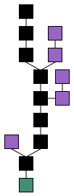
Branching Blockchains
Orphan Block
Genesis Block
time

Slide 9
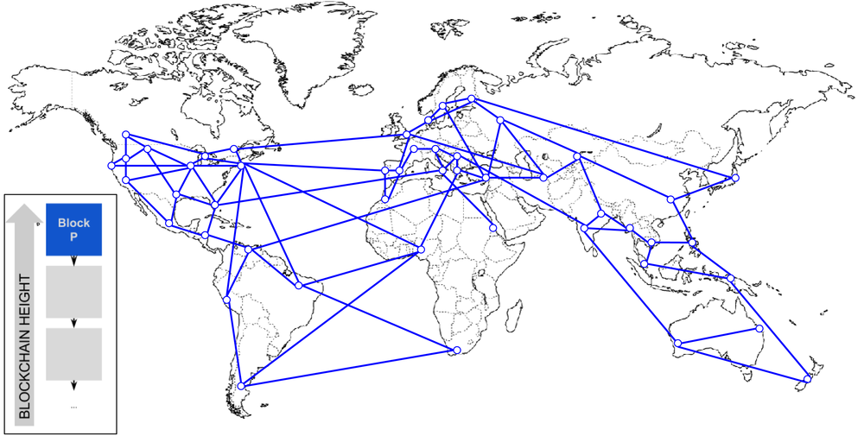
Distributed Blockchain Ledger

Slide 10
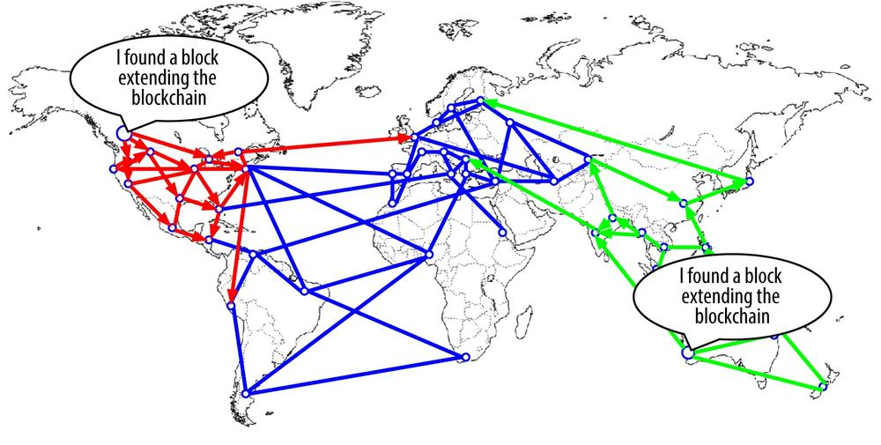

Slide 11
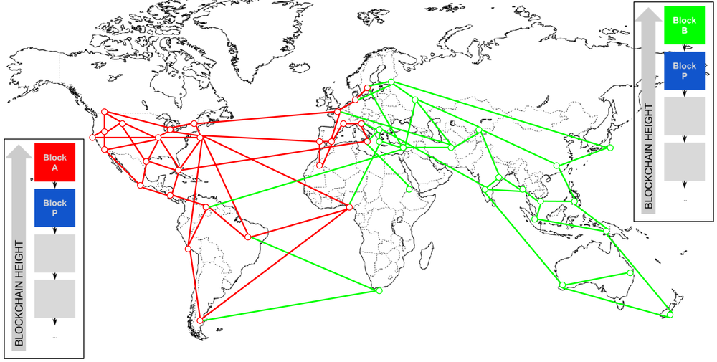

Slide 12
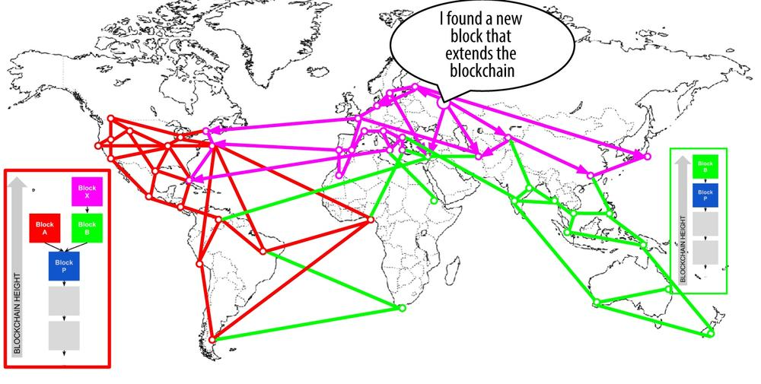

Slide 13
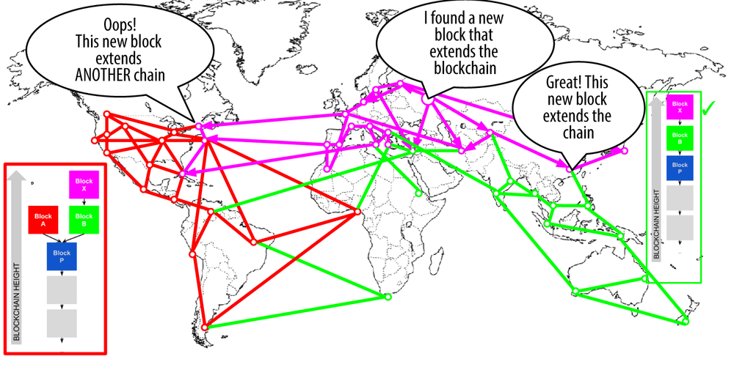

Slide 14
Proof of Work

Slide 15
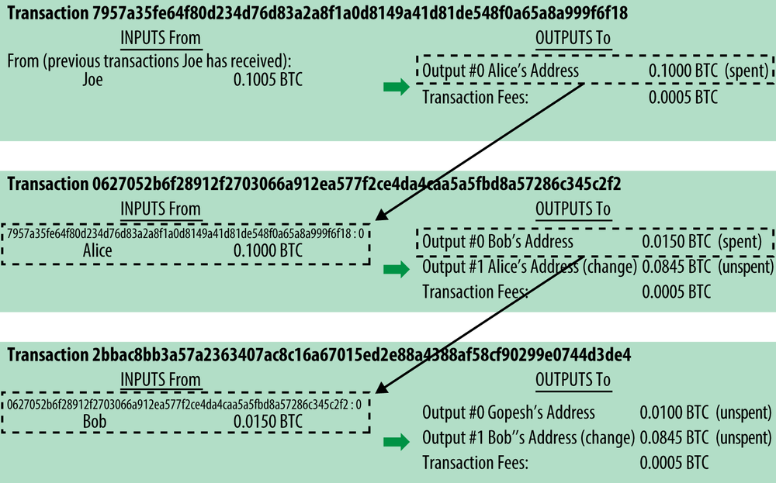
Bitcoin

Slide 16
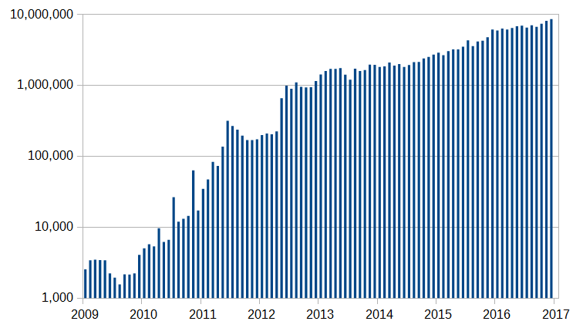
Monthly Bitcoin Transactions

Slide 17
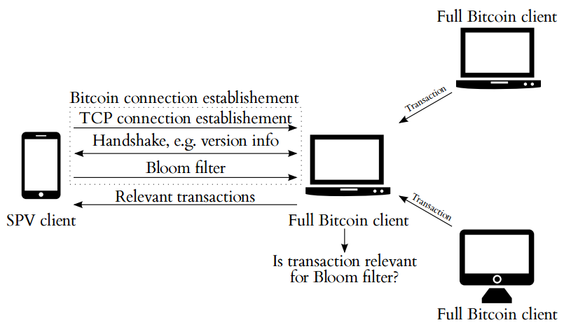
Simplified Payment Verification (SPV)

Slide 18
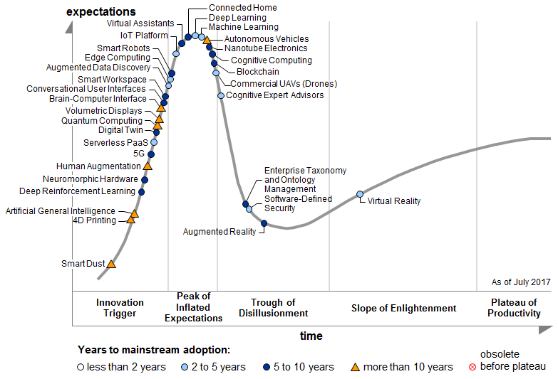
Gartner Hype Cycle

Slide 19
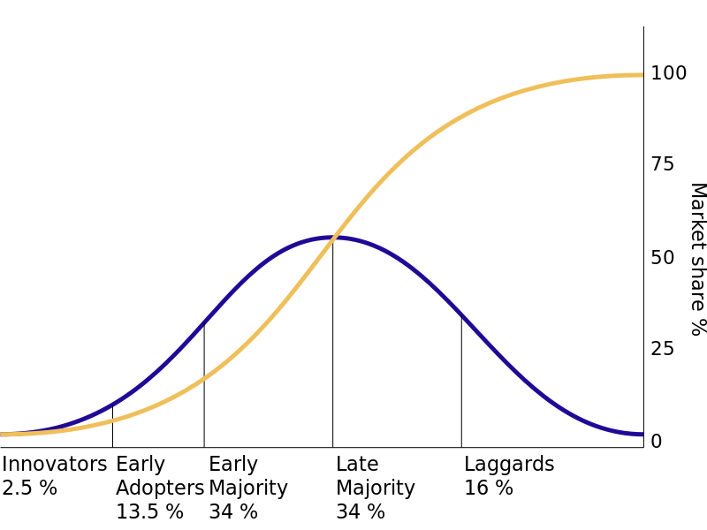
Adoption Curves

Slide 20
Some Predictors of Adoption
Relative advantage
Compatibility with existing systems
Trialability
Ease of learning
Reinvention potential

Slide 21
Social Structure of Adoption
Innovators
Communicators
Opinion leaders
Early adopters

