Slide 1
Data Centers
Session 36
INST 346
Technologies, Infrastructure and Architecture

Slide 2
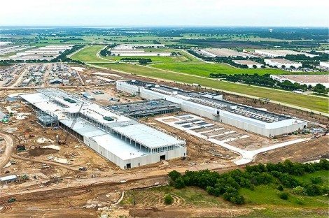
Facebook Data Center, Dallas

Slide 3
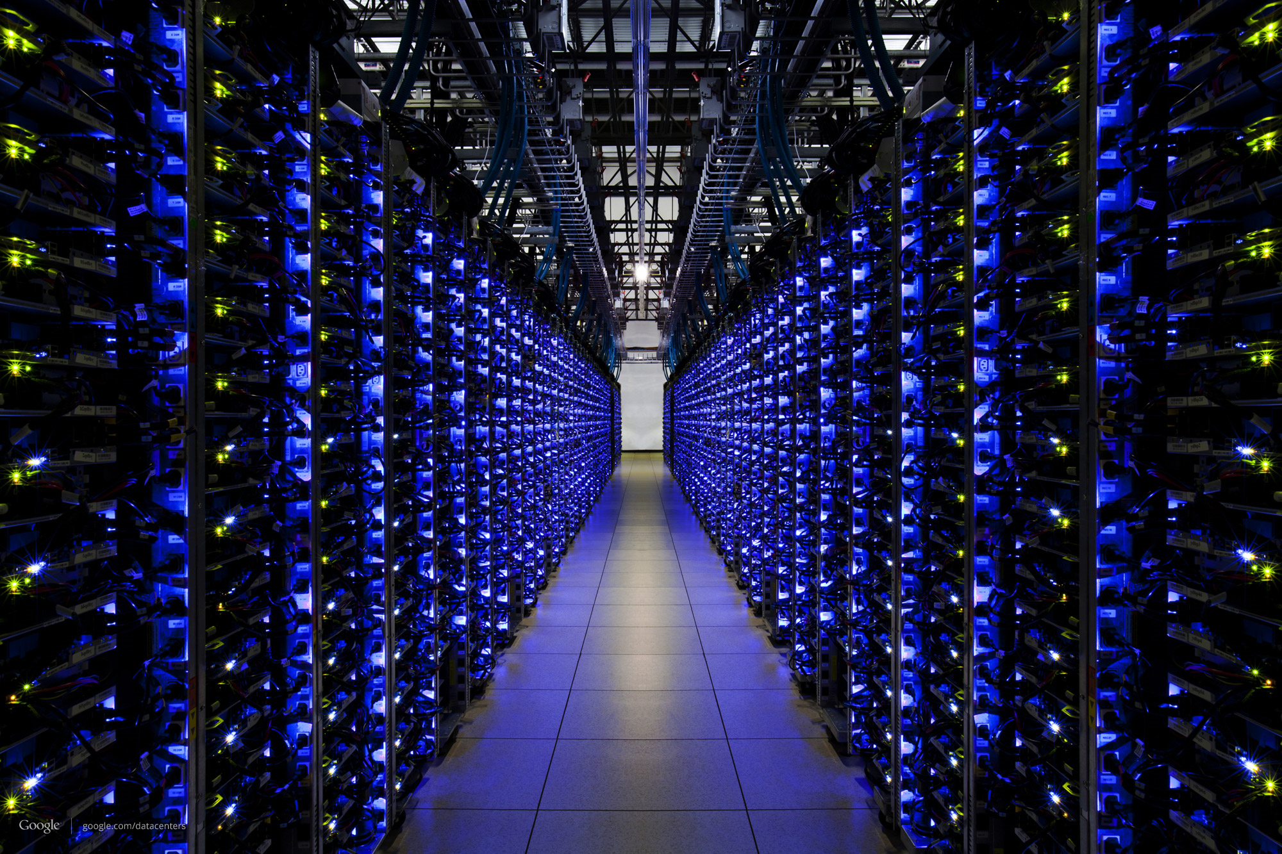
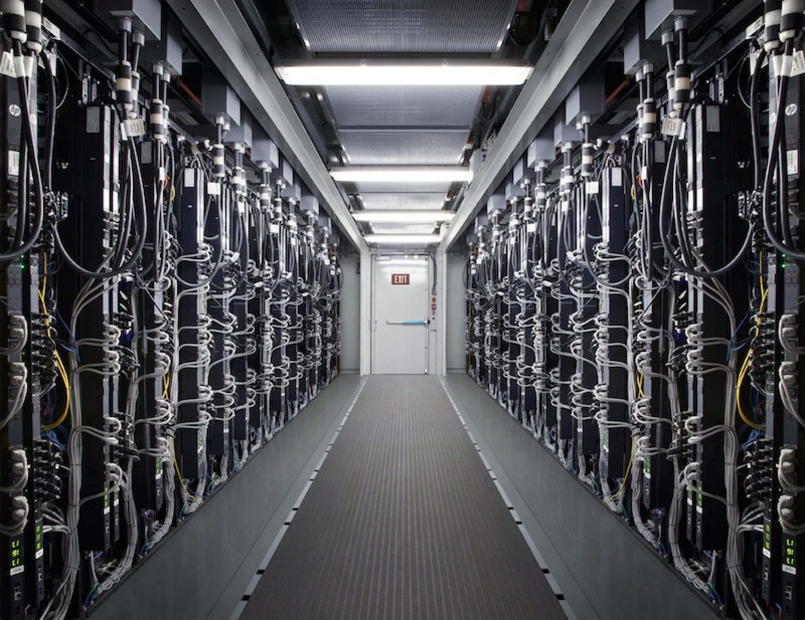

Slide 4
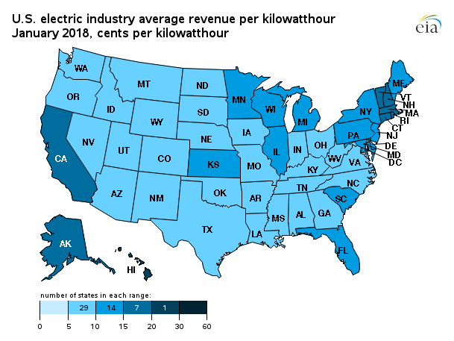
Electricity Costs

Slide 5
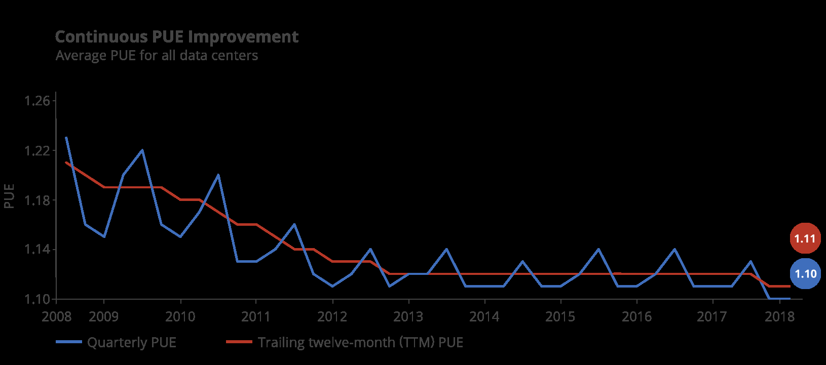
Power Use Efficiency

Slide 6
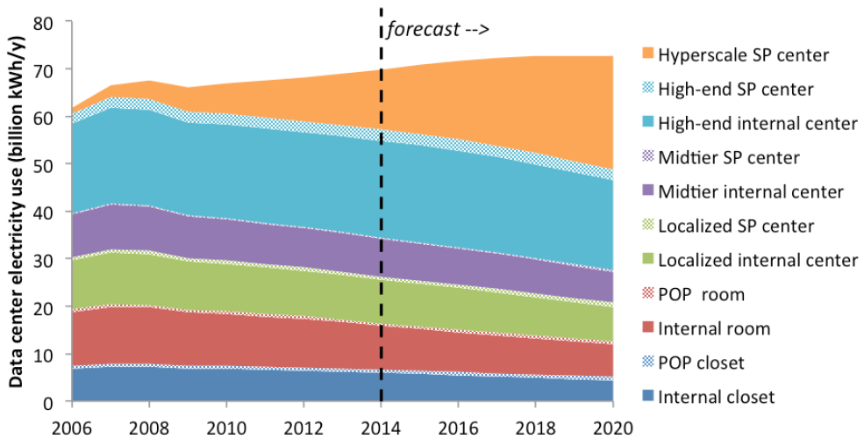
Electricity Use

Slide 8
Total Cost of Ownership

Slide 9
“Submarine” Fiber Optic Cables

Slide 10
Design for Failure
In each [1,800-server] cluster's first year, it's typical that 1,000 individual machine failures will occur; thousands of hard drive failures will occur; one power distribution unit will fail, bringing down 500 to 1,000 machines for about 6 hours; 20 racks will fail, each time causing 40 to 80 machines to vanish from the network; 5 racks will "go wonky," with half their network packets missing in action; and the cluster will have to be rewired once, affecting 5 percent of the machines at any given moment over a 2-day span, Dean said. And there's about a 50 percent chance that the cluster will overheat, taking down most of the servers in less than 5 minutes and taking 1 to 2 days to recover.
Google, 2008

Slide 11
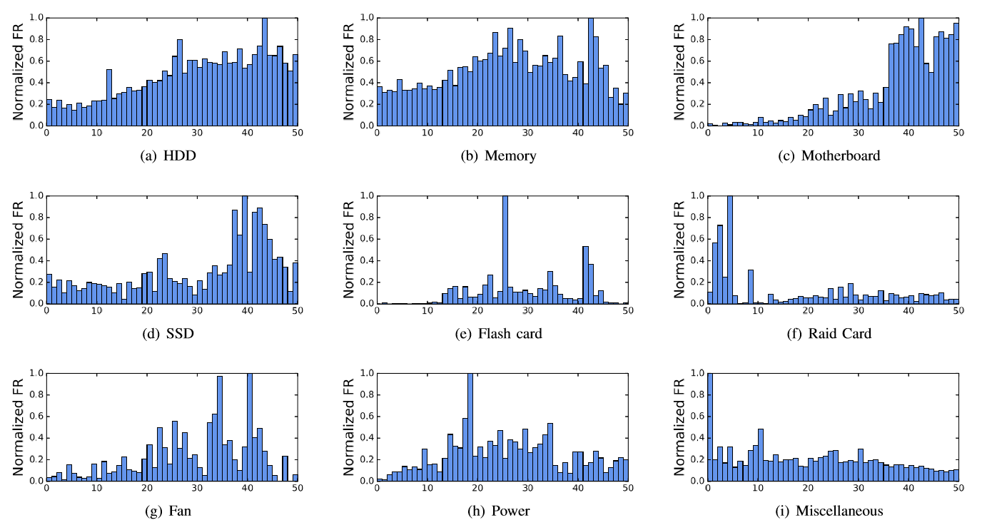
Failure Rates

Slide 12
