Slide 1
Data Architecture
Session 34
INST 346
Technologies, Infrastructure and Architecture

Slide 2
Goals for Today
Finishing up Information Architecture
Data Architecture
Quiz

Slide 3
Information Heterogeneity
Types
Data, documents, multimedia, interactive sys
Sources
Internal, External
Status
Ephemeral, operational, archival

Slide 4
(Logical) Data Architecture
Enterprise-wide data model
Common data element definitions
Common data element representation
Enterprise-wide data flows
Enterprise-level data stewards

Slide 5
Enterprise Data Modeling
Bottom-up
Aggregated
Enterprise, Business areas, Applications
Multi-scale
Strategic, Tactical
Requirements-driven
Transactions, Analysis, Reuse

Slide 6
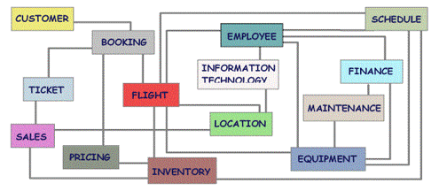
Enterprise Subject Area Model

