Slide 1

Information Architecture
Session 33
INST 346
Technologies, Infrastructure and Architecture

Slide 2
Content Management Systems
Database to store content
  Also stores access control data and parameters
PHP to control user experience
  Reads database, generates HTML
  “Canned” settings provide standard behaviors
HTML to convey user experience

Slide 3
Client Hardware
(PC)
Interface
Design
Web Browser
(Chrome, Edge)
Client-side Programming
(JavaScript)
Interaction
Design
Interchange Language
(HTML, XML)
Server-side Programming
(PHP)
Business
rules
Database
(MySQL)
Server Hardware
(PC, Unix)

Slide 4
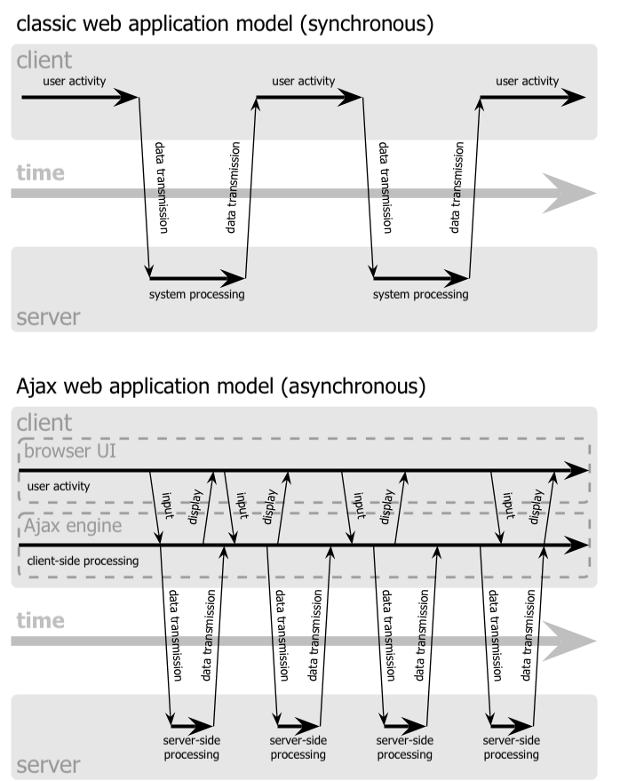

Slide 6
Information Architecture
The structural design of an “information space” to facilitate access to content
Two components:
  Static design
  Interaction design

Slide 7
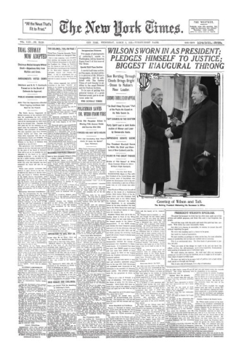

Notes:
1913 & 2013

Slide 8
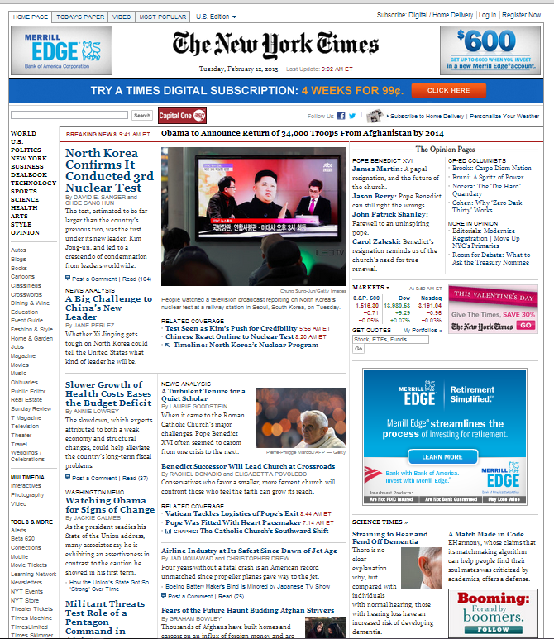
Notes:
Print & online

Slide 9

Patterns for Web Design
Posture – genre, type, purpose
  Commercial, informative, social, creative, combo
  The posture of the site it becomes clearer what kinds of experiences to design
Experience
  User tasks and goals within the realm of the posture
    High-level tasks & goals
    Primary & secondary level experiences
Task
  Specific solutions and strategies for creating experiences
  Can be drawn as wireframes or sketches
Action
  Low-level widgets & features that contribute to
  task performance

Slide 10
Wire Framing
Design, brainstorming technique
  Highly conceptual
  Low-fi
  Low risk, low cost
  Rapid
Incorporates three elements of Web design:
  Information design. Which information will go where?
  Navigation design. How will users get around?
  Interface design. What kinds of elements convey functionality?

Slide 11
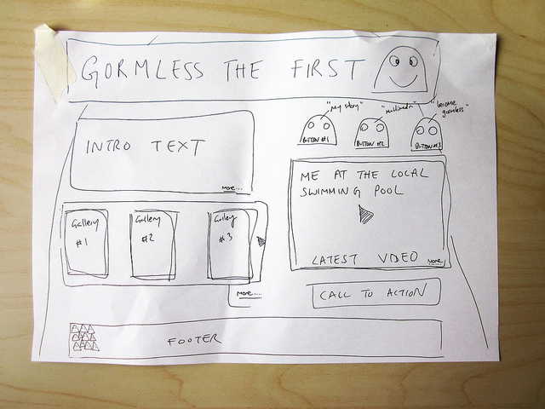
Notes:
By Flickr user Simon Collision. http://www.flickr.com/photos/collylogic/4971094116/.

Slide 12
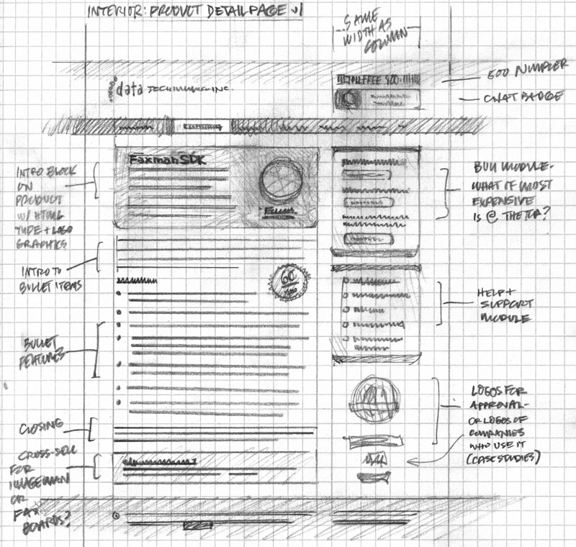
Notes:
By Flickr user Mike Rohde. http://www.flickr.com/photos/rohdesign/3307066409/.

Slide 13
Static Design
Organizing principles
  Logical: e.g., chronological, alphabetical
  Functional: by task
  Demographic: by user
Metaphors
  Organizational: e.g., e-government
  Physical: e.g., online grocery store
  Functional: e.g., cut, paste
  Visual: e.g., octagon for stop

Slide 14
“Site Blueprint”
Main
Homepage
Teaching
Research
Other
Activities
LBSC 690
Ph.D.
Students
IR
Colloquium
INFM 718R
Publications
TREC
Doctoral
Seminar
Projects

Slide 15

Grid Layout: NY Times

Slide 16
Grid Layout: NY Times
Navigation
Banner Ad
Another Ad
Content
Popular
Articles

Slide 17

Grid Layout: ebay

Slide 18
Grid Layout: ebay
Navigation
Banner Ad
Navigation
Related
Search Results

Slide 19

Grid Layout: Amazon

Slide 20
Grid Layout: Amazon
Navigation
Navigation
Related
Search Results

Slide 21
Some Layout Guidelines
Contrast: make different things different
  to bring out dominant elements
  to create dynamism
Repetition: reuse design throughout the interface
  to achieve consistency
Alignment: visually connect elements
  to create flow
Proximity: make effective use of spacing
  to group related and separate unrelated elements

Slide 22
Stages of Interaction
Goals
Intention
Expectation
Evaluation
Selection
Interpretation
Mental Activity
Physical Activity
System
Execution
Perception

Slide 23
Mental Models
How the user thinks the machine works
  What actions can be taken?
  What results are expected from an action?
  How should system output be interpreted?
Mental models exist at many levels
  Hardware, operating system, and network
  Application programs
  Information resources

Slide 24
Interaction Design
Chess analogy: a few simple rules that disguise an infinitely complex game
The three-part structure
  Openings: many strategies, lots of books about this
  End game: well-defined, well-understood
  Middle game: nebulous, hard to describe
Information navigation has a similar structure!
  Middle game is underserved
From Hearst, Smalley, & Chandler (CHI 2006)

Slide 25
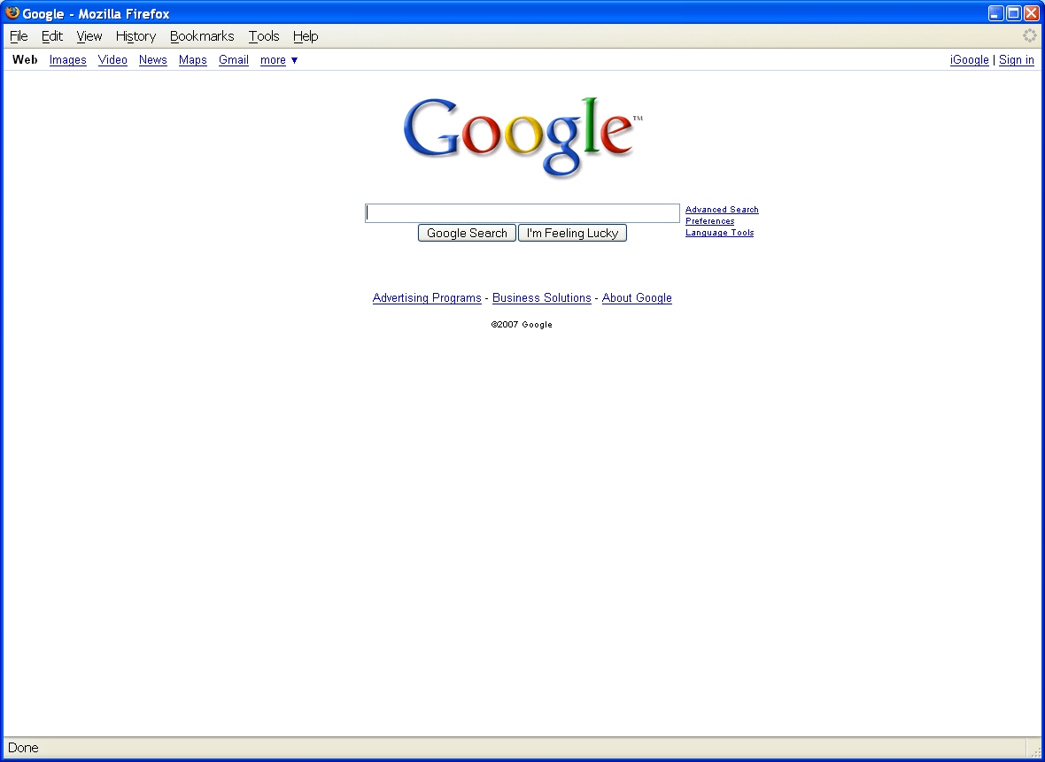
Opening Moves

Slide 26
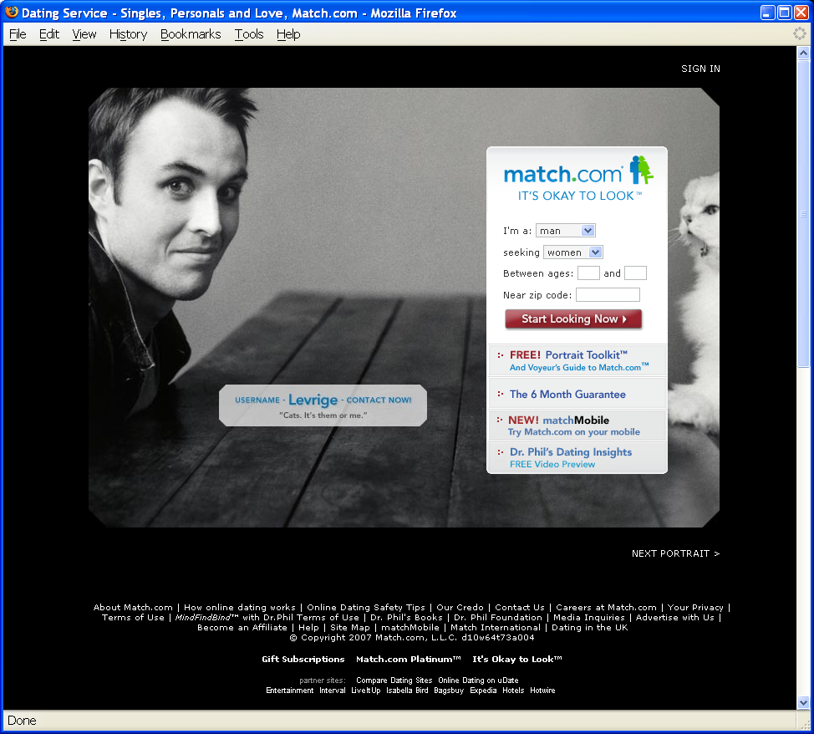
Opening Moves

Slide 27

Opening Moves

Slide 28

Middle Game

Slide 29

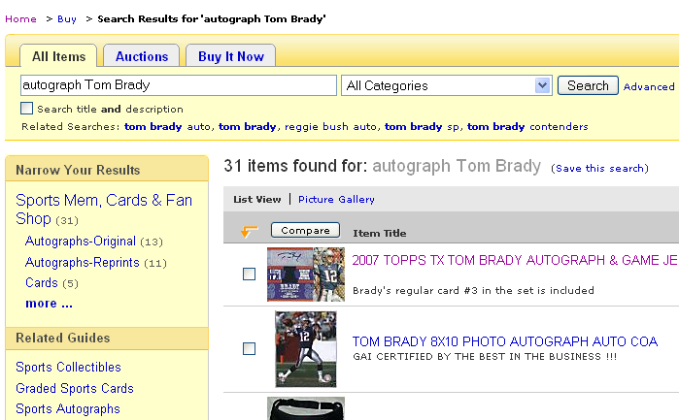
Middle Game

Slide 30
Navigation Patterns
Drive to content
Drive to advertisement
Move up a level
Move to next in sequence
Jump to related

