Slide 1

PHP
Session 32
INST 346
Technologies, Infrastructure and Architecture

Slide 2
Goals for Today
Finishing up the Web
(Starting on) PHP
Analysis Team 8

Slide 3
HTTP request message
two types of HTTP messages: request, response
HTTP request message:
  ASCII (human-readable format)
request line
(GET, POST, HEAD
commands)
carriage return character
line-feed character
GET /index.html HTTP/1.1\r\n
Host: www-net.cs.umass.edu\r\n
User-Agent: Firefox/3.6.10\r\n
Accept: text/html,application/xhtml+xml\r\n
Accept-Language: en-us,en;q=0.5\r\n
Accept-Encoding: gzip,deflate\r\n
Accept-Charset: ISO-8859-1,utf-8;q=0.7\r\n
Keep-Alive: 115\r\n
Connection: keep-alive\r\n
\r\n
header
lines
carriage return, line feed at start of line indicates
end of header lines
* Check out the online interactive exercises for more examples: http://gaia.cs.umass.edu/kurose_ross/interactive/

Slide 4
HTTP response message
status line
(protocol
status code
status phrase)
HTTP/1.1 200 OK\r\n
Date: Sun, 26 Sep 2010 20:09:20 GMT\r\n
Server: Apache/2.0.52 (CentOS)\r\n
Last-Modified: Tue, 30 Oct 2007 17:00:02 GMT\r\n
ETag: "17dc6-a5c-bf716880"\r\n
Accept-Ranges: bytes\r\n
Content-Length: 2652\r\n
Keep-Alive: timeout=10, max=100\r\n
Connection: Keep-Alive\r\n
Content-Type: text/html; charset=ISO-8859-1\r\n
\r\n
data data data data data ...
header
lines
data, e.g.,
requested
HTML file
* Check out the online interactive exercises for more examples: http://gaia.cs.umass.edu/kurose_ross/interactive/

Slide 5
HTTP response status codes
status code appears in 1st line in server-to-client response message.
some sample codes:
200 OK
  request succeeded, requested object later in this msg
301 Moved Permanently
  requested object moved, new location specified later in this msg (Location:)
400 Bad Request
  request msg not understood by server
404 Not Found
  requested document not found on this server
505 HTTP Version Not Supported

Slide 6
HTTP request message: general format
method
sp
URL
sp
version
cr
lf
request
line
header field name
value
cr
lf
~
~
header
lines
~
~
header field name
value
cr
lf
cr
lf
~
entity body
~
body
~
~

Slide 7
Cookies
aside
what cookies can be used for:
authorization
shopping carts
recommendations
user session state (Web e-mail)
cookies and privacy:
cookies permit sites to learn a lot about you
you may supply name and e-mail to sites
how to keep “state”:
protocol endpoints: maintain state at sender/receiver over multiple transactions
cookies: http messages carry state

Slide 8
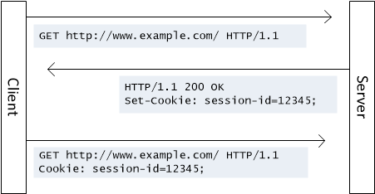
Cookies

Slide 9
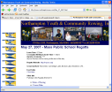

Web caches (proxy server)
goal: satisfy client request without involving origin server
user sets browser: Web accesses via cache
browser sends all HTTP requests to cache
  object in cache: cache returns object
  else cache requests object from origin server, then returns object to client
proxy
server
HTTP request
HTTP request
client
origin
server
HTTP response
HTTP response
HTTP request
HTTP response
client

Slide 10
Why Web caching
reduce response time for client request
reduce traffic on an institution’s access link
Internet dense with caches enables low-bandwidth content providers to effectively deliver content

Slide 11

Caching example: without local cache
assumptions:
avg object size: 100K bits
avg request rate from browsers to origin servers:15/sec
avg data rate to browsers: 1.50 Mbps
RTT from institutional router to any origin server: 2 sec
access link rate: 1.54 Mbps
consequences:
LAN utilization: 15%
access link utilization = 99%
total delay = Internet delay + access delay + LAN delay
= 2 sec + minutes + usecs
origin
servers
public
Internet
1.54 Mbps
access link
problem!
institutional
network
1 Gbps LAN

Slide 12
Caching example: install local cache
Calculating access link utilization, delay with cache:
suppose cache hit rate is 0.4
  40% requests satisfied at cache, 60% requests satisfied at origin
origin
servers
public
Internet
access link utilization:
  60% of requests use access link
data rate to browsers over access link
= 0.6*1.50 Mbps = .9 Mbps
  utilization = 0.9/1.54 = .58
1.54 Mbps
access link
institutional
network
total delay
  = 0.6 * (delay from origin servers) +0.4 * (delay when satisfied at cache)
  = 0.6 (2.01) + 0.4 (~msecs) = ~ 1.2 secs
1 Gbps LAN
local web
cache

Slide 13
Conditional GET
client
server
Goal: don’t send object if cache has up-to-date cached version
  no object transmission delay
  lower link utilization
cache: specify date of cached copy in HTTP request
  If-modified-since: <date>
server: response contains no object if cached copy is up-to-date:
  HTTP/1.0 304 Not Modified
HTTP request msg
If-modified-since: <date>
object
not
modified
before
<date>
HTTP response
HTTP/1.0
304 Not Modified
HTTP request msg
If-modified-since: <date>
object
modified
after
<date>
HTTP response
HTTP/1.0 200 OK
<data>

Slide 14
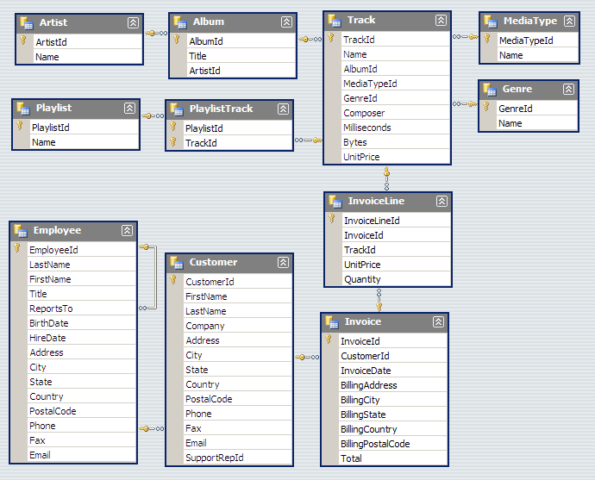

Slide 15
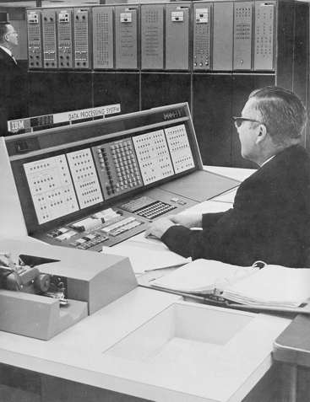
Databases Yesterday…

Slide 16










Databases today…
Wait, but these are websites?

Slide 17
Multi-Tiered Architectures
Browser
Browser
Client
Server
Web Server
Web Server
“Middleware”
Database
Database

Slide 18
Putting the Pieces Together…
Browser
Web Server
Database (MySQL)
HTML
SQL query
CGI
PHP
HTML
Results

Slide 19
What is PHP?
PHP is a server-side scripting language
  Must run on a server (not in the browser)
  More specifically, runs inside the web server
Typical PHP script:
  Fetches input from user forms
  Executes SQL queries
  Constructs an HTML page containing results
Part of the “LAMP” stack
  Linux, Apache, MySQL, PHP

Slide 20
PHP Scripts
Are just like normal HTML pages
With the exception of code between <?php … ?>
Variables begin with dollar signs
  E.g., $a, $b
Use “echo” to output HTML
  Just like document.writeln(…) in JavaScript
Use “.” to concatenate string
  E.g., “here is” . “ some text”
  Just like “here is” + “ some text” in JavaScript

Slide 21
Making PHP
----- HTML stuff -----
<?php
----- PHP stuff -----
?>
----- HTML stuff -----
http://---URL stuff---/xxxxx.php

Slide 22
Sample PHP Script
Get input from user from
Connect to the database
Execute SQL query
Process results to generate HTML

Slide 23
Using PHP with (X)HTML Forms
<form action=“formResponseDemo.php”, method=“post”>
email: <input type=“text”, name=“email”, value=“<?php echo $email ?>”, size=30 />
<input type=“radio”, name=“sure”, value=“yes” /> Yes
<input type=“radio”, name=“sure”, value=“no” /> No
<input type=“submit”, name=“submit”, value=“Submit” />
<input type=“hidden”, name=“submitted”, value=“TRUE” />
</form>
if (isset($_POST[“submitted”])) {
echo “Your email address is $email.”;
} else {
echo “Error: page reached without proper form submission!”;
}

Slide 24
Connecting PHP to MySQL
On XAMPP:
$dbc=mysql_connect (‘localhost’, ‘userid’, ‘password’);
On unix:
$dbc=mysql_connect(‘:/export/software/otal/mysql/run/mysqld.sock’,
‘userid’, ‘password’);

Slide 25
<?php # Script 8.1 - mysql_connect.php
// Set the database access information as constants.
DEFINE ('DB_USER', 'tester');
DEFINE ('DB_PASSWORD', 'tester');
DEFINE ('DB_HOST', 'localhost');
DEFINE ('DB_NAME', 'sitename');
// Make the connection.
$dbc = @mysql_connect (DB_HOST, DB_USER, DB_PASSWORD) OR die ('Could not connect to MySQL: ' . mysql_error() );
// Select the database.
@mysql_select_db (DB_NAME) OR die ('Could not select the database: ' . mysql_error() );
// Create a function for escaping the data.
function escape_data ($data) {
// Address Magic Quotes.
if (ini_get('magic_quotes_gpc')) {
$data = stripslashes($data);
}
// Check for mysql_real_escape_string() support.
if (function_exists('mysql_real_escape_string')) {
global $dbc; // Need the connection.
$data = mysql_real_escape_string (trim($data), $dbc);
} else {
$data = mysql_escape_string (trim($data));
}
// Return the escaped value.
return $data;
} // End of function.
?>

Slide 26
<?php # Script 9.15 - login.php (7th version after Scripts 9.1, 9.3, 9.6, 9.10. 9.13 & 9.14)
// Send NOTHING to the Web browser prior to the session_start() line!
// Check if the form has been submitted.
if (isset($_POST['submitted'])) {
require_once ('../mysql_connect.php'); // Connect to the db.
$errors = array(); // Initialize error array.
// Check for an email address.
if (empty($_POST['email'])) {
$errors[] = 'You forgot to enter your email address.';
} else {
$e = escape_data($_POST['email']);
}
// Check for a password.
if (empty($_POST['password'])) {
$errors[] = 'You forgot to enter your password.';
} else {
$p = escape_data($_POST['password']);
}

Slide 27
if (empty($errors)) { // If everything's OK.
/* Retrieve the user_id and first_name for that email/password combination. */
$query = "SELECT user_id, first_name FROM users WHERE email='$e' AND password=SHA('$p')";
$result = @mysql_query ($query); // Run the query.
$row = mysql_fetch_array ($result, MYSQL_NUM); // Return a record, if applicable.
if ($row) { // A record was pulled from the database.
// Set the session data & redirect.
session_name ('YourVisitID');
session_start();
$_SESSION['user_id'] = $row[0];
$_SESSION['first_name'] = $row[1];
$_SESSION['agent'] = md5($_SERVER['HTTP_USER_AGENT']);
// Redirect the user to the loggedin.php page.
// Start defining the URL.
$url = 'http://' . $_SERVER['HTTP_HOST'] . dirname($_SERVER['PHP_SELF']);
// Check for a trailing slash.
if ((substr($url, -1) == '/') OR (substr($url, -1) == '\\') ) {
$url = substr ($url, 0, -1); // Chop off the slash.
}
// Add the page.
$url .= '/loggedin.php';
header("Location: $url");
exit(); // Quit the script.
} else { // No record matched the query.
$errors[] = 'The email address and password entered do not match those on file.'; // Public message.
$errors[] = mysql_error() . '<br /><br />Query: ' . $query; // Debugging message.
}
} // End of if (empty($errors)) IF.
mysql_close(); // Close the database connection.
} else { // Form has not been submitted.
$errors = NULL;
} // End of the main Submit conditional.

Slide 28
// Begin the page now.
$page_title = 'Login';
include ('./includes/header.html');
if (!empty($errors)) { // Print any error messages.
echo '<h1 id="mainhead">Error!</h1>
<p class="error">The following error(s) occurred:<br />';
foreach ($errors as $msg) { // Print each error.
echo " - $msg<br />\n";
}
echo '</p><p>Please try again.</p>';
}
// Create the form.
?>
<h2>Login</h2>
<form action="login.php" method="post">
<p>Email Address: <input type="text" name="email" size="20" maxlength="40" /> </p>
<p>Password: <input type="password" name="password" size="20" maxlength="20" /></p>
<p><input type="submit" name="submit" value="Login" /></p>
<input type="hidden" name="submitted" value="TRUE" />
</form>
<?php
include ('./includes/footer.html');
?>

Slide 29
Statements in PHP
Sequential
  {…; …;…;}
  Semicolons are required at the end of every statement
Conditional
  if (3==i) {…} else {…}
Loop
  foreach ($array as $key => $value) {…}
  while ($row=mysql_fetch_array(…)) {…}
  For ($i=0; $i<10; $i++) {…}
Braces are optional around a single statement

Slide 30
Arrays in PHP
A set of key-element pairs
  $days = array(“Jan”->31, “Feb”=>28, …);
  $months = explode(“/”, “Jan/Feb/Mar/…/Dec”);
  $_POST
Each element is accessed by the key
  $months[0];
  {$days[“Jan”]}
PHP unifies arrays and hashtables
  Elements may be different types

Slide 31
Functions in PHP
Declaration
  function multiply($a, $b=3){return $a*$b;}
Invoking a method
  $b = multiply($b, 7);
All variables in a function have only local scope
  Unless declared as “global” in the function

