Slide 1

The Web
Session 31
INST 346
Technologies, Infrastructure and Architecture

Slide 2
Goals for Today
Exam 2 and homework comments
HTTP
Analysis Team 7

Slide 3
Exam 2 Results

Slide 4
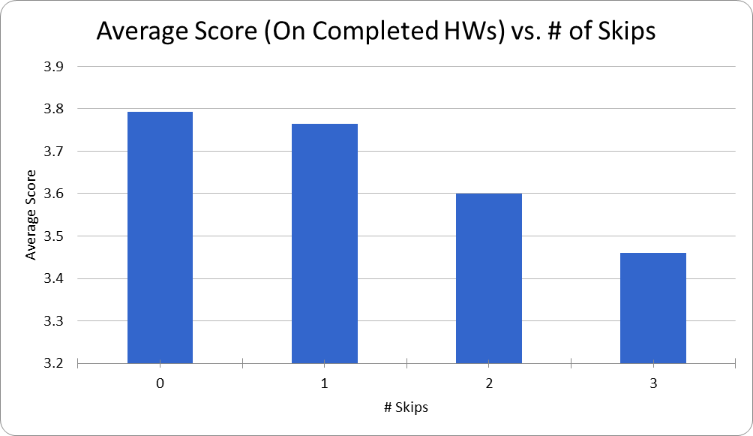

Slide 5
HTTP request message
two types of HTTP messages: request, response
HTTP request message:
  ASCII (human-readable format)
request line
(GET, POST, HEAD
commands)
carriage return character
line-feed character
GET /index.html HTTP/1.1\r\n
Host: www-net.cs.umass.edu\r\n
User-Agent: Firefox/3.6.10\r\n
Accept: text/html,application/xhtml+xml\r\n
Accept-Language: en-us,en;q=0.5\r\n
Accept-Encoding: gzip,deflate\r\n
Accept-Charset: ISO-8859-1,utf-8;q=0.7\r\n
Keep-Alive: 115\r\n
Connection: keep-alive\r\n
\r\n
header
lines
carriage return, line feed at start of line indicates
end of header lines
* Check out the online interactive exercises for more examples: http://gaia.cs.umass.edu/kurose_ross/interactive/

Slide 6
HTTP request message: general format
method
sp
URL
sp
version
cr
lf
request
line
header field name
value
cr
lf
~
~
header
lines
~
~
header field name
value
cr
lf
cr
lf
~
entity body
~
body
~
~

Slide 7
Method types
HTTP/1.0:
GET
POST
  input is uploaded to server in entity body
HEAD
  asks server to leave requested object out of response
HTTP/1.1:
GET, POST, HEAD
PUT
  uploads file in entity body to path specified in URL field
DELETE
  deletes file specified in the URL field

Slide 8
HTTP response message
status line
(protocol
status code
status phrase)
HTTP/1.1 200 OK\r\n
Date: Sun, 26 Sep 2010 20:09:20 GMT\r\n
Server: Apache/2.0.52 (CentOS)\r\n
Last-Modified: Tue, 30 Oct 2007 17:00:02 GMT\r\n
ETag: "17dc6-a5c-bf716880"\r\n
Accept-Ranges: bytes\r\n
Content-Length: 2652\r\n
Keep-Alive: timeout=10, max=100\r\n
Connection: Keep-Alive\r\n
Content-Type: text/html; charset=ISO-8859-1\r\n
\r\n
data data data data data ...
header
lines
data, e.g.,
requested
HTML file
* Check out the online interactive exercises for more examples: http://gaia.cs.umass.edu/kurose_ross/interactive/

Slide 9
HTTP response status codes
status code appears in 1st line in server-to-client response message.
some sample codes:
200 OK
  request succeeded, requested object later in this msg
301 Moved Permanently
  requested object moved, new location specified later in this msg (Location:)
400 Bad Request
  request msg not understood by server
404 Not Found
  requested document not found on this server
505 HTTP Version Not Supported

Slide 10
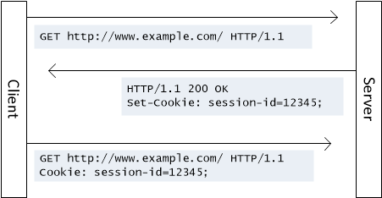
Cookies

Slide 11
Cookies
aside
what cookies can be used for:
authorization
shopping carts
recommendations
user session state (Web e-mail)
cookies and privacy:
cookies permit sites to learn a lot about you
you may supply name and e-mail to sites
how to keep “state”:
protocol endpoints: maintain state at sender/receiver over multiple transactions
cookies: http messages carry state

Slide 12


Web caches (proxy server)
goal: satisfy client request without involving origin server
user sets browser: Web accesses via cache
browser sends all HTTP requests to cache
  object in cache: cache returns object
  else cache requests object from origin server, then returns object to client
proxy
server
HTTP request
HTTP request
client
origin
server
HTTP response
HTTP response
HTTP request
HTTP response
client

Slide 13
Why Web caching
reduce response time for client request
reduce traffic on an institution’s access link
Internet dense with caches enables low-bandwidth content providers to effectively deliver content

Slide 14

Caching example: without local cache
assumptions:
avg object size: 100K bits
avg request rate from browsers to origin servers:15/sec
avg data rate to browsers: 1.50 Mbps
RTT from institutional router to any origin server: 2 sec
access link rate: 1.54 Mbps
consequences:
LAN utilization: 15%
access link utilization = 99%
total delay = Internet delay + access delay + LAN delay
= 2 sec + minutes + usecs
origin
servers
public
Internet
1.54 Mbps
access link
problem!
institutional
network
1 Gbps LAN

Slide 15
Caching example: install local cache
Calculating access link utilization, delay with cache:
suppose cache hit rate is 0.4
  40% requests satisfied at cache, 60% requests satisfied at origin
origin
servers
public
Internet
access link utilization:
  60% of requests use access link
data rate to browsers over access link
= 0.6*1.50 Mbps = .9 Mbps
  utilization = 0.9/1.54 = .58
1.54 Mbps
access link
institutional
network
total delay
  = 0.6 * (delay from origin servers) +0.4 * (delay when satisfied at cache)
  = 0.6 (2.01) + 0.4 (~msecs) = ~ 1.2 secs
1 Gbps LAN
local web
cache

Slide 16
Conditional GET
client
server
Goal: don’t send object if cache has up-to-date cached version
  no object transmission delay
  lower link utilization
cache: specify date of cached copy in HTTP request
  If-modified-since: <date>
server: response contains no object if cached copy is up-to-date:
  HTTP/1.0 304 Not Modified
HTTP request msg
If-modified-since: <date>
object
not
modified
before
<date>
HTTP response
HTTP/1.0
304 Not Modified
HTTP request msg
If-modified-since: <date>
object
modified
after
<date>
HTTP response
HTTP/1.0 200 OK
<data>

