Slide 1
Wearables
Session 3
INST 346
Doug Oard

Slide 2
Agenda
Virtual reality
Augmented reality
Lifelogging
Homework 1

Slide 3
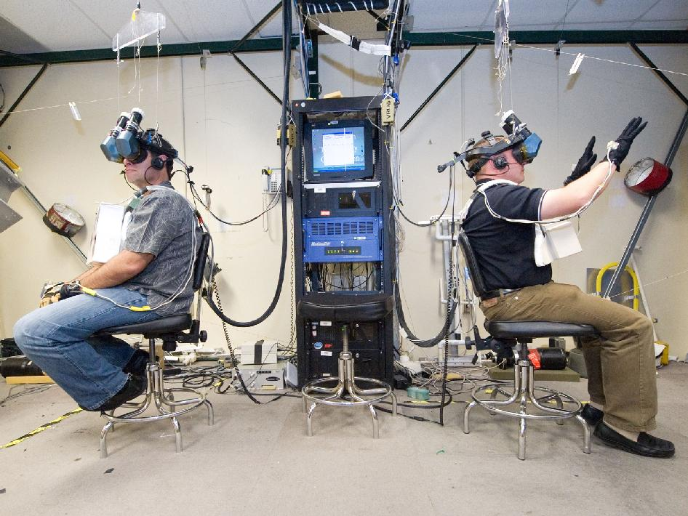

Slide 4
Human Senses
Visual
Position/motion, color/contrast, symbols
Auditory
Position/motion, tones/volume, speech
Haptic
Mechanical, thermal, electrical, kinesthethic
Olfactory
Smell, taste
Vestibular

Slide 5
Virtual Reality Output
Image
Head-mounted, projection
Acoustic
Headphones, speakers, spatialization
Tactile
Vibrotactile, pneumatic, piezoelectric
Force feedback
Exoskeleton, flight controls, …

Slide 6
Virtual Reality Output
Inertial
Motion-based simulators
Olfactory
Chemical
Locomotive
Ambulatory, stationary bicycle, treadmill
Physical
Thermal, wind, water spray, …

Slide 7
Virtual Reality Input
Language
Speech recognition
3-D direct manipulation
Wand, data glove
Remote sensing
Camera, speaker ID, head tracker, eye tracker
Simulation
Mechanical controls (flight, car, parachute, …)

Slide 8
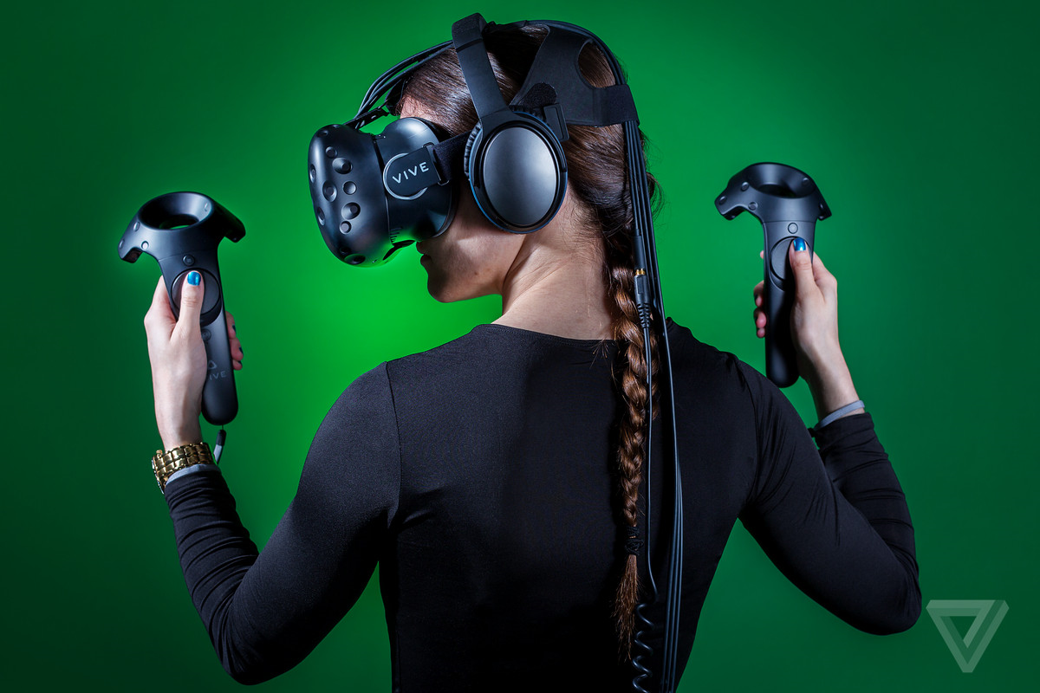

Slide 9
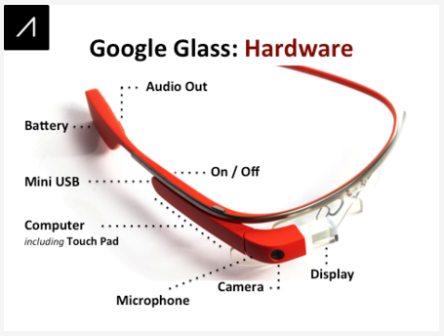

Slide 10
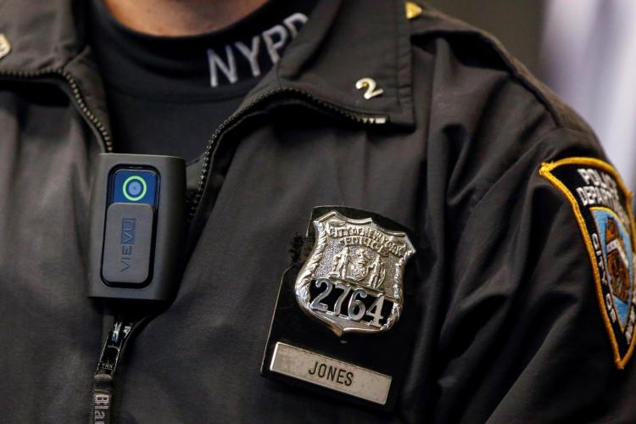

Slide 11
Lifelogging
Images
Sensecam, video
Audio
Maryland is a two-party consent state
Spatial
Position tracking with GPS, WiFi, cellular, …
Biometric
Heart rate, respiration, galvanic skin response
Files
Email, SMS, photos, …

Slide 12
H1
Due Friday before class

