Slide 1
Internet Governance
Session 27
INST 346
Technologies, Infrastructure and Architecture

Slide 2
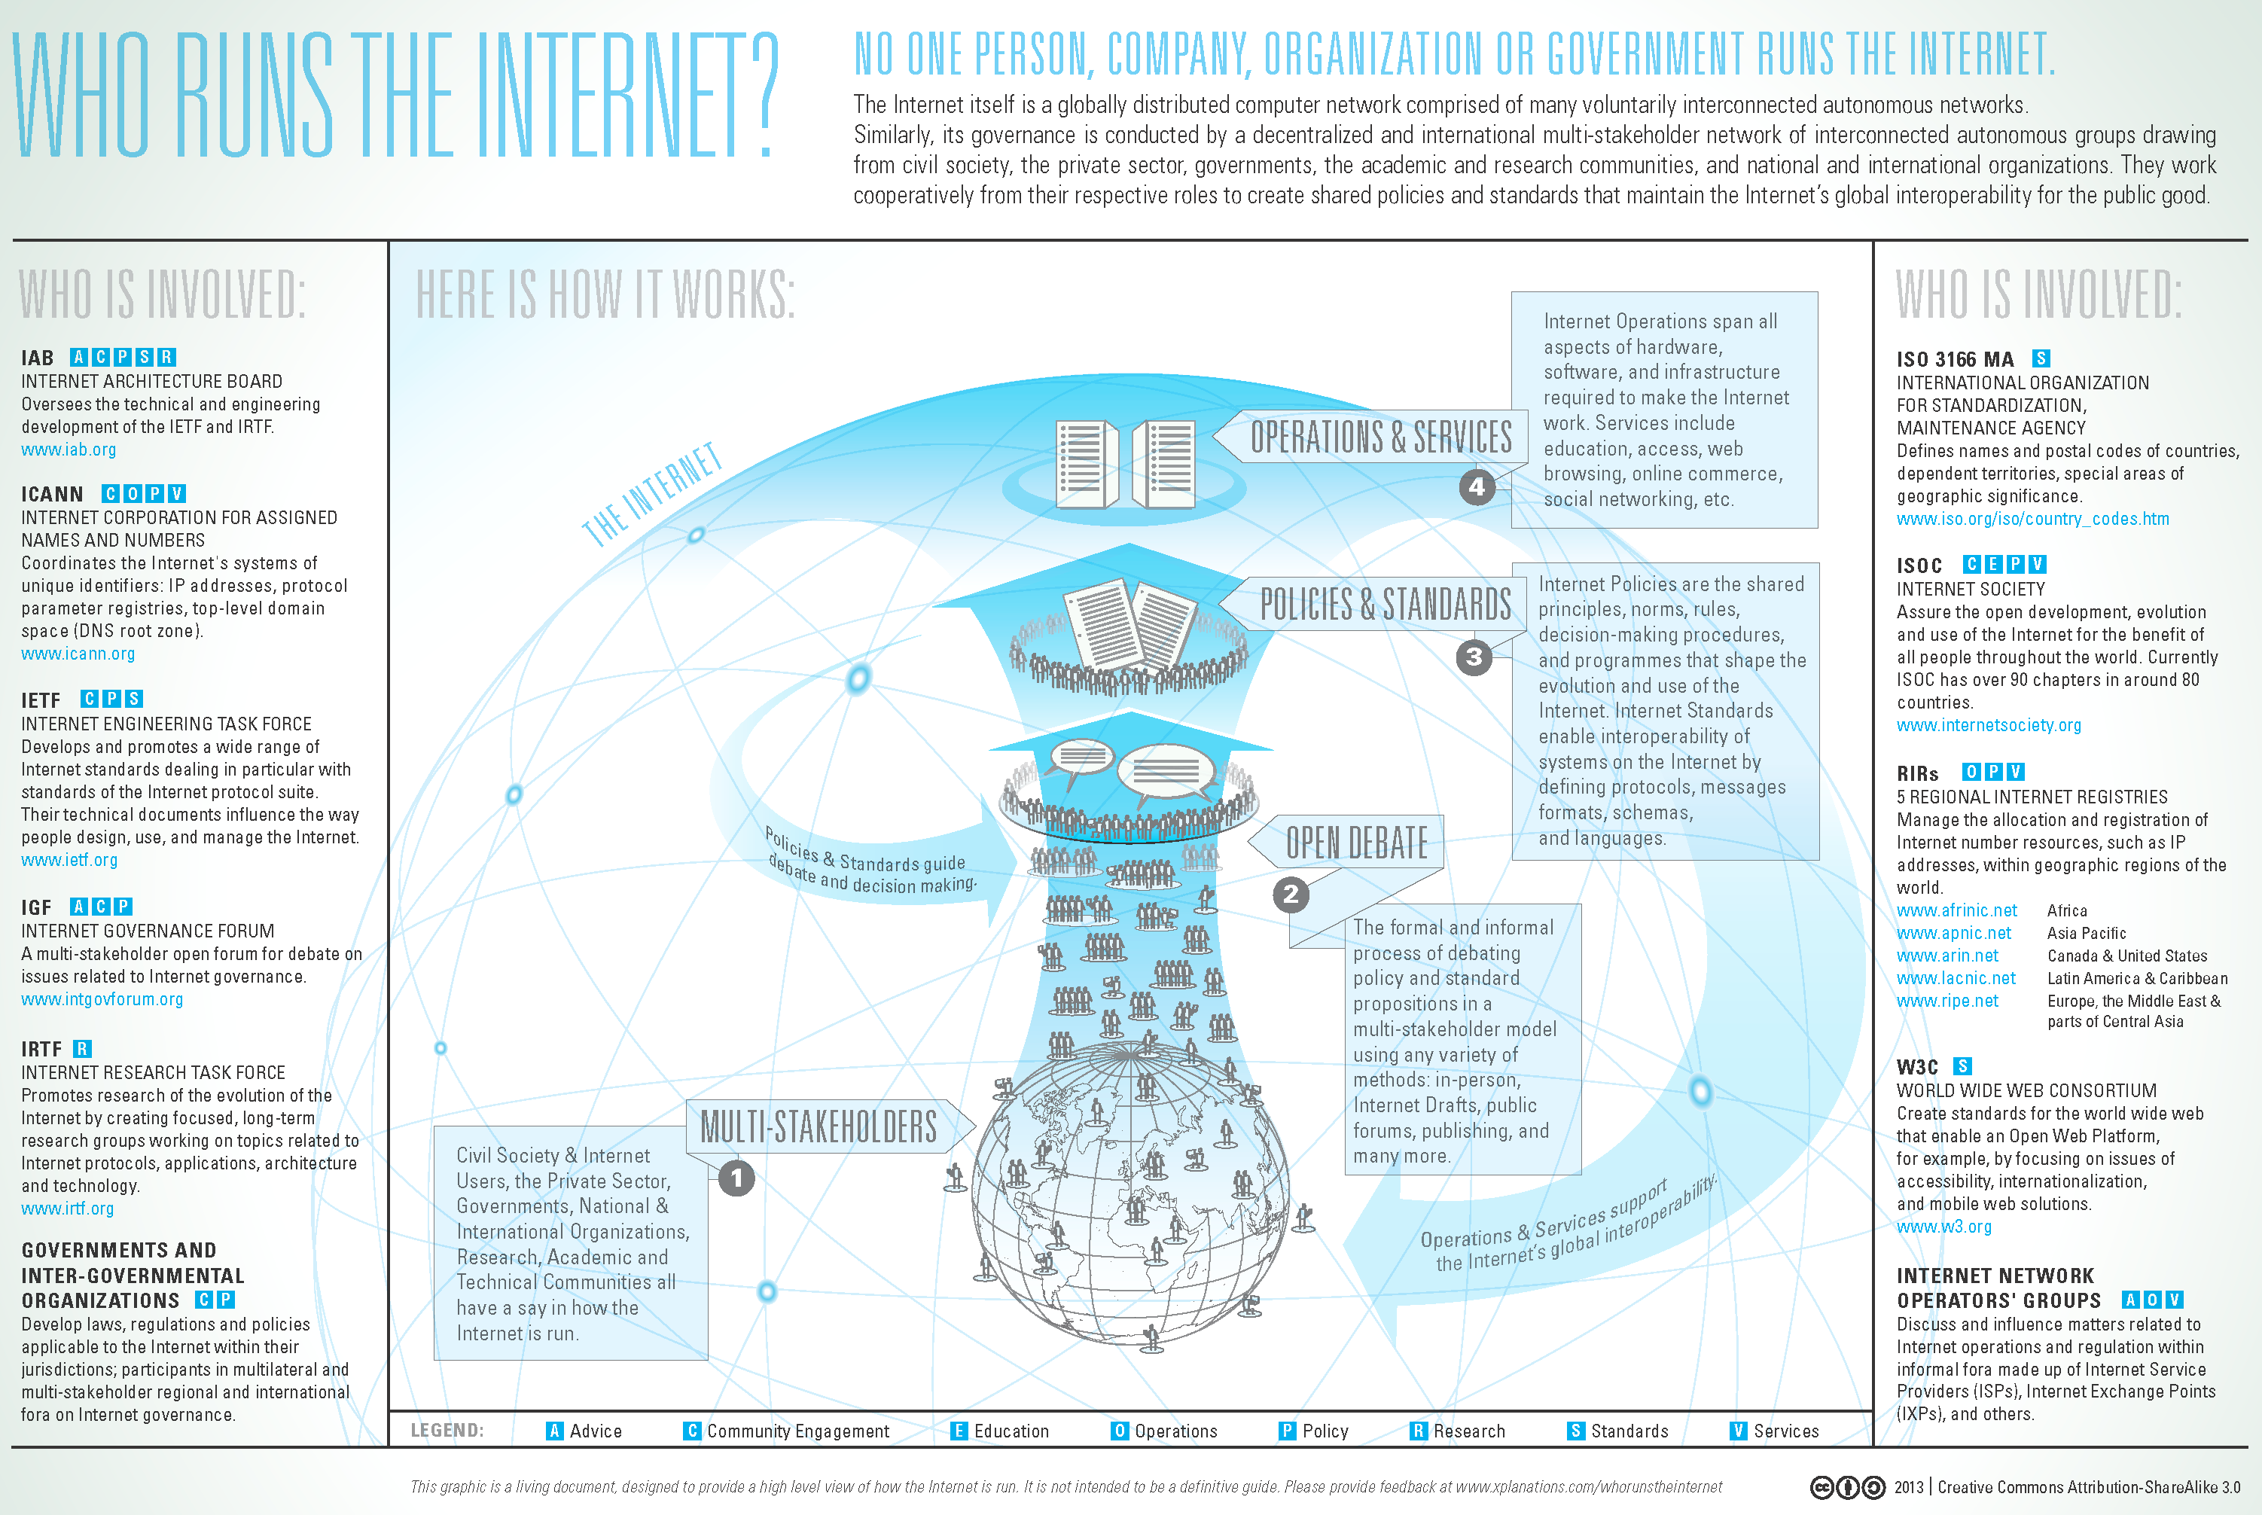

Slide 3
“Layers” of Internet Governance
Physical Infrastructure
Logical Layer
Content Layer

Slide 4
Agenda
Jurisdiction
Internet Engineering Task Force (IETF)
ICANN
Other Standards
US-CERT

Slide 5
Multiple Jurisdictions
Content creator
Server owner
Server location
Router location
Storage location
User location
User nationality
International (radio, oceans, outer space)

Slide 6
Some IETF “Requests for Comment”
RFC 5000 Internet Official Protocol Standards, 5/2008
RFC 1700 Assigned Numbers, J. Reynolds, 10/20/1994
RFC 1122 Requirements for Internet Hosts - Communication layers, 10/1/1989
RFC 1123 Requirements for Internet Hosts - Application and support, 10/1/1989
RFC 791 Internet Protocol, 9/1/1981
RFC 792 Internet Control Message Protocol, 9/1/1981
RFC 1112 Host extensions for IP multicasting, 8/1/1989
RFC 768 User Datagram Protocol, 8/28/1980
RFC 793 Transmission Control Protocol, 9/1/1981
RFC 854 Telnet Protocol specification, 5/1/1983
RFC 855 Telnet option specifications, 5/1/1983
RFC 959 File Transfer Protocol, 10/1/1985
RFC 821 Simple Mail Transfer Protocol, 8/1/1982
RFC 1869 SMTP Service Extensions, 11/6/1995
RFC 1870 SMTP Service Extension for Message Size Declaration, 11/6/1995
RFC 822 Standard for the format of ARPA Internet text messages, 8/13/1982
RFC 1049 Content-type header field for Internet messages, 3/1/1988
RFC 1034 Domain names - concepts and facilities, 11/1/1987
RFC 1035 Domain names - implementation and specification, 11/1/1987
RFC 974 Mail routing and the domain system, 1/1/1986

Slide 7
Internet Corporation for Assigned Names and Numbers (ICANN)
Mission: Enable universal resolvability
Assigns IPv4 and IPv6 address blocks
Subassigned to Regional Internet Registries
Domain name management
Auctions Top-Level Domain (TLD) names
Accredits domain name registrars
Establishes dispute resolution framework
Establishes WHOIS policy
Assigns well-known port numbers

Slide 8
Other Standards Bodies
World Wide Web Consortium (W3C)
Web standards (HTTP, HTML, CSS, DOM, …)
International Standards Organization (ISO)
Unicode
IEEE
Link-layer standards for Ethernet and WiFi
One-off standards
JPEG, MPEG

Slide 9
CERT-US and CERT/CC
Accept reports of vulnerabilities
Mandatory for US government (to CERT-US)
Voluntary for others (to CERT/CC)
Generally disclosed within 45 days
Coordinated national incident response
NIST National Vulnerability Database

