Slide 1

Routing
Session 20
INST 346
Technologies, Infrastructure and Architecture

Slide 2
Goals for Today
Shortest-Path Routing
Routers
Border Gateway Protocol
Analysis Group 4

Slide 3
Internet approach to scalable routing
aggregate routers into regions known as “autonomous systems” (AS) (a.k.a. “domains”)
intra-AS routing
routing among hosts, routers in same AS (“network”)
all routers in AS must run same intra-domain protocol
routers in different AS can run different intra-domain routing protocol
gateway router: at “edge” of its own AS, has link(s) to router(s) in other AS’es
inter-AS routing
routing among AS’es
gateways perform inter-domain routing (as well as intra-domain routing)

Slide 4
Interconnected ASes
3c
3a
2c
3b
AS3
2a
1c
2b
AS2
1a
1b
1d
AS1
forwarding table configured by both intra- and inter-AS routing algorithm
  intra-AS routing determine entries for destinations within AS
  inter-AS & intra-AS determine entries for external destinations
Intra-AS
Routing
algorithm
Inter-AS
Routing
algorithm
Forwarding
table

Slide 5
Intra-AS Routing
also known as interior gateway protocols (IGP)
most common intra-AS routing protocols:
  RIP: Routing Information Protocol
  OSPF: Open Shortest Path First (IS-IS protocol essentially same as OSPF)
  IGRP: Interior Gateway Routing Protocol (Cisco proprietary for decades, until 2016)

Slide 6
Intra-AS Routing (OSPF)
(Open) Shortest Path First
A “link state” method
First get a complete network map at each node
  Each router floods the AS with OSPF “advertisements”
  Advertisement: list of adjacent routers with estimated delay
Use Dijkstra’s algorithm for shortest path computation

Slide 7
Dijsktra’s algorithm
c(x,y): link cost from node x to y; = ∞ if not direct neighbors
D(v): current value of cost of path from source to dest. v
p(v): predecessor node along path from source to v
N': set of nodes whose least cost path definitively known
1 Initialization:
2 N' = {u}
3 for all nodes v
4 if v adjacent to u
5 then D(v) = c(u,v)
6 else D(v) = ∞
7
8 Loop
9 find w not in N' such that D(w) is a minimum
10 add w to N'
11 update D(v) for all v adjacent to w and not in N' :
12 D(v) = min( D(v), D(w) + c(w,v) )
13 /* new cost to v is either old cost to v or known
14 shortest path cost to w plus cost from w to v */
15 until all nodes in N'

Slide 8
Dijkstra’s algorithm: example
D(v): current value of cost of path from source to dest. v
p(v): predecessor node along path from source to v
N': set of nodes whose least cost path definitively known
D(v)
p(v)
D(w)
p(w)
D(x)
p(x)
D(y)
p(y)
D(z)
p(z)
Step
N'
0
u
7,u
3,u
5,u
∞
∞
1
uw
6,w
5,u
11,w
∞
2
uwx
6,w
11,w
14,x
3
uwxv
10,v
14,x
4
uwxvy
12,y
5
uwxvyz
x
9
construct shortest path tree by tracing predecessor nodes
5
7
4
8
u
3
w
y
z
2
3
7
4
v

Slide 9
Dijkstra’s algorithm: another example
Step
0
1
2
3
4
5
N'
u
ux
uxy
uxyv
uxyvw
uxyvwz
D(v),p(v)
2,u
2,u
2,u
D(w),p(w)
5,u
4,x
3,y
3,y
D(x),p(x)
1,u
D(y),p(y)
∞
2,x
D(z),p(z)
∞
∞
4,y
4,y
4,y
5
D(v): current value of cost of path from source to dest. v
p(v): predecessor node along path from source to v
N': set of nodes whose least cost path definitively known
v
3
w
2
5
u
2
1
z
3
1
2
x
y
1

Slide 10
Dijkstra’s algorithm: solution
resulting shortest-path tree from u:
v
w
u
z
x
y
resulting forwarding table in u:
destination
link
v
(u,v)
x
(u,x)
y
(u,x)
w
(u,x)
z
(u,x)

Slide 11
Logically centralized control plane
A distinct (typically remote) controller interacts with local control agents (CAs) in routers to compute forwarding tables
Remote Controller
control
plane
data
plane
CA
CA
CA
CA
CA

Slide 12
Router architecture overview
high-level view of generic router architecture:
routing, management
control plane (software)
operates in millisecond
time frame
routing
processor
forwarding data plane (hardware) operttes in nanosecond timeframe
high-seed
switching
fabric
router input ports
router output ports

Slide 13
Input port functions
lookup,
forwarding
queueing
line
termination
link
layer
protocol
(receive)
switch
fabric
physical layer:
bit-level reception
data link layer:
e.g., Ethernet
decentralized switching:
using header field values, lookup output port using forwarding table in input port memory
goal: complete input port processing at ‘line speed’
queuing: if datagrams arrive faster than forwarding rate into switch fabric

Slide 14
Input port queuing
fabric slower than input ports combined -> queueing may occur at input queues
  queueing delay and loss due to input buffer overflow!
Head-of-the-Line (HOL) blocking: queued datagram at front of queue prevents others in queue from moving forward
switch
fabric
switch
fabric
output port contention:
only one red datagram can be transferred.
lower red packet is blocked
one packet time later: green packet experiences HOL blocking

Slide 15
Switching via a bus
datagram from input port memory
to output port memory via a shared bus
bus contention: switching speed limited by bus bandwidth
32 Gbps bus, Cisco 5600: sufficient speed for access and enterprise routers
bus

Slide 16
Destination-based forwarding
forwarding table
Destination Address Range
11001000 00010111 00010000 00000000
through
11001000 00010111 00010111 11111111
11001000 00010111 00011000 00000000
through
11001000 00010111 00011000 11111111
11001000 00010111 00011001 00000000
through
11001000 00010111 00011111 11111111
otherwise
Link Interface
0
1
2
3
Q: but what happens if ranges don’t divide up so nicely?

Slide 17
Longest prefix matching
longest prefix matching
when looking for forwarding table entry for given destination address, use longest address prefix that matches destination address.
Destination Address Range
11001000 00010111 00010*** *********
11001000 00010111 00011000 *********
11001000 00010111 00011*** *********
otherwise
Link interface
0
1
2
3
examples:
DA: 11001000 00010111 00010110 10100001
which interface?
DA: 11001000 00010111 00011000 10101010
which interface?

Slide 18
Longest prefix matching
longest prefix matching: often performed using ternary content addressable memories (TCAMs)
  content addressable: present address to TCAM: retrieve address in one clock cycle, regardless of table size
  Cisco Catalyst: can up ~1M routing table entries in TCAM

Slide 19
Output ports
This slide in HUGELY important!
datagram
buffer
queueing
switch
fabric
link
layer
protocol
(send)
line
termination
buffering required when datagrams arrive from fabric faster than the transmission rate
scheduling discipline chooses among queued datagrams for transmission
Datagram (packets) can be lost due to congestion, lack of buffers
Priority scheduling – who gets best performance, network neutrality

Slide 20
Output port queueing
switch
fabric
switch
fabric
at t, packets more
from input to output
one packet time later
buffering when arrival rate via switch exceeds output line speed
queueing (delay) and loss due to output port buffer overflow!

Slide 21
How much buffering?
RFC 3439 rule of thumb: average buffering equal to “typical” RTT (say 250 msec) times link capacity C
  e.g., C = 10 Gpbs link: 2.5 Gbit buffer
recent recommendation: with N flows, buffering equal to
.
RTT C
N

Slide 22
Scheduling policies
scheduling: choose next packet to send on link
FIFO (first in first out) scheduling: send in order of arrival to queue
  real-world example?
  discard policy: if packet arrives to full queue: who to discard?
    tail drop: drop arriving packet
    priority: drop/remove on priority basis
    random: drop/remove randomly
packet
arrivals
packet
departures
queue
(waiting area)
link
(server)

Slide 23
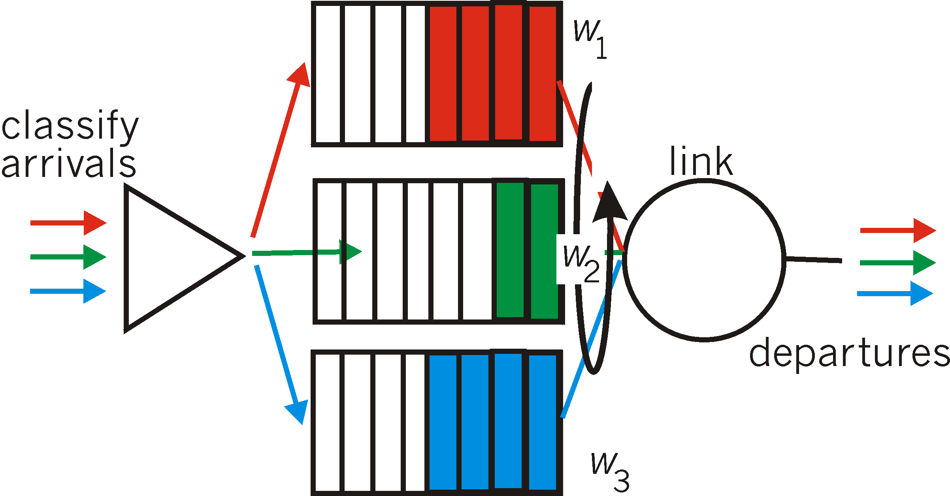
Scheduling policies
Weighted Fair Queuing (WFQ):
generalized Round Robin
each class gets weighted amount of service in each cycle

Slide 24
Hierarchical OSPF
boundary router
backbone router
backbone
area
border
routers
area 3
internal
routers
area 1
area 2

Slide 25
Hierarchical OSPF
two-level hierarchy: local area, backbone.
  link-state advertisements only in area
  each nodes has detailed area topology; only know direction (shortest path) to nets in other areas.
area border routers: “summarize” distances to nets in own area, advertise to other Area Border routers.
backbone routers: run OSPF routing limited to backbone.
boundary routers: connect to other AS’es.

Slide 26
Inter-AS routing is different
policy:
intra-AS: single admin, so single consistent policy
inter-AS: each admin wants control over how its traffic routed and who routes through its AS
performance:
intra-AS: can focus on performance
inter-AS: policy may dominate over performance

Slide 27
Inter-AS tasks
suppose router in AS1 receives datagram destined outside of AS1:
  router should forward packet to gateway router, but which one?
AS1 must:
learn which dests are reachable through AS2, which through AS3
propagate this reachability info to all routers in AS1
3c
3a
3b
AS3
2c
other
networks
1c
2a
other
networks
1a
2b
1b
AS2
AS1
1d

Slide 28
Internet inter-AS routing: BGP
BGP (Border Gateway Protocol): the de facto inter-domain routing protocol
  “glue that holds the Internet together”
BGP provides each AS a means to:
  eBGP: obtain subnet reachability information from neighboring ASes
  iBGP: propagate reachability information to all AS-internal routers.
  determine “good” routes to other networks based on reachability information and policy
allows subnet to advertise its existence to rest of Internet: “I am here”

Slide 29
eBGP, iBGP connections
2b
∂
2a
2c
1b
3b
2d
∂
1a
1c
3a
3c
AS 2
1d
3d
AS 1
eBGP connectivity
AS 3
iBGP connectivity
1c
gateway routers run both eBGP and iBGP protools

Slide 30
BGP basics
BGP session: two BGP routers (“peers”) exchange BGP messages over semi-permanent TCP connection:
  advertising paths to different destination network prefixes (BGP is a “path vector” protocol)
when AS3 gateway router 3a advertises path AS3,X to AS2 gateway router 2c:
  AS3 promises to AS2 it will forward datagrams towards X
AS 3
3b
AS 1
1b
3a
3c
1a
1c
AS 2
2b
3d
X
1d
2a
2c
BGP advertisement:
AS3, X
2d

Slide 31
Path attributes and BGP routes
advertised prefix includes BGP attributes
  prefix + attributes = “route”
two important attributes:
  AS-PATH: list of ASes through which prefix advertisement has passed
  NEXT-HOP: indicates specific internal-AS router to next-hop AS
Policy-based routing:
  gateway receiving route advertisement uses import policy to accept/decline path (e.g., never route through AS Y).
  AS policy also determines whether to advertise path to other other neighboring ASes

Slide 32
BGP path advertisement
AS3
3b
AS1
1b
3a
3c
1a
1c
AS2
2b
3d
X
1d
AS3,X
AS2,AS3,X
2a
2c
2d
AS2 router 2c receives path advertisement AS3,X (via eBGP) from AS3 router 3a
Based on AS2 policy, AS2 router 2c accepts path AS3,X, propagates (via iBGP) to all AS2 routers
Based on AS2 policy, AS2 router 2a advertises (via eBGP) path AS2, AS3, X to AS1 router 1c

Slide 33
BGP path advertisement
AS3
3b
AS1
1b
AS3,X
3a
3c
1a
1c
AS2
2b
3d
X
1d
AS3,X
AS2,AS3,X
2a
2c
2d
gateway router may learn about multiple paths to destination:
AS1 gateway router 1c learns path AS2,AS3,X from 2a
AS1 gateway router 1c learns path AS3,X from 3a
Based on policy, AS1 gateway router 1c chooses path AS3,X, and advertises path within AS1 via iBGP

Slide 34
BGP: achieving policy via advertisements
legend:
provider
B
network
X
W
A
customer
C
network:
Y
Suppose an ISP only wants to route traffic to/from its customer networks (does not want to carry transit traffic between other ISPs)
A advertises path Aw to B and to C
B chooses not to advertise BAw to C:
  B gets no “revenue” for routing CBAw, since none of C, A, w are B’s customers
  C does not learn about CBAw path
C will route CAw (not using B) to get to w

Slide 35
BGP: achieving policy via advertisements
legend:
provider
B
network
X
W
A
customer
C
network:
Y
Suppose an ISP only wants to route traffic to/from its customer networks (does not want to carry transit traffic between other ISPs)
A,B,C are provider networks
X,W,Y are customer (of provider networks)
X is dual-homed: attached to two networks
policy to enforce: X does not want to route from B to C via X
  .. so X will not advertise to B a route to C

Slide 36
BGP route selection
router may learn about more than one route to destination AS, selects route based on:
  local preference value attribute (policy decision)
  shortest AS-PATH
  closest NEXT-HOP router (hot potato routing)
  additional criteria

Slide 37
Hot Potato Routing
AS3
3b
AS1
1b
3a
3c
1a
1c
AS2
2b
3d
X
1d
112
152
AS3,X
AS1,AS3,X
2a
263
2c
201
OSPF link weights
2d
2d learns (via iBGP) it can route to X via 2a or 2c
hot potato routing: choose local gateway that has least intra-domain cost (e.g., 2d chooses 2a, even though more AS hops to X): don’t worry about inter-domain cost!

Slide 38
Network Layer Summary
IPv4 addresses
  Hierarchical structure (subnet mask)
Routing
  Hierarchical structure (Autonomous Systems)
Routers
  Structure (input queue, switch, output queue)
  Routing tables (hierarchical structure)
Network layer packets
  IPv4, IPv6

