Slide 1

Mobile Phones
Session 2
INST 346

Slide 2
Agenda
Mobile phones
Cellular networks
Sensors

Slide 3
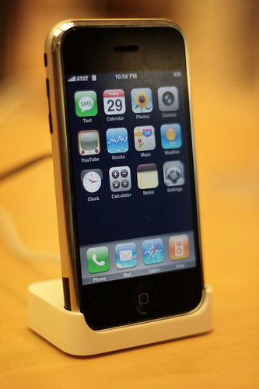
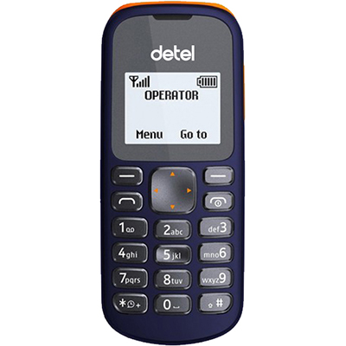

Slide 4


Cellular network architecture
Mobile
Switching
Center
Public telephone
network
Mobile
Switching
Center
wired network

Slide 5
Communications Types
Voice
Mobile Data
  3G has separates voice and data
  4G uses data for everything (including voice)
WiFi
Bluetooth

Slide 6
Orientation Sensors
Accelerometer (g-sensor)
Gyroscope
Compass (magnetometer)

Slide 7
Position Measurement
GPS
Cellular
WiFi

Slide 8
Environmental Sensors
Proximity (to your ear, to your pocket, …)
Light (to adjust screen brightness)
Barometric pressure (for elevation)
Temperature

Slide 9
Signal Acquisition
Camera
  Still images
  Video
Microphone
FM Radio
Fingerprint

Slide 10
User Interaction
Touchscreen
  Point
  Gesture
  Type
Audio
  Speech
  Earcons
Haptic
Predictive analytics

Slide 11
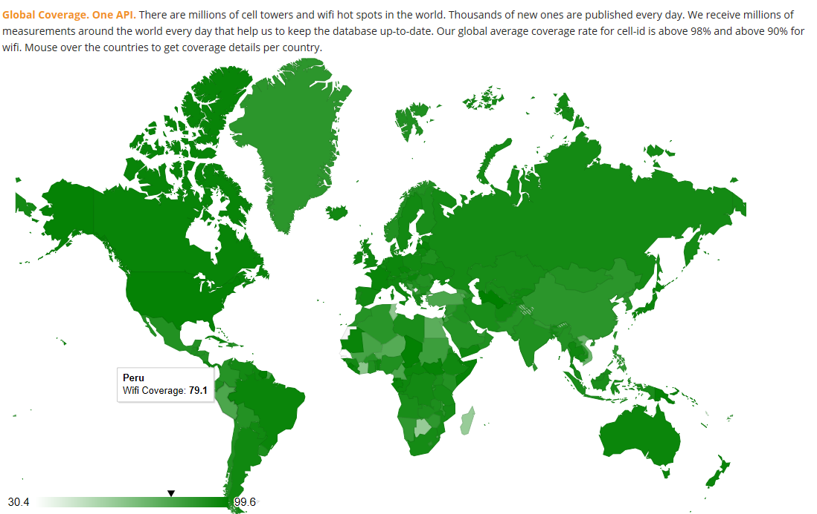
Combain

Slide 12
How Wi-Fi positioning works with GPS
Devices with both Wi-Fi and GPS can be used to send information about a Wi-Fi network back to a location service provider. This makes it possible to determine where the particular Wi-Fi network is. This is done by having the device send the access point’s MAC address along with the location determined by GPS. If GPS is used to determine the location of a device it will also scan nearby networks that can be used to identify the network. When the location of Wi-Fi networks are found the information will be recorded for public access. Next time someone is close to one of those Wi-Fi networks, but lack a GPS-signal, this service will be used to determine a location as the network’s location is recorded.
https://combain.com/about/about-positioning/about-indoor-positioning/

Slide 13
Vendors collecting Wi-Fi information
Wi-Fi positioning information is gathered by vendors to provide more accurate location services to users. Gathering this kind of network information is public knowledge, Wi-Fi passwords are not needed to do this. Determining user locations in this way is usually part of cell phone carrier’s terms-of-service agreement though most phones allow the user to turn off location services.
https://combain.com/about/about-positioning/about-indoor-positioning/

Slide 14
Before You Go
On a sheet of paper, answer the following (ungraded) question (no names, please):
What was the muddiest point in today’s class?

