Slide 1

Ethernet
Session 16
INST 346

Slide 2
Goals for Today
Finishing up error correction
Ethernet
Switched Ethernet
H5

Slide 3
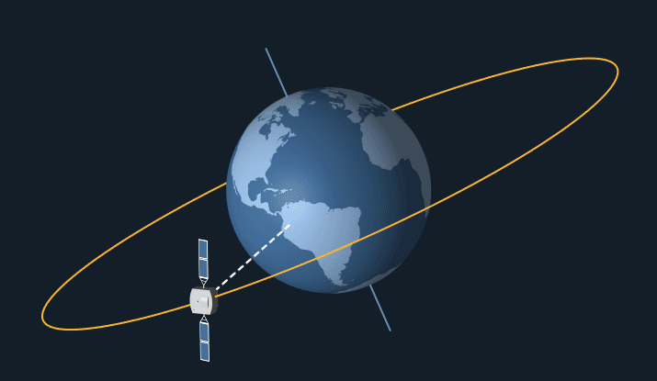

Slide 4
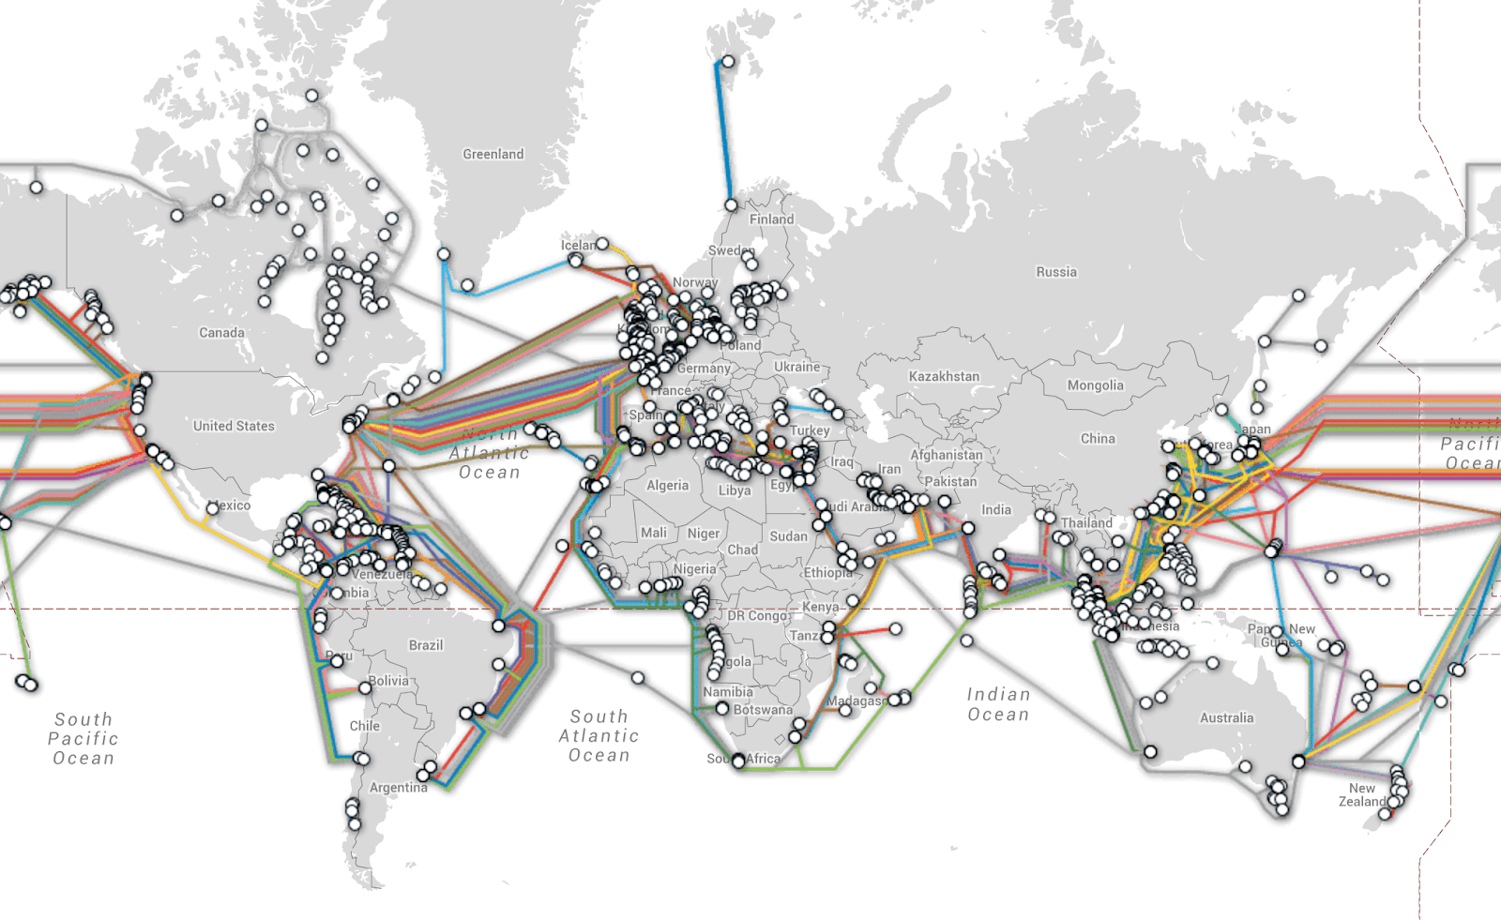
“Submarine” Fiber Optic Cables

Slide 5
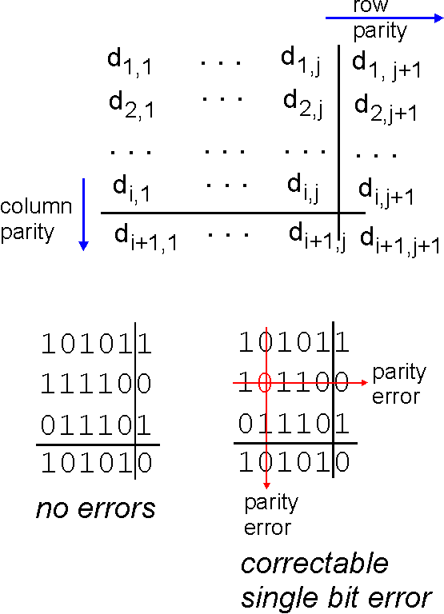
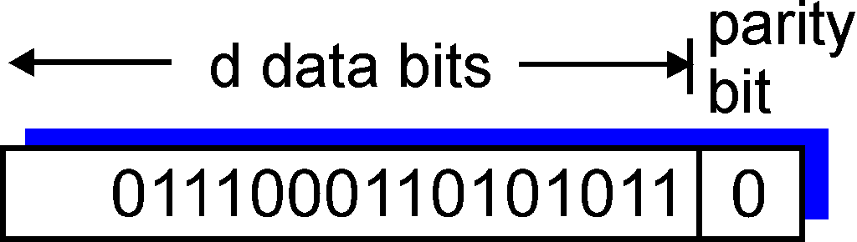
Parity checking
single bit parity:
detect single bit errors
two-dimensional bit parity:
detect and correct single bit errors
0
0
* Check out the online interactive exercises for more examples: http://gaia.cs.umass.edu/kurose_ross/interactive/

Slide 6
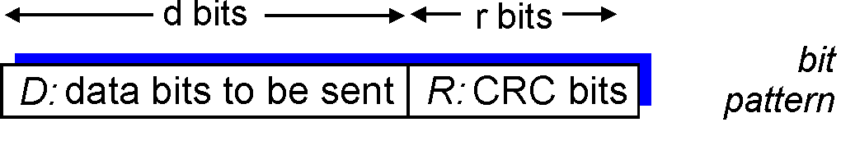
Cyclic redundancy check
more powerful error-detection coding
view data bits, D, as a binary number
choose r+1 bit pattern (generator), G
goal: choose r CRC bits, R, such that
  <D,R> exactly divisible by G (modulo 2)
  receiver knows G, divides <D,R> by G. If non-zero remainder: error detected!
  can detect all burst errors less than r+1 bits
widely used in practice (Ethernet, 802.11 WiFi)

Slide 7

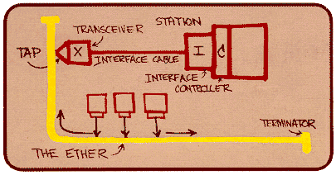
Ethernet
“dominant” wired LAN technology:
single chip, multiple speeds (e.g., Broadcom BCM5761)
first widely used LAN technology
simpler, cheap
kept up with speed race: 10 Mbps – 10 Gbps
Metcalfe’s Ethernet sketch

Slide 8
Ethernet: unreliable, connectionless
connectionless: no handshaking between sending and receiving NICs
unreliable: receiving NIC doesn't send acks or nacks to sending NIC
  data in dropped frames recovered only if initial sender uses higher layer rdt (e.g., TCP), otherwise dropped data lost
Ethernet’s MAC protocol: unslotted CSMA/CD with binary backoff

Slide 9
CSMA (carrier sense multiple access)
CSMA: listen before transmit:
if channel sensed idle: transmit entire frame
if channel sensed busy, defer transmission
human analogy: don’t interrupt others!

Slide 10
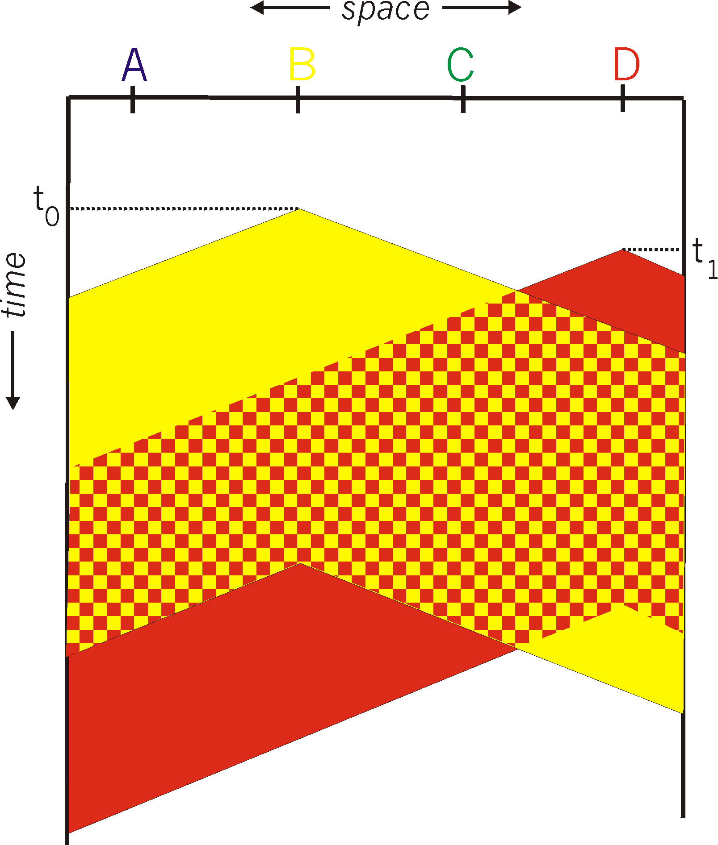

CSMA collisions
spatial layout of nodes
collisions can still occur: propagation delay means two nodes may not hear each other’s transmission
collision: entire packet transmission time wasted
  distance & propagation delay play role in in determining collision probability

Slide 11
CSMA/CD (collision detection)
CSMA/CD: carrier sensing, deferral as in CSMA
  collisions detected within short time
  colliding transmissions aborted, reducing channel wastage
collision detection:
  easy in wired LANs: measure signal strengths, compare transmitted, received signals
  difficult in wireless LANs: received signal strength overwhelmed by local transmission strength
human analogy: the polite conversationalist

Slide 12
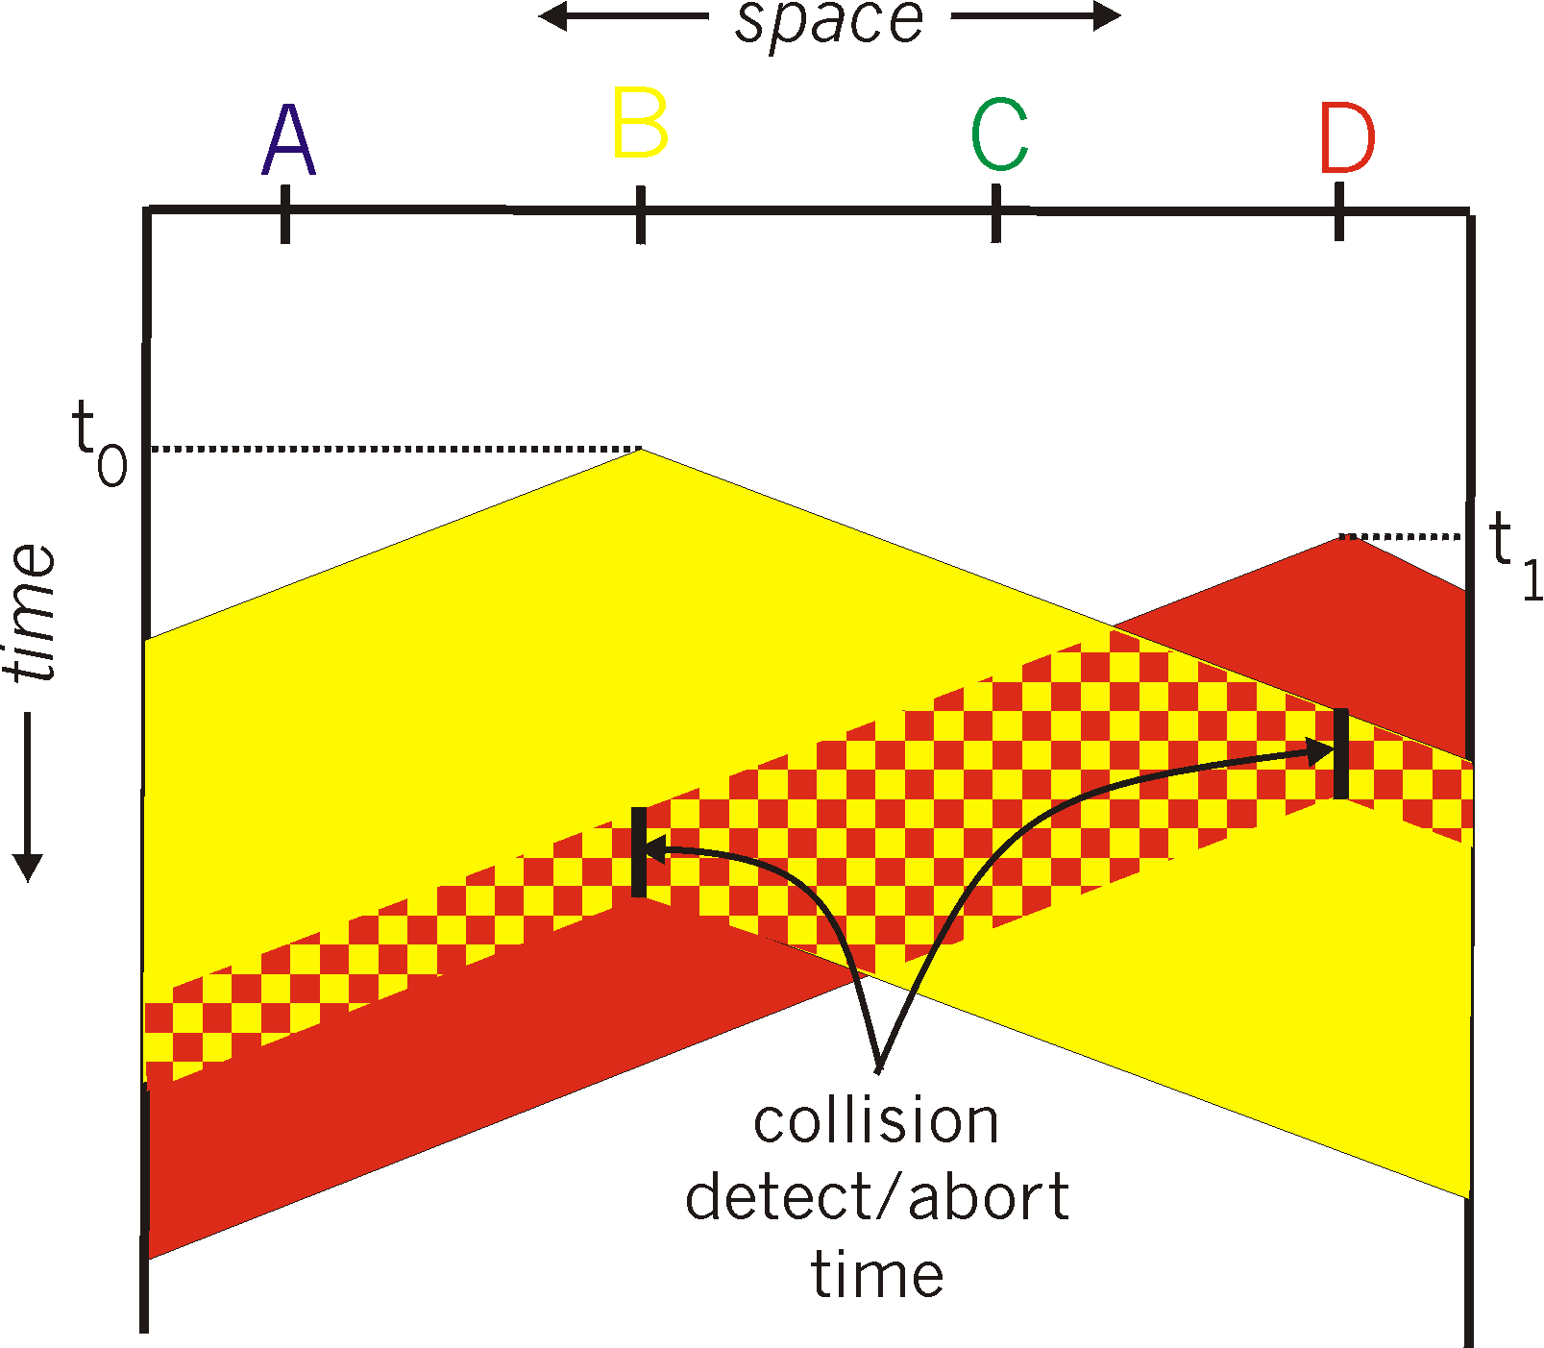
CSMA/CD (collision detection)
spatial layout of nodes

Slide 13
MAC addresses and ARP
32-bit IP address:
  network-layer address for interface
  used for layer 3 (network layer) forwarding
MAC (or LAN or physical or Ethernet) address:
  function: used ‘locally” to get frame from one interface to another physically-connected interface (same network, in IP-addressing sense)
  48 bit MAC address (for most LANs) burned in NIC ROM, also sometimes software settable
  e.g.: 1A-2F-BB-76-09-AD
hexadecimal (base 16) notation
(each “numeral” represents 4 bits)
Notes:
MAC address, base 16, to binary

Slide 14

LAN addresses and ARP
each adapter on LAN has unique LAN address
1A-2F-BB-76-09-AD
LAN
(wired or
wireless)
adapter
71-65-F7-2B-08-53
58-23-D7-FA-20-B0
0C-C4-11-6F-E3-98

Slide 15
LAN addresses (more)
MAC address allocation administered by IEEE
manufacturer buys portion of MAC address space (to assure uniqueness)
analogy:
  MAC address: like Social Security Number
  IP address: like postal address
MAC flat address ➜ portability
  can move LAN card from one LAN to another
IP hierarchical address not portable
  address depends on IP subnet to which node is attached
Notes:
MAC addresses are not routable

Slide 16
ARP protocol: same LAN
A wants to send datagram to B
  B’s MAC address not in A’s ARP table.
A broadcasts ARP query packet, containing B's IP address
  destination MAC address = FF-FF-FF-FF-FF-FF
  all nodes on LAN receive ARP query
B receives ARP packet, replies to A with its (B's) MAC address
  frame sent to A’s MAC address (unicast)
A caches (saves) IP-to-MAC address pair in its ARP table until information becomes old (times out)
  soft state: information that times out (goes away) unless refreshed
ARP is “plug-and-play”:
  nodes create their ARP tables without intervention from net administrator
Notes:
Ethernet is broadcast , not in internet – unicast, waste bandwidth
It is very fast within the subnet
Expensive for long dist

Slide 17
Ethernet frame structure
sending adapter encapsulates IP datagram (or other network layer protocol packet) in Ethernet frame
preamble:
7 bytes with pattern 10101010 followed by one byte with pattern 10101011
used to synchronize receiver, sender clock rates
type
preamble
dest.
address
source
address
data (payload)
CRC

Slide 18
Ethernet frame structure (more)
addresses: 6 byte source, destination MAC addresses
  if adapter receives frame with matching destination address, or with broadcast address (e.g. ARP packet), it passes data in frame to network layer protocol
  otherwise, adapter discards frame
type: indicates higher layer protocol (mostly IP but others possible, e.g., Novell IPX, AppleTalk)
CRC: cyclic redundancy check at receiver
  error detected: frame is dropped
type
preamble
dest.
address
source
address
data (payload)
CRC

Slide 19
802.3 Ethernet standards: link & physical layers
many different Ethernet standards
  common MAC protocol and frame format
  different speeds: 2 Mbps, 10 Mbps, 100 Mbps, 1Gbps, 10 Gbps, 40 Gbps
  different physical layer media: fiber, cable
application
transport
network
link
physical
MAC protocol
and frame format
100BASE-TX
100BASE-T2
100BASE-FX
100BASE-T4
100BASE-SX
100BASE-BX
copper (twister
pair) physical layer
fiber physical layer

Slide 20


Ethernet: physical topology
bus: popular through mid 90s
  all nodes in same collision domain (can collide with each other)
star: prevails today
  active switch in center
  each “spoke” runs a (separate) Ethernet protocol (nodes do not collide with each other)
switch
star
bus: coaxial cable

Slide 21
Ethernet switch
link-layer device: takes an active role
  store, forward Ethernet frames
  examine incoming frame’s MAC address, selectively forward frame to one-or-more outgoing links when frame is to be forwarded on segment, uses CSMA/CD to access segment
transparent
  hosts are unaware of presence of switches
plug-and-play, self-learning
  switches do not need to be configured

Slide 22
Switch: multiple simultaneous transmissions
hosts have dedicated, direct connection to switch
switches buffer packets
Ethernet protocol used on each incoming link, but no collisions; full duplex
  each link is its own collision domain
switching: A-to-A’ and B-to-B’ can transmit simultaneously, without collisions
A
C’
B
6
1
2
5
4
3
B’
C
A’
switch with six interfaces
(1,2,3,4,5,6)

Slide 23
Switch forwarding table
Q: how does switch know A’ reachable via interface 4, B’ reachable via interface 5?
A
C’
B
A: each switch has a switch table, each entry:
  (MAC address of host, interface to reach host, time stamp)
  looks like a routing table!
6
1
2
5
4
3
B’
C
A’
Q: how are entries created, maintained in switch table?
  something like a routing protocol?
switch with six interfaces
(1,2,3,4,5,6)

Slide 24
Switch: self-learning
Source: A
Dest: A’
switch learns which hosts can be reached through which interfaces
  when frame received, switch “learns” location of sender: incoming LAN segment
  records sender/location pair in switch table
A
A A’
C’
B
6
1
2
5
4
3
B’
C
A’
MAC addr interface TTL
A
1
60
Switch table
(initially empty)

Slide 25
Self-learning, forwarding: example
Source: A
Dest: A’
A
A A’
frame destination, A’, location unknown:
flood
C’
B
destination A location known:
6
1
2
A A’
A A’
A A’
A A’
selectively send
on just one link
A A’
5
4
3
B’
C
A’ A
A’
MAC addr interface TTL
A
1
60
switch table
(initially empty)
A’
4
60

Slide 26

Interconnecting switches
self-learning switches can be connected together:
S₄
S₁
S₃
A
S₂
F
I
B
C
D
E
G
H
Q: sending from A to G - how does S₁ know to forward frame destined to G via S₄ and S₃?
A: self learning! (works exactly the same as in single-switch case!)

Slide 27
Self-learning multi-switch example
Suppose C sends frame to I, I responds to C
S₄
S₁
S₃
A
S₂
F
I
B
C
D
E
G
H
Q: show switch tables and packet forwarding in S₁, S₂, S₃, S₄

Slide 28
H5

Slide 29
Before You Go
On a sheet of paper, answer the following (ungraded) question (no names, please):
What one thing could the instructor change to improve your learning?

