Slide 1

Point-To-Point Links
Session 15
INST 346

Slide 2
Goals for Today
Finishing up Internet overview
Physical Layer: Point to Point Links
Link Layer services
Error Detection and Correction

Slide 3
TCP/IP layer architecture
Application
Application
Virtual network service
Transport
Transport
Virtual link for end to end packets
Network
Network
Network
Network
Virtual link for packets
Link
Link
Link
Link
Link
Link
Link for bits
Link for bits
Link for bits

Slide 4
Transmission Control Protocol (TCP)
Guarantees delivery all data
  Retransmits missing data
Guarantees data will be delivered in order
  “Buffers” subsequent packets if necessary
No guarantee of delivery time
  Long delays may occur without warning

Slide 5
User Datagram Protocol (UDP)
The Internet’s basic transport service
  Sends every packet immediately
  Passes received packets to the application
No delivery guarantee
  Collisions can result in packet loss
Example: sending clicks on web browser
Notes:
No connection establishment. As we shall discuss in Section 3.5, TCP uses a three-way handshake before it starts to transfer data. UDP just blasts away without any formal preliminaries. Thus UDP does not introduce any delay to establish a connection. This is probably the principle reason why DNS runs over UDP rather than TCP -- DNS would be much slower if it ran over TCP. HTTP uses TCP rather than UDP, since reliability is critical for Web pages with text. But, as we briefly discussed in Section 2.2, the TCP connection establishment delay in HTTP is an important contributor to the "world wide wait".
No connection state. TCP maintains connection state in the end systems. This connection state includes receive and send buffers, congestion control parameters, and sequence and acknowledgment number parameters. We will see in Section 3.5 that this state information is needed to implement TCP's reliable data transfer service and to provide congestion control. UDP, on the other hand, does not maintain connection state and does not track any of these parameters. For this reason, a server devoted to a particular application can typically support many more active clients when the application runs over UDP rather than TCP.
Small segment header overhead. The TCP segment has 20 bytes of header overhead in every segment, whereas UDP only has 8 bytes of overhead.
Unregulated send rate. TCP has a congestion control mechanism that throttles the sender when one or more links between sender and receiver becomes excessively congested. This throttling can have a severe impact on real-time applications, which can tolerate some packet loss but require a minimum send rate. On the other hand, the speed at which UDP sends data is only constrained by the rate at which the application generates data, the capabilities of the source (CPU, clock rate, etc.) and the access bandwidth to the Internet. We should keep in mind, however, that the receiving host does not necessarily receive all the data - when the network is congested, a significant fraction of the UDP-transmitted data could be lost due to router buffer overflow. Thus, the receive rate is limited by network congestion even if the sending rate is not constrained.

Slide 6
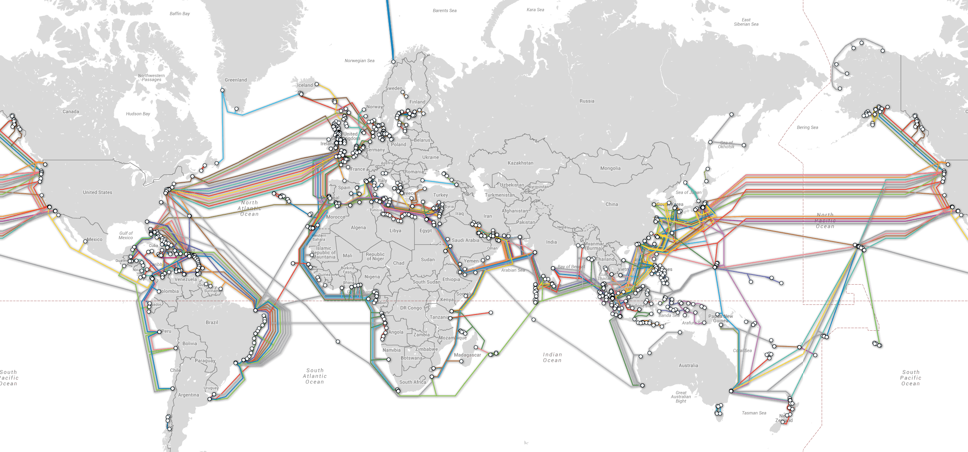
“Submarine” Fiber Optic Cables

Slide 7

Physical media: Fiber optics
fiber optic cable:
glass fiber carrying light pulses, each pulse a bit
high-speed operation:
  high-speed point-to-point transmission (e.g., 10’s-100’s Gbps transmission rate)
low error rate:
  repeaters spaced far apart
  immune to electromagnetic noise

Slide 8
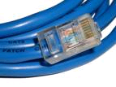

Physical media: wired
twisted “pair” (TP)
two (or more) insulated copper wires
  Category 5: 100 Mbps, 1 Gbps Ethernet
  Category 6: 10Gbps
coaxial cable:
two concentric copper conductors
broadband:
  Used to send multiple channels on cable TV

Slide 9

Digital subscriber line (DSL)
central office
telephone
network
DSL
modem
splitter
DSLAM
ISP
voice, data transmitted
at different frequencies over
dedicated line to central office
DSL access
multiplexer
  use existing telephone line to central office DSL access multiplexer
    data over DSL phone line goes to Internet
    voice over DSL phone line goes to telephone net
  < 2.5 Mbps upstream transmission rate (typically < 1 Mbps)
  < 24 Mbps downstream transmission rate (typically < 10 Mbps)

Slide 10
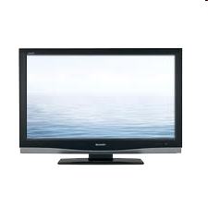


Cable access network
Internet frames, TV channels, control transmitted
downstream at different frequencies
cable headend
…
CMTS
…
splitter
cable
modem
cable modem
termination system
ISP
upstream Internet frames, TV control, transmitted
upstream at different frequencies in time slots
multiple 40Mbps downstream (broadcast) channels
  single CMTS transmits into channels
multiple 30 Mbps upstream channels
  multiple access: all users contend for certain upstream channel time slots (others assigned)

Slide 11
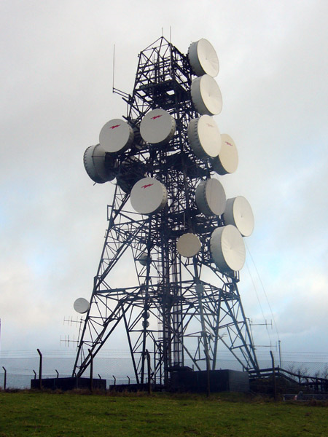
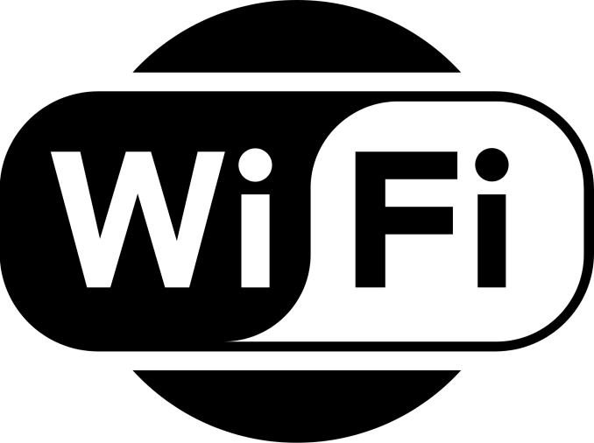
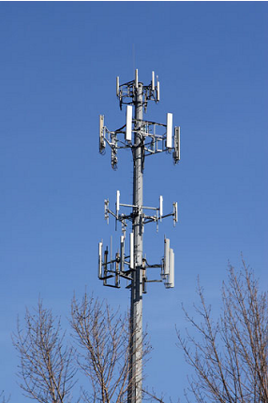

Physical media: radio
signal carried in electromagnetic spectrum
no physical wire
propagation environment effects:
  reflection
  obstruction by objects
  interference
radio link types:
terrestrial microwave
  e.g. up to 45 Mbps channels
LAN (e.g., WiFi)
  54 Mbps
wide-area (e.g., cellular)
  4G cellular: ~ 10 Mbps
satellite
  Up to 45Mbps channels (or multiple smaller channels)
  Two types
    270 msec end-end delay for geosynchronous
    Low-earth orbit

Slide 12

















Link layer: introduction
terminology:
hosts and routers: nodes
communication channels that connect adjacent nodes along communication path: links
  wired links
  wireless links
  LANs
layer-2 packet: frame, encapsulates datagram
data-link layer has responsibility of
transferring datagram from one node
to physically adjacent node over a link

Slide 13
Link layer services
framing, link access:
  encapsulate datagram into frame, adding header, trailer
  channel access if shared medium
  “MAC” addresses used in frame headers to identify source, destination
    different from IP address!
reliable delivery between adjacent nodes
  we learned how to do this already (chapter 3)!
  seldom used on low bit-error link (fiber, some twisted pair)
  wireless links: high error rates
    Q: why both link-level and end-end reliability?

Slide 14
Link layer services (more)
flow control:
  pacing between adjacent sending and receiving nodes
error detection:
  errors caused by signal attenuation, noise.
  receiver detects presence of errors:
    signals sender for retransmission or drops frame
error correction:
  receiver identifies and corrects bit error(s) without resorting to retransmission
half-duplex and full-duplex
  with half duplex, nodes at both ends of link can transmit, but not at same time

Slide 15
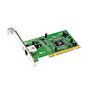
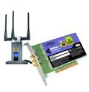
Where is the link layer implemented?
in each and every host
link layer implemented in “adaptor” (aka network interface card NIC) or on a chip
  Ethernet card, 802.11 card; Ethernet chipset
  implements link, physical layer
attaches into host’s system buses
combination of hardware, software, firmware
application
transport
network
link
cpu
memory
link
physical
host
bus
(e.g., PCI)
controller
physical
transmission
network adapter
card

Slide 16
Adaptors communicating
datagram
datagram
controller
controller
sending host
receiving host
datagram
frame
sending side:
  encapsulates datagram in frame
  adds error checking bits, rdt, flow control, etc.
receiving side
  looks for errors, rdt, flow control, etc.
  extracts datagram, passes to upper layer at receiving side

Slide 17
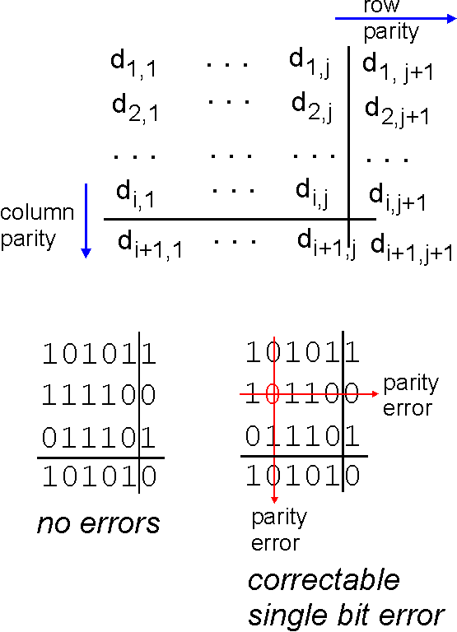
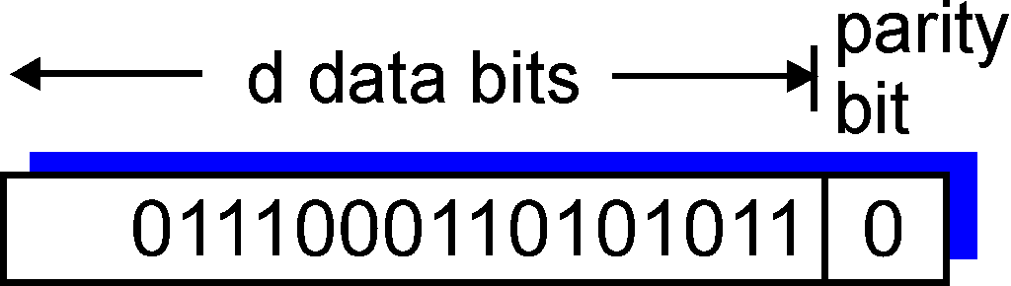
Parity checking
single bit parity:
detect single bit errors
two-dimensional bit parity:
detect and correct single bit errors
0
0
* Check out the online interactive exercises for more examples: http://gaia.cs.umass.edu/kurose_ross/interactive/

Slide 18
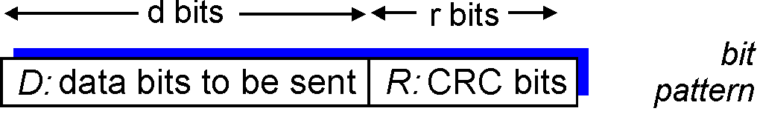
Cyclic redundancy check
more powerful error-detection coding
view data bits, D, as a binary number
choose r+1 bit pattern (generator), G
goal: choose r CRC bits, R, such that
  <D,R> exactly divisible by G (modulo 2)
  receiver knows G, divides <D,R> by G. If non-zero remainder: error detected!
  can detect all burst errors less than r+1 bits
widely used in practice (Ethernet, 802.11 WiFi)

Slide 19
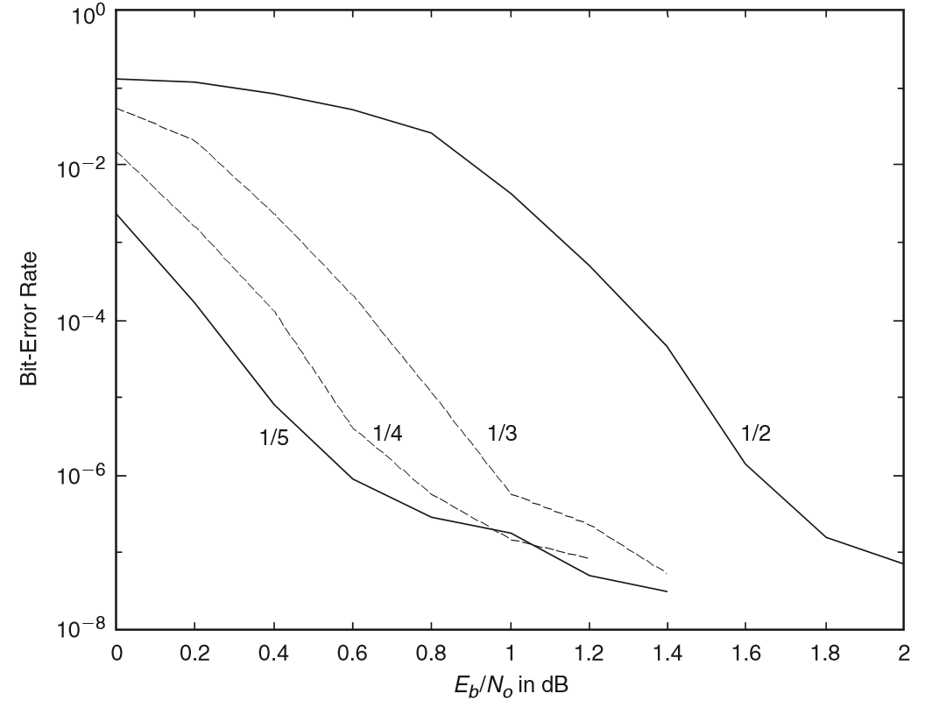
Turbo Codes: Forward Error Correction
Every bit
is wrong
About 25% more
signal than noise
(per bit)
1 bit in 100
is wrong
Fraction of bits
carrying content

Slide 20
Before You Go
On a sheet of paper, answer the following (ungraded) question (no names, please):
What one thing could the instructor change to improve your learning?

