Slide 1
The Internet
Session 14
INST 346

Slide 2
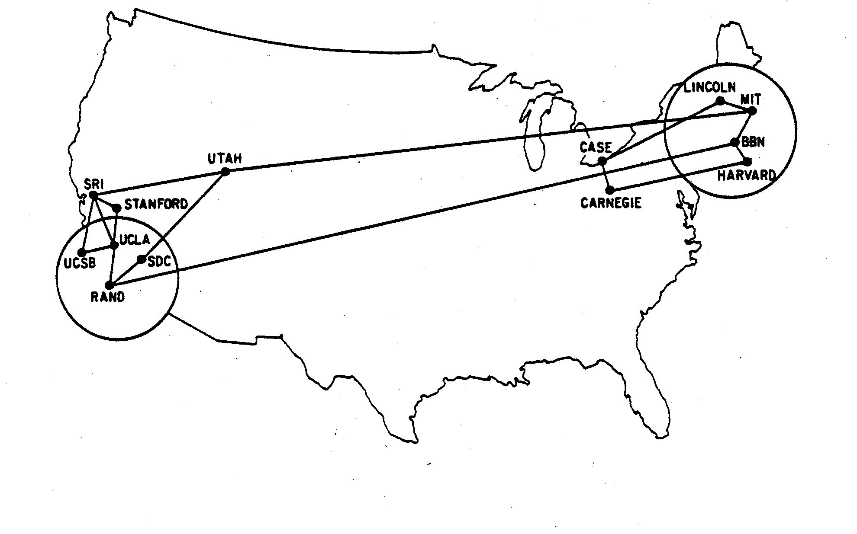
The ARPANET
December 1970

Slide 3
Networks of Networks
Local Area Networks (LAN)
Connections within a room, or perhaps a building
Wide Area Networks (WAN)
Provide connections between LANs
Internet
Collection of WANs across multiple organizations

Slide 4
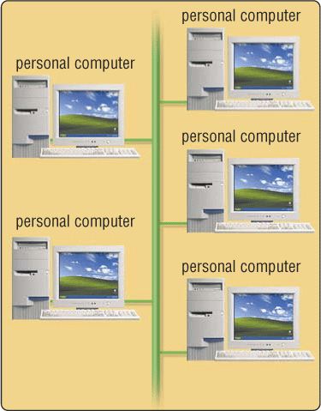
Ethernet Local Area Network (LAN)
All attach to the same cable
Transmit anytime
Collision detection
Automatic retransmission
Inexpensive and flexible
Easy to add new machines
Robust to computer failure
Inefficient
Half the bandwidth is wasted

Slide 5
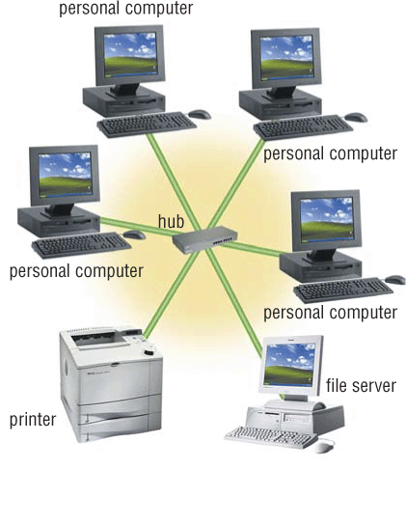
Switched (“Star”) Network
All attach directly to a hub
Switched Ethernet
Digital Subscriber Lines (DSL)
Higher cost
Line from hub to each machine
Hub must handle every packet
Much higher bandwidth
No sharing, no collisions

Slide 6
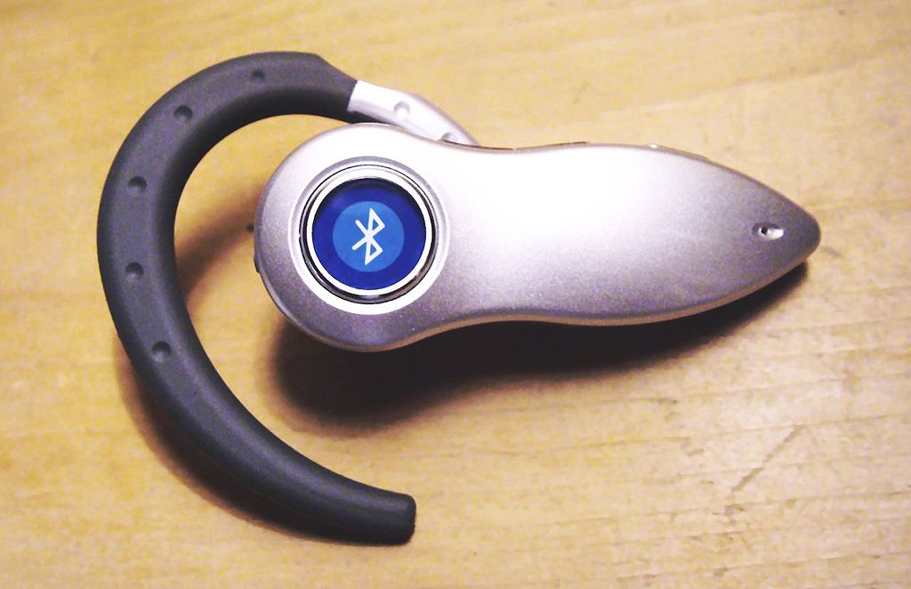
Wireless Networks
WiFi is available in several (“maximum”) speeds
IEEE 802.11b: 10Mb/s
IEEE 802.11g: 54Mb/s (required for video)
IEEE 802.11n: 248Mb/s
IEEE 802.11ac: 7 Gb/s
“Wireless Data” plans typical speeds:
3G: At least 200 kb/s
4G: At least 100 Mb/sec (required for video)
Bluetooth for peer-to-peer short range
At least 24 kb/s; max range is about 30 feet

Slide 7
An Internet Protocol (IP) Address
Identifies a LAN
54.84.241.99
Identifies a specific device

Slide 8
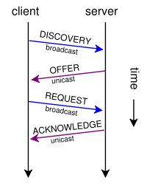
“Leasing” an IP Address
Dynamic Host Configuration Protocol (DHCP)

Slide 9
Routing Tables
IP Prefix | Next Router | Estimated Delay
216.141.xxx.xxx | 120.0.0.0 | 18 ms
216.xxx.xxx.xxx | 121.0.0.0 | 34 ms
101.42.224.xxx | 120.0.0.0 | 21 ms
xxx.xxx.xxx.xxx | 121.0.0.0 | 250 ms
120.0.0.0
45.0.2.10
121.0.0.0
Windows: route print
Mac: netstat -nr

Slide 10
Wide Area Networks
Two key ideas:
Unshared “point-to-point” links
Automatic forwarding
Challenge: Routing is complex
Which paths are possible?
Which is shortest?
Which is least busy?

Slide 11
Domain Name Service (DNS)
Domain Names
Easier to remember than IP addresses
Written like a postal address: specific-to-general
Each “name server” knows one level of names
“Top level” name servers know .edu, .com, .mil, …
.edu name server knows umd, umbc, stanford, …
.umd.edu name server knows terpconnect, ischool, …
…

Slide 12
Ports
“Well-known” ports for initial contact
22 Secure Shell (SSH and SFTP)
53 Domain Name Service (DNS)
68 Dynamic Host Configuration Protocol (DHCP)
80 Hypertext Transfer Protocol (HTTP)
143 Internet Message Access Protocol (IMAP)
…
Registered ports for specialized services
e.g., 8080 may be a user-created HTTP server
Ephemeral ports
Established as needed for ongoing interactions

Slide 13
Hands-on: Learn About Your IP Address
Find your IP address
Launch a command shell
Type “ipconfig /all” (and press enter)
See who “owns” that address
Use http://remote.12dt.com/
See where in the world it (probably) is
http://geobytes.com/iplocator/

Slide 14
Hands On: TraceRoute
See how packets get from somewhere to you
Use http://www.traceroute.org/
Look at the same data visually
http://www.monitis.com/traceroute/

Slide 15
TCP/IP layer architecture
Application
Application
Virtual network service
Transport
Transport
Virtual link for end to end packets
Network
Network
Network
Network
Virtual link for packets
Link
Link
Link
Link
Link
Link
Link for bits
Link for bits
Link for bits

Slide 16
Transmission Control Protocol (TCP)
Built on the network-layer version of UDP
Guarantees delivery all data
Retransmits missing data
Guarantees data will be delivered in order
“Buffers” subsequent packets if necessary
No guarantee of delivery time
Long delays may occur without warning

Slide 17
User Datagram Protocol (UDP)
The Internet’s basic transport service
Sends every packet immediately
Passes received packets to the application
No delivery guarantee
Collisions can result in packet loss
Example: sending clicks on web browser
Notes:
No connection establishment. As we shall discuss in Section 3.5, TCP uses a three-way handshake before it starts to transfer data. UDP just blasts away without any formal preliminaries. Thus UDP does not introduce any delay to establish a connection. This is probably the principle reason why DNS runs over UDP rather than TCP -- DNS would be much slower if it ran over TCP. HTTP uses TCP rather than UDP, since reliability is critical for Web pages with text. But, as we briefly discussed in Section 2.2, the TCP connection establishment delay in HTTP is an important contributor to the "world wide wait".
No connection state. TCP maintains connection state in the end systems. This connection state includes receive and send buffers, congestion control parameters, and sequence and acknowledgment number parameters. We will see in Section 3.5 that this state information is needed to implement TCP's reliable data transfer service and to provide congestion control. UDP, on the other hand, does not maintain connection state and does not track any of these parameters. For this reason, a server devoted to a particular application can typically support many more active clients when the application runs over UDP rather than TCP.
Small segment header overhead. The TCP segment has 20 bytes of header overhead in every segment, whereas UDP only has 8 bytes of overhead.
Unregulated send rate. TCP has a congestion control mechanism that throttles the sender when one or more links between sender and receiver becomes excessively congested. This throttling can have a severe impact on real-time applications, which can tolerate some packet loss but require a minimum send rate. On the other hand, the speed at which UDP sends data is only constrained by the rate at which the application generates data, the capabilities of the source (CPU, clock rate, etc.) and the access bandwidth to the Internet. We should keep in mind, however, that the receiving host does not necessarily receive all the data - when the network is congested, a significant fraction of the UDP-transmitted data could be lost due to router buffer overflow. Thus, the receive rate is limited by network congestion even if the sending rate is not constrained.

Slide 18
Before You Go
On a sheet of paper, answer the following (ungraded) question (no names, please):
What was the muddiest point in today’s class?

