Slide 1
Computers
Session 1
INST 346

Slide 2
Agenda
The Computer
The Course

Slide 3
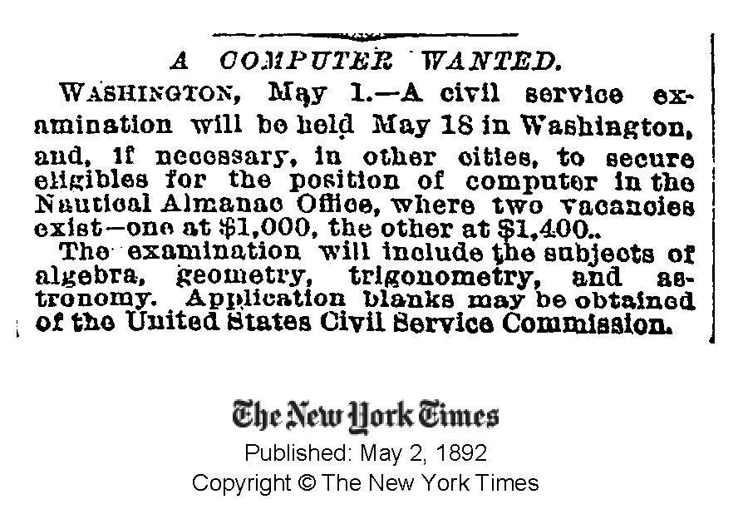

Slide 4
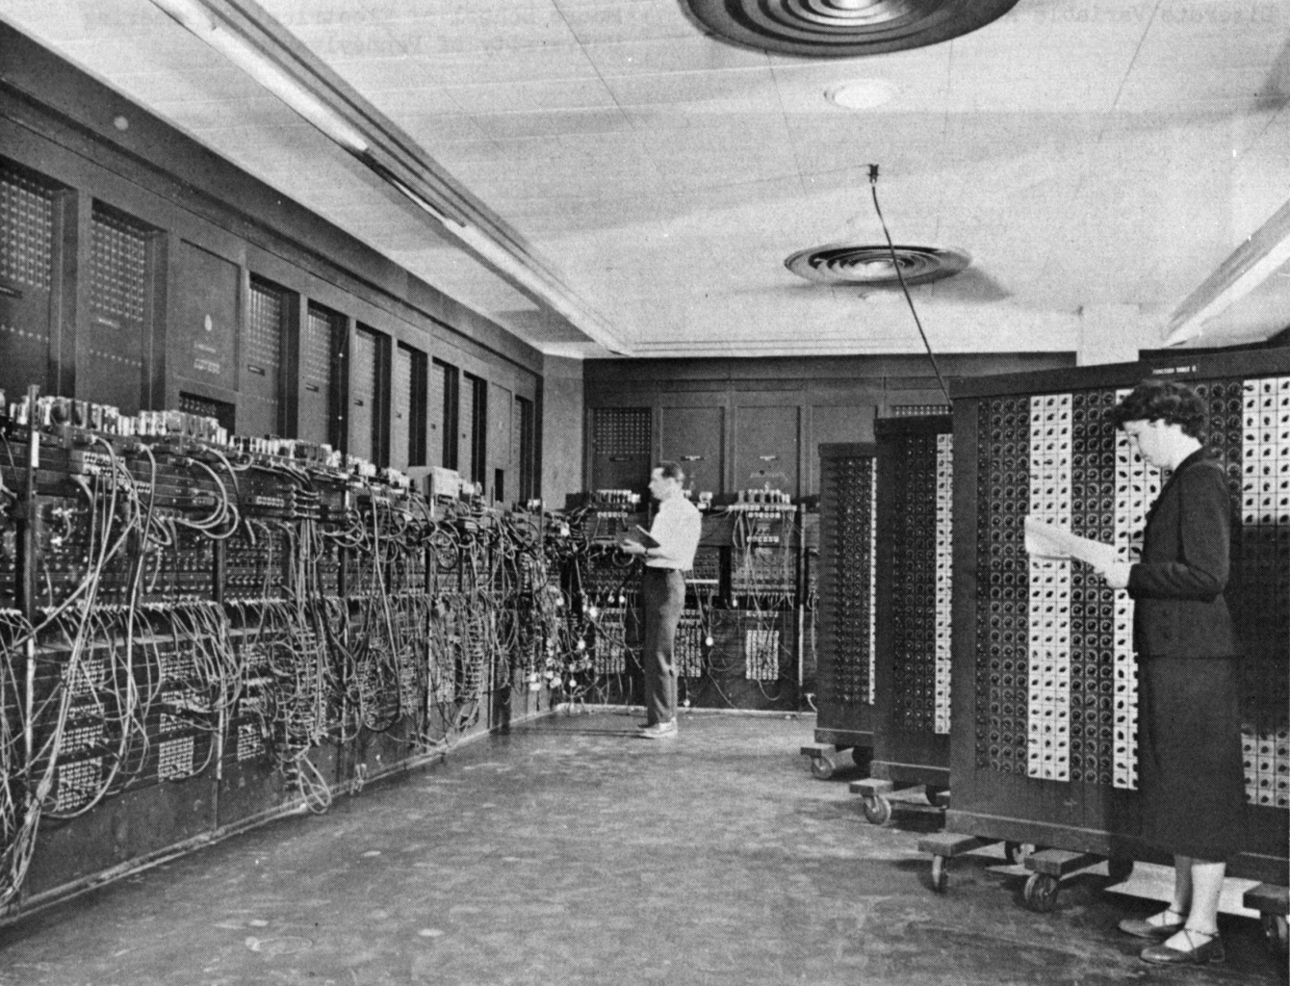
Source: Wikipedia

Slide 5
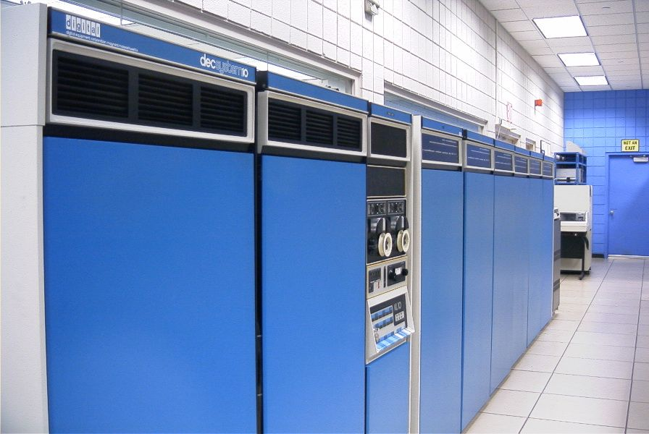
Source: Wikipedia

Slide 6
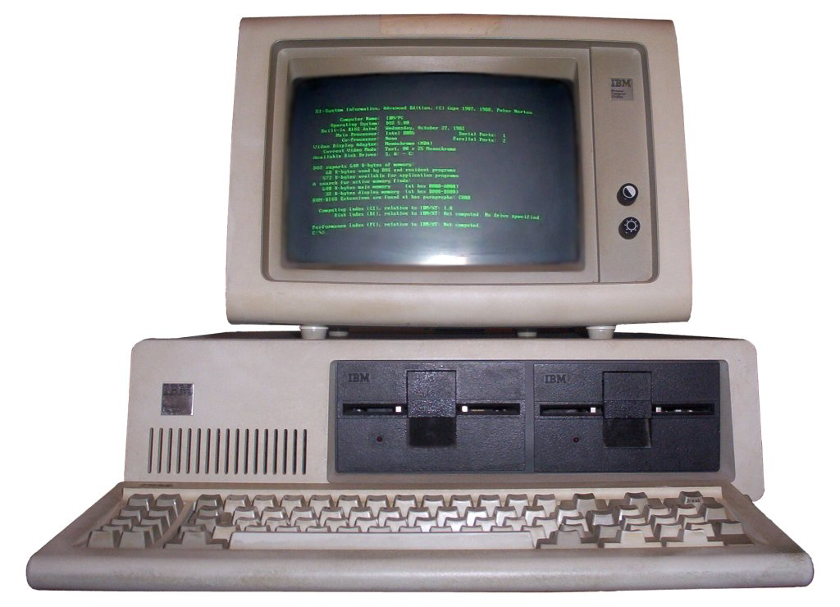
Source: Wikipedia

Slide 7
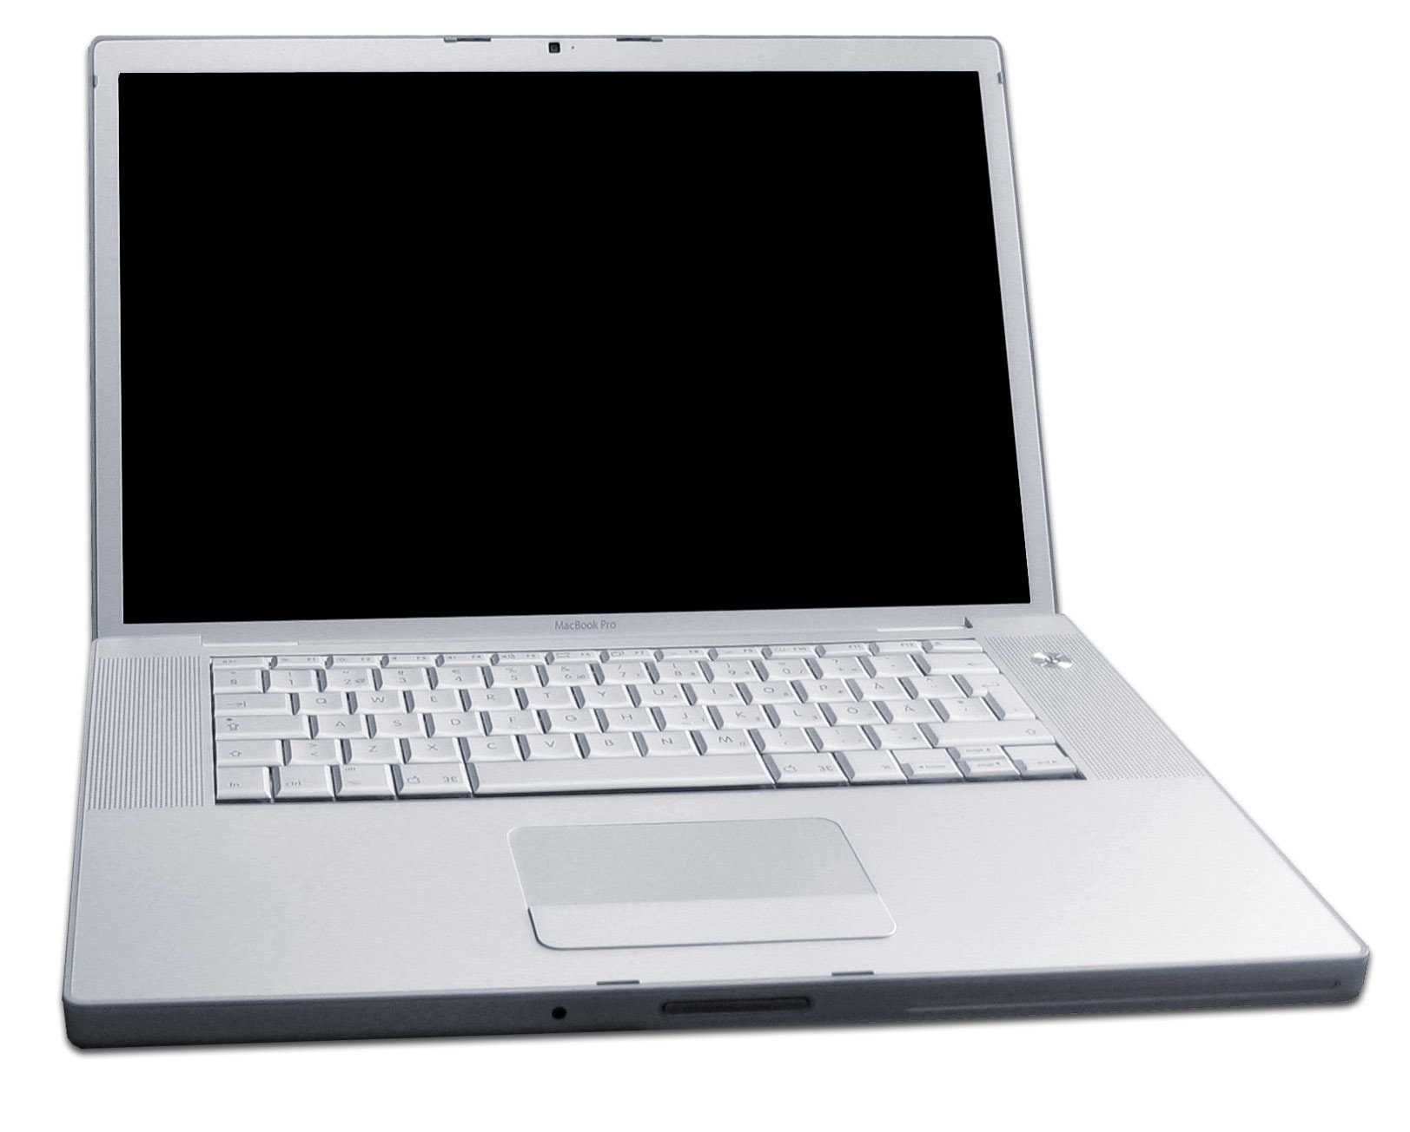
Source: Wikipedia

Slide 8
The Big Picture
Memory
Processor
Network

Slide 9
Hardware Processing Cycle
Input comes from somewhere
Keyboard, mouse, microphone, camera, …
The system does something with it
Processor, memory, software, network, …
Output goes somewhere
Monitor, speaker, robot controls, …

Slide 10
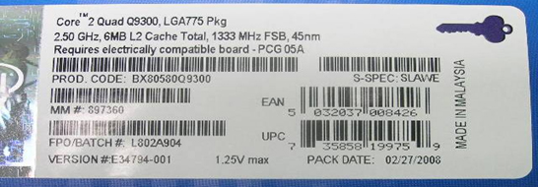
What’s that?

Slide 11
Frequency
Unit | Abbreviation | Cycles per second
hertz | Hz | 1
kilohertz | KHz | 10³ = 1,000
megahertz | MHz | 10⁶ = 1,000,000
gigahertz | GHz | 10⁹ = 1,000,000,000
Time
Unit | Abbreviation | Duration (seconds)
second | sec/s | 1
millisecond | ms | 10⁻³ = 1/1,000
microsecond | μs | 10⁻⁶ = 1/1,000,000
nanosecond | ns | 10⁻⁹ = 1/1,000,000,000
picosecond | ps | 10⁻¹² = 1/1,000,000,000,000
femtosecond | fs | 10⁻¹⁵ = 1/1,000,000,000,000,000

Slide 13
More cores!

Slide 14
System Architecture
Keyboard
Mouse
Sound
Card
Video
Card
Input
Controller
System Bus
Front Side Bus
Hard
Drive
CD/
DVD
L2
RAM
USB Port
CPU
L1
Cache
Motherboard

Slide 15
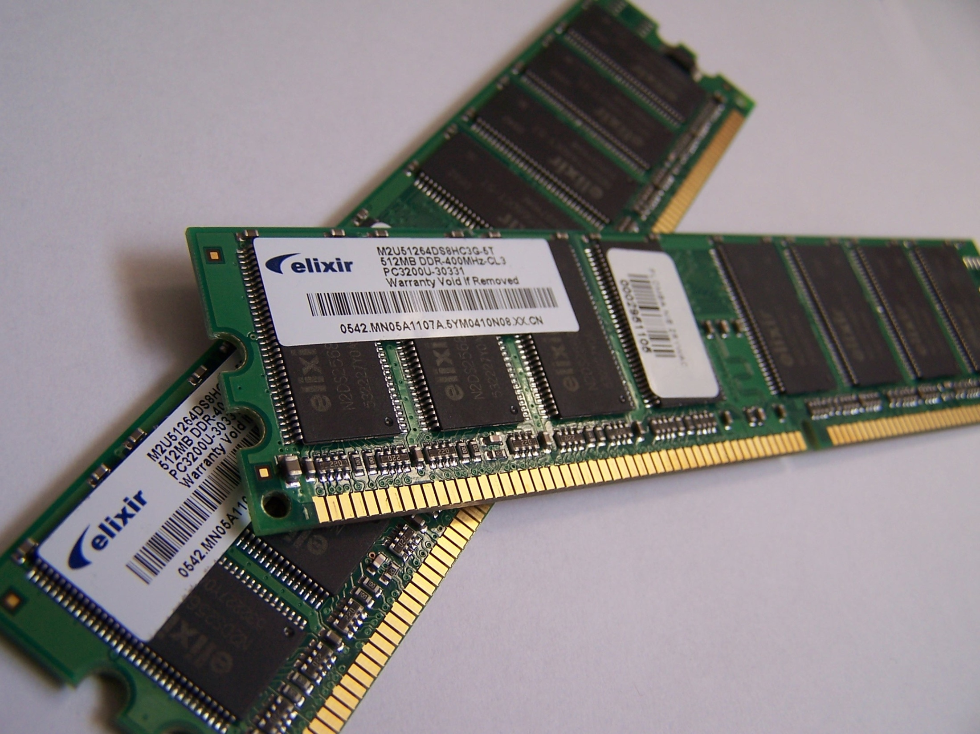
Source: Wikipedia

Slide 16
Units of Size
Unit | Abbreviation | Size (bytes)
bit | b | 1/8
byte | B | 1
kilobyte | KB | 2¹⁰ = 1024
megabyte | MB | 2²⁰ = 1,048,576
gigabyte | GB | 2³⁰ = 1,073,741,824
terabyte | TB | 2⁴⁰ = 1,099,511,627,776
petabyte | PB | 2⁵⁰ = 1,125,899,906,842,624

Slide 17
Moore’s Law
Processing speed doubles every 18 months
Faster CPU, longer words, larger cache, more cores
Cost/bit for RAM drops 50% every 12 months
Less need for “virtual memory”

Slide 18
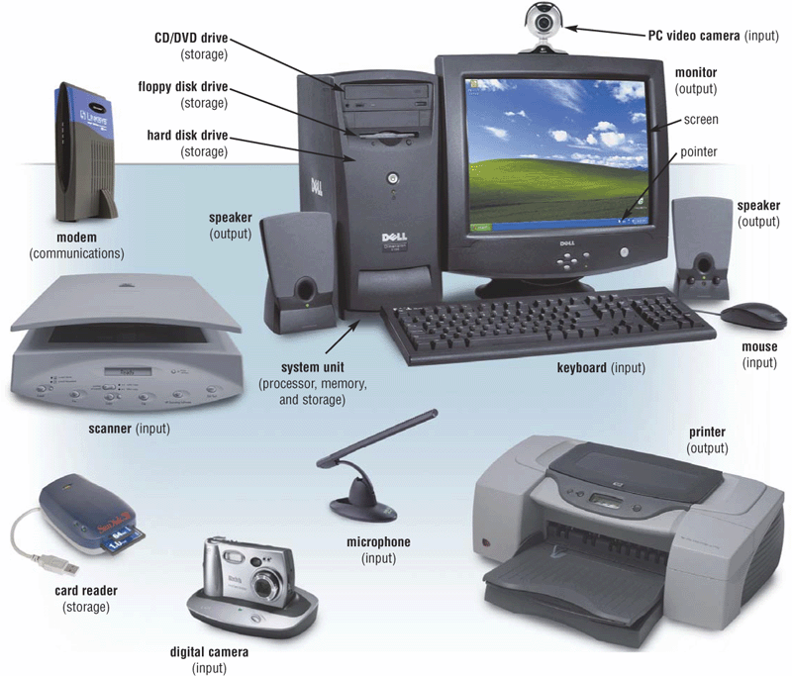
Extracted From Shelly Cashman Vermatt’s Discovering Computers 2004

Slide 19
Input Devices
Text
Keyboard, optical character recognition
Speech recognition, handwriting recognition
Direct manipulation
2-D: mouse, trackball, touchpad, touchscreen
3-D: wand, data glove
Remote sensing
Camera, speaker ID, head tracker, eye tracker

Slide 20
Binary Data Representation
Example: American Standard Code for Information Interchange (ASCII)
01000001 = A
01000010 = B
01000011 = C
01000100 = D
01000101 = E
01000110 = F
01000111 = G
01001000 = H
01001001 = I
01001010 = J
01001011 = K
01001100 = L
01001101 = M
01001110 = N
01001111 = O
01010000 = P
01010001 = Q
…
01100001 = a
01100010 = b
01100011 = c
01100100 = d
01100101 = e
01100110 = f
01100111 = g
01101000 = h
01101001 = i
01101010 = j
01101011 = k
01101100 = l
01101101 = m
01101110 = n
01101111 = o
01110000 = p
01110001 = q
…

Slide 21
Output Devices
Visual
Screen, projector, head-mounted display, CAVE
Acoustic
Speakers, headphones
Physical
Tactile (vibrotactile, pneumatic, piezoelectric)
Force feedback (pen, joystick, exoskeleton)
Thermal
Vestibular (motion-based simulators)
Locomotive (treadmill, stationary bicycle)
Olfactory

Slide 22
Agenda
The Computer
The Course

Slide 23
A Personal Approach to Learning
Work ahead, so that you are never behind
Find new questions everywhere
Then find the answers somewhere
Enrich your practical skills relentlessly
Pick topics you want to learn more about

Slide 24
The Fine Print
Group work is encouraged on homework
But you must personally write what you turn in
Deadlines are firm and sharp
Allowances for individual circumstances are included in the grading computation
Academic integrity is a serious matter
No group work during the exam!
Scrupulously respect time limits

Slide 25
Before You Go
On a sheet of paper, answer the following (ungraded) question (no names, please):
What was the muddiest point in today’s class?

