Slide 1

TCP
Session 9
INST 346
Technologies, Infrastructure and Architecture

Slide 2
Goals for Today
Remarks on H2
TCP Part 2

Slide 3
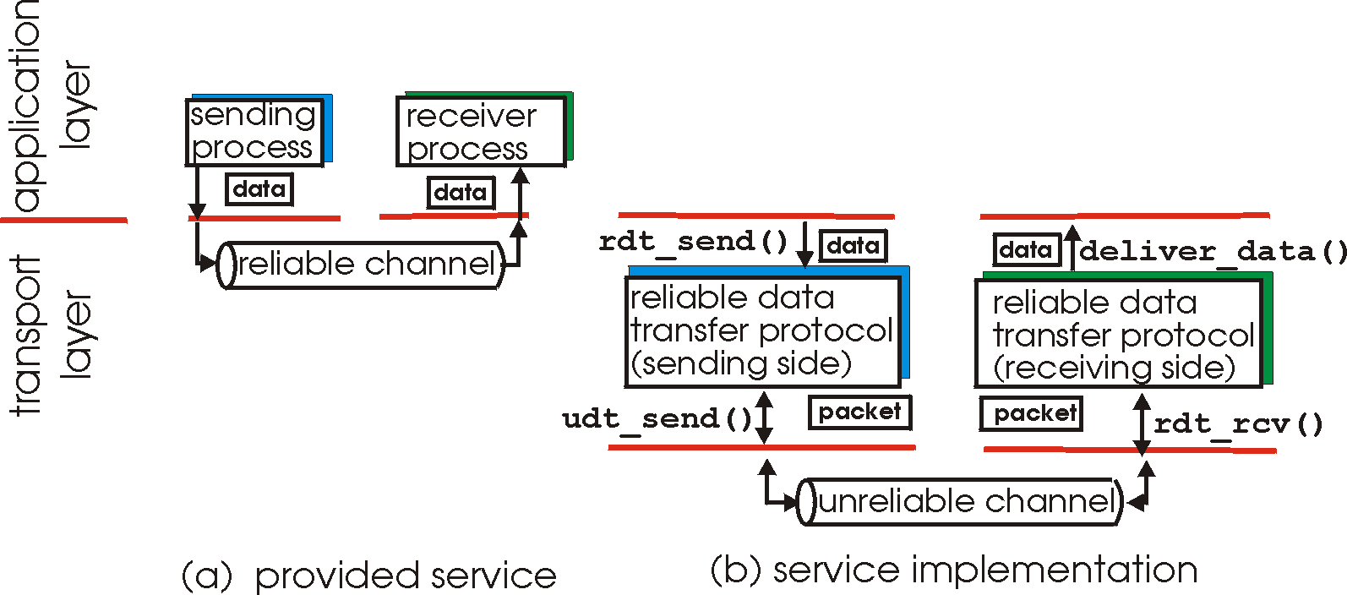
Principles of reliable data transfer
important in application, transport, link layers
  top-10 list of important networking topics!
characteristics of unreliable channel will determine complexity of reliable data transfer protocol (rdt)

Slide 4
rdt2.1: sender, handles garbled ACK/NAKs
rdt_send(data)
sndpkt = make_pkt(0, data, checksum)
udt_send(sndpkt)
rdt_rcv(rcvpkt) &&
( corrupt(rcvpkt) ||
isNAK(rcvpkt) )
Wait for call 0 from above
Wait for ACK or NAK 0
udt_send(sndpkt)
rdt_rcv(rcvpkt)
&& notcorrupt(rcvpkt)
&& isACK(rcvpkt)
rdt_rcv(rcvpkt)
&& notcorrupt(rcvpkt)
&& isACK(rcvpkt)
Λ
Λ
Wait for ACK or NAK 1
Wait for
call 1 from above
rdt_rcv(rcvpkt) &&
( corrupt(rcvpkt) ||
isNAK(rcvpkt) )
rdt_send(data)
udt_send(sndpkt)
sndpkt = make_pkt(1, data, checksum)
udt_send(sndpkt)

Slide 5
rdt2.1: receiver, handles garbled ACK/NAKs
rdt_rcv(rcvpkt) && notcorrupt(rcvpkt)
&& has_seq0(rcvpkt)
extract(rcvpkt,data)
deliver_data(data)
sndpkt = make_pkt(ACK, chksum)
udt_send(sndpkt)
rdt_rcv(rcvpkt) && (corrupt(rcvpkt)
rdt_rcv(rcvpkt) && (corrupt(rcvpkt)
sndpkt = make_pkt(NAK, chksum)
udt_send(sndpkt)
sndpkt = make_pkt(NAK, chksum)
udt_send(sndpkt)
Wait for
0 from below
Wait for
1 from below
rdt_rcv(rcvpkt) &&
not corrupt(rcvpkt) &&
has_seq1(rcvpkt)
rdt_rcv(rcvpkt) &&
not corrupt(rcvpkt) &&
has_seq0(rcvpkt)
sndpkt = make_pkt(ACK, chksum)
udt_send(sndpkt)
sndpkt = make_pkt(ACK, chksum)
udt_send(sndpkt)
rdt_rcv(rcvpkt) && notcorrupt(rcvpkt)
&& has_seq1(rcvpkt)
extract(rcvpkt,data)
deliver_data(data)
sndpkt = make_pkt(ACK, chksum)
udt_send(sndpkt)

Slide 6
rdt2.1: discussion
sender:
seq # added to pkt
two seq. #’s (0,1) will suffice. Why?
must check if received ACK/NAK corrupted
twice as many states
  state must “remember” whether “expected” pkt should have seq # of 0 or 1
receiver:
must check if received packet is duplicate
  state indicates whether 0 or 1 is expected pkt seq #
note: receiver can not know if its last ACK/NAK received OK at sender

Slide 7
rdt2.2: a NAK-free protocol
same functionality as rdt2.1, using ACKs only
instead of NAK, receiver sends ACK for last pkt received OK
  receiver must explicitly include seq # of pkt being ACKed
duplicate ACK at sender results in same action as NAK: retransmit current pkt

Slide 8
rdt2.2: sender, receiver fragments
rdt_send(data)
sndpkt = make_pkt(0, data, checksum)
udt_send(sndpkt)
rdt_rcv(rcvpkt) &&
( corrupt(rcvpkt) ||
isACK(rcvpkt,1) )
Wait for call 0 from above
Wait for ACK
0
udt_send(sndpkt)
sender FSM
fragment
rdt_rcv(rcvpkt)
&& notcorrupt(rcvpkt)
&& isACK(rcvpkt,0)
rdt_rcv(rcvpkt) &&
(corrupt(rcvpkt) ||
has_seq1(rcvpkt))
Λ
Wait for
0 from below
receiver FSM
fragment
udt_send(sndpkt)
rdt_rcv(rcvpkt) && notcorrupt(rcvpkt)
&& has_seq1(rcvpkt)
extract(rcvpkt,data)
deliver_data(data)
sndpkt = make_pkt(ACK1, chksum)
udt_send(sndpkt)

Slide 9
rdt3.0: channels with errors and loss
new assumption: underlying channel can also lose packets (data, ACKs)
  checksum, seq. #, ACKs, retransmissions will be of help … but not enough
approach: sender waits “reasonable” amount of time for ACK
retransmits if no ACK received in this time
if pkt (or ACK) just delayed (not lost):
  retransmission will be duplicate, but seq. #’s already handles this
  receiver must specify seq # of pkt being ACKed
requires countdown timer

Slide 10
rdt3.0 sender
rdt_send(data)
rdt_rcv(rcvpkt) &&
( corrupt(rcvpkt) ||
isACK(rcvpkt,1) )
sndpkt = make_pkt(0, data, checksum)
udt_send(sndpkt)
start_timer
rdt_rcv(rcvpkt)
Λ
Λ
Wait for
call 0from above
Wait for ACK0
timeout
udt_send(sndpkt)
start_timer
rdt_rcv(rcvpkt)
&& notcorrupt(rcvpkt)
&& isACK(rcvpkt,1)
rdt_rcv(rcvpkt)
&& notcorrupt(rcvpkt)
&& isACK(rcvpkt,0)
stop_timer
stop_timer
Wait for ACK1
Wait for
call 1 from above
timeout
udt_send(sndpkt)
start_timer
rdt_rcv(rcvpkt)
rdt_send(data)
Λ
rdt_rcv(rcvpkt) &&
( corrupt(rcvpkt) ||
isACK(rcvpkt,0) )
sndpkt = make_pkt(1, data, checksum)
udt_send(sndpkt)
start_timer
Λ

Slide 11

rdt3.0 in action
sender
receiver
sender
receiver
send pkt0
pkt0
send pkt0
pkt0
rcv pkt0
rcv pkt0
ack0
send ack0
ack0
send ack0
rcv ack0
rcv ack0
send pkt1
pkt1
send pkt1
pkt1
rcv pkt1
X
ack1
send ack1
loss
rcv ack1
send pkt0
pkt0
rcv pkt0
timeout
resend pkt1
ack0
send ack0
pkt1
rcv pkt1
ack1
send ack1
rcv ack1
send pkt0
pkt0
(a) no loss
rcv pkt0
ack0
send ack0
(b) packet loss

Slide 12
rdt3.0 in action
sender
receiver
sender
receiver
send pkt0
pkt0
send pkt0
pkt0
rcv pkt0
rcv pkt0
ack0
send ack0
send ack0
rcv ack0
ack0
send pkt1
pkt1
rcv ack0
rcv pkt1
send pkt1
pkt1
send ack1
rcv pkt1
ack1
send ack1
ack1
X
loss
timeout
resend pkt1
pkt1
rcv pkt1
timeout
resend pkt1
rcv ack1
pkt1
rcv pkt1
pkt0
(detect duplicate)
send pkt0
send ack1
ack1
(detect duplicate)
ack1
rcv pkt0
rcv ack1
send ack1
rcv ack1
ack0
send ack0
pkt0
send pkt0
pkt0
send pkt0
rcv pkt0
rcv pkt0
ack0
(detect duplicate)
ack0
send ack0
send ack0
(c) ACK loss
(d) premature timeout/ delayed ACK

Slide 13
Performance of rdt3.0
rdt3.0 is correct, but way too slow to use in practice
e.g.: 1 Gbps link, 15 ms prop. delay, 8000 bit packet:
L
8000 bits
D_{trans} =
=
=
8 microsecs
R
10⁹ bits/sec
sender
receiver
first packet bit transmitted, t = 0
last packet bit transmitted, t = L / R
first packet bit arrives
RTT
last packet bit arrives, send ACK
ACK arrives, send next
packet, t = RTT + L / R

Slide 14
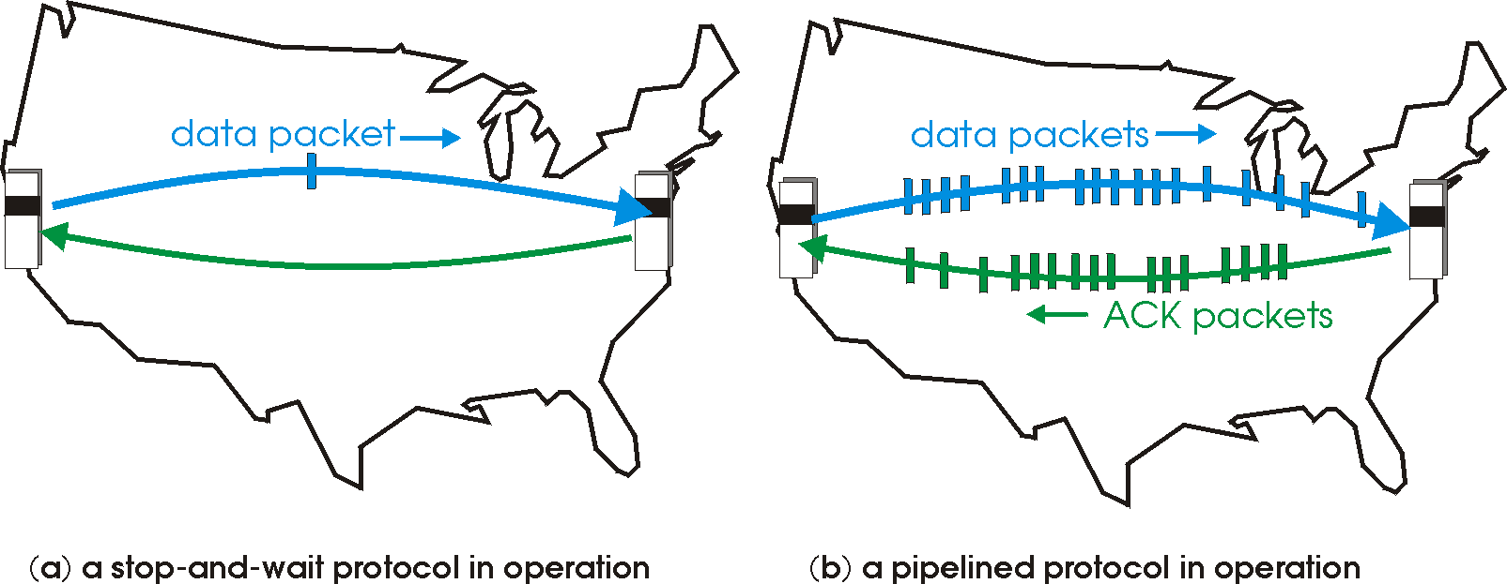

Pipelined protocols
pipelining: sender allows multiple, “in-flight”, yet-to-be-acknowledged pkts
  range of sequence numbers must be increased
  buffering at sender and/or receiver

Slide 15
Pipelining: increased utilization
sender
receiver
first packet bit transmitted, t = 0
last bit transmitted, t = L / R
first packet bit arrives
RTT
last packet bit arrives, send ACK
last bit of 2nd packet arrives, send ACK
last bit of 3rd packet arrives, send ACK
ACK arrives, send next
packet, t = RTT + L / R
3-packet pipelining increases
utilization by a factor of 3!

Slide 16
Pipelined protocols: overview
Go-back-N:
sender can have up to N unacked packets in pipeline
receiver only sends cumulative ack
  doesn’t ack packet if there’s a gap
sender has timer for oldest unacked packet
  when timer expires, retransmit all unacked packets
Selective Repeat:
sender can have up to N unack’ed packets in pipeline
rcvr sends individual ack for each packet
sender maintains timer for each unacked packet
  when timer expires, retransmit only that unacked packet

Slide 17
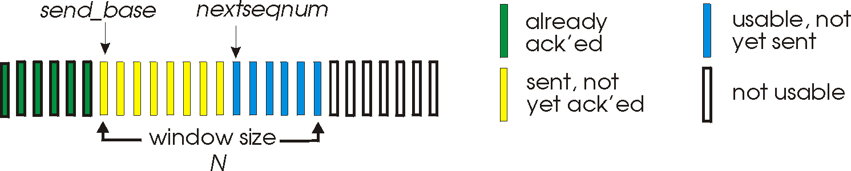
Go-Back-N: sender
k-bit seq # in pkt header
“window” of up to N, consecutive unack’ed pkts allowed
ACK(n): ACKs all pkts up to, including seq # n - “cumulative ACK”
  may receive duplicate ACKs (see receiver)
timer for oldest in-flight pkt
timeout(n): retransmit packet n and all higher seq # pkts in window

Slide 18
GBN: sender extended FSM
rdt_send(data)
if (nextseqnum < base+N) {
sndpkt[nextseqnum] = make_pkt(nextseqnum,data,chksum)
udt_send(sndpkt[nextseqnum])
if (base == nextseqnum)
start_timer
nextseqnum++
}
else
refuse_data(data)
Λ
base=1
nextseqnum=1
timeout
Wait
start_timer
udt_send(sndpkt[base])
udt_send(sndpkt[base+1])
…
udt_send(sndpkt[nextseqnum-1])
rdt_rcv(rcvpkt)
&& corrupt(rcvpkt)
rdt_rcv(rcvpkt) &&
notcorrupt(rcvpkt)
base = getacknum(rcvpkt)+1
If (base == nextseqnum)
stop_timer
else
start_timer

Slide 19
GBN: receiver extended FSM
default
udt_send(sndpkt)
rdt_rcv(rcvpkt)
&& notcurrupt(rcvpkt)
&& hasseqnum(rcvpkt,expectedseqnum)
Λ
Wait
extract(rcvpkt,data)
deliver_data(data)
sndpkt = make_pkt(expectedseqnum,ACK,chksum)
udt_send(sndpkt)
expectedseqnum++
expectedseqnum=1
sndpkt =
make_pkt(expectedseqnum,ACK,chksum)
ACK-only: always send ACK for correctly-received pkt with highest in-order seq #
  may generate duplicate ACKs
  need only remember expectedseqnum
out-of-order pkt:
  discard (don’t buffer): no receiver buffering!
  re-ACK pkt with highest in-order seq #

Slide 20
GBN in action
sender window (N=4)
sender
receiver
0 1 2 3 4 5 6 7 8
send pkt0
send pkt1
send pkt2
send pkt3
(wait)
0 1 2 3 4 5 6 7 8
receive pkt0, send ack0
receive pkt1, send ack1
receive pkt3, discard,
(re)send ack1
0 1 2 3 4 5 6 7 8
X
0 1 2 3 4 5 6 7 8
loss
0 1 2 3 4 5 6 7 8
rcv ack0, send pkt4
rcv ack1, send pkt5
0 1 2 3 4 5 6 7 8
receive pkt4, discard,
(re)send ack1
ignore duplicate ACK
receive pkt5, discard,
(re)send ack1
pkt 2 timeout
0 1 2 3 4 5 6 7 8
send pkt2
send pkt3
send pkt4
send pkt5
0 1 2 3 4 5 6 7 8
0 1 2 3 4 5 6 7 8
rcv pkt2, deliver, send ack2
rcv pkt3, deliver, send ack3
rcv pkt4, deliver, send ack4
rcv pkt5, deliver, send ack5
0 1 2 3 4 5 6 7 8

Slide 21
TCP: Overview RFCs: 793,1122,1323, 2018, 2581
point-to-point:
  one sender, one receiver
reliable, in-order byte steam:
  no “message boundaries”
pipelined:
  TCP congestion and flow control set window size
full duplex data:
  bi-directional data flow in same connection
  MSS: maximum segment size
connection-oriented:
  handshaking (exchange of control msgs) inits sender, receiver state before data exchange
flow controlled:
  sender will not overwhelm receiver

Slide 22
TCP segment structure
32 bits
URG: urgent data
(generally not used)
counting
by bytes
of data
(not segments!)
source port #
dest port #
sequence number
ACK: ACK #
valid
acknowledgement number
head
len
not
used
U
receive window
A
PSH: push data now
(generally not used)
P
R
S
F
# bytes
rcvr willing
to accept
checksum
Urg data pointer
RST, SYN, FIN:
connection estab
(setup, teardown
commands)
options (variable length)
application
data
(variable length)
Internet
checksum
(as in UDP)

Slide 23
TCP seq. numbers, ACKs
outgoing segment from sender
sequence numbers:
  byte stream “number” of first byte in segment’s data
acknowledgements:
  seq # of next byte expected from other side
  cumulative ACK
Q: how receiver handles out-of-order segments
  A: TCP spec doesn’t say, - up to implementor
source port #
dest port #
sequence number
acknowledgement number
rwnd
checksum
urg pointer
window size
N
  sender sequence number space
sent
ACKed
sent, not-yet ACKed
(“in-flight”)
usable
but not
yet sent
not
usable
incoming segment to sender
source port #
dest port #
sequence number
acknowledgement number
A
rwnd
checksum
urg pointer

Slide 24

TCP seq. numbers, ACKs
Host A
Host B
User
types
‘C’
Seq=42, ACK=79, data = ‘C’
host ACKs
receipt of
‘C’, echoes
back ‘C’
Seq=79, ACK=43, data = ‘C’
host ACKs
receipt
of echoed
‘C’
Seq=43, ACK=80
simple telnet scenario

Slide 25
TCP round trip time, timeout
Q: how to set TCP timeout value?
longer than RTT
  but RTT varies
too short: premature timeout, unnecessary retransmissions
too long: slow reaction to segment loss
Q: how to estimate RTT?
SampleRTT: measured time from segment transmission until ACK receipt
  ignore retransmissions
SampleRTT will vary, want estimated RTT “smoother”
  average several recent measurements, not just current SampleRTT

Slide 26
TCP round trip time, timeout
EstimatedRTT = (1- α)*EstimatedRTT + α*SampleRTT
exponential weighted moving average
influence of past sample decreases exponentially fast
typical value: α = 0.125
RTT: gaia.cs.umass.edu to fantasia.eurecom.fr
RTT (milliseconds)
sampleRTT
EstimatedRTT
time (seconds)

Slide 27

TCP round trip time, timeout
timeout interval: EstimatedRTT plus “safety margin”
  large variation in EstimatedRTT -> larger safety margin
estimate SampleRTT deviation from EstimatedRTT:
DevRTT = (1-β)*DevRTT +
β*|SampleRTT-EstimatedRTT|
(typically, β = 0.25)
TimeoutInterval = EstimatedRTT + 4*DevRTT
estimated RTT
“safety margin”
* Check out the online interactive exercises for more examples: http://gaia.cs.umass.edu/kurose_ross/interactive/

Slide 28
TCP reliable data transfer
TCP creates rdt service on top of IP’s unreliable service
  pipelined segments
  cumulative acks
  single retransmission timer
retransmissions triggered by:
  timeout events
  duplicate acks
let’s initially consider simplified TCP sender:
  ignore duplicate acks
  ignore flow control, congestion control

Slide 29
TCP sender events:
data rcvd from app:
create segment with seq #
seq # is byte-stream number of first data byte in segment
start timer if not already running
  think of timer as for oldest unacked segment
  expiration interval: TimeOutInterval
timeout:
retransmit segment that caused timeout
restart timer
ack rcvd:
if ack acknowledges previously unacked segments
  update what is known to be ACKed
  start timer if there are still unacked segments

Slide 30
TCP sender (simplified)
data received from application above
create segment, seq. #: NextSeqNum
pass segment to IP (i.e., “send”)
NextSeqNum = NextSeqNum + length(data)
if (timer currently not running)
start timer
Λ
NextSeqNum = InitialSeqNum
SendBase = InitialSeqNum
wait
for
event
timeout
retransmit not-yet-acked segment with smallest seq. #
start timer
ACK received, with ACK field value y
if (y > SendBase) {
SendBase = y
/* SendBase–1: last cumulatively ACKed byte */
if (there are currently not-yet-acked segments)
start timer
else stop timer
}

Slide 31
TCP: retransmission scenarios
Host A
Host B
Host A
Host B
SendBase=92
Seq=92, 8 bytes of data
Seq=92, 8 bytes of data
timeout
timeout
Seq=100, 20 bytes of data
ACK=100
X
ACK=100
ACK=120
Seq=92, 8 bytes of data
Seq=92, 8
bytes of data
SendBase=100
SendBase=120
ACK=100
ACK=120
SendBase=120
lost ACK scenario
premature timeout

Slide 32
TCP: retransmission scenarios
Host A
Host B
Seq=92, 8 bytes of data
Seq=100, 20 bytes of data
timeout
ACK=100
X
ACK=120
Seq=120, 15 bytes of data
cumulative ACK

Slide 33
TCP ACK generation [RFC 1122, RFC 2581]
event at receiver
arrival of in-order segment with
expected seq #. All data up to
expected seq # already ACKed
arrival of in-order segment with
expected seq #. One other
segment has ACK pending
arrival of out-of-order segment
higher-than-expect seq. # .
Gap detected
arrival of segment that
partially or completely fills gap
TCP receiver action
delayed ACK. Wait up to 500ms
for next segment. If no next segment,
send ACK
immediately send single cumulative
ACK, ACKing both in-order segments
immediately send duplicate ACK,
indicating seq. # of next expected byte
immediate send ACK, provided that
segment starts at lower end of gap

Slide 34
TCP fast retransmit
time-out period often relatively long:
  long delay before resending lost packet
detect lost segments via duplicate ACKs.
  sender often sends many segments back-to-back
  if segment is lost, there will likely be many duplicate ACKs.
TCP fast retransmit
if sender receives 3 ACKs for same data
(“triple duplicate ACKs”), resend unacked segment with smallest seq #
  likely that unacked segment lost, so don’t wait for timeout
(“triple duplicate ACKs”),

Slide 35
TCP fast retransmit
Host A
Host B
Seq=92, 8 bytes of data
Seq=100, 20 bytes of data
X
ACK=100
timeout
ACK=100
ACK=100
ACK=100
Seq=100, 20 bytes of data
fast retransmit after sender
receipt of triple duplicate ACK

Slide 36
TCP flow control
application
process
application may
remove data from
TCP socket buffers ….
application
TCP socket
receiver buffers
OS
… slower than TCP
receiver is delivering
(sender is sending)
TCP
code
flow control
IP
code
receiver controls sender, so sender won’t overflow receiver’s buffer by transmitting too much, too fast
from sender
receiver protocol stack

Slide 37
TCP flow control
receiver “advertises” free buffer space by including rwnd value in TCP header of receiver-to-sender segments
  RcvBuffer size set via socket options (typical default is 4096 bytes)
  many operating systems autoadjust RcvBuffer
sender limits amount of unacked (“in-flight”) data to receiver’s rwnd value
guarantees receive buffer will not overflow
to application process
RcvBuffer
buffered data
rwnd
free buffer space
TCP segment payloads
receiver-side buffering

Slide 38
Before You Go
On a sheet of paper, answer the following (ungraded) question (no names, please):
What was the muddiest point in today’s class?

Slide 39
Backup Slides

Slide 40
Selective repeat
receiver individually acknowledges all correctly received pkts
  buffers pkts, as needed, for eventual in-order delivery to upper layer
sender only resends pkts for which ACK not received
  sender timer for each unACKed pkt
sender window
  N consecutive seq #’s
  limits seq #s of sent, unACKed pkts

Slide 41
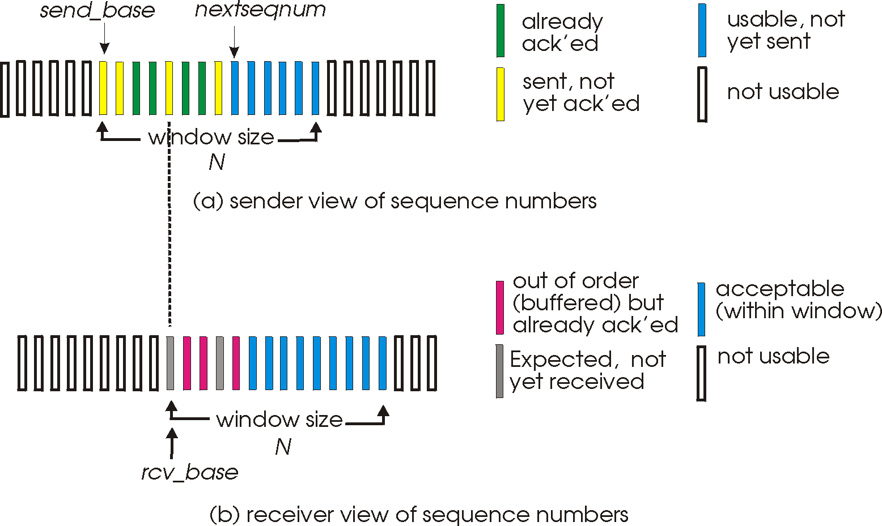
Selective repeat: sender, receiver windows

Slide 42
Selective repeat
sender
receiver
data from above:
if next available seq # in window, send pkt
timeout(n):
resend pkt n, restart timer
ACK(n) in [sendbase,sendbase+N]:
mark pkt n as received
if n smallest unACKed pkt, advance window base to next unACKed seq #
pkt n in [rcvbase, rcvbase+N-1]
send ACK(n)
out-of-order: buffer
in-order: deliver (also deliver buffered, in-order pkts), advance window to next not-yet-received pkt
pkt n in [rcvbase-N,rcvbase-1]
ACK(n)
otherwise:
ignore

Slide 43
Selective repeat in action
sender window (N=4)
sender
receiver
0 1 2 3 4 5 6 7 8
send pkt0
send pkt1
send pkt2
send pkt3
(wait)
0 1 2 3 4 5 6 7 8
receive pkt0, send ack0
receive pkt1, send ack1
receive pkt3, buffer,
send ack3
0 1 2 3 4 5 6 7 8
X
0 1 2 3 4 5 6 7 8
loss
0 1 2 3 4 5 6 7 8
rcv ack0, send pkt4
rcv ack1, send pkt5
0 1 2 3 4 5 6 7 8
receive pkt4, buffer,
send ack4
record ack3 arrived
receive pkt5, buffer,
send ack5
pkt 2 timeout
0 1 2 3 4 5 6 7 8
send pkt2
0 1 2 3 4 5 6 7 8
record ack4 arrived
0 1 2 3 4 5 6 7 8
rcv pkt2; deliver pkt2,
pkt3, pkt4, pkt5; send ack2
record ack5 arrived
0 1 2 3 4 5 6 7 8
Q: what happens when ack2 arrives?

Slide 44

Selective repeat: dilemma
sender window
(after receipt)
receiver window
(after receipt)
0 1 2 3 0 1 2
pkt0
0 1 2 3 0 1 2
pkt1
0 1 2 3 0 1 2
example:
seq #’s: 0, 1, 2, 3
window size=3
0 1 2 3 0 1 2
pkt2
0 1 2 3 0 1 2
0 1 2 3 0 1 2
0 1 2 3 0 1 2
pkt3
X
0 1 2 3 0 1 2
pkt0
will accept packet
with seq number 0
receiver sees no difference in two scenarios!
duplicate data accepted as new in (b)
Q: what relationship between seq # size and window size to avoid problem in (b)?
(a) no problem
receiver can’t see sender side.
receiver behavior identical in both cases!
something’s (very) wrong!
0 1 2 3 0 1 2
pkt0
0 1 2 3 0 1 2
pkt1
0 1 2 3 0 1 2
0 1 2 3 0 1 2
pkt2
0 1 2 3 0 1 2
X
0 1 2 3 0 1 2
X
timeout
retransmit pkt0
X
0 1 2 3 0 1 2
pkt0
will accept packet
with seq number 0
(b) oops!

