Slide 1

UDP
Session 8
INST 346
Technologies, Infrastructure and Architecture

Slide 2
Goals for Today
Questions on L2
The role of the network layer
UDP
TCP Part 1

Slide 3
Chapter 3: Transport Layer
our goals:
understand principles behind transport layer services:
  multiplexing, demultiplexing
  reliable data transfer
  flow control
  congestion control
learn about Internet transport layer protocols:
  UDP: connectionless transport
  TCP: connection-oriented reliable transport
  TCP congestion control

Slide 4

















Transport services and protocols
application
transport
network
data link
physical
provide logical communication between app processes running on different hosts
transport protocols run in end systems
  send side: breaks app messages into segments, passes to network layer
  rcv side: reassembles segments into messages, passes to app layer
more than one transport protocol available to apps
  Internet: TCP and UDP
logical end-end transport
application
transport
network
data link
physical

Slide 5
Transport vs. network layer
network layer: logical communication between hosts
transport layer: logical communication between processes
  relies on, enhances, network layer services
household analogy:
12 kids in Ann’s house sending letters to 12 kids in Bill’s house:
hosts = houses
processes = kids
app messages = letters in envelopes
transport protocol = Ann and Bill who demux to in-house siblings
network-layer protocol = postal service

Slide 6

Multiplexing/demultiplexing
multiplexing at sender:
handle data from multiple
sockets, add transport header (later used for demultiplexing)
demultiplexing at receiver:
use header info to deliver
received segments to correct
socket
application
application
P1
P2
application
socket
P3
transport
P4
process
transport
network
transport
network
link
network
link
physical
link
physical
physical

Slide 7
How demultiplexing works
host receives IP datagrams
  each datagram has source IP address, destination IP address
  each datagram carries one transport-layer segment
  each segment has source, destination port number
host uses IP addresses & port numbers to direct segment to appropriate socket
32 bits
source port #
dest port #
other header fields
application
data
(payload)
TCP/UDP segment format

Slide 8
Connectionless demultiplexing
when creating datagram to send into UDP socket, must specify
  destination IP address
  destination port #
created socket has host-local port #:
DatagramSocket mySocket1 = new DatagramSocket(12534);
when host receives UDP segment:
  checks destination port # in segment
  directs UDP segment to socket with that port #
IP datagrams with same destination port #, but different source IP addresses and/or source port numbers will be directed to same socket at destination

Slide 9
Connectionless demux: example
DatagramSocket serverSocket = new DatagramSocket
(6428);
DatagramSocket mySocket2 = new DatagramSocket
(9157);
DatagramSocket mySocket1 = new DatagramSocket (5775);
application
application
P1
application
P3
P4
transport
transport
network
transport
network
link
network
link
physical
link
physical
physical
source port: 6428
dest port: 9157
source port: ?
dest port: ?
source port: 9157
dest port: 6428
source port: ?
dest port: ?

Slide 10
UDP: User Datagram Protocol [RFC 768]
“no frills” Internet transport protocol
“best effort” service, UDP segments may be:
  lost
  delivered out-of-order to app
connectionless:
  no handshaking between UDP sender, receiver
  each UDP segment handled independently of others
UDP use:
  streaming multimedia apps (loss tolerant, rate sensitive)
  DNS
  VoIP
reliable transfer over UDP:
  add reliability at application layer
  application-specific error recovery

Slide 11
UDP: segment header
length, in bytes of UDP segment, including header
32 bits
source port #
dest port #
length
checksum
why is there a UDP?
no connection establishment (which can add delay)
simple: no connection state at sender, receiver
small header size
no congestion control: UDP can blast away as fast as desired
application
data
(payload)
UDP segment format

Slide 12
UDP checksum
Goal: detect “errors” (e.g., flipped bits) in transmitted segment
sender:
treat segment contents, including header fields, as sequence of 16-bit integers
checksum: addition (one’s complement sum) of segment contents
sender puts checksum value into UDP checksum field
receiver:
compute checksum of received segment
check if computed checksum equals checksum field value:
  NO - error detected
  YES - no error detected. But maybe errors nonetheless?

Slide 13
Internet checksum: example
example: add two 16-bit integers
1 1 1 1 0 0 1 1 0 0 1 1 0 0 1 1 0
1 1 1 0 1 0 1 0 1 0 1 0 1 0 1 0 1
1 1 0 1 1 1 0 1 1 1 0 1 1 1 0 1 1
1 1 0 1 1 1 0 1 1 1 0 1 1 1 1 0 0
1 0 1 0 0 0 1 0 0 0 1 0 0 0 0 1 1
wraparound
sum
checksum
Note: when adding numbers, a carryout from the most significant bit needs to be added to the result
* Check out the online interactive exercises for more examples: http://gaia.cs.umass.edu/kurose_ross/interactive/
Notes:
Kurose and Ross forgot to say anything about wrapping the carry and adding it to low order bit

Slide 14
Connection-oriented demux
TCP socket identified by 4-tuple:
  source IP address
  source port number
  dest IP address
  dest port number
demux: receiver uses all four values to direct segment to appropriate socket
server host may support many simultaneous TCP sockets:
  each socket identified by its own 4-tuple
web servers have different sockets for each connecting client
  non-persistent HTTP will have different socket for each request

Slide 15
Connection-oriented demux: example
application
application
P4
P5
P6
application
P3
P2
P3
transport
transport
network
transport
network
link
network
link
physical
link
physical
server: IP address B
physical
host: IP address A
source IP,port: B,80
dest IP,port: A,9157
host: IP address C
source IP,port: C,5775
dest IP,port: B,80
source IP,port: A,9157
dest IP, port: B,80
source IP,port: C,9157
dest IP,port: B,80
three segments, all destined to IP address: B,
dest port: 80 are demultiplexed to different sockets

Slide 16
Connection-oriented demux: example
threaded server
application
application
application
P4
P3
P3
P2
transport
transport
network
transport
network
link
network
link
physical
link
physical
server: IP address B
physical
host: IP address A
source IP,port: B,80
dest IP,port: A,9157
host: IP address C
source IP,port: C,5775
dest IP,port: B,80
source IP,port: A,9157
dest IP, port: B,80
source IP,port: C,9157
dest IP,port: B,80

Slide 17
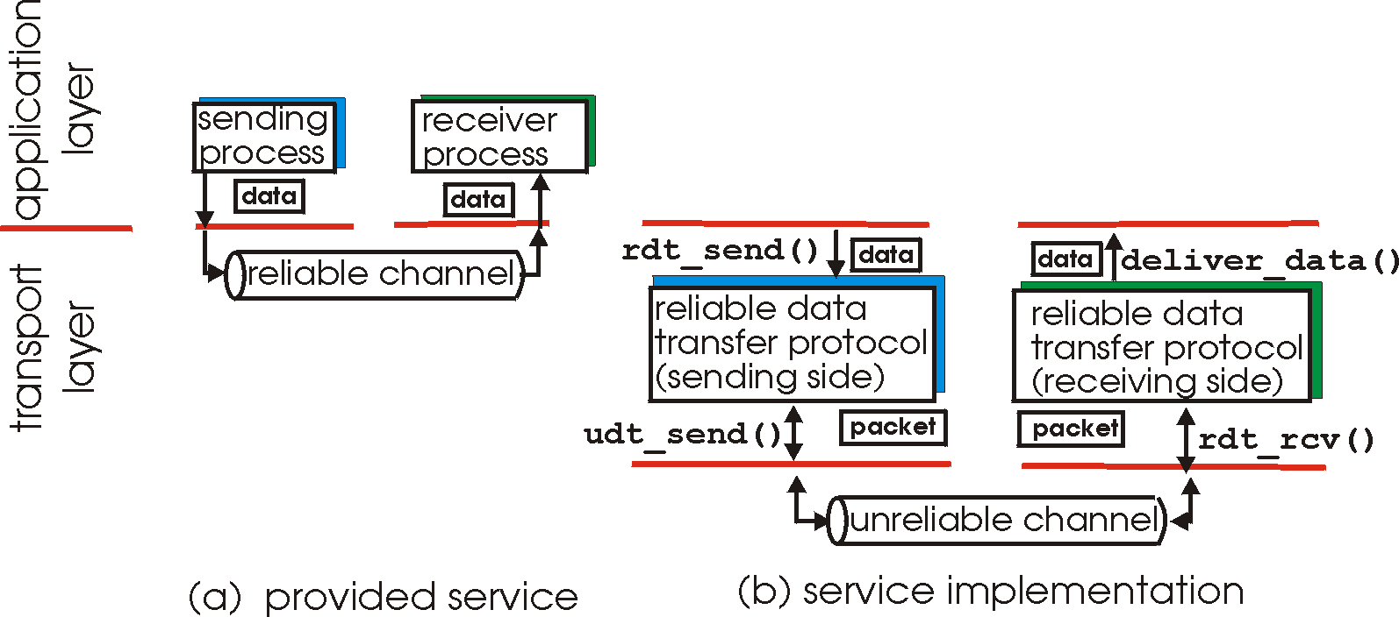
Principles of reliable data transfer
important in application, transport, link layers
characteristics of unreliable channel will determine complexity of reliable data transfer protocol (rdt)

Slide 18
Principles of reliable data transfer
important in application, transport, link layers
  top-10 list of important networking topics!
characteristics of unreliable channel will determine complexity of reliable data transfer protocol (rdt)

Slide 19
Principles of reliable data transfer
important in application, transport, link layers
  top-10 list of important networking topics!
characteristics of unreliable channel will determine complexity of reliable data transfer protocol (rdt)

Slide 20
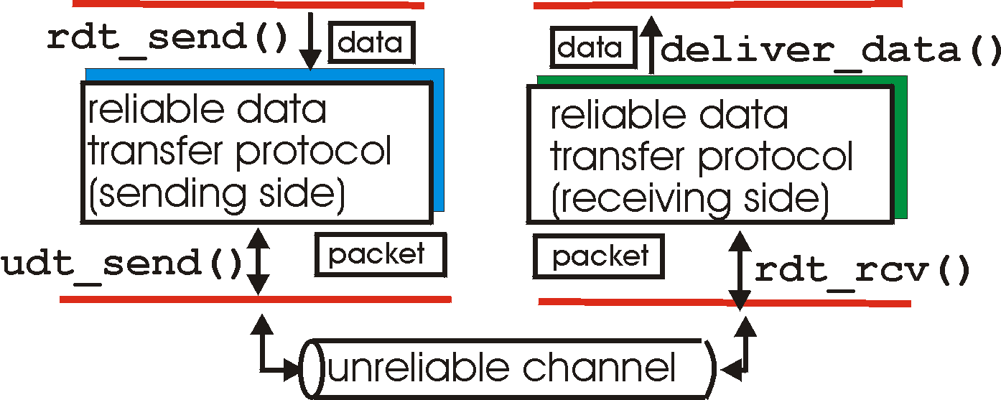
Reliable data transfer: getting started
rdt_send(): called from above, (e.g., by app.). Passed data to
deliver to receiver upper layer
deliver_data(): called by rdt to deliver data to upper
send
side
receive
side
udt_send(): called by rdt,
to transfer packet over
unreliable channel to receiver
rdt_rcv(): called when packet arrives on rcv-side of channel

Slide 21
Reliable data transfer: getting started
we’ll:
incrementally develop sender, receiver sides of reliable data transfer protocol (rdt)
consider only unidirectional data transfer
  but control info will flow on both directions!
use finite state machines (FSM) to specify sender, receiver
event causing state transition
actions taken on state transition
state: when in this “state” next state uniquely determined by next event
state
1
state
2
event
actions

Slide 22
rdt1.0: reliable transfer over a reliable channel
underlying channel perfectly reliable
  no bit errors
  no loss of packets
separate FSMs for sender, receiver:
  sender sends data into underlying channel
  receiver reads data from underlying channel
Wait for call from above
rdt_send(data)
Wait for call from below
rdt_rcv(packet)
extract (packet,data)
deliver_data(data)
packet = make_pkt(data)
udt_send(packet)
sender
receiver

Slide 23
rdt2.0: channel with bit errors
underlying channel may flip bits in packet
  checksum to detect bit errors
the question: how to recover from errors:
  acknowledgements (ACKs): receiver explicitly tells sender that pkt received OK
  negative acknowledgements (NAKs): receiver explicitly tells sender that pkt had errors
  sender retransmits pkt on receipt of NAK
new mechanisms in rdt2.0 (beyond rdt1.0):
  error detection
  receiver feedback: control msgs (ACK,NAK) rcvr->sender
How do humans recover from “errors”
during conversation?

Slide 24
rdt2.0: channel with bit errors
underlying channel may flip bits in packet
  checksum to detect bit errors
the question: how to recover from errors:
  acknowledgements (ACKs): receiver explicitly tells sender that pkt received OK
  negative acknowledgements (NAKs): receiver explicitly tells sender that pkt had errors
  sender retransmits pkt on receipt of NAK
new mechanisms in rdt2.0 (beyond rdt1.0):
  error detection
  feedback: control msgs (ACK,NAK) from receiver to sender

Slide 25
rdt2.0: FSM specification
rdt_send(data)
sndpkt = make_pkt(data, checksum)
udt_send(sndpkt)
receiver
rdt_rcv(rcvpkt) &&
isNAK(rcvpkt)
Wait for call from above
Wait for ACK or NAK
rdt_rcv(rcvpkt) &&
corrupt(rcvpkt)
udt_send(sndpkt)
udt_send(NAK)
rdt_rcv(rcvpkt) && isACK(rcvpkt)
Λ
Wait for call from below
sender
rdt_rcv(rcvpkt) &&
notcorrupt(rcvpkt)
extract(rcvpkt,data)
deliver_data(data)
udt_send(ACK)

Slide 26
rdt2.0: operation with no errors
rdt_send(data)
snkpkt = make_pkt(data, checksum)
udt_send(sndpkt)
rdt_rcv(rcvpkt) &&
isNAK(rcvpkt)
Wait for call from above
Wait for ACK or NAK
rdt_rcv(rcvpkt) &&
corrupt(rcvpkt)
udt_send(sndpkt)
udt_send(NAK)
rdt_rcv(rcvpkt) && isACK(rcvpkt)
Wait for call from below
Λ
rdt_rcv(rcvpkt) &&
notcorrupt(rcvpkt)
extract(rcvpkt,data)
deliver_data(data)
udt_send(ACK)

Slide 27
rdt2.0: error scenario
rdt_send(data)
snkpkt = make_pkt(data, checksum)
udt_send(sndpkt)
rdt_rcv(rcvpkt) &&
isNAK(rcvpkt)
Wait for call from above
Wait for ACK or NAK
rdt_rcv(rcvpkt) &&
corrupt(rcvpkt)
udt_send(sndpkt)
udt_send(NAK)
rdt_rcv(rcvpkt) && isACK(rcvpkt)
Wait for call from below
Λ
rdt_rcv(rcvpkt) &&
notcorrupt(rcvpkt)
extract(rcvpkt,data)
deliver_data(data)
udt_send(ACK)

Slide 28
rdt2.0 has a fatal flaw!
what happens if ACK/NAK corrupted?
sender doesn’t know what happened at receiver!
can’t just retransmit: possible duplicate
handling duplicates:
sender retransmits current pkt if ACK/NAK corrupted
sender adds sequence number to each pkt
receiver discards (doesn’t deliver up) duplicate pkt
stop and wait
sender sends one packet,
then waits for receiver
response

Slide 29
rdt2.1: sender, handles garbled ACK/NAKs
rdt_send(data)
sndpkt = make_pkt(0, data, checksum)
udt_send(sndpkt)
rdt_rcv(rcvpkt) &&
( corrupt(rcvpkt) ||
isNAK(rcvpkt) )
Wait for call 0 from above
Wait for ACK or NAK 0
udt_send(sndpkt)
rdt_rcv(rcvpkt)
&& notcorrupt(rcvpkt)
&& isACK(rcvpkt)
rdt_rcv(rcvpkt)
&& notcorrupt(rcvpkt)
&& isACK(rcvpkt)
Λ
Λ
Wait for ACK or NAK 1
Wait for
call 1 from above
rdt_rcv(rcvpkt) &&
( corrupt(rcvpkt) ||
isNAK(rcvpkt) )
rdt_send(data)
udt_send(sndpkt)
sndpkt = make_pkt(1, data, checksum)
udt_send(sndpkt)

Slide 30
rdt2.1: receiver, handles garbled ACK/NAKs
rdt_rcv(rcvpkt) && notcorrupt(rcvpkt)
&& has_seq0(rcvpkt)
extract(rcvpkt,data)
deliver_data(data)
sndpkt = make_pkt(ACK, chksum)
udt_send(sndpkt)
rdt_rcv(rcvpkt) && (corrupt(rcvpkt)
rdt_rcv(rcvpkt) && (corrupt(rcvpkt)
sndpkt = make_pkt(NAK, chksum)
udt_send(sndpkt)
sndpkt = make_pkt(NAK, chksum)
udt_send(sndpkt)
Wait for
0 from below
Wait for
1 from below
rdt_rcv(rcvpkt) &&
not corrupt(rcvpkt) &&
has_seq1(rcvpkt)
rdt_rcv(rcvpkt) &&
not corrupt(rcvpkt) &&
has_seq0(rcvpkt)
sndpkt = make_pkt(ACK, chksum)
udt_send(sndpkt)
sndpkt = make_pkt(ACK, chksum)
udt_send(sndpkt)
rdt_rcv(rcvpkt) && notcorrupt(rcvpkt)
&& has_seq1(rcvpkt)
extract(rcvpkt,data)
deliver_data(data)
sndpkt = make_pkt(ACK, chksum)
udt_send(sndpkt)

Slide 31
rdt2.1: discussion
sender:
seq # added to pkt
two seq. #’s (0,1) will suffice. Why?
must check if received ACK/NAK corrupted
twice as many states
  state must “remember” whether “expected” pkt should have seq # of 0 or 1
receiver:
must check if received packet is duplicate
  state indicates whether 0 or 1 is expected pkt seq #
note: receiver can not know if its last ACK/NAK received OK at sender

Slide 32
rdt2.2: a NAK-free protocol
same functionality as rdt2.1, using ACKs only
instead of NAK, receiver sends ACK for last pkt received OK
  receiver must explicitly include seq # of pkt being ACKed
duplicate ACK at sender results in same action as NAK: retransmit current pkt

Slide 33
rdt2.2: sender, receiver fragments
rdt_send(data)
sndpkt = make_pkt(0, data, checksum)
udt_send(sndpkt)
rdt_rcv(rcvpkt) &&
( corrupt(rcvpkt) ||
isACK(rcvpkt,1) )
Wait for call 0 from above
Wait for ACK
0
udt_send(sndpkt)
sender FSM
fragment
rdt_rcv(rcvpkt)
&& notcorrupt(rcvpkt)
&& isACK(rcvpkt,0)
rdt_rcv(rcvpkt) &&
(corrupt(rcvpkt) ||
has_seq1(rcvpkt))
Λ
Wait for
0 from below
receiver FSM
fragment
udt_send(sndpkt)
rdt_rcv(rcvpkt) && notcorrupt(rcvpkt)
&& has_seq1(rcvpkt)
extract(rcvpkt,data)
deliver_data(data)
sndpkt = make_pkt(ACK1, chksum)
udt_send(sndpkt)

Slide 34
rdt3.0: channels with errors and loss
new assumption: underlying channel can also lose packets (data, ACKs)
  checksum, seq. #, ACKs, retransmissions will be of help … but not enough
approach: sender waits “reasonable” amount of time for ACK
retransmits if no ACK received in this time
if pkt (or ACK) just delayed (not lost):
  retransmission will be duplicate, but seq. #’s already handles this
  receiver must specify seq # of pkt being ACKed
requires countdown timer

Slide 35
rdt3.0 sender
rdt_send(data)
rdt_rcv(rcvpkt) &&
( corrupt(rcvpkt) ||
isACK(rcvpkt,1) )
sndpkt = make_pkt(0, data, checksum)
udt_send(sndpkt)
start_timer
rdt_rcv(rcvpkt)
Λ
Λ
Wait for
call 0from above
Wait for ACK0
timeout
udt_send(sndpkt)
start_timer
rdt_rcv(rcvpkt)
&& notcorrupt(rcvpkt)
&& isACK(rcvpkt,1)
rdt_rcv(rcvpkt)
&& notcorrupt(rcvpkt)
&& isACK(rcvpkt,0)
stop_timer
stop_timer
Wait for ACK1
Wait for
call 1 from above
timeout
udt_send(sndpkt)
start_timer
rdt_rcv(rcvpkt)
rdt_send(data)
Λ
rdt_rcv(rcvpkt) &&
( corrupt(rcvpkt) ||
isACK(rcvpkt,0) )
sndpkt = make_pkt(1, data, checksum)
udt_send(sndpkt)
start_timer
Λ

Slide 36

rdt3.0 in action
sender
receiver
sender
receiver
send pkt0
pkt0
send pkt0
pkt0
rcv pkt0
rcv pkt0
ack0
send ack0
ack0
send ack0
rcv ack0
rcv ack0
send pkt1
pkt1
send pkt1
pkt1
rcv pkt1
X
ack1
send ack1
loss
rcv ack1
send pkt0
pkt0
rcv pkt0
timeout
resend pkt1
ack0
send ack0
pkt1
rcv pkt1
ack1
send ack1
rcv ack1
send pkt0
pkt0
(a) no loss
rcv pkt0
ack0
send ack0
(b) packet loss

Slide 37
rdt3.0 in action
sender
receiver
sender
receiver
send pkt0
pkt0
send pkt0
pkt0
rcv pkt0
rcv pkt0
ack0
send ack0
send ack0
rcv ack0
ack0
send pkt1
pkt1
rcv ack0
rcv pkt1
send pkt1
pkt1
send ack1
rcv pkt1
ack1
send ack1
ack1
X
loss
timeout
resend pkt1
pkt1
rcv pkt1
timeout
resend pkt1
rcv ack1
pkt1
rcv pkt1
pkt0
(detect duplicate)
send pkt0
send ack1
ack1
(detect duplicate)
ack1
rcv pkt0
rcv ack1
send ack1
rcv ack1
ack0
send ack0
pkt0
send pkt0
pkt0
send pkt0
rcv pkt0
rcv pkt0
ack0
(detect duplicate)
ack0
send ack0
send ack0
(c) ACK loss
(d) premature timeout/ delayed ACK

Slide 38
Performance of rdt3.0
rdt3.0 is correct, but way too slow to use in practice
e.g.: 1 Gbps link, 15 ms prop. delay, 8000 bit packet:
L
8000 bits
D_{trans} =
=
=
8 microsecs
R
10⁹ bits/sec
  U _{sender}: utilization – fraction of time sender busy sending
  if RTT=30 msec, 1KB pkt every 30 msec: 33kB/sec thruput over 1 Gbps link
network protocol limits use of physical resources!

Slide 39
rdt3.0: stop-and-wait operation
sender
receiver
first packet bit transmitted, t = 0
last packet bit transmitted, t = L / R
first packet bit arrives
RTT
last packet bit arrives, send ACK
ACK arrives, send next
packet, t = RTT + L / R

Slide 40
Before You Go
On a sheet of paper, answer the following (ungraded) question (no names, please):
What was the muddiest point in today’s class?

