Slide 1
Domain Names
Session 6
INST 346
Technologies, Infrastructure and Architecture

Slide 2
Quiz
Start: 5:00 sharp
End: 5:05 sharp (pencil down or zero credit)
Include your name!
No communication with anyone till 5:05
No email, no talking, no SMS, no chat, …
Even if you finish early!
Open book, open notes, open Web, open mind

Slide 3
Muddiest Points
Socket programming
How much programming is in this class?
Difference between POP3 and IMAP
Blocking on socket input

Slide 4
Goals for Today
Demo socket programming
Domain Name System
Preview H2

Slide 5
Socket Programming Demo

Slide 6
DNS: domain name system
people: many identifiers:
SSN, name, passport #
Internet hosts, routers:
IP address (32 bit) - used for addressing datagrams
“name”, e.g., www.yahoo.com - used by humans
Q: how to map between IP address and name, and vice versa ?
Domain Name System:
distributed database implemented in hierarchy of many name servers
application-layer protocol: hosts, name servers communicate to resolve names (address/name translation)
note: core Internet function, implemented as application-layer protocol
complexity at network’s “edge”
Notes:
4 octates of base 10, Phone numbers to , domain names, names to numbers, app layer p

Slide 7
Designing DNS
Centralized design – problems :
Single point of failure
Traffic volume
Distant centralized database
Maintenance

Slide 8
DNS
A distributed database
Implemented on a hierarchy of DNS servers
An application-layer protocol that allows hosts to query the distributed database.
Runs over UDP, Port 53
Employed by other app level protocols
Notes:
DNS uses UDP because TCP has a round trip handshaking cost to establish a connection. If the query fails the first time, we can send it again, so not much harm using UDP.

Slide 9
DNS: a distributed, hierarchical database
Root DNS Servers
…
…
com DNS servers
org DNS servers
edu DNS servers
yahoo.com
DNS servers
pbs.org
DNS servers
poly.edu
DNS servers
umass.edu
DNS servers
amazon.com
DNS servers
client wants IP for www.amazon.com; 1st approximation:
client queries root server to find com DNS server
client queries .com DNS server to get amazon.com DNS server
client queries amazon.com DNS server to get IP address for www.amazon.com

Slide 10
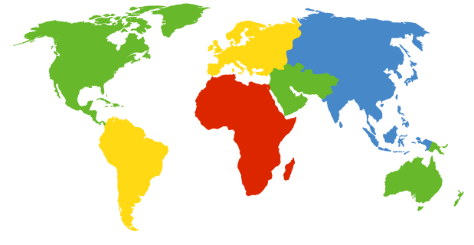
DNS: root name servers
contacted by local name server that can not resolve name
root name server:
contacts authoritative name server if name mapping not known
gets mapping
returns mapping to local name server
c. Cogent, Herndon, VA (5 other sites)
d. U Maryland College Park, MD
h. ARL Aberdeen, MD
j. Verisign, Dulles VA (69 other sites )
k. RIPE London (17 other sites)
i. Netnod, Stockholm (37 other sites)
e. NASA Mt View, CA
f. Internet Software C.
Palo Alto, CA (and 48 other sites)
m. WIDE Tokyo
(5 other sites)
13 logical root name “servers” worldwide
each “server” replicated many times
a. Verisign, Los Angeles CA
(5 other sites)
b. USC-ISI Marina del Rey, CA
l. ICANN Los Angeles, CA
(41 other sites)
g. US DoD Columbus, OH (5 other sites)

Slide 11
13 Root Name Servers
Source: https://www.iana.org/domains/root/servers

Slide 12
Local DNS name server
does not strictly belong to hierarchy
each ISP (residential ISP, company, university) has one
also called “default name server”
when host makes DNS query, query is sent to its local DNS server
has local cache of recent name-to-address translation pairs (but may be out of date!)
acts as proxy, forwards query into hierarchy

Slide 13
DNS name resolution example
root DNS server
2
host at cis.poly.edu wants IP address for gaia.cs.umass.edu
3
TLD DNS server
4
5
iterated query:
contacted server replies with name of server to contact
“I don’t know this name, but ask this server”
local DNS server
dns.poly.edu
7
6
1
8
authoritative DNS server
dns.cs.umass.edu
requesting host
cis.poly.edu
gaia.cs.umass.edu

Slide 14
DNS name resolution example
root DNS server
2
3
recursive query:
puts burden of name resolution on contacted name server
heavy load at upper levels of hierarchy?
7
6
TLD DNS
server
local DNS server
dns.poly.edu
5
4
1
8
authoritative DNS server
dns.cs.umass.edu
requesting host
cis.poly.edu
gaia.cs.umass.edu

Slide 15
DNS: caching, updating records
once (any) name server learns mapping, it caches mapping
cache entries timeout (disappear) after some time (TTL)
TLD servers typically cached in local name servers
thus root name servers not often visited
cached entries may be out-of-date (best effort name-to-address translation!)
if name host changes IP address, may not be known Internet-wide until all TTLs expire

Slide 16
DNS records
DNS: distributed database storing resource records (RR)
RR format: (name, value, type, ttl)
type=A
name is hostname
value is IP address
type=CNAME
name is alias name for some “canonical” (the real) name
www.ibm.com is really
servereast.backup2.ibm.com
value is canonical name
type=NS
name is domain (e.g., foo.com)
value is hostname of authoritative name server for this domain
type=MX
value is name of mailserver associated with name
Notes:
A domian can have the same alias for its web server and its mail server.

Slide 17
DNS Aliasing
Complicated canonical names, better hit rate
Host name aliasing
Mail server aliasing
Example:
1. All redirect to facebook.com
facebook.org; facebook.us; facebook.in
2. gmail.com mail.google.com

Slide 18
Example DNS lookup
Try on your command line or terminal :
$ nslookup www.umd.edu

Slide 19
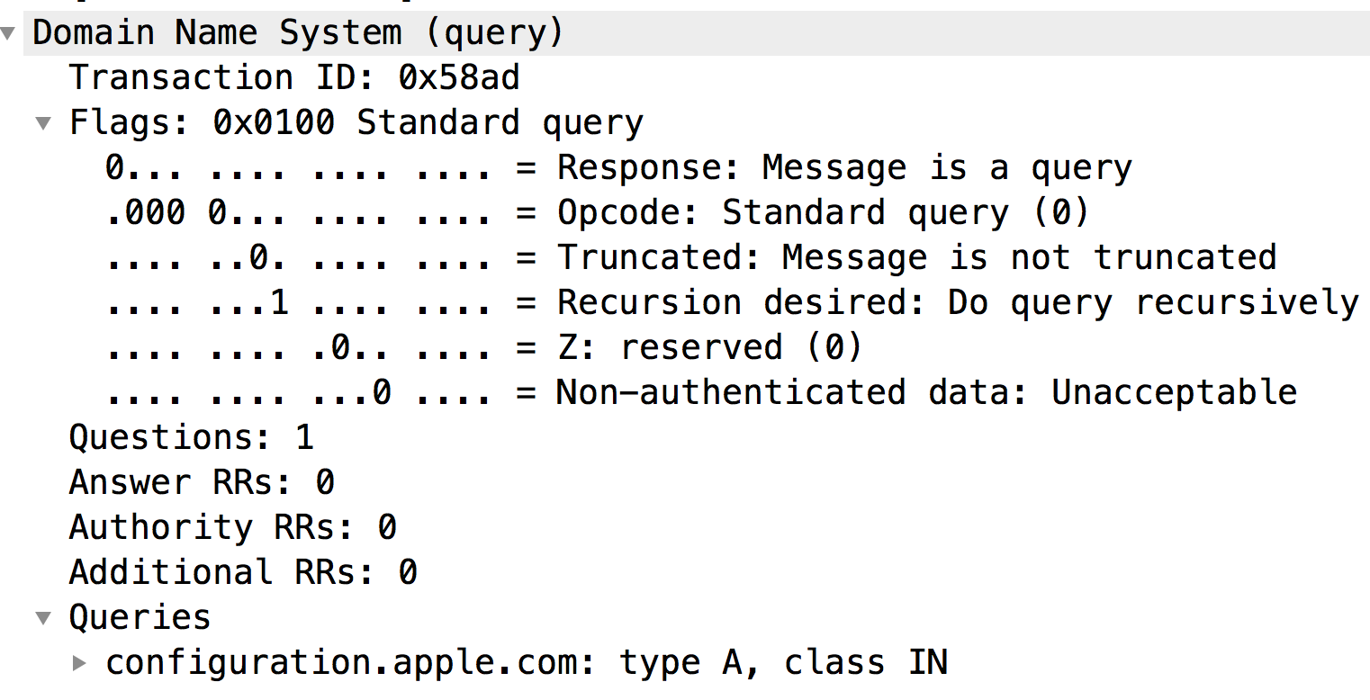
DNS protocol, messages
query and reply - both same message format
2 bytes
2 bytes
identification
flags
# questions
# answer RRs
# authority RRs
# additional RRs
questions (variable #questions)
answers (variable #RRs)
authority (variable #RRs)
additional info (variable #RRs)

Slide 20
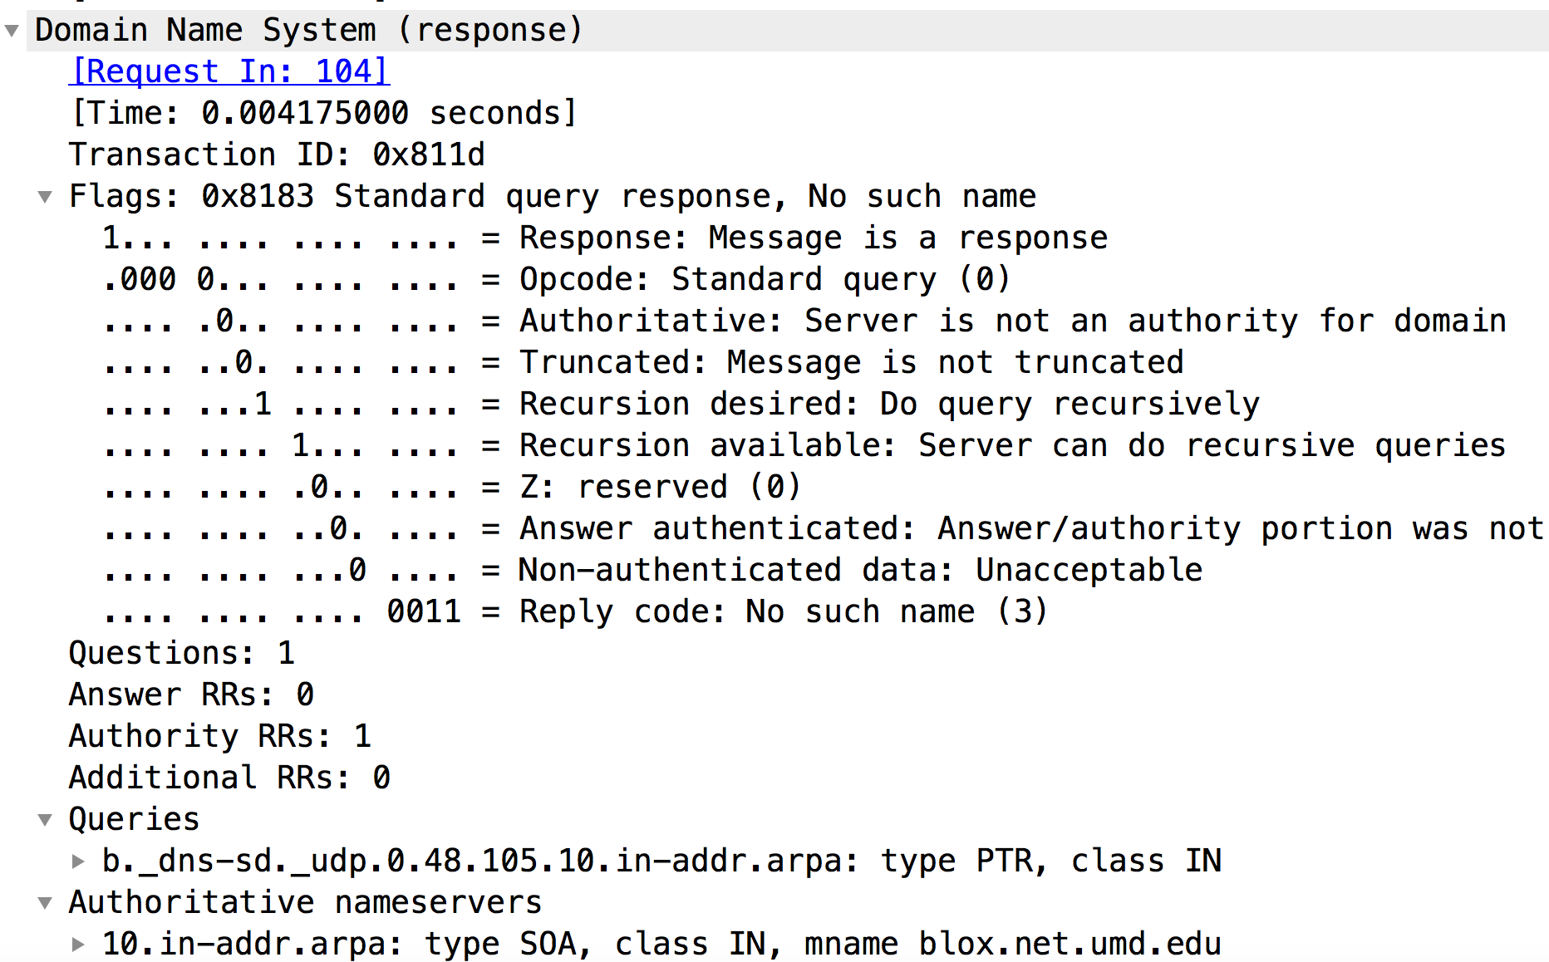
DNS Reply message

Slide 21
Inserting records into DNS
example: new startup “Network Utopia”
register name networkuptopia.com at DNS registrar (e.g., Network Solutions)
provide names, IP addresses of authoritative name server (primary and secondary)
registrar inserts two RRs into .com TLD server: (networkutopia.com, dns1.networkutopia.com, NS)
(dns1.networkutopia.com, 212.212.212.1, A)
create authoritative server type A record for www.networkuptopia.com; type MX record for networkutopia.com

Slide 22
DNS takeaways
Translating domain names to IP addresses
Distributed, hierarchical database design
Root, TLD, authoritative, local DNS servers
Resource Records (RR)
Aliasing
Caching, Updating, Inserting RRs
DNS protocol and messages

Slide 23
H2 Preview

Slide 24
Before You Go
On a sheet of paper, answer the following (ungraded) question (no names, please):
Name one thing the instructor could do to improve her teaching

