Slide 1
Global Internet Access
Session 28
INST 346
Technologies, Infrastructure and Architecture

Slide 2
Goals
Global internet access – Problem
Target population
Projects
Context Sensitivity
Threats
Solutions

Slide 3
The Need
About 3.5 billion people in the world don’t have internet access
Notes:
Now, this might seem like a stretch. How many people don’t have electricity among these people – 1.3 billion people? What about illiterates? Do you think they would benefit from having internet?

Slide 4
Notes:
Low income groups? About 2 billion people live on less than $2 per day. How many of you can donate your cell-phones? Solar panels are becoming cheaper too.

Slide 5
Google Loon Project
Notes:
Government can raise subsidies by compelling taxes from the haves and providing to the have nots. Charity organizations can collect money from volunteering donors – Wikipedia model. Organizations can make a value proposition and have a business model to earn money.

Slide 6
DakNet

Slide 7
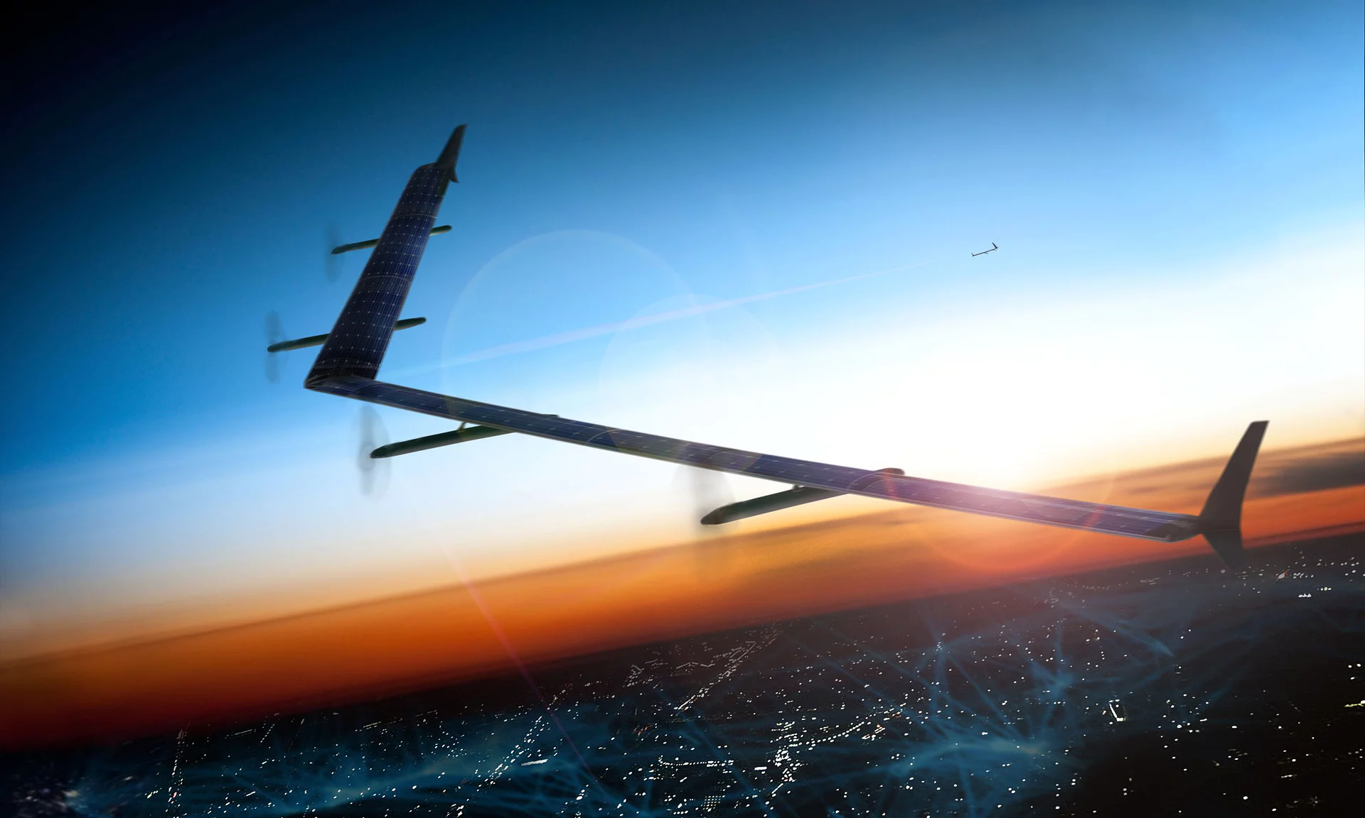
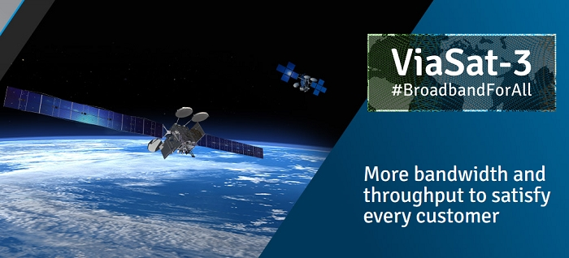
Other Projects
Notes:
In addition there is video and other data distribution on memory sticks.

Slide 8
Facebook’s solution
… created more problems

Slide 9
Solutions
Allowing users to design what they want
Testing and improving incrementally
What causes people to use it?

