Slide 1
The Interplanetary Internet
Session 27
INST 346
Technologies, Infrastructure and Architecture

Slide 2
Goals for Today
Communicating with Mars
Sneakernet and edge cacheing
Interplanetary Internetworking
Final comments

Slide 3
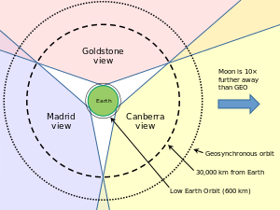

Slide 4
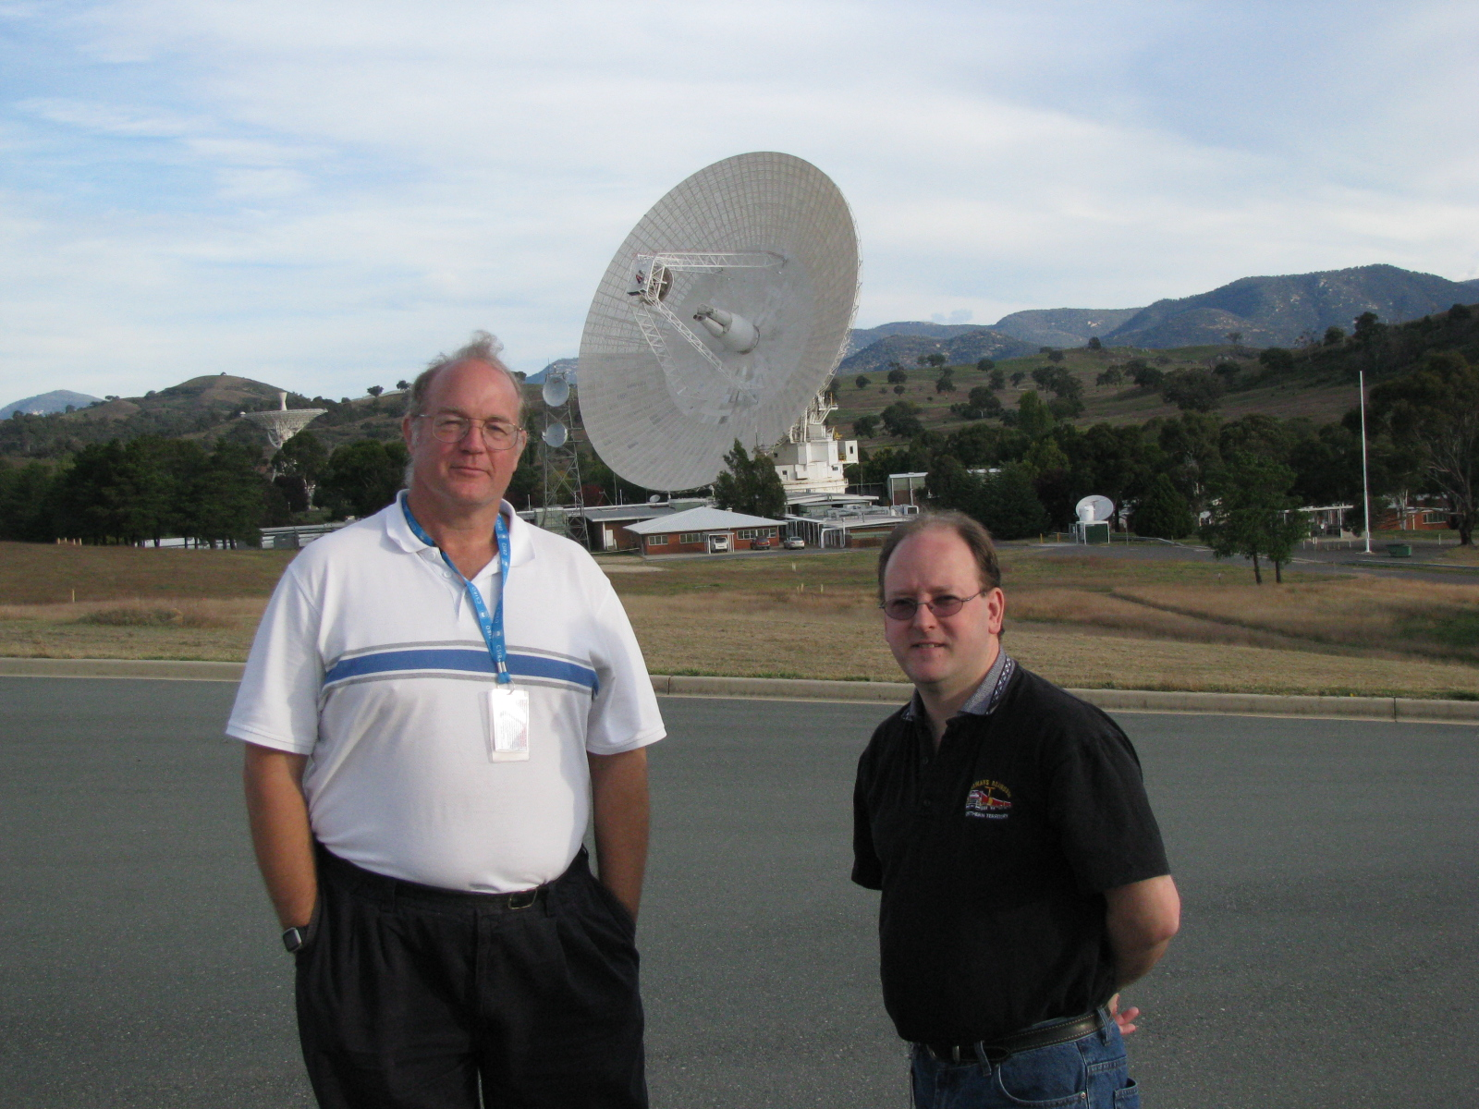

Slide 5
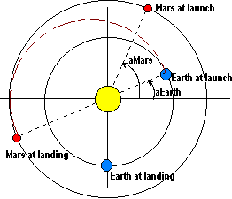

Slide 6
Final Comments
Next week
Tuesday: Global Internet Access
Thursday: Exam review
Week after
Text chat review session: Th Dec 14 at 8 PM
Final Exam
Monday Dec 18 from 4-6 PM (usual room)
Computer with Wireshark required

