Slide 1
Twitter
Session 26
INST 346
Technologies, Infrastructure and Architecture

Slide 2
Goals for Today
L5 comments
H6 questions (if any)
How Twitter got created
How new Internet services get created
L6

Slide 3
L5

Slide 4
H6 Questions?

Slide 5
Development Models
Waterfall
Spiral
Agile

Slide 6
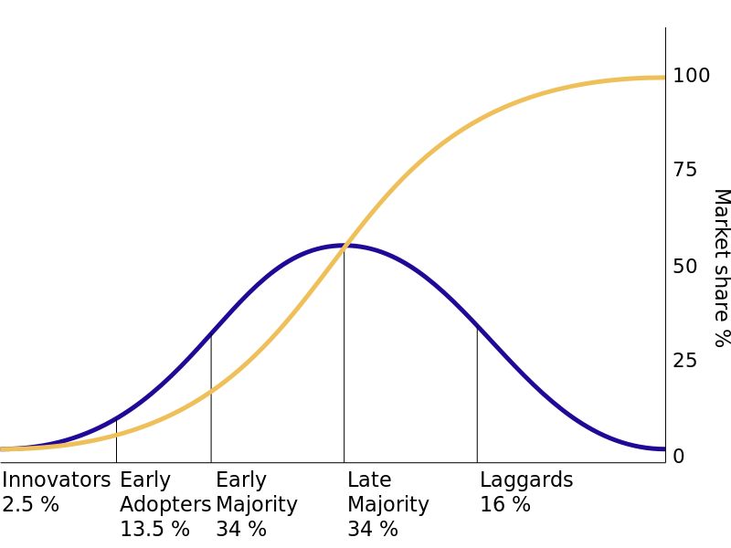
Adoption Curves

Slide 7
Some Predictors of Adoption
Relative advantage
Compatibility with existing systems
Trialability
Ease of learning
Reinvention potential

Slide 8
Social Structure of Adoption
Innovators
Communicators
Opinion leaders
Early adopters

Slide 9
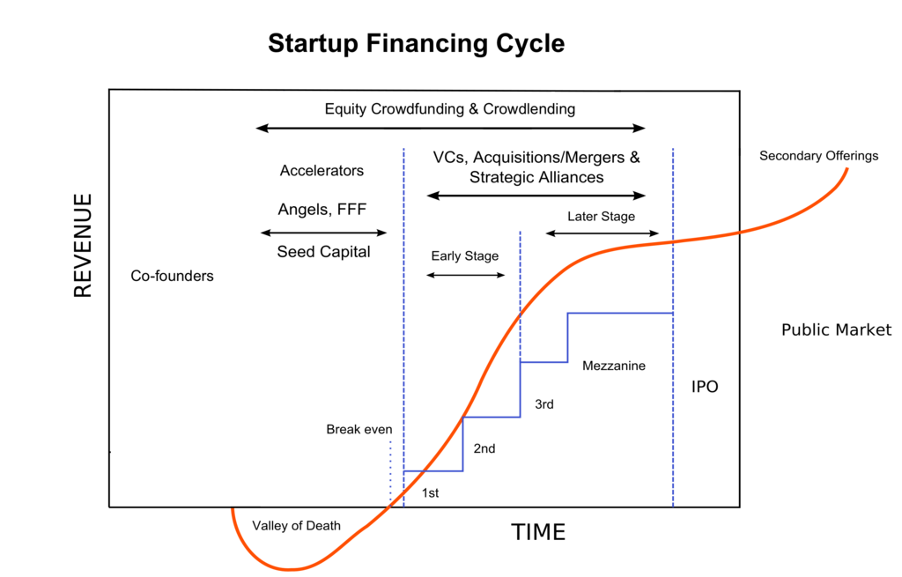

Slide 10
L6

