Slide 1

The Internet
Session 2
INST 346
Technologies, Infrastructure and Architecture

Slide 2
















Network structure
network edge:
  hosts: clients and servers
  servers often in data centers
mobile network
global ISP
access networks, physical media: wired, wireless communication links
home
network
regional ISP
network core:
  interconnected routers
  network of networks
institutional
network

Slide 3









The network core
mesh of interconnected routers
packet-switching: hosts break application-layer messages into packets
  forward packets from one router to the next, across links on path from source to destination
  each packet transmitted at full link capacity

Slide 4
Internet structure: network of networks
Tier 1 ISP
Tier 1 ISP
Google
IXP
IXP
IXP
Regional ISP
Regional ISP
access
ISP
access
ISP
access
ISP
access
ISP
access
ISP
access
ISP
access
ISP
access
ISP
at center: small # of well-connected large networks
  “tier-1” commercial ISPs (e.g., Level 3, Sprint, AT&T, NTT), national & international coverage
  content provider network (e.g., Google): private network that connects it data centers to Internet, often bypassing tier-1, regional ISPs

Slide 5

Encapsulation
source
message
M
application
transport
network
link
physical
segment
H_{t}
M
H_{t}
datagram
H_{n}
H_{n}
H_{t}
M
frame
H_{l}
H_{n}
H_{t}
M
link
physical
switch
destination
H_{n}
H_{t}
M
network
link
physical
M
application
transport
network
link
physical
H_{l}
H_{n}
H_{t}
M
H_{n}
H_{t}
M
H_{t}
M
H_{n}
H_{t}
M
H_{l}
H_{n}
H_{t}
M
router

Slide 6
Why layering?
dealing with complex systems:
explicit structure allows identification, relationship of complex system’s pieces
  layered reference model for discussion
modularization eases maintenance, updating of system
  change of implementation of layer’s service transparent to rest of system
  e.g., change in gate procedure doesn’t affect rest of system
layering considered harmful?

Slide 7
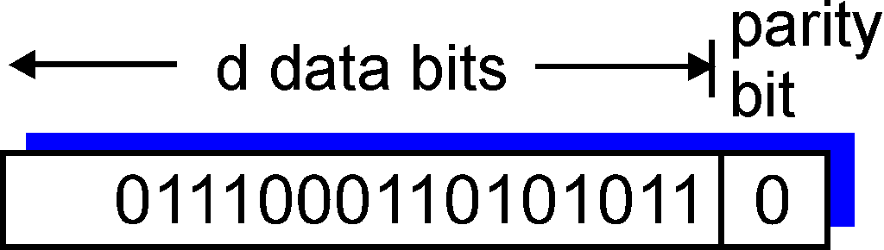
Link Layer Example: Parity checking
single bit parity:
detect single bit errors

Slide 8



Packet-switching: store-and-forward
L bits
per packet
source
3
2
1
R bps
R bps
destination
takes L/R seconds to transmit (push out) L-bit packet into link at R bps
store and forward: entire packet must arrive at router before it can be transmitted on next link
one-hop numerical example:
L = 7.5 Mbits
R = 1.5 Mbps
one-hop transmission delay = 5 sec
end-end delay = 2L/R (assuming zero propagation delay)
more on delay shortly …

Slide 9
Two key network-core functions
routing: determines source-destination route taken by packets
  routing algorithms
forwarding: move packets from router’s input to appropriate router output
routing algorithm
local forwarding table
header value
output link
0100
0101
0111
1001
3
2
2
1
1
3
2
0111
destination address in arriving
packet’s header

Slide 10
Throughput
throughput: rate (bits/time unit) at which bits transferred between sender/receiver
  instantaneous: rate at given point in time
  average: rate over longer period of time
server, with
file of F bits
to send to client
link capacity
R_{s} bits/sec
link capacity
R_{c} bits/sec
server sends bits
(fluid) into pipe
pipe that can carry
fluid at rate
R_{s} bits/sec)
pipe that can carry
fluid at rate
R_{c} bits/sec)

Slide 11
Packet Switching: queueing delay, loss
R = 100 Mb/s
C
A
D
R = 1.5 Mb/s
B
E
queue of packets
waiting for output link
queuing and loss:
if arrival rate (in bits) to link exceeds transmission rate of link for a period of time:
  packets will queue, wait to be transmitted on link
  packets can be dropped (lost) if memory (buffer) fills up

Slide 12
How do loss and delay occur?
packets queue in router buffers
packet arrival rate to link (temporarily) exceeds output link capacity
packets queue, wait for turn
packet being transmitted (delay)
A
B
packets queueing (delay)
free (available) buffers: arriving packets
dropped (loss) if no free buffers

Slide 13
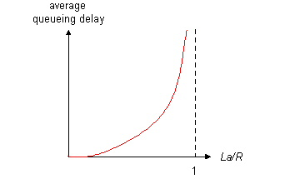

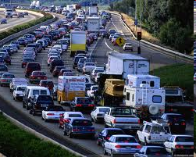
Queueing delay
R: link bandwidth (bps)
L: packet length (bits)
a: average packet arrival rate
average queueing delay
traffic intensity
= La/R
La/R ~ 0: avg. queueing delay small
La/R -> 1: avg. queueing delay large
La/R > 1: more “work” arriving
than can be serviced, average delay infinite!
La/R ~ 0
La/R -> 1
* Check online interactive animation on queuing and loss

Slide 14
Four sources of packet delay
transmission
A
propagation
B
nodal
processing
queueing
d_{nodal} = d_{proc} + d_{queue} + d_{trans} + d_{prop}
d_{proc}: nodal processing
check bit errors
determine output link
typically < msec
d_{queue}: queueing delay
time waiting at output link for transmission
depends on congestion level of router

Slide 15
Four sources of packet delay
transmission
A
propagation
B
nodal
processing
queueing
d_{nodal} = d_{proc} + d_{queue} + d_{trans} + d_{prop}
d_{trans}: transmission delay:
L: packet length (bits)
R: link bandwidth (bps)
d_{trans} = L/R
d_{prop}: propagation delay:
d: length of physical link
s: propagation speed (~2x10⁸ m/sec)
d_{prop} = d/s
d_{trans} and d_{prop}
very different
* Check out the online interactive exercises for more examples: http://gaia.cs.umass.edu/kurose_ross/interactive/
* Check out the Java applet for an interactive animation on trans vs. prop delay
Notes:
15

Slide 16
Packet loss
queue (aka buffer) preceding link in buffer has finite capacity
packet arriving to full queue dropped (aka lost)
lost packet may be retransmitted by previous node, by source end system, or not at all
buffer
(waiting area)
A
packet being transmitted
B
packet arriving to
full buffer is lost
* Check out the Java applet for an interactive animation on queuing and loss

Slide 17
“Real” Internet delays and routes
what do “real” Internet delay & loss look like?
traceroute program: provides delay measurement from source to router along end-end Internet path towards destination. For all i:
  sends three packets that will reach router i on path towards destination
  router i will return packets to sender
  sender times interval between transmission and reply.
3 probes
3 probes
3 probes

Slide 18
“Real” Internet delays, routes
traceroute: gaia.cs.umass.edu to www.eurecom.fr
3 delay measurements from
gaia.cs.umass.edu to cs-gw.cs.umass.edu
1 cs-gw (128.119.240.254) 1 ms 1 ms 2 ms
2 border1-rt-fa5-1-0.gw.umass.edu (128.119.3.145) 1 ms 1 ms 2 ms
3 cht-vbns.gw.umass.edu (128.119.3.130) 6 ms 5 ms 5 ms
4 jn1-at1-0-0-19.wor.vbns.net (204.147.132.129) 16 ms 11 ms 13 ms
5 jn1-so7-0-0-0.wae.vbns.net (204.147.136.136) 21 ms 18 ms 18 ms
6 abilene-vbns.abilene.ucaid.edu (198.32.11.9) 22 ms 18 ms 22 ms
7 nycm-wash.abilene.ucaid.edu (198.32.8.46) 22 ms 22 ms 22 ms
8 62.40.103.253 (62.40.103.253) 104 ms 109 ms 106 ms
9 de2-1.de1.de.geant.net (62.40.96.129) 109 ms 102 ms 104 ms
10 de.fr1.fr.geant.net (62.40.96.50) 113 ms 121 ms 114 ms
11 renater-gw.fr1.fr.geant.net (62.40.103.54) 112 ms 114 ms 112 ms
12 nio-n2.cssi.renater.fr (193.51.206.13) 111 ms 114 ms 116 ms
13 nice.cssi.renater.fr (195.220.98.102) 123 ms 125 ms 124 ms
14 r3t2-nice.cssi.renater.fr (195.220.98.110) 126 ms 126 ms 124 ms
15 eurecom-valbonne.r3t2.ft.net (193.48.50.54) 135 ms 128 ms 133 ms
16 194.214.211.25 (194.214.211.25) 126 ms 128 ms 126 ms
17 * * *
18 * * *
19 fantasia.eurecom.fr (193.55.113.142) 132 ms 128 ms 136 ms
trans-oceanic
link
* means no response (probe lost, router not replying)
* Do some traceroutes from exotic countries at www.traceroute.org

Slide 19
Multi-hop Throughput
R_{s} < R_{c} What is average end-end throughput?
R_{s} bits/sec
R_{c} bits/sec
R_{s} > R_{c} What is average end-end throughput?
R_{s} bits/sec
R_{c} bits/sec
bottleneck link
link on end-end path that constrains end-end throughput

Slide 20
An alternative: Multiplexing
Example:
FDM
4 users
frequency
time
TDM
frequency
time
Multiplexing makes “circuit switching” more efficient
Notes:
Two simple multiple access control techniques.
Each mobile’s share of the bandwidth is divided into portions for the uplink and the downlink. Also, possibly, out of band signaling.
As we will see, used in AMPS, GSM, IS-54/136

Slide 21
Packet switching versus circuit switching
packet switching allows more users to use network!
example:
1 Mb/s link
each user:
  100 kb/s when “active”
  active 10% of time
circuit-switching:
  10 users
packet switching:
  with 35 users, probability > 10 active at same time is less than .0004 *
N
users
…..
1 Mbps link
Q: how did we get value 0.0004?
Q: what happens if > 35 users ?
* Check out the online interactive exercises for more examples: http://gaia.cs.umass.edu/kurose_ross/interactive/

Slide 22
Acing the Homework
See what parts you find easy
  Work with friends to master the rest
Set it aside and then come back and check it
Office hours on Monday are well timed!
  AVW 3126 from 3:30-4:30 PM
Submit early and often
  Sharp cutoff at 5 PM Tuesday, no credit for late

Slide 23
Before You Go
On a sheet of paper, answer the following (ungraded) question (no names, please):
What was the muddiest point in today’s class?

Slide 24
What’s the Internet: a service view
mobile network
infrastructure that provides services to applications:
  Web, VoIP, email, games, e-commerce, social nets, …
provides programming interface to apps
  hooks that allow sending and receiving app programs to “connect” to Internet
  provides service options, analogous to postal service
global ISP
home
network
regional ISP
institutional
network

Slide 25
What’s a protocol?
human protocols:
“what’s the time?”
“I have a question”
introductions
… specific messages sent
… specific actions taken when messages received, or other events
network protocols:
machines rather than humans
all communication activity in Internet governed by protocols
protocols define format, order of messages sent and received among network entities, and actions taken on message transmission, receipt

Slide 26


What’s a protocol?
a human protocol and a computer network protocol:
Hi
TCP connection
request
Hi
TCP connection
response
Got the
time?
Get http://www.awl.com/kurose-ross
2:00
<file>
time
Q: other human protocols?

Slide 27

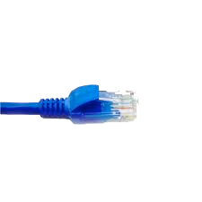
application
(www browser,
email client)
packet
analyzer
application
OS
packet
capture
(pcap)
Transport (TCP/UDP)
Network (IP)
Link (Ethernet)
Physical
copy of all Ethernet frames sent/received

