Slide 1

Mobile Data
Session 18
INST 346
Technologies, Infrastructure and Architecture

Slide 2
Goals for Today
Cellular networks
Mobility
  Same-network
  Roaming

Slide 3


Components of cellular network architecture
MSC
connects cells to wired tel. net.
manages call setup (more later!)
handles mobility (more later!)
cell
covers geographical region
base station (BS) analogous to 802.11 AP
mobile users attach to network through BS
air-interface: physical and link layer protocol between mobile and BS
Mobile
Switching
Center
Public telephone
network
Mobile
Switching
Center
wired network

Slide 4
Cellular networks: the first hop
Two techniques for sharing mobile-to-BS radio spectrum
combined FDMA/TDMA: divide spectrum in frequency channels, divide each channel into time slots
CDMA: code division multiple access
time slots
frequency
bands

Slide 5
Code Division Multiple Access (CDMA)
unique “code” assigned to each user; i.e., code set partitioning
  all users share same frequency, but each user has own “chipping” sequence (i.e., code) to encode data
  allows multiple users to “coexist” and transmit simultaneously with minimal interference (if codes are “orthogonal”)
encoded signal = (original data) X (chipping sequence)
decoding: inner-product of encoded signal and chipping sequence

Slide 6
CDMA encode/decode
channel output Z_{i,m}
Z_{i,m}= d_{i}.c_{m}
data
bits
d₀ = 1
1
1
1
1
1
d₁ = -1
1
1
1
-
-
-
-
1
-
-
-
1
-
1
1
1
1
1
sender
1
1
slot 1
channel
output
slot 0
channel
output
1
1
1
1
1
code
1
1
-
-
-
1
-
1
1
1
-
-
-
1
-
1
1
1
slot 1
slot 0
M
D_{i} = Σ Z_{i,m}.c_{m}
m=1
M
received
input
1
1
1
1
1
1
1
1
d₀ = 1
-
-
-
-
1
-
-
-
1
-
1
1
1
1
1
1
d₁ = -1
1
slot 1
channel
output
slot 0
channel
output
1
1
1
1
1
code
1
1
-
-
-
1
-
1
1
1
-
-
-
1
-
1
1
1
receiver
slot 1
slot 0

Slide 7
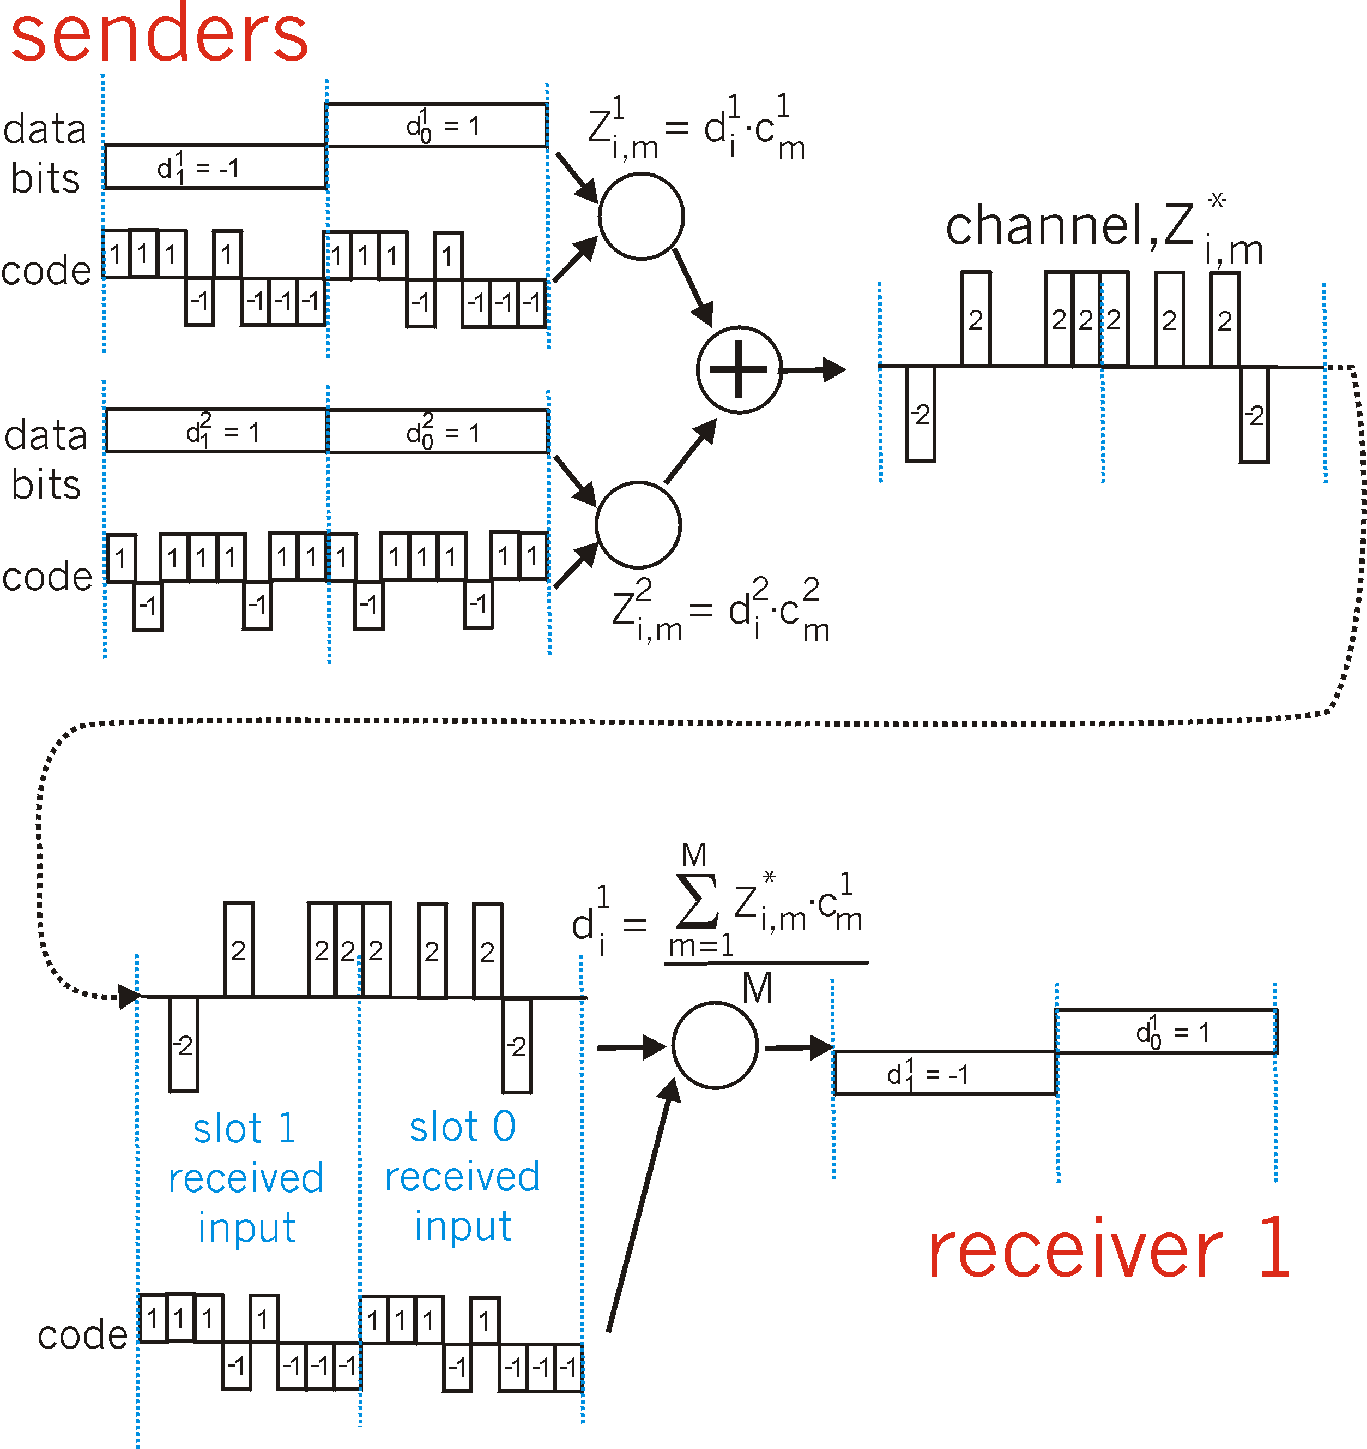
CDMA: two-sender interference
channel sums together transmissions by sender 1 and 2
Sender 1
Sender 2
using same code as sender 1, receiver recovers sender 1’s original data from summed channel data!

Slide 8
4G LTE
all IP core: IP packets tunneled (through core IP network) from base station to gateway
no separation between voice and data – all traffic carried over IP core to gateway
Mobility
Management
Entity (MME)
Home Subscriber
Server(HSS)
Serving
Gateway
(S-GW)
Packet data
network
Gateway
(P-GW)
UE
(user element)
eNodeB
(base station)
HSS
MME
control
G
G
Public
Internet
data
S-GW
P-GW
radio access network
Universal Terrestrial Radio
Access Network (UTRAN)
Evolved Packet Core
(EPC)

Slide 9
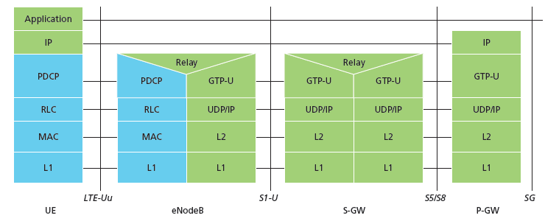
4G LTE
IP packet from UE encapsulated in GPRS Tunneling Protocol (GTP) message at ENodeB
GTP message encapsulated in UDP, then encapsulated in IP. large IP packet addressed to SGW
UE
G
G
eNodeB
S-GW
P-GW
tunnel
link-layer radio net

Slide 10
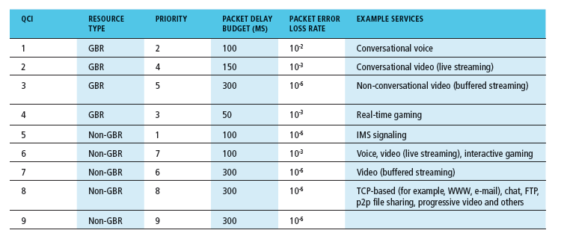
Quality of Service in 4G LTE
QoS from eNodeB to SGW: min and max guaranteed bit rate
QoS in radio access network: one of 12 QCI values

Slide 11
Handoff between cell towers (3G)
handoff goal: route call via new cell tower (without interruption)
reasons for handoff:
  stronger signal to/from new tower (continuing connectivity, less battery drain)
  load balance: free up channel in current tower
handoff initiated by old tower
Mobile
Switching
Center
old
routing
new
routing
old BSS
new BSS

Slide 12
Handoff between cell towers (3G)
1. old tower informs MSC of impending handoff, provides list of 1⁺ new towers
2. MSC sets up path (allocates resources) to new tower
3. new tower allocates radio channel for use by mobile
4. new tower signals MSC, old tower: ready
5. old tower tells mobile: perform handoff to new tower
6. mobile, new tower signal to activate new channel
7. mobile signals via new tower to MSC: handoff complete. MSC reroutes call
8 MSC-old-tower resources released
Mobile
Switching
Center
4
2
1
8
7
3
old BSS
5
6
new BSS

Slide 13
Same-Network Mobility in 4G LTE
Paging: idle UE may move from cell to cell: network does not know where the idle UE is resident
  paging message from MME broadcast by all eNodeB to locate UE
handoff: similar to 3G:
  preparation phase
  execution phase
  completion phase
source
MME
P-GW
target
MME
old
routing
new
routing
old
eNodeB
new
eNodeB

Slide 14




“Roaming” Mobility: vocabulary
home network: permanent “home” of mobile
(e.g., 128.119.40/24)
home agent: entity that will perform mobility functions on behalf of mobile, when mobile is remote
wide area network
permanent address: address in home network, can always be used to reach mobile
e.g., 128.119.40.186

Slide 15
Roaming Mobility: more vocabulary
permanent address: remains constant (e.g., 128.119.40.186)
visited network: network in which mobile currently resides (e.g., 79.129.13/24)
care-of-address: address in visited network.
(e.g., 79,129.13.2)
wide area network
foreign agent: entity in visited network that performs mobility functions on behalf of mobile.
correspondent: wants to communicate with mobile

Slide 16
Roaming Mobility: approaches
let routing handle it: routers advertise permanent address of mobile-nodes-in-residence via usual routing table exchange.
  routing tables indicate where each mobile located
  no changes to end-systems
let end-systems handle it:
  indirect routing: communication from correspondent to mobile goes through home agent, then forwarded to remote
  direct routing: correspondent gets foreign address of mobile, sends directly to mobile

Slide 17
Roaming Mobility: approaches
let routing handle it: routers advertise permanent address of mobile-nodes-in-residence via usual routing table exchange.
  routing tables indicate where each mobile located
  no changes to end-systems
let end-systems handle it:
  indirect routing: communication from correspondent to mobile goes through home agent, then forwarded to remote
  direct routing: correspondent gets foreign address of mobile, sends directly to mobile
not
scalable
to millions of
mobiles

Slide 18
Roaming Mobility: registration
visited network
home network
1
2
wide area network
mobile contacts foreign agent on entering visited network
foreign agent contacts home agent home: “this mobile is resident in my network”
end result:
foreign agent knows about mobile
home agent knows location of mobile

Slide 19

Roaming Mobility via indirect routing
foreign agent receives packets, forwards to mobile
home agent intercepts packets, forwards to foreign agent
visited
network
home
network
3
wide area network
2
1
correspondent addresses packets using home address of mobile
4
mobile replies directly to correspondent

Slide 20



Indirect Routing: comments
mobile uses two addresses:
  permanent address: used by correspondent (hence mobile location is transparent to correspondent)
  care-of-address: used by home agent to forward datagrams to mobile
foreign agent functions may be done by mobile itself
triangle routing: correspondent-home-network-mobile
  inefficient when
  correspondent, mobile
  are in same network

Slide 21
Indirect routing: moving between networks
suppose mobile user moves to another network
  registers with new foreign agent
  new foreign agent registers with home agent
  home agent update care-of-address for mobile
  packets continue to be forwarded to mobile (but with new care-of-address)
mobility, changing foreign networks transparent: on going connections can be maintained!

Slide 22
Wireless, mobility: impact on higher layer protocols
logically, impact should be minimal …
  best effort service model remains unchanged
  TCP and UDP can (and do) run over wireless, mobile
… but performance-wise:
  packet loss/delay due to bit-errors (discarded packets, delays for link-layer retransmissions), and handoff
  TCP interprets loss as congestion, will decrease congestion window un-necessarily
  delay impairments for real-time traffic
  limited bandwidth of wireless links

Slide 23
Link Layer: Key Ideas
The physical layer’s characteristics are key
Point to point fiber is straightforward
Switched Ethernet is nearly as simple
Wireless links introduce many challenges
  Adaptation to changing signal characteristics
  Managing shared channels
  Mobility

Slide 24
Before You Go
On a sheet of paper, answer the following (ungraded) question (no names, please):
What was the muddiest point in today’s class?

