Slide 1

WiFi
Session 17
INST 346
Technologies, Infrastructure and Architecture

Slide 2
L3 Results

Slide 3
Q6 Results
16 of 26 earned full credit
1: CRC works well in terrestrial point to point links, where retransmission is easy; FEC might be better for high-delay links (e.g., satellite) [also better for low signal strength settings]
2: Dijkstra’s algorithm would not scale to Internet (flood routing, n log n computation time)

Slide 4
Muddiest Points
(from Point-to-Point)
Ethernet
Radio links
Parity checking
Error correction

Slide 5
Goals for Today
WiFi
Getahead: Cellular networks
L4 preview

Slide 6
Wireless Networks
# wireless Internet-connected devices equals # wireline Internet-connected devices
  laptops, tablets, phones, IOT
two important (but different) challenges
  Wireless (all week): communication over wireless link
  Mobility (Thursday): handling the mobile user who changes point of attachment to network

Slide 7
Characteristics of selected wireless links
1300
802.11 ac
450
802.11n
54
802.11a,g
802.11a,g point-to-point
5-11
802.11b
4G: LTE
4
3G: UMTS/WCDMA-HSPDA, CDMA2000-1xEVDO
Data rate (Mbps)
1
802.15
.384
2.5G: UMTS/WCDMA, CDMA2000
.056
2G: IS-95, CDMA, GSM
Indoor
10-30m
Outdoor
50-200m
Mid-range
outdoor
200m – 4 Km
Long-range
outdoor
5Km – 20 Km

Slide 8
IEEE 802.11 Wireless LAN
802.11b
2.4-5 GHz unlicensed spectrum
up to 11 Mbps
direct sequence spread spectrum (DSSS) in physical layer
  all hosts use same chipping code
802.11a
  5-6 GHz range
  up to 54 Mbps
802.11g
  2.4-5 GHz range
  up to 54 Mbps
802.11n: multiple antennae
  2.4-5 GHz range
  up to 200 Mbps
all use CSMA/CA for multiple access
all have infrastructure and ad-hoc network versions

Slide 9
Wireless Link Characteristics (1)
important differences from wired link ….
  decreased signal strength: radio signal attenuates as it propagates through matter (path loss)
  interference from other sources: standardized wireless network frequencies (e.g., 2.4 GHz) shared by other devices (e.g., phone); devices (motors) interfere as well
  multipath propagation: radio signal reflects off objects ground, arriving ad destination at slightly different times
…. make communication across (even a point to point) wireless link much more difficult

Slide 10
Wireless Link Characteristics (2)
SNR: signal-to-noise ratio
  larger SNR – easier to extract signal from noise (a “good thing”)
SNR versus Bit Error Rate tradeoff
  given a physical layer:
    increase power -> increase SNR
    Increase SNR -> decrease BER
  given the actual SNR:
    choose the physical layer with the highest throughput that meets the Bit Error Rate target
SNR may change with mobility
  dynamically adapt physical layer (modulation technique, data rate)
10⁻¹
10⁻²
10⁻³
BER
10⁻⁴
10⁻⁵
10⁻⁶
10⁻⁷
10
20
30
40
SNR(dB)
QAM256 (8 Mbps)
QAM16 (4 Mbps)
BPSK (1 Mbps)

Slide 11
Adaptive Rate Selection
base station, mobile dynamically change transmission rate (physical layer modulation technique) as mobile host moves
10⁻¹
10⁻²
10⁻³
BER
10⁻⁴
10⁻⁵
10⁻⁶
10⁻⁷
10
20
30
40
SNR(dB)
1. SNR decreases, BER increases as host moves away from base station
QAM256 (8 Mbps)
QAM16 (4 Mbps)
2. When BER becomes too high, switch to lower transmission rate but with lower BER
BPSK (1 Mbps)
operating point

Slide 12






802.11 LAN architecture
wireless host communicates with base station (“Access Point” (AP))
Basic Service Set (BSS) in infrastructure mode contains:
  wireless hosts
  access point
Internet
hub, switch
or router
BSS 1
BSS 2

Slide 13
802.11: passive/active scanning
BBS 1
BBS 2
BBS 1
BBS 2
1
AP 2
AP 1
1
1
AP 2
AP 1
2
2
2
3
3
4
H1
H1
passive scanning:
beacon frames sent from APs
association Request frame sent: H1 to selected AP
association Response frame sent from selected AP to H1
active scanning:
Probe Request frame broadcast from H1
Probe Response frames sent from APs
Association Request frame sent: H1 to selected AP
Association Response frame sent from selected AP to H1

Slide 14
802.11: Channels, association
802.11b: 2.4GHz-2.485GHz spectrum divided into 11 channels at different frequencies
  AP admin chooses frequency for AP
  interference possible: channel can be same as that chosen by neighboring AP!
host: must associate with an AP
  scans channels, listening for beacon frames containing AP’s name (SSID) and MAC address
  selects AP to associate with
  may perform authentication [Chapter 8]
  will typically run DHCP to get IP address in AP’s subnet

Slide 15
IEEE 802.11: multiple access
avoid collisions: 2⁺ nodes transmitting at same time
CSMA - sense before transmitting
  don’t collide with ongoing transmission by other node
  May not sense some senders: “hidden terminal problem”
no collision detection!
  difficult to receive (sense collisions) when transmitting due to weak received signals (fading)
  goal: avoid collisions: CSMA/CA (Collision Avoidance)

Slide 16


The Hidden Terminal Problem
Multiple wireless senders and receivers create additional problems”
A
B
C
C
A’s signal
strength
C’s signal
strength
B
A
Hidden terminal problem
B, A hear each other
B, C hear each other
A, C can not hear each other means A, C unaware of their interference at B
space
Signal attenuation:
B, A hear each other
B, C hear each other
A, C can not hear each other interfering at B

Slide 17
IEEE 802.11 MAC Protocol: CSMA/CA
802.11 sender
- if channel idle for 50 μs Distributed Coordination Function (DCF) Inter-Frame Space (DIFS) then
  transmit entire frame
- if channel busy then
  start random backoff time
  timer counts down while channel idle
  transmit when timer expires
  if no ACK, increase random backoff interval, repeat
802.11 receiver
if frame received OK, return ACK after 10 μs “Short Inter-Frame Space” (SIFS)
  ACK is needed due to hidden terminal problem
sender
receiver
50 μs
data
10 μs
ACK
DIFS and SIFS
delays are for 802.11b

Slide 18
Channel Reservations
idea: allow sender to “reserve” channel rather than random access of data frames: avoid collisions of long data frames
sender first transmits small request-to-send (RTS) packets to AP using CSMA
  RTSs may still collide with each other (but they’re short)
AP broadcasts clear-to-send (CTS) in response to RTS
CTS heard by all nodes
  sender transmits data frame
  other stations defer transmissions
RTS fits inside DIFS, but CTS costs time
Only worth it for long packets with frequent collisions

Slide 19


Collision Avoidance: RTS-CTS exchange
A
B
AP
RTS(B)
RTS(A)
reservation collision
RTS(A)
CTS(A)
CTS(A)
DATA (A)
defer
time
ACK(A)
ACK(A)

Slide 20
802.11 frame: addressing
2
2
6
6
6
2
6
0 - 2312
4
frame
control
duration
address
1
address
2
address
3
seq
control
address
4
payload
CRC
Address 4: used only in ad hoc mode
Address 1: MAC address
of wireless host or AP
to receive this frame
Address 3: MAC address
of router interface to which AP is attached
Address 2: MAC address
of wireless host or AP
transmitting this frame

Slide 21
802.11 frame: addressing
Internet
H1
R1
router
R1 MAC addr H1 MAC addr
dest. address
source address
802.3 Ethernet frame
AP MAC addr H1 MAC addr R1 MAC addr
address 1
address 2
address 3
802.11 WiFi frame

Slide 22
802.11 frame: more
frame seq #
(for managing ACKs)
duration of reserved
transmission time (RTS/CTS)
2
2
6
6
6
2
6
0 - 2312
4
frame
control
duration
address
1
address
2
address
3
seq
control
address
4
payload
CRC
2
2
4
1
1
1
1
1
1
1
1
Protocol
version
Type
Subtype
To
AP
From
AP
More
frag
Retry
Power
mgt
More
data
WEP
Rsvd
frame type
(RTS, CTS, ACK, data)

Slide 23











802.11: mobility within same subnet
H1 remains in same IP subnet: IP address can remain same
switch: which AP is associated with H1?
  self-learning: switch will see the first frame from H1 through the new AP and “remember” which switch port can be used to reach H1
BBS 1
H1
BBS 2

Slide 24
802.11: advanced capabilities
power management
node-to-AP: “I am going to sleep until next beacon frame”
  AP knows not to transmit frames to this node
  node wakes up before next beacon frame
beacon frame: contains list of mobiles with AP-to-mobile frames waiting to be sent
  node will stay awake if AP-to-mobile frames to be sent; otherwise sleep again until next beacon frame

Slide 25
Wireless network taxonomy
single hop
multiple hops
host connects to
base station (WiFi,
WiMAX, cellular)
which connects to
larger Internet
host may have to
relay through several
wireless nodes to
connect to larger
Internet: mesh net
infrastructure
(e.g., APs)
no
infrastructure
no base station, no
connection to larger
Internet (Bluetooth,
ad hoc nets)

Slide 26


Components of cellular network architecture
MSC
connects cells to wired tel. net.
manages call setup (more later!)
handles mobility (more later!)
cell
covers geographical region
base station (BS) analogous to 802.11 AP
mobile users attach to network through BS
air-interface: physical and link layer protocol between mobile and BS
Mobile
Switching
Center
Public telephone
network
Mobile
Switching
Center
wired network

Slide 27
Cellular networks: the first hop
Two techniques for sharing mobile-to-BS radio spectrum
combined FDMA/TDMA: divide spectrum in frequency channels, divide each channel into time slots
CDMA: code division multiple access
time slots
frequency
bands

Slide 28
Code Division Multiple Access (CDMA)
unique “code” assigned to each user; i.e., code set partitioning
  all users share same frequency, but each user has own “chipping” sequence (i.e., code) to encode data
  allows multiple users to “coexist” and transmit simultaneously with minimal interference (if codes are “orthogonal”)
encoded signal = (original data) X (chipping sequence)
decoding: inner-product of encoded signal and chipping sequence

Slide 29
CDMA encode/decode
channel output Z_{i,m}
Z_{i,m}= d_{i}.c_{m}
data
bits
d₀ = 1
1
1
1
1
1
d₁ = -1
1
1
1
-
-
-
-
1
-
-
-
1
-
1
1
1
1
1
sender
1
1
slot 1
channel
output
slot 0
channel
output
1
1
1
1
1
code
1
1
-
-
-
1
-
1
1
1
-
-
-
1
-
1
1
1
slot 1
slot 0
M
D_{i} = Σ Z_{i,m}.c_{m}
m=1
M
received
input
1
1
1
1
1
1
1
1
d₀ = 1
-
-
-
-
1
-
-
-
1
-
1
1
1
1
1
1
d₁ = -1
1
slot 1
channel
output
slot 0
channel
output
1
1
1
1
1
code
1
1
-
-
-
1
-
1
1
1
-
-
-
1
-
1
1
1
receiver
slot 1
slot 0

Slide 30
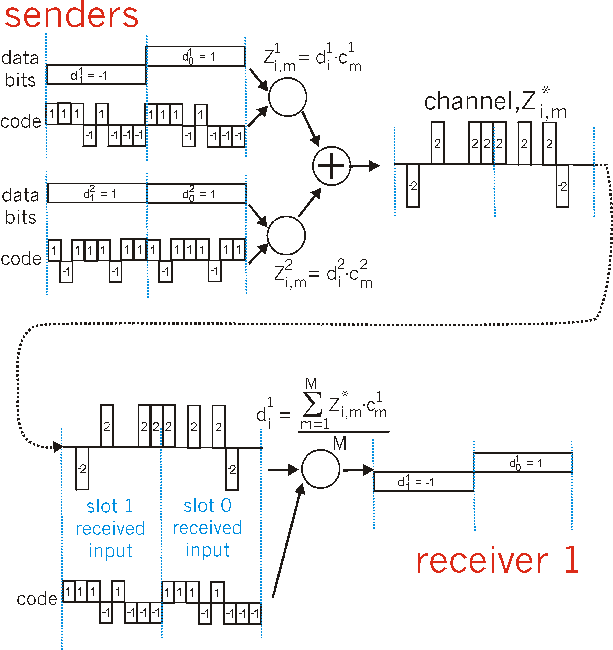
CDMA: two-sender interference
channel sums together transmissions by sender 1 and 2
Sender 1
Sender 2
using same code as sender 1, receiver recovers sender 1’s original data from summed channel data!

Slide 31
3G (voice+data) network architecture
MSC
G
Public
telephone
network
radio
network
controller
Gateway
MSC
G
Public
Internet
SGSN
Key insight: new cellular data
network operates in parallel
(except at edge) with existing
cellular voice network
voice network unchanged in core
data network operates in parallel
GGSN
Serving GPRS Support Node (SGSN)
Gateway GPRS Support Node (GGSN)

Slide 32
3G (voice+data) network architecture
MSC
G
Public
telephone
network
radio
network
controller
Gateway
MSC
G
Public
Internet
SGSN
GGSN
radio interface
(WCDMA, HSPA)
radio access network
Universal Terrestrial Radio
Access Network (UTRAN)
core network
General Packet Radio Service
(GPRS) Core Network
public
Internet

Slide 33
3G versus 4G LTE network architecture
MSC
G
Public
telephone
network
3G
radio
network
controller
Gateway
MSC
G
Public
Internet
SGSN
GGSN
4G-LTE
HSS
MME
G
G
Public
Internet
S-GW
P-GW
radio access network
Universal Terrestrial Radio
Access Network (UTRAN)
Evolved Packet Core
(EPC)

Slide 34
4G: differences from 3G
all IP core: IP packets tunneled (through core IP network) from base station to gateway
no separation between voice and data – all traffic carried over IP core to gateway
Mobility
Management
Entity (MME)
Home Subscriber
Server(HSS)
(like HLR+VLR)
Serving
Gateway
(S-GW)
Packet data
network
Gateway
(P-GW)
UE
(user element)
eNodeB
(base station)
HSS
MME
control
G
G
Public
Internet
data
S-GW
P-GW
radio access network
Universal Terrestrial Radio
Access Network (UTRAN)
Evolved Packet Core
(EPC)

Slide 35
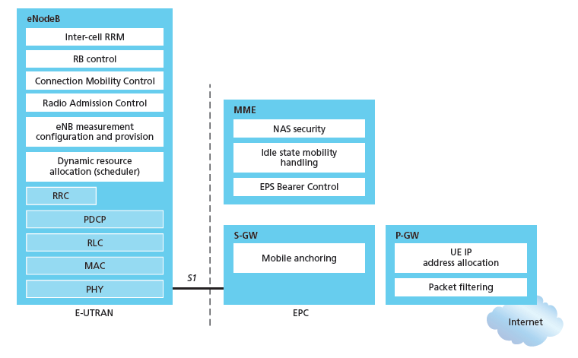
Functional split of major LTE components
handles idle/active UE transitions
pages UE
sets up eNodeB-PGW tunnel (aka bearer)
holds idle UE info
QoS enforcement

Slide 36
L4 Preview

Slide 37
Before You Go
On a sheet of paper, answer the following (ungraded) question (no names, please):
What was the muddiest point in today’s class?

