Slide 1

Ethernet
Session 16
INST 346
Technologies, Infrastructure and Architecture

Slide 2
Goals for Today
Revisit CSMA
Link layer addressing MAC and ARP
Ethernet
Switch
VLAN
H4 preview

Slide 3
CSMA (carrier sense multiple access)
CSMA: listen before transmit:
if channel sensed idle: transmit entire frame
if channel sensed busy, defer transmission
human analogy: don’t interrupt others!

Slide 4
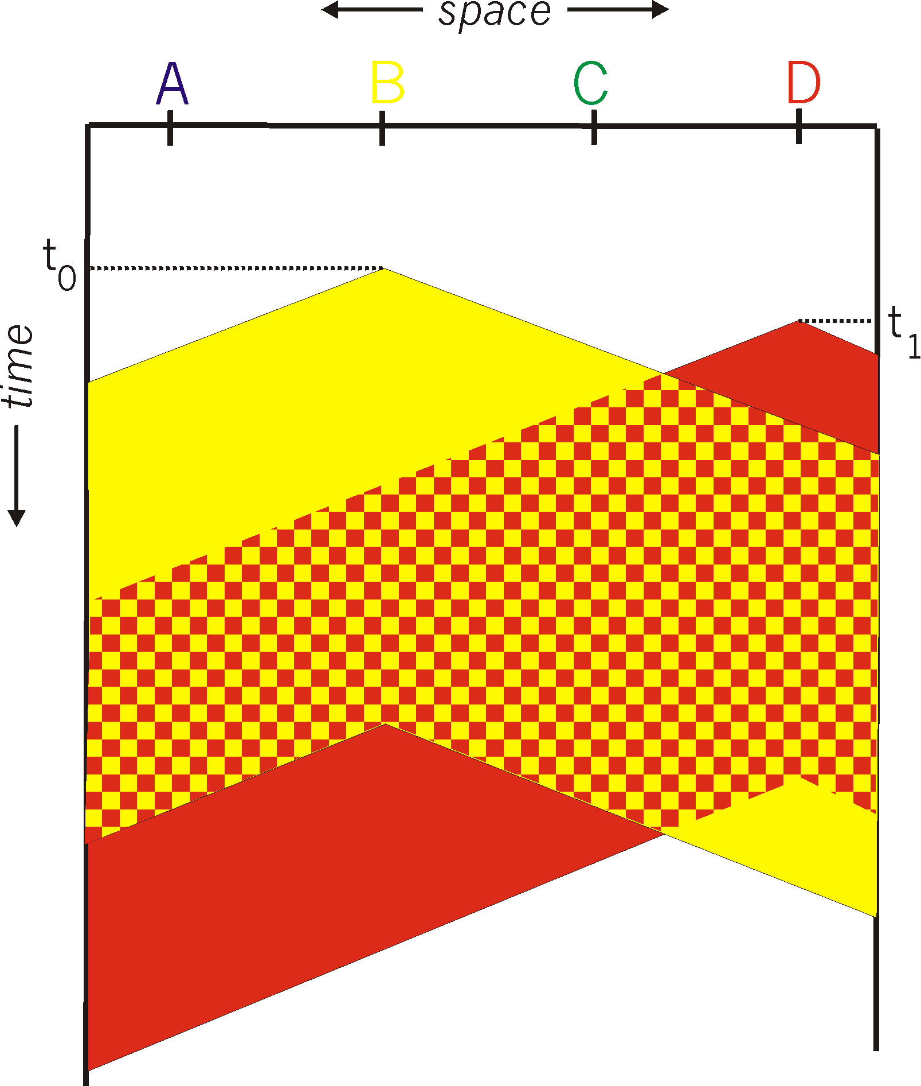

CSMA collisions
spatial layout of nodes
collisions can still occur: propagation delay means two nodes may not hear each other’s transmission
collision: entire packet transmission time wasted
  distance & propagation delay play role in in determining collision probability

Slide 5
CSMA/CD (collision detection)
CSMA/CD: carrier sensing, deferral as in CSMA
  collisions detected within short time
  colliding transmissions aborted, reducing channel wastage
collision detection:
  easy in wired LANs: measure signal strengths, compare transmitted, received signals
  difficult in wireless LANs: received signal strength overwhelmed by local transmission strength
human analogy: the polite conversationalist

Slide 6
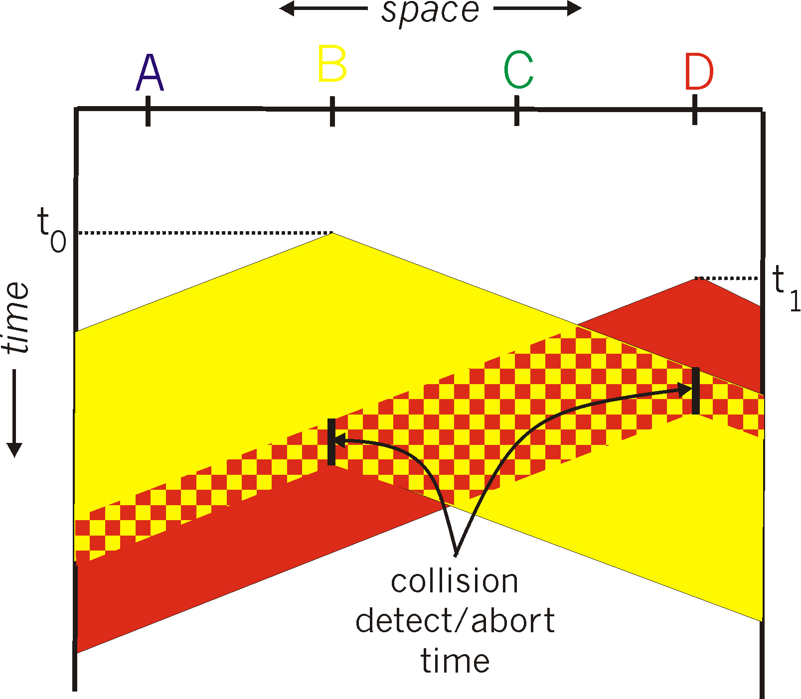
CSMA/CD (collision detection)
spatial layout of nodes

Slide 7
Ethernet CSMA/CD algorithm
1. NIC receives datagram from network layer, creates frame
2. If NIC senses channel idle, starts frame transmission. If NIC senses channel busy, waits until channel idle, then transmits.
3. If NIC transmits entire frame without detecting another transmission, NIC is done with frame !
4. If NIC detects another transmission while transmitting, aborts and sends jam signal
5. After aborting, NIC enters binary (exponential) backoff:
  after mth collision, NIC chooses K at random from {0,1,2, …, 2^{m}-1}. NIC waits K·512 bit times, returns to Step 2
  longer backoff interval with more collisions

Slide 8
CSMA/CD efficiency
T_{prop} = max prop delay between 2 nodes in LAN
t_{trans} = time to transmit max-size frame
efficiency goes to 1
  as t_{prop} goes to 0
  as t_{trans} goes to infinity
better performance than ALOHA: and simple, cheap, decentralized!

Slide 9
MAC addresses and ARP
32-bit IP address:
  network-layer address for interface
  used for layer 3 (network layer) forwarding
MAC (or LAN or physical or Ethernet) address:
  function: used ‘locally” to get frame from one interface to another physically-connected interface (same network, in IP-addressing sense)
  48 bit MAC address (for most LANs) burned in NIC ROM, also sometimes software settable
  e.g.: 1A-2F-BB-76-09-AD
hexadecimal (base 16) notation
(each “numeral” represents 4 bits)
Notes:
MAC address, base 16, to binary

Slide 10

LAN addresses and ARP
each adapter on LAN has unique LAN address
1A-2F-BB-76-09-AD
LAN
(wired or
wireless)
adapter
71-65-F7-2B-08-53
58-23-D7-FA-20-B0
0C-C4-11-6F-E3-98

Slide 11
LAN addresses (more)
MAC address allocation administered by IEEE
manufacturer buys portion of MAC address space (to assure uniqueness)
analogy:
  MAC address: like Social Security Number
  IP address: like postal address
MAC flat address ➜ portability
  can move LAN card from one LAN to another
IP hierarchical address not portable
  address depends on IP subnet to which node is attached
Notes:
MAC addresses are not routable

Slide 12
ARP protocol: same LAN
A wants to send datagram to B
  B’s MAC address not in A’s ARP table.
A broadcasts ARP query packet, containing B's IP address
  destination MAC address = FF-FF-FF-FF-FF-FF
  all nodes on LAN receive ARP query
B receives ARP packet, replies to A with its (B's) MAC address
  frame sent to A’s MAC address (unicast)
A caches (saves) IP-to-MAC address pair in its ARP table until information becomes old (times out)
  soft state: information that times out (goes away) unless refreshed
ARP is “plug-and-play”:
  nodes create their ARP tables without intervention from net administrator
Notes:
Ethernet is broadcast , not in internet – unicast, waste bandwidth
It is very fast within the subnet
Expensive for long dist

Slide 13

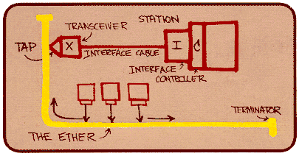
Ethernet
“dominant” wired LAN technology:
single chip, multiple speeds (e.g., Broadcom BCM5761)
first widely used LAN technology
simpler, cheap
kept up with speed race: 10 Mbps – 10 Gbps
Metcalfe’s Ethernet sketch

Slide 14


Ethernet: physical topology
bus: popular through mid 90s
  all nodes in same collision domain (can collide with each other)
star: prevails today
  active switch in center
  each “spoke” runs a (separate) Ethernet protocol (nodes do not collide with each other)
switch
star
bus: coaxial cable

Slide 15
Ethernet frame structure
sending adapter encapsulates IP datagram (or other network layer protocol packet) in Ethernet frame
preamble:
7 bytes with pattern 10101010 followed by one byte with pattern 10101011
used to synchronize receiver, sender clock rates
type
preamble
dest.
address
source
address
data (payload)
CRC

Slide 16
Ethernet frame structure (more)
addresses: 6 byte source, destination MAC addresses
  if adapter receives frame with matching destination address, or with broadcast address (e.g. ARP packet), it passes data in frame to network layer protocol
  otherwise, adapter discards frame
type: indicates higher layer protocol (mostly IP but others possible, e.g., Novell IPX, AppleTalk)
CRC: cyclic redundancy check at receiver
  error detected: frame is dropped
type
preamble
dest.
address
source
address
data (payload)
CRC

Slide 17
Ethernet: unreliable, connectionless
connectionless: no handshaking between sending and receiving NICs
unreliable: receiving NIC doesn't send acks or nacks to sending NIC
  data in dropped frames recovered only if initial sender uses higher layer rdt (e.g., TCP), otherwise dropped data lost
Ethernet’s MAC protocol: unslotted CSMA/CD with binary backoff

Slide 18
802.3 Ethernet standards: link & physical layers
many different Ethernet standards
  common MAC protocol and frame format
  different speeds: 2 Mbps, 10 Mbps, 100 Mbps, 1Gbps, 10 Gbps, 40 Gbps
  different physical layer media: fiber, cable
application
transport
network
link
physical
MAC protocol
and frame format
100BASE-TX
100BASE-T2
100BASE-FX
100BASE-T4
100BASE-SX
100BASE-BX
copper (twister
pair) physical layer
fiber physical layer

Slide 19
Addressing: routing to another LAN
walkthrough: send datagram from A to B via R
  focus on addressing – at IP (datagram) and MAC layer (frame)
  assume A knows B’s IP address
  assume A knows IP address of first hop router, R (how?)
  assume A knows R’s MAC address (how?)
A
B
R
111.111.111.111
222.222.222.222
74-29-9C-E8-FF-55
49-BD-D2-C7-56-2A
222.222.222.220
1A-23-F9-CD-06-9B
111.111.111.112
111.111.111.110
222.222.222.221
CC-49-DE-D0-AB-7D
E6-E9-00-17-BB-4B
88-B2-2F-54-1A-0F

Slide 20
Addressing: routing to another LAN
A creates IP datagram with IP source A, destination B
A creates link-layer frame with R's MAC address as destination address, frame contains A-to-B IP datagram
MAC src: 74-29-9C-E8-FF-55
MAC dest: E6-E9-00-17-BB-4B
IP
Eth
Phy
IP src: 111.111.111.111
IP dest: 222.222.222.222
A
B
R
111.111.111.111
222.222.222.222
74-29-9C-E8-FF-55
49-BD-D2-C7-56-2A
222.222.222.220
1A-23-F9-CD-06-9B
111.111.111.112
111.111.111.110
222.222.222.221
CC-49-DE-D0-AB-7D
E6-E9-00-17-BB-4B
88-B2-2F-54-1A-0F

Slide 21
Addressing: routing to another LAN
frame sent from A to R
frame received at R, datagram removed, passed up to IP
MAC src: 74-29-9C-E8-FF-55
MAC dest: E6-E9-00-17-BB-4B
IP src: 111.111.111.111
IP dest: 222.222.222.222
IP
Eth
Phy
IP src: 111.111.111.111
IP dest: 222.222.222.222
IP
Eth
Phy
A
B
R
111.111.111.111
222.222.222.222
74-29-9C-E8-FF-55
49-BD-D2-C7-56-2A
222.222.222.220
1A-23-F9-CD-06-9B
111.111.111.112
111.111.111.110
222.222.222.221
CC-49-DE-D0-AB-7D
E6-E9-00-17-BB-4B
88-B2-2F-54-1A-0F

Slide 22
Addressing: routing to another LAN
R forwards datagram with IP source A, destination B
R creates link-layer frame with B's MAC address as destination address, frame contains A-to-B IP datagram
MAC src: 1A-23-F9-CD-06-9B
MAC dest: 49-BD-D2-C7-56-2A
IP
Eth
Phy
IP
Eth
Phy
IP src: 111.111.111.111
IP dest: 222.222.222.222
A
B
R
111.111.111.111
222.222.222.222
74-29-9C-E8-FF-55
49-BD-D2-C7-56-2A
222.222.222.220
1A-23-F9-CD-06-9B
111.111.111.112
111.111.111.110
222.222.222.221
CC-49-DE-D0-AB-7D
E6-E9-00-17-BB-4B
88-B2-2F-54-1A-0F
Notes:
Do ARP across subnets later

Slide 23
Addressing: routing to another LAN
R forwards datagram with IP source A, destination B
R creates link-layer frame with B's MAC address as destination address, frame contains A-to-B IP datagram
MAC src: 1A-23-F9-CD-06-9B
MAC dest: 49-BD-D2-C7-56-2A
IP
Eth
Phy
IP
Eth
Phy
IP src: 111.111.111.111
IP dest: 222.222.222.222
A
B
R
111.111.111.111
222.222.222.222
74-29-9C-E8-FF-55
49-BD-D2-C7-56-2A
222.222.222.220
1A-23-F9-CD-06-9B
111.111.111.112
111.111.111.110
222.222.222.221
CC-49-DE-D0-AB-7D
E6-E9-00-17-BB-4B
88-B2-2F-54-1A-0F

Slide 24
Ethernet switch
link-layer device: takes an active role
  store, forward Ethernet frames
  examine incoming frame’s MAC address, selectively forward frame to one-or-more outgoing links when frame is to be forwarded on segment, uses CSMA/CD to access segment
transparent
  hosts are unaware of presence of switches
plug-and-play, self-learning
  switches do not need to be configured

Slide 25
Switch: multiple simultaneous transmissions
hosts have dedicated, direct connection to switch
switches buffer packets
Ethernet protocol used on each incoming link, but no collisions; full duplex
  each link is its own collision domain
switching: A-to-A’ and B-to-B’ can transmit simultaneously, without collisions
A
C’
B
6
1
2
5
4
3
B’
C
A’
switch with six interfaces
(1,2,3,4,5,6)

Slide 26
Switch forwarding table
Q: how does switch know A’ reachable via interface 4, B’ reachable via interface 5?
A
C’
B
A: each switch has a switch table, each entry:
  (MAC address of host, interface to reach host, time stamp)
  looks like a routing table!
6
1
2
5
4
3
B’
C
A’
Q: how are entries created, maintained in switch table?
  something like a routing protocol?
switch with six interfaces
(1,2,3,4,5,6)

Slide 27
Switch: self-learning
Source: A
Dest: A’
switch learns which hosts can be reached through which interfaces
  when frame received, switch “learns” location of sender: incoming LAN segment
  records sender/location pair in switch table
A
A A’
C’
B
6
1
2
5
4
3
B’
C
A’
MAC addr interface TTL
A
1
60
Switch table
(initially empty)

Slide 28
Self-learning, forwarding: example
Source: A
Dest: A’
A
A A’
frame destination, A’, location unknown:
flood
C’
B
destination A location known:
6
1
2
A A’
A A’
A A’
A A’
selectively send
on just one link
A A’
5
4
3
B’
C
A’ A
A’
MAC addr interface TTL
A
1
60
switch table
(initially empty)
A’
4
60

Slide 29

Interconnecting switches
self-learning switches can be connected together:
S₄
S₁
S₃
A
S₂
F
I
B
C
D
E
G
H
Q: sending from A to G - how does S₁ know to forward frame destined to G via S₄ and S₃?
A: self learning! (works exactly the same as in single-switch case!)

Slide 30
Self-learning multi-switch example
Suppose C sends frame to I, I responds to C
S₄
S₁
S₃
A
S₂
F
I
B
C
D
E
G
H
Q: show switch tables and packet forwarding in S₁, S₂, S₃, S₄

Slide 31
Switches vs. routers
application
transport
network
link
physical
both are store-and-forward:
routers: network-layer devices (examine network-layer headers)
switches: link-layer devices (examine link-layer headers)
both have forwarding tables:
routers: compute tables using routing algorithms, IP addresses
switches: learn forwarding table using flooding, learning, MAC addresses
datagram
frame
link
physical
frame
switch
network
link
physical
datagram
frame
application
transport
network
link
physical

Slide 32


VLANs: motivation
consider:
CS user moves office to EE, but wants connect to CS switch?
single broadcast domain:
  all layer-2 broadcast traffic (ARP, DHCP, unknown location of destination MAC address) must cross entire LAN
  security/privacy, efficiency issues
Computer
Science
Computer
Engineering
Electrical
Engineering

Slide 33
VLANs
port-based VLAN: switch ports grouped (by switch management software) so that single physical switch ……
Virtual Local
Area Network
1
7
9
15
2
8
10
16
switch(es) supporting VLAN capabilities can be configured to define multiple virtual LANS over single physical LAN infrastructure.
…
…
Electrical Engineering
(VLAN ports 1-8)
Computer Science
(VLAN ports 9-15)
… operates as multiple virtual switches
1
7
9
15
2
8
10
16
…
…
Electrical Engineering
(VLAN ports 1-8)
Computer Science
(VLAN ports 9-16)

Slide 34
Port-based VLAN
router
traffic isolation: frames to/from ports 1-8 can only reach ports 1-8
  can also define VLAN based on MAC addresses of endpoints, rather than switch port
1
7
9
15
2
8
10
16
dynamic membership: ports can be dynamically assigned among VLANs
…
…
Electrical Engineering
(VLAN ports 1-8)
Computer Science
(VLAN ports 9-15)
forwarding between VLANS: done via routing (just as with separate switches)
  in practice vendors sell combined switches plus routers

Slide 35
VLANS spanning multiple switches
1
7
9
15
1
3
5
7
2
8
10
16
2
4
6
8
…
…
Electrical Engineering
(VLAN ports 1-8)
Computer Science
(VLAN ports 9-15)
Ports 2,3,5 belong to EE VLAN
Ports 4,6,7,8 belong to CS VLAN
trunk port: carries frames between VLANS defined over multiple physical switches
  frames forwarded within VLAN between switches can’t be vanilla 802.1 frames (must carry VLAN ID info)
  802.1q protocol adds/removed additional header fields for frames forwarded between trunk ports

Slide 36
802.1Q VLAN frame format
type
preamble
dest.
address
source
address
data (payload)
CRC
802.1 frame
type
preamble
dest.
address
source
address
data (payload)
CRC
802.1Q frame
2-byte Tag Protocol Identifier
(value: 81-00)
Recomputed
CRC
Tag Control Information (12 bit VLAN ID field,
3 bit priority field like IP TOS)

Slide 37
Summary
Multiple Access Protocol – CSMA/CD
Ethernet as one CSMA/CD
MAC address (compared to IP address)
ARP protocol (compared to DNS)
Ethernet Switch (compared to hub and router)
VLANs

Slide 38
Last Slide
H4 preview
Muddiest points and feedback

