Slide 1

Point-to-Point
Session 15
INST 346
Technologies, Infrastructure and Architecture

Slide 2
H3 Results
1: thread together three types of tasks
  Open a TCP connection
  Send HTTP messages over the TCP connection
  Close the TCP connection
2: Get the details right
  Flags
  Sequence numbers (for message and for ACK)

Slide 3
Goals for Today
Link Layer
Physical Layer
Multiple access channels
H4 preview

Slide 4

















Link layer: introduction
terminology:
hosts and routers: nodes
communication channels that connect adjacent nodes along communication path: links
  wired links
  wireless links
  LANs
layer-2 packet: frame, encapsulates datagram
data-link layer has responsibility of
transferring datagram from one node
to physically adjacent node over a link

Slide 5
Link layer: context
datagram transferred by different link protocols over different links:
  e.g., Ethernet on first link, frame relay on intermediate links, 802.11 on last link
each link protocol provides different services
  e.g., may or may not provide rdt over link
transportation analogy:
trip from Princeton to Lausanne
  limo: Princeton to JFK
  plane: JFK to Geneva
  train: Geneva to Lausanne
tourist = datagram
transport segment = communication link
transportation mode = link layer protocol
travel agent = routing algorithm

Slide 6
Link layer services
framing, link access:
  encapsulate datagram into frame, adding header, trailer
  channel access if shared medium
  “MAC” addresses used in frame headers to identify source, destination
    different from IP address!
reliable delivery between adjacent nodes
  we learned how to do this already (chapter 3)!
  seldom used on low bit-error link (fiber, some twisted pair)
  wireless links: high error rates
    Q: why both link-level and end-end reliability?

Slide 7
Link layer services (more)
flow control:
  pacing between adjacent sending and receiving nodes
error detection:
  errors caused by signal attenuation, noise.
  receiver detects presence of errors:
    signals sender for retransmission or drops frame
error correction:
  receiver identifies and corrects bit error(s) without resorting to retransmission
half-duplex and full-duplex
  with half duplex, nodes at both ends of link can transmit, but not at same time

Slide 8
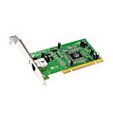
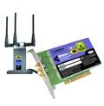

Where is the link layer implemented?
in each and every host
link layer implemented in “adaptor” (aka network interface card NIC) or on a chip
  Ethernet card, 802.11 card; Ethernet chipset
  implements link, physical layer
attaches into host’s system buses
combination of hardware, software, firmware
application
transport
network
link
cpu
memory
link
physical
host
bus
(e.g., PCI)
controller
physical
transmission
network adapter
card

Slide 9
Adaptors communicating
datagram
datagram
controller
controller
sending host
receiving host
datagram
frame
sending side:
  encapsulates datagram in frame
  adds error checking bits, rdt, flow control, etc.
receiving side
  looks for errors, rdt, flow control, etc.
  extracts datagram, passes to upper layer at receiving side

Slide 10



Links
two types of “links”:
point-to-point
  Internet backbone
  ADSL
broadcast (shared “medium”)
  Ethernet (wired)
  802.11 “wireless LAN”
shared wire (e.g.,
cabled Ethernet)
shared RF
(e.g., 802.11 WiFi)
shared RF
(satellite)

Slide 11
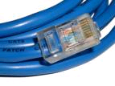

Physical media: wired
twisted “pair” (TP)
two (or more) insulated copper wires
  Category 5: 100 Mbps, 1 Gbps Ethernet
  Category 6: 10Gbps
coaxial cable:
two concentric copper conductors
broadband:
  Used to send multiple channels on cable TV

Slide 12
Digital subscriber line (DSL)
central office
telephone
network
DSL
modem
splitter
DSLAM
ISP
voice, data transmitted
at different frequencies over
dedicated line to central office
DSL access
multiplexer
  use existing telephone line to central office DSL access multiplexer
    data over DSL phone line goes to Internet
    voice over DSL phone line goes to telephone net
  < 2.5 Mbps upstream transmission rate (typically < 1 Mbps)
  < 24 Mbps downstream transmission rate (typically < 10 Mbps)

Slide 13
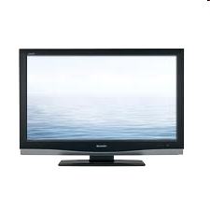


Cable access network
Internet frames, TV channels, control transmitted
downstream at different frequencies
cable headend
…
CMTS
…
splitter
cable
modem
cable modem
termination system
ISP
upstream Internet frames, TV control, transmitted
upstream at different frequencies in time slots
multiple 40Mbps downstream (broadcast) channels
  single CMTS transmits into channels
multiple 30 Mbps upstream channels
  multiple access: all users contend for certain upstream channel time slots (others assigned)

Slide 14

Physical media: Fiber optics
fiber optic cable:
glass fiber carrying light pulses, each pulse a bit
high-speed operation:
  high-speed point-to-point transmission (e.g., 10’s-100’s Gbps transmission rate)
low error rate:
  repeaters spaced far apart
  immune to electromagnetic noise

Slide 15
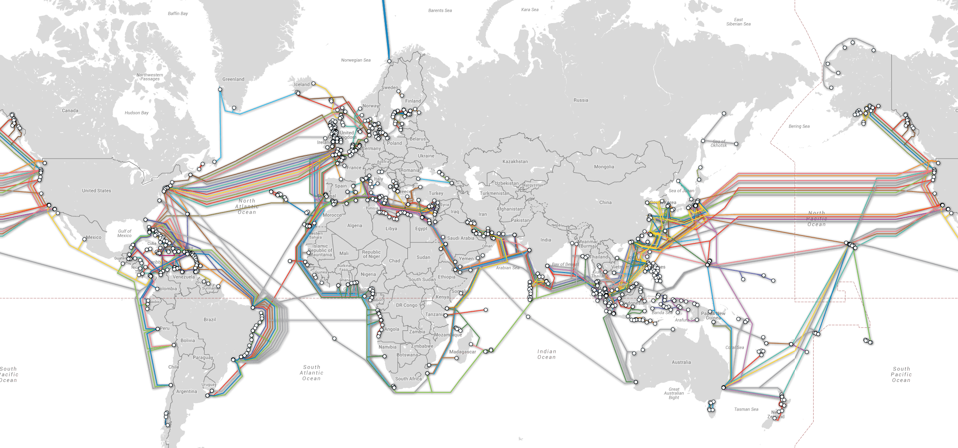
“Submarine” Fiber Optic Cables

Slide 16
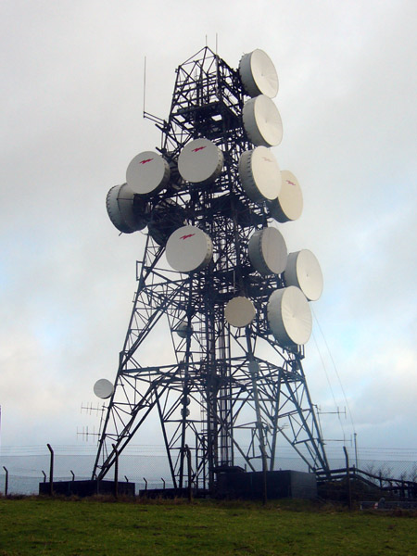

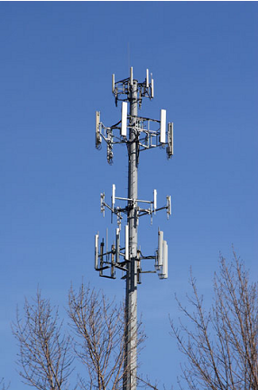
Physical media: radio
signal carried in electromagnetic spectrum
no physical wire
propagation environment effects:
  reflection
  obstruction by objects
  interference
radio link types:
terrestrial microwave
  e.g. up to 45 Mbps channels
LAN (e.g., WiFi)
  54 Mbps
wide-area (e.g., cellular)
  4G cellular: ~ 10 Mbps
satellite
  Up to 45Mbps channels (or multiple smaller channels)
  Two types
    270 msec end-end delay for geosynchronous
    Low-earth orbit

Slide 17
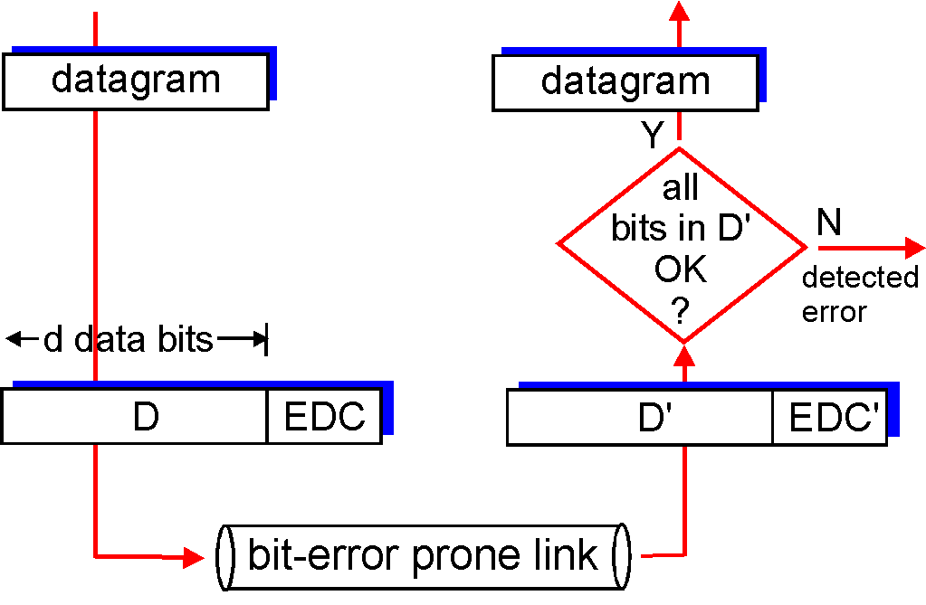
Error detection
EDC= Error Detection and Correction bits (redundancy)
D = Data protected by error checking, may include header fields
Error detection not 100% reliable!
  protocol may miss some errors, but rarely
  larger EDC field yields better detection and correction
otherwise

Slide 18
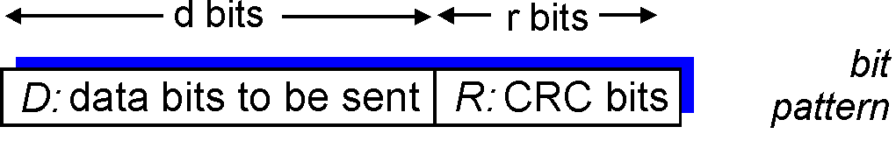
Cyclic redundancy check
more powerful error-detection coding
view data bits, D, as a binary number
choose r+1 bit pattern (generator), G
goal: choose r CRC bits, R, such that
  <D,R> exactly divisible by G (modulo 2)
  receiver knows G, divides <D,R> by G. If non-zero remainder: error detected!
  can detect all burst errors less than r+1 bits
widely used in practice (Ethernet, 802.11 WiFi)

Slide 19
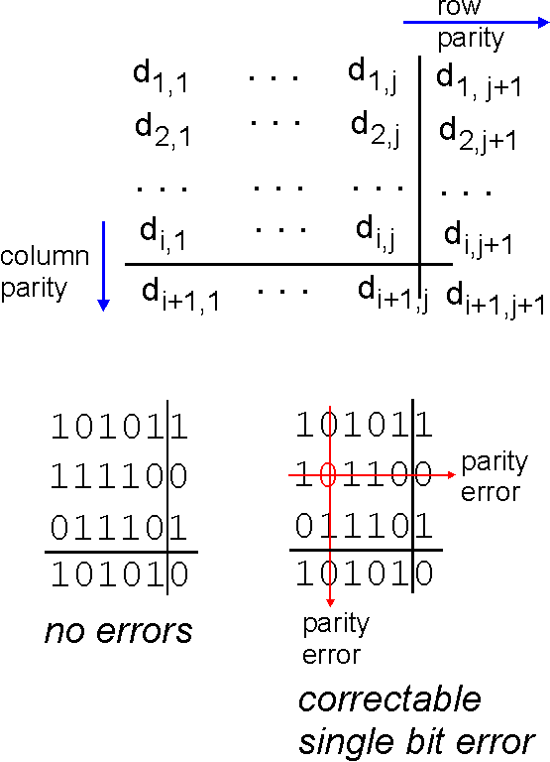
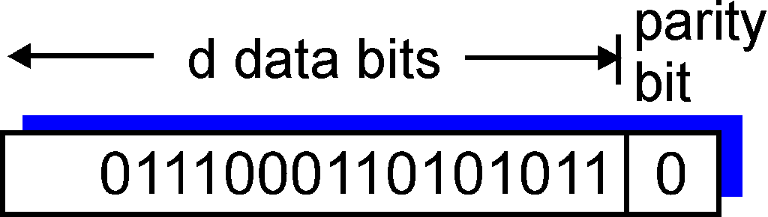
Parity checking
single bit parity:
detect single bit errors
two-dimensional bit parity:
detect and correct single bit errors
0
0
* Check out the online interactive exercises for more examples: http://gaia.cs.umass.edu/kurose_ross/interactive/

Slide 20
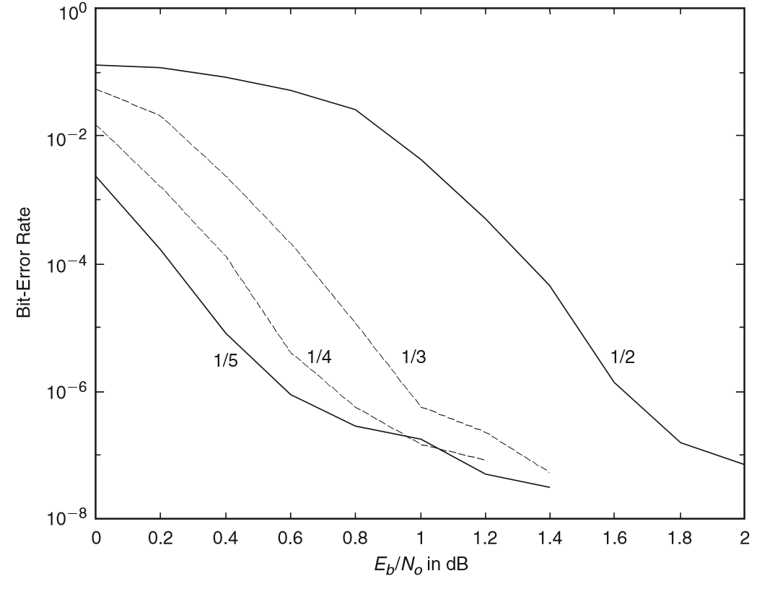
Turbo Codes: Forward Error Correction
Every bit
is wrong
About 25% more
signal than noise
(per bit)
1 bit in 100
is wrong
Fraction of bits
carrying content

Slide 21

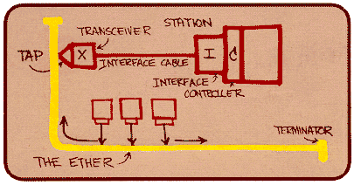
Ethernet
“dominant” wired LAN technology:
single chip, multiple speeds (e.g., Broadcom BCM5761)
first widely used LAN technology
simpler, cheap
kept up with speed race: 10 Mbps – 10 Gbps
Metcalfe’s Ethernet sketch

Slide 22
Multiple access protocols
single shared broadcast channel
two or more simultaneous transmissions by nodes: interference
  collision if node receives two or more signals at the same time
multiple access protocol
distributed algorithm that determines how nodes share channel, i.e., determine when node can transmit
communication about channel sharing must use channel itself!
  no out-of-band channel for coordination

Slide 23
An ideal multiple access protocol
given: broadcast channel of rate R bps
desiderata:
  1. when one node wants to transmit, it can send at rate R.
  2. when M nodes want to transmit, each can send at average rate R/M
  3. fully decentralized:
    no special node to coordinate transmissions
    no synchronization of clocks, slots
  4. simple

Slide 24
Random access protocols
when node has packet to send
  transmit at full channel data rate R.
  no a priori coordination among nodes
two or more transmitting nodes ➜ “collision”,
random access MAC protocol specifies:
  how to detect collisions
  how to recover from collisions (e.g., via delayed retransmissions)
examples of random access MAC protocols:
  slotted ALOHA
  ALOHA
  CSMA, CSMA/CD, CSMA/CA

Slide 25
CSMA (carrier sense multiple access)
CSMA: listen before transmit:
if channel sensed idle: transmit entire frame
if channel sensed busy, defer transmission
human analogy: don’t interrupt others!

Slide 26
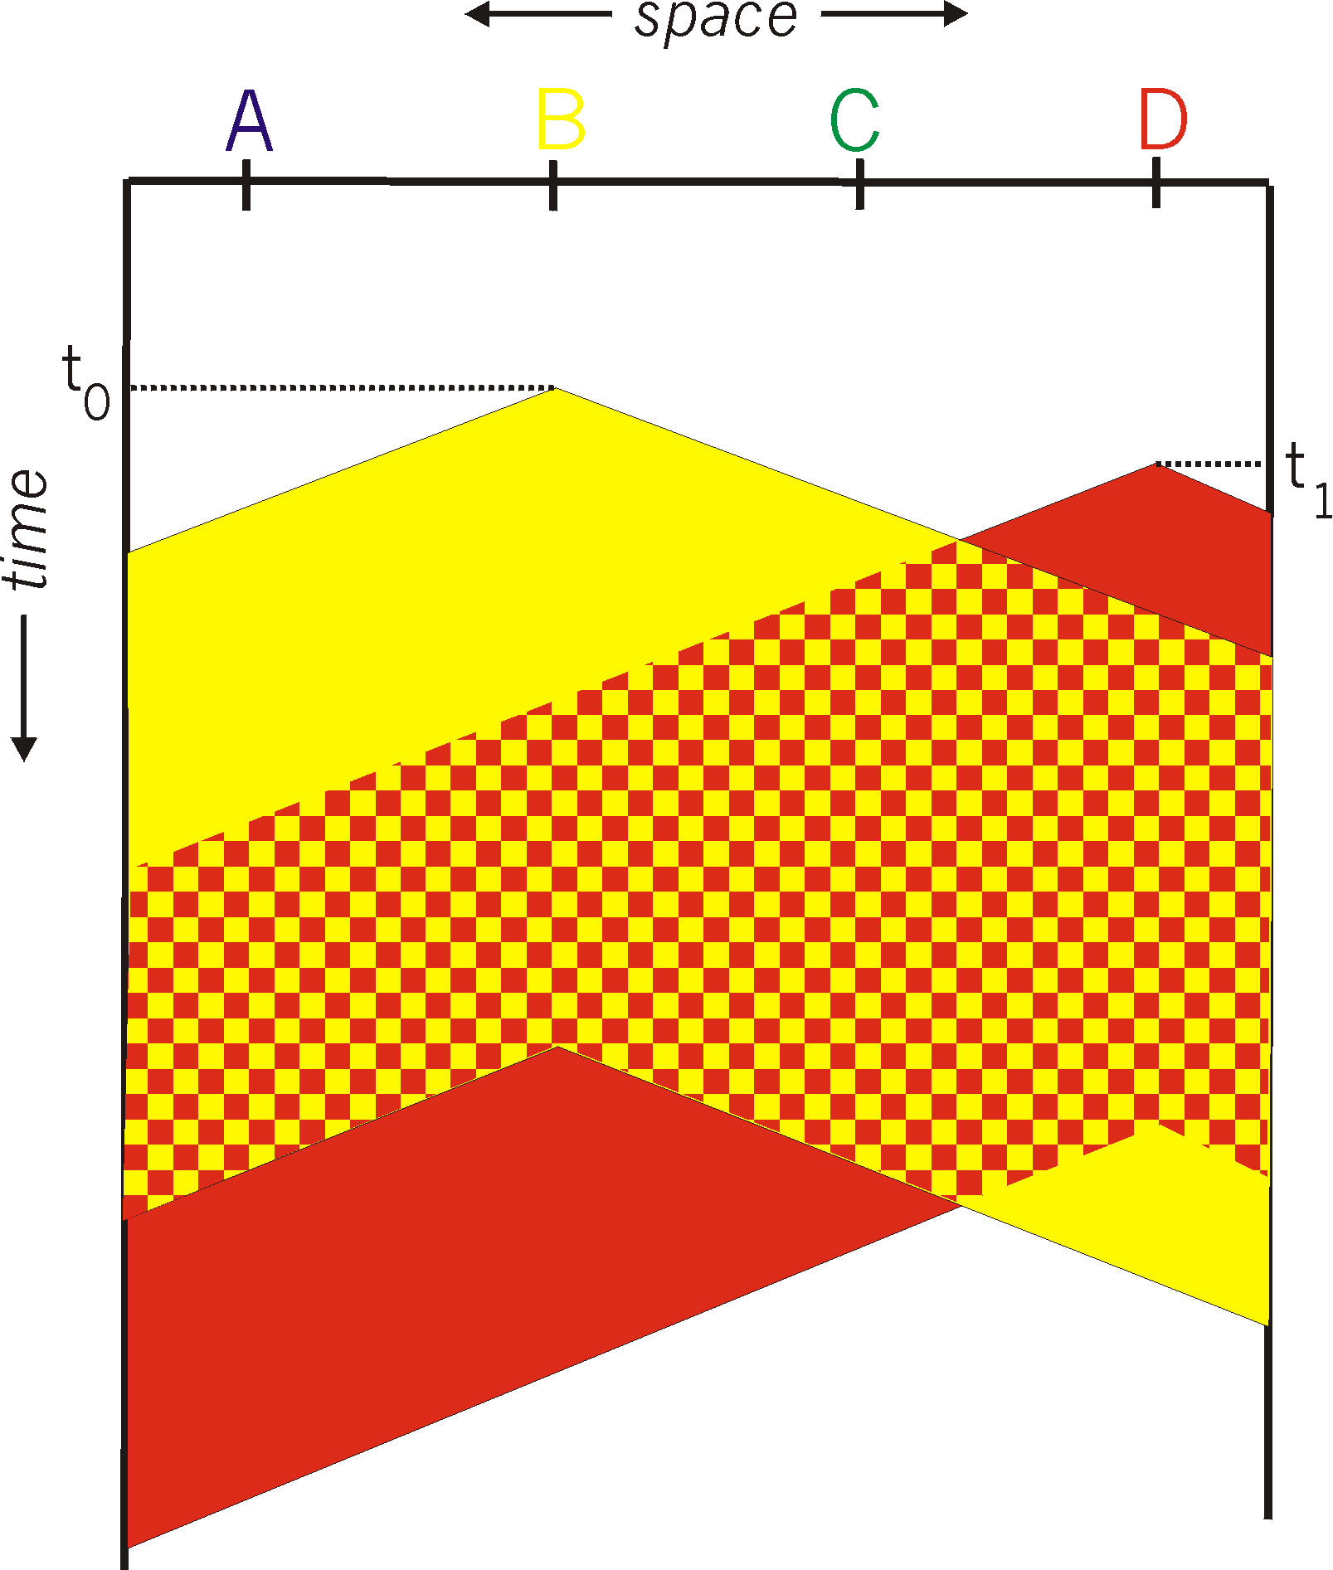
CSMA collisions
spatial layout of nodes
collisions can still occur: propagation delay means two nodes may not hear each other’s transmission
collision: entire packet transmission time wasted
  distance & propagation delay play role in in determining collision probability

Slide 27
CSMA/CD (collision detection)
CSMA/CD: carrier sensing, deferral as in CSMA
  collisions detected within short time
  colliding transmissions aborted, reducing channel wastage
collision detection:
  easy in wired LANs: measure signal strengths, compare transmitted, received signals
  difficult in wireless LANs: received signal strength overwhelmed by local transmission strength
human analogy: the polite conversationalist

Slide 28
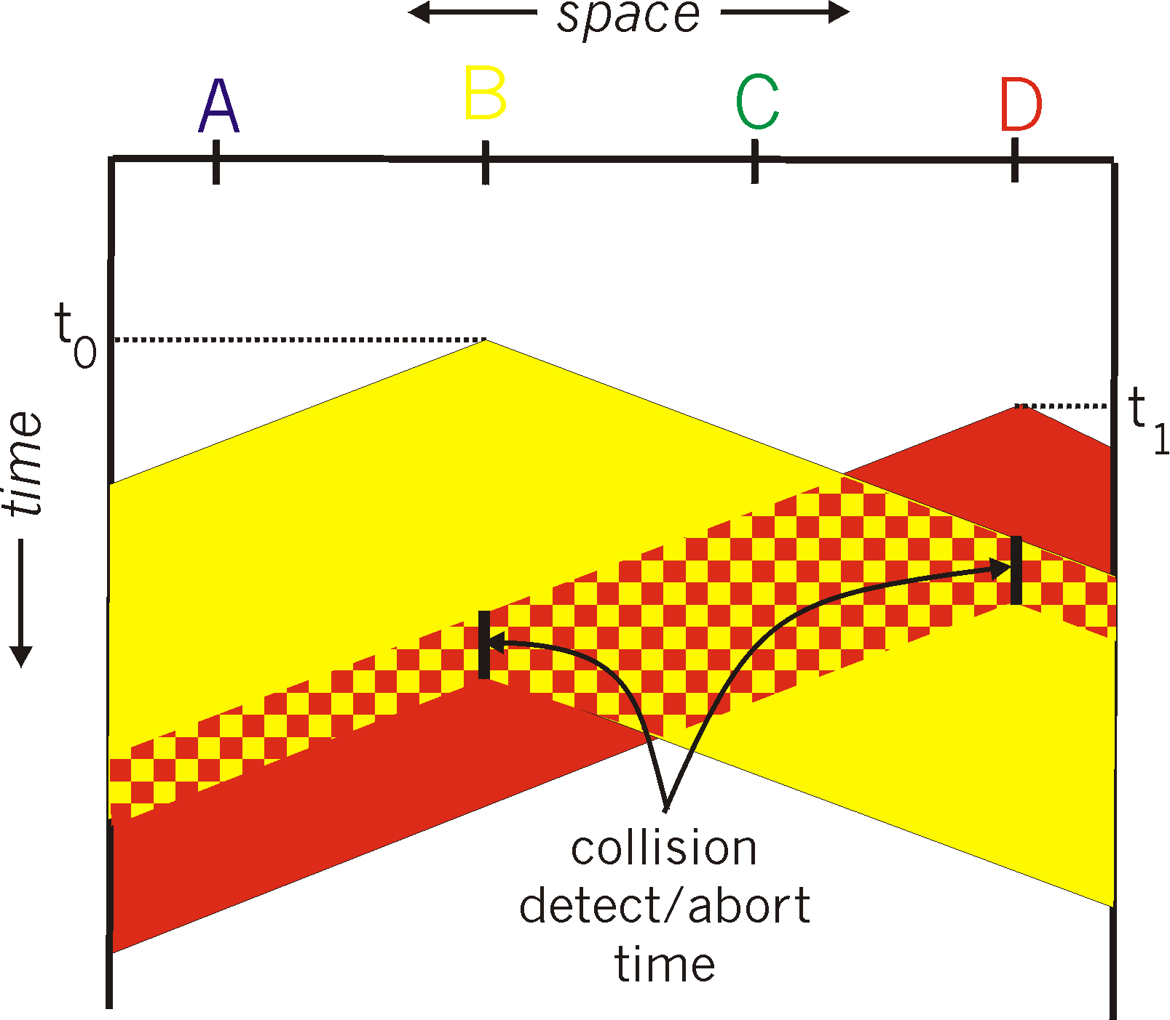
CSMA/CD (collision detection)
spatial layout of nodes

Slide 29
Ethernet CSMA/CD algorithm
1. NIC receives datagram from network layer, creates frame
2. If NIC senses channel idle, starts frame transmission. If NIC senses channel busy, waits until channel idle, then transmits.
3. If NIC transmits entire frame without detecting another transmission, NIC is done with frame !
4. If NIC detects another transmission while transmitting, aborts and sends jam signal
5. After aborting, NIC enters binary (exponential) backoff:
  after mth collision, NIC chooses K at random from {0,1,2, …, 2^{m}-1}. NIC waits K·512 bit times, returns to Step 2
  longer backoff interval with more collisions

Slide 30
CSMA/CD efficiency
T_{prop} = max prop delay between 2 nodes in LAN
t_{trans} = time to transmit max-size frame
efficiency goes to 1
  as t_{prop} goes to 0
  as t_{trans} goes to infinity
this typically works out to about 35%

Slide 31
“Taking turns” MAC protocols
polling:
master node “invites” slave nodes to transmit in turn
typically used with “dumb” slave devices
concerns:
  polling overhead
  latency
  single point of failure (master)
data
poll
master
data
slaves

Slide 32
“Taking turns” MAC protocols
token passing:
control token passed from one node to next sequentially.
token message
concerns:
  token overhead
  latency
  single point of failure (token)
T
(nothing
to send)
T
data

Slide 33


Ethernet: physical topology
bus: popular through mid 90s
  all nodes in same collision domain (can collide with each other)
star: prevails today
  active switch in center
  each “spoke” runs a (separate) Ethernet protocol (nodes do not collide with each other)
switch
star
bus: coaxial cable

Slide 34
Switches vs. routers
application
transport
network
link
physical
both are store-and-forward:
routers: network-layer devices (examine network-layer headers)
switches: link-layer devices (examine link-layer headers)
both have forwarding tables:
routers: compute tables using routing algorithms, IP addresses
switches: learn forwarding table using flooding, learning, MAC addresses
datagram
frame
link
physical
frame
switch
network
link
physical
datagram
frame
application
transport
network
link
physical

Slide 35
H4 Preview

Slide 36
Before You Go
On a sheet of paper, answer the following (ungraded) question (no names, please):
What was the muddiest point in today’s class?

