Slide 1

Routers
Session 12
INST 346
Technologies, Infrastructure and Architecture

Slide 2
Goals for Today
Finish up TCP
  Flow control, timeout selection, close connection
Network layer overview
Structure of a router
Getahead: IPv4 addresses

Slide 3
TCP segment structure
32 bits
source port #
dest port #
counting
by bytes
of data
(not segments!)
sequence number
ACK: ACK #
valid
acknowledgement number
head
len
not
used
U
receive window
A
P
R
S
F
# bytes
rcvr willing
to accept
checksum
Urg data pointer
RST, SYN, FIN:
connection estab
(setup, teardown
commands)
options (variable length)
application
data
(variable length)
Internet
checksum
(as in UDP)

Slide 4

TCP flow control
application
process
application may
remove data from
TCP socket buffers ….
application
TCP socket
receiver buffers
OS
… slower than TCP
receiver is delivering
(sender is sending)
TCP
code
flow control
IP
code
receiver controls sender, so sender won’t overflow receiver’s buffer by transmitting too much, too fast
from sender
receiver protocol stack

Slide 5
TCP round trip time, timeout
Q: how to set TCP timeout value?
longer than RTT
  but RTT varies
too short: premature timeout, unnecessary retransmissions
too long: slow reaction to segment loss
Q: how to estimate RTT?
SampleRTT: measured time from segment transmission until ACK receipt
  ignore retransmissions
SampleRTT will vary, want estimated RTT “smoother”
  average several recent measurements, not just current SampleRTT

Slide 6
TCP round trip time, timeout
EstimatedRTT = (1- α)*EstimatedRTT + α*SampleRTT
exponential weighted moving average
influence of past sample decreases exponentially fast
typical value: α = 0.125
RTT: gaia.cs.umass.edu to fantasia.eurecom.fr
RTT (milliseconds)
sampleRTT
EstimatedRTT
time (seconds)

Slide 7

TCP round trip time, timeout
timeout interval: EstimatedRTT plus “safety margin”
  large variation in EstimatedRTT -> larger safety margin
estimate SampleRTT deviation from EstimatedRTT:
DevRTT = (1-β)*DevRTT +
β*|SampleRTT-EstimatedRTT|
(typically, β = 0.25)
TimeoutInterval = EstimatedRTT + 4*DevRTT
estimated RTT
“safety margin”
* Check out the online interactive exercises for more examples: http://gaia.cs.umass.edu/kurose_ross/interactive/

Slide 8
TCP flow control
receiver “advertises” free buffer space by including rwnd value in TCP header of receiver-to-sender segments
  RcvBuffer size set via socket options (typical default is 4096 bytes)
  many operating systems autoadjust RcvBuffer
sender limits amount of unacked (“in-flight”) data to receiver’s rwnd value
guarantees receive buffer will not overflow
to application process
RcvBuffer
buffered data
rwnd
free buffer space
TCP segment payloads
receiver-side buffering

Slide 9
TCP: closing a connection
client, server each close their side of connection
  send TCP segment with FIN bit = 1
respond to received FIN with ACK
  on receiving FIN, ACK can be combined with own FIN
simultaneous FIN exchanges can be handled

Slide 10
TCP: closing a connection
client state
server state
ESTAB
ESTAB
clientSocket.close()
FIN_WAIT_1
can no longer
send but can
receive data
FINbit=1, seq=x
CLOSE_WAIT
ACKbit=1; ACKnum=x+1
can still
send data
FIN_WAIT_2
wait for server
close
LAST_ACK
FINbit=1, seq=y
TIMED_WAIT
can no longer
send data
ACKbit=1; ACKnum=y+1
timed wait
for 2*max
segment lifetime
CLOSED
CLOSED

Slide 11
















Network layer
transport segment from sending to receiving host
on sending side encapsulates segments into datagrams
on receiving side, delivers segments to transport layer
network layer protocols in every host, router
router examines header fields in all IP datagrams passing through it
application
transport
network
data link
physical
network
data link
physical
network
data link
physical
network
data link
physical
network
data link
physical
network
data link
physical
network
data link
physical
network
data link
physical
network
data link
physical
network
data link
physical
application
transport
network
data link
physical
network
data link
physical
network
data link
physical

Slide 12
Two key network-layer functions
network-layer functions:
forwarding: move packets from router’s input to appropriate router output
routing: determine route taken by packets from source to destination
  routing algorithms
analogy: taking a trip
forwarding: process of getting through single interchange
routing: process of planning trip from source to destination

Slide 13
Network layer: data plane, control plane
Data plane
local, per-router function
determines how datagram arriving on router input port is forwarded to router output port
forwarding function
Control plane
network-wide logic
determines how datagram is routed among routers along end-end path from source host to destination host
two control-plane approaches:
  traditional routing algorithms: implemented in routers
  software-defined networking (SDN): implemented in (remote) servers
values in arriving
packet header
0111
1
3
2

Slide 14
Router architecture overview
high-level view of generic router architecture:
routing, management
control plane (software)
operates in millisecond
time frame
routing
processor
forwarding data plane (hardware) operttes in nanosecond timeframe
high-seed
switching
fabric
router input ports
router output ports

Slide 15
IP addressing: introduction
223.1.1.1
IP address: 32-bit identifier for host, router interface
interface: connection between host/router and physical link
  router’s typically have multiple interfaces
  host typically has one or two interfaces (e.g., wired Ethernet, wireless 802.11)
IP addresses associated with each interface
223.1.2.1
223.1.1.2
223.1.1.4
223.1.2.9
223.1.1.3
223.1.3.27
223.1.2.2
223.1.3.1
223.1.3.2
223.1.1.1 = 11011111 00000001 00000001 00000001
223
1
1
1

Slide 16
Subnets
IP address:
  subnet part - high order bits
  host part - low order bits
what’s a subnet ?
  device interfaces with same subnet part of IP address
  can physically reach each other without intervening router
223.1.1.1
223.1.1.2
223.1.2.1
223.1.1.4
223.1.2.9
223.1.2.2
223.1.1.3
223.1.3.27
subnet
223.1.3.1
223.1.3.2
network consisting of 3 subnets

Slide 17
IP addressing: CIDR
CIDR: Classless InterDomain Routing
  subnet portion of address of arbitrary length
  address format: a.b.c.d/x, where x is # bits in subnet portion of address
subnet
part
host
part
11001000 00010111 00010000 00000000
200.23.16.0/23

Slide 18
IP addresses: how to get one?
Q: how does network get subnet part of IP addr?
A: gets allocated portion of its provider ISP’s address space
ISP's block 11001000 00010111 00010000 00000000 200.23.16.0/20
Organization 0 11001000 00010111 00010000 00000000 200.23.16.0/23
Organization 1 11001000 00010111 00010010 00000000 200.23.18.0/23
Organization 2 11001000 00010111 00010100 00000000 200.23.20.0/23
... ….. …. ….
Organization 7 11001000 00010111 00011110 00000000 200.23.30.0/23

Slide 19
IP addressing: the last word...
Q: how does an ISP get block of addresses?
A: ICANN: Internet Corporation for Assigned
Names and Numbers http://www.icann.org/
  allocates addresses
  manages DNS
  assigns domain names, resolves disputes

Slide 20
Hierarchical addressing: route aggregation
hierarchical addressing allows efficient advertisement of routing
information:
Organization 0
200.23.16.0/23
Organization 1
200.23.18.0/23
“Send me anything
with addresses
beginning
200.23.16.0/20”
Organization 2
200.23.20.0/23
.
Fly-By-Night-ISP
.
.
.
.
Internet
Organization 7
.
200.23.30.0/23
ISPs-R-Us
“Send me anything
with addresses
beginning
199.31.0.0/16”

Slide 21
IP datagram format
IP protocol version
number
32 bits
total datagram
length (bytes)
header length
(bytes)
head.
len
type of
service
ver
length
for
fragmentation/
reassembly
“type” of data
flgs
fragment
offset
16-bit identifier
max number
remaining hops
(decremented at
each router)
time to
live
upper
layer
header
checksum
32 bit source IP address
upper layer protocol
to deliver payload to
32 bit destination IP address
options (if any)
e.g. timestamp,
record route
taken, specify
list of routers
to visit.
data
(variable length,
typically a TCP
or UDP segment)
how much overhead?
20 bytes of TCP
20 bytes of IP
= 40 bytes + app layer overhead

Slide 22
Input port functions
lookup,
forwarding
queueing
line
termination
link
layer
protocol
(receive)
switch
fabric
physical layer:
bit-level reception
data link layer:
e.g., Ethernet
decentralized switching:
using header field values, lookup output port using forwarding table in input port memory
goal: complete input port processing at ‘line speed’
queuing: if datagrams arrive faster than forwarding rate into switch fabric

Slide 23
Destination-based forwarding
forwarding table
Destination Address Range
11001000 00010111 00010000 00000000
through
11001000 00010111 00010111 11111111
11001000 00010111 00011000 00000000
through
11001000 00010111 00011000 11111111
11001000 00010111 00011001 00000000
through
11001000 00010111 00011111 11111111
otherwise
Link Interface
0
1
2
3
Q: but what happens if ranges don’t divide up so nicely?

Slide 24
Longest prefix matching
longest prefix matching
when looking for forwarding table entry for given destination address, use longest address prefix that matches destination address.
Destination Address Range
11001000 00010111 00010*** *********
11001000 00010111 00011000 *********
11001000 00010111 00011*** *********
otherwise
Link interface
0
1
2
3
examples:
DA: 11001000 00010111 00010110 10100001
which interface?
DA: 11001000 00010111 00011000 10101010
which interface?

Slide 25
Longest prefix matching
longest prefix matching: often performed using ternary content addressable memories (TCAMs)
  content addressable: present address to TCAM: retrieve address in one clock cycle, regardless of table size
  Cisco Catalyst: can up ~1M routing table entries in TCAM

Slide 26
Switching fabrics
transfer packet from input buffer to appropriate output buffer
switching rate: rate at which packets can be transfer from inputs to outputs
  often measured as multiple of input/output line rate
  N inputs: switching rate N times line rate desirable
three types of switching fabrics
memory
memory
bus
crossbar

Slide 27
Switching via a bus
datagram from input port memory
to output port memory via a shared bus
bus contention: switching speed limited by bus bandwidth
32 Gbps bus, Cisco 5600: sufficient speed for access and enterprise routers
bus

Slide 28
Input port queuing
fabric slower than input ports combined -> queueing may occur at input queues
  queueing delay and loss due to input buffer overflow!
Head-of-the-Line (HOL) blocking: queued datagram at front of queue prevents others in queue from moving forward
switch
fabric
switch
fabric
output port contention:
only one red datagram can be transferred.
lower red packet is blocked
one packet time later: green packet experiences HOL blocking

Slide 29
Output ports
This slide in HUGELY important!
datagram
buffer
queueing
switch
fabric
link
layer
protocol
(send)
line
termination
buffering required when datagrams arrive from fabric faster than the transmission rate
scheduling discipline chooses among queued datagrams for transmission
Datagram (packets) can be lost due to congestion, lack of buffers
Priority scheduling – who gets best performance, network neutrality

Slide 30
Output port queueing
switch
fabric
switch
fabric
at t, packets more
from input to output
one packet time later
buffering when arrival rate via switch exceeds output line speed
queueing (delay) and loss due to output port buffer overflow!

Slide 31
How much buffering?
RFC 3439 rule of thumb: average buffering equal to “typical” RTT (say 250 msec) times link capacity C
  e.g., C = 10 Gpbs link: 2.5 Gbit buffer
recent recommendation: with N flows, buffering equal to
.
RTT C
N

Slide 32
Scheduling policies
scheduling: choose next packet to send on link
FIFO (first in first out) scheduling: send in order of arrival to queue
  real-world example?
  discard policy: if packet arrives to full queue: who to discard?
    tail drop: drop arriving packet
    priority: drop/remove on priority basis
    random: drop/remove randomly
packet
arrivals
packet
departures
queue
(waiting area)
link
(server)

Slide 33
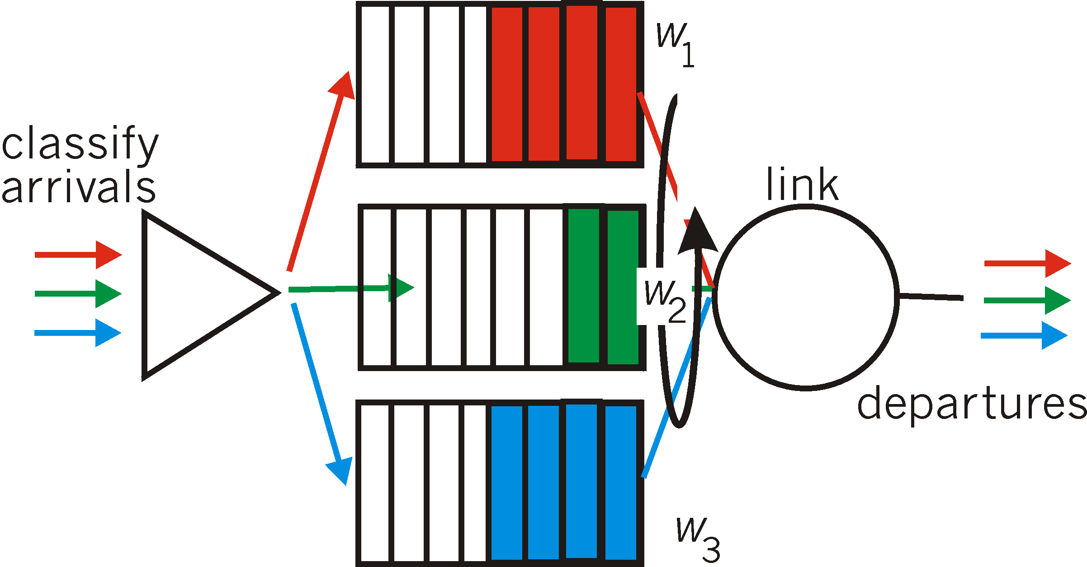
Scheduling policies
Weighted Fair Queuing (WFQ):
generalized Round Robin
each class gets weighted amount of service in each cycle

Slide 34
Before You Go
On a sheet of paper, answer the following (ungraded) question (no names, please):
What one or two possible improvements to the way the class is being taught would make the most difference?

