Slide 1

Networks
Session 1
INST 346
Technologies, Infrastructure and Architecture

Slide 2
Goals for Today
Understand what a network is
Learn about the design of the Internet
Get an overview of the course

Slide 3
Student
Student ID
First name
Last name
Department
E-mail
…
Enrollment
Student
Course
Grade
…
has
has
associated with
Course
Course ID
Course Name
…
Department
Department ID
Department Name
…

Slide 4
Some Other Networks
Genealogy
Post office
Telephone
The Web
Bacon numbers

Slide 5
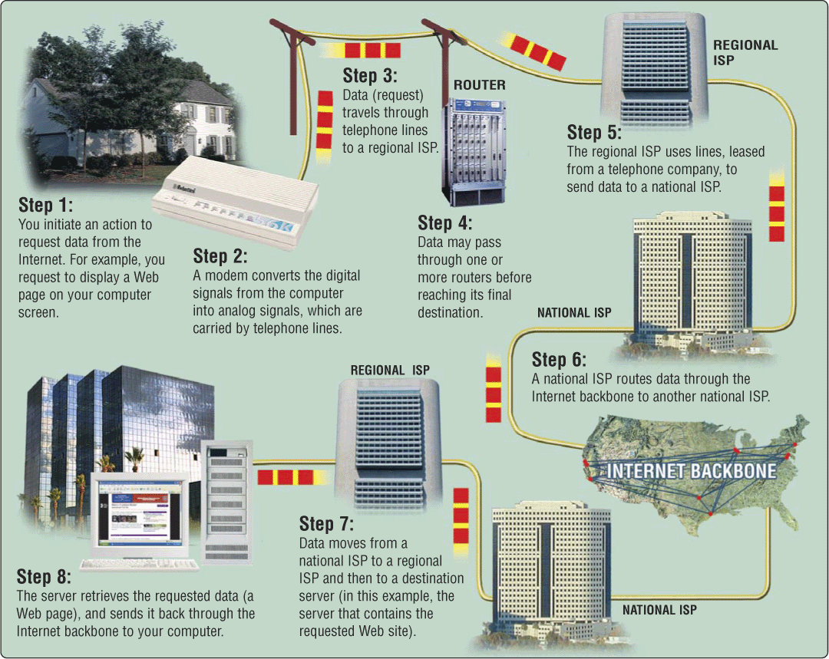
The Internet

Slide 6
The Internet
Global collection of public “IP” networks
  Private IP networks are often called “intranets”
Independent
  Each organization maintains its own network
Cooperating (e.g., ICANN)
  Internet Protocol (IP) address blocks
  Domain names

Slide 7
A Short History of the Internet
1969: Origins in government research
  Advanced Research Projects Agency (ARPAnet)
  Key standards: UDP, TCP, DNS
1983: Design adopted by other agencies
  Created a need for inter-network connections
  Key standards: IP
Notes:
Moore’s law make shift from large time sharing computer facilities to individual, small but powerful computer systems, and

Slide 8
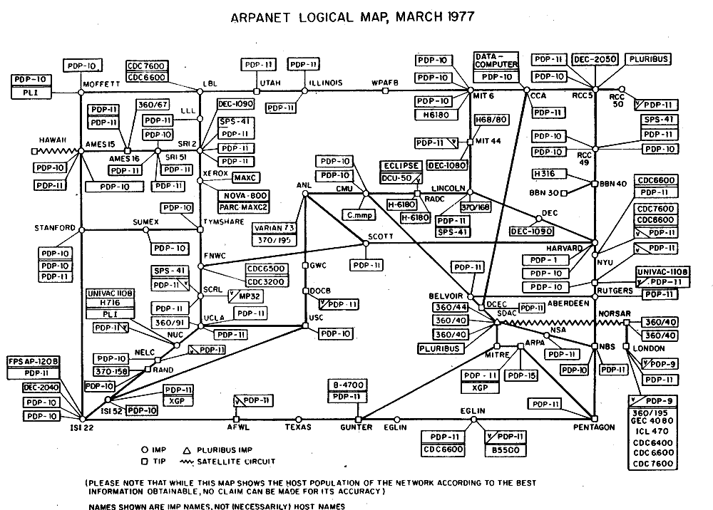

Slide 9
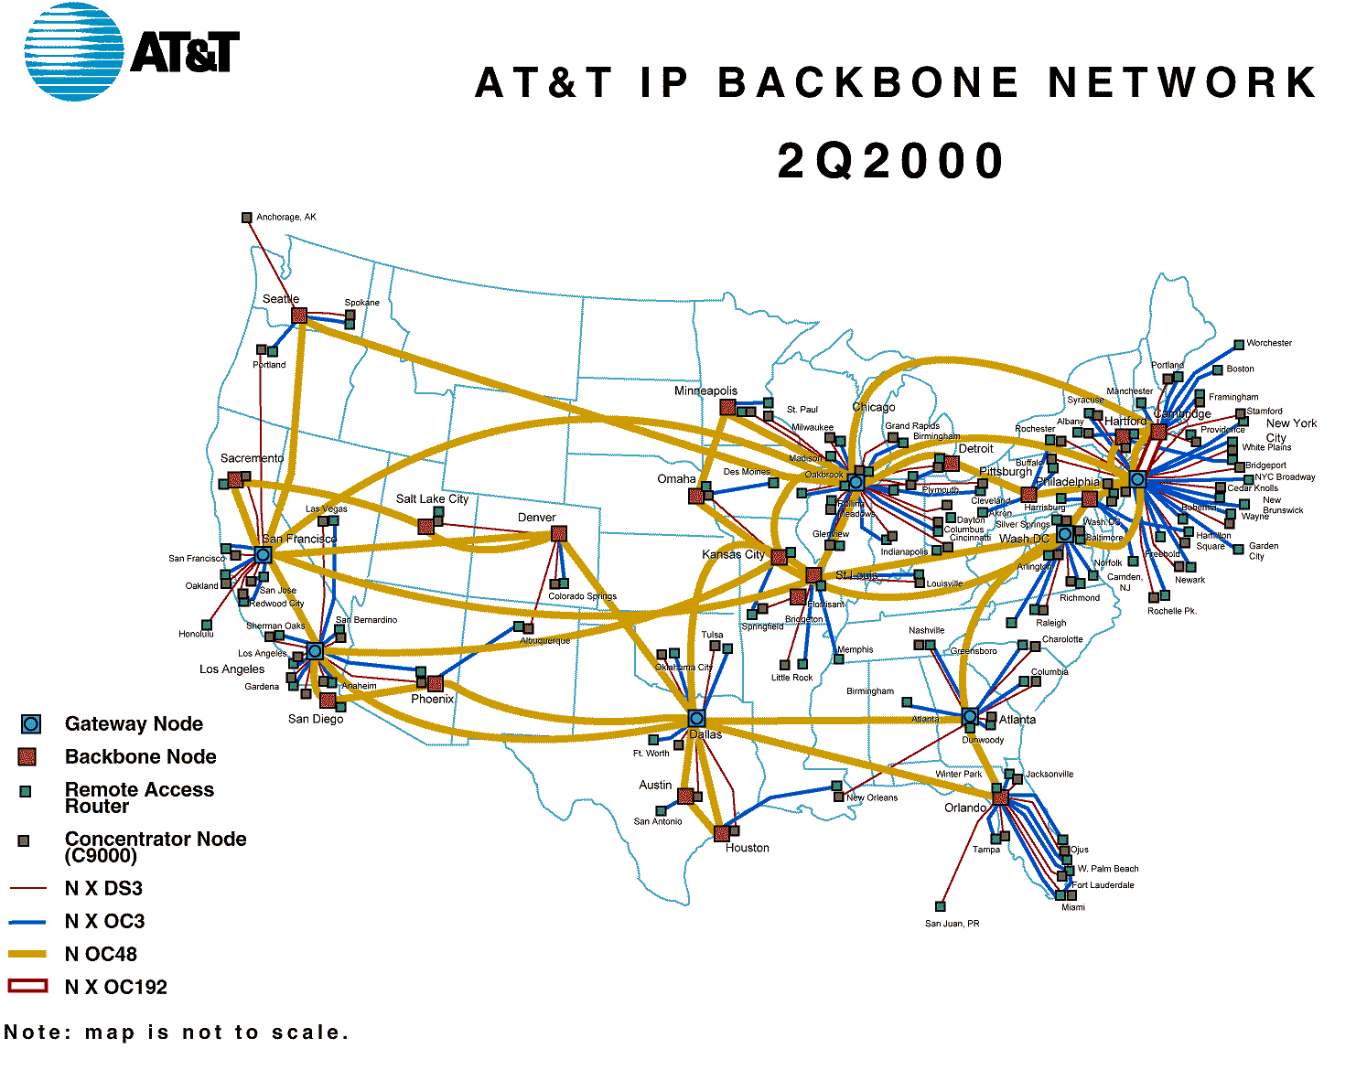
http://www.geog.ucl.ac.uk/casa/martin/atlas/isp_maps.html

Slide 10
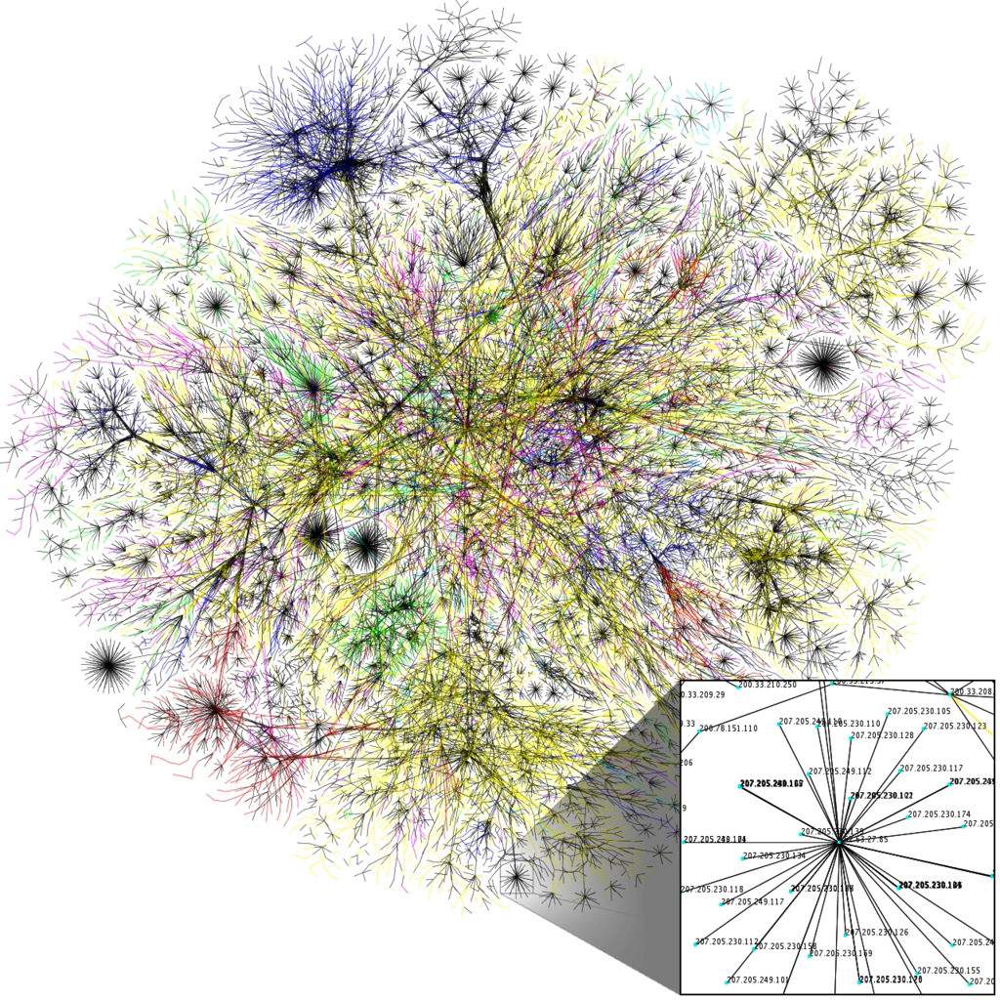
The Internet
Image from the Opte Project

Slide 11
Types of Internet “Nodes”
Hosts
  Computers that use the network to do something
Routers
  Specialized computers that route packets
Gateway
  Routers that connect two networks
Firewall
  Gateways that pass packets selectively

Slide 12
Types of Digital Links
“Backbone”
  Microwave
  Satellite
  Fiber
“Last mile” wired
  Telephone modem
  Cable modem
  Fiber
“Last mile” wireless
  Wi-Fi (IEEE 802.11)
  Mobile data (GSM, 4G)

Slide 13
Layered Internmet Architecture
Application
Application
Virtual network service
Transport
Transport
Virtual link for end to end packets
Network
Network
Network
Network
Virtual link for packets
Link
Link
Link
Link
Link
Link
Link for bits
Link for bits
Link for bits

Slide 14
Layering of airline functionality
ticket (purchase)
baggage (check)
gates (load)
runway (takeoff)
airplane routing
ticket (complain)
baggage (claim
gates (unload)
runway (land)
airplane routing
ticket
baggage
gate
takeoff/landing
airplane routing
airplane routing
airplane routing
departure
airport
intermediate air-traffic
control centers
arrival
airport
layers: each layer implements a service
  via its own internal-layer actions
  relying on services provided by layer below

Slide 15
An Internet Protocol (IP) Address
Identifies a LAN
IP address: 216.183.103.150
Identifies a specific computer

Slide 16
Hands-on:
Learn About Your IP Address
Find your IP address
  Windows: “cmd” in the search box, then ipconfig /all
  Mac: open a Terminal, then ifconfig
See who “owns” that address
  Use http://remote.12dt.com/
See where in the world it (probably) is
  http://www.geobytes.com/ipLocator.htm

Slide 17
Thinking About Speed
Two parts of moving data from here to there:
  Getting the first bit there (latency)
  Getting everything there (throughput)
Latency: Amount of time it takes data to travel from source to destination
Throughput: Amount of data that can be sent in some amount of time (e.g., 1 second)

Slide 18

Modules
Overview
Application
Transport
Network
Link/Physical
TCP/IP "Stack"
Exam 1
Network Security
Exam 2
Social Issues
Scenarios
Final Exam

Slide 19
Required Background
Algebra
Statistics
Programming
Database design

Slide 20
Keys to Success
Don’t get behind
  20 pages or so of reading for every class
Use class to deepen your understanding
  You’re here to discuss it, not to listen to it!
Use homeworks and labs to gain mastery
  Work together, share ideas online
  Final submission must be written by you!
Proactively use office hours
  We can’t help if you don’t ask!

Slide 21
Grading
No curve, no extra credit.
  90 for A-, 93 for A, etc.
No single-point failures
  50%: Best 2 of 3 exams (individual work)
  10%: Best 8 of 10 quizzes (individual work)
  20%: Best 4 of 5 homeworks (work together)
  20%: Best 4 of 5 labs (work together)
Attendance is not separately graded
  But it is strongly correlated with success

Slide 22
Pair Up
Turn to the person next to you and discuss:
What do you most want to learn in this course?

