Slide 1
Enterprise Information Systems
Session 9
INST 301
Introduction to Information Science

Slide 2
Organizing Effort
The Market
The Firm
The Network

Slide 3
Organizations: The Classic View

Slide 4
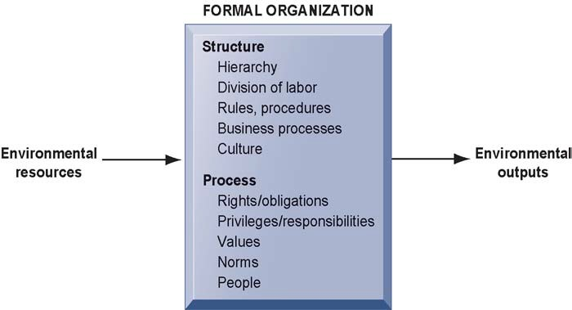
Organizations: The Real Story

Slide 5
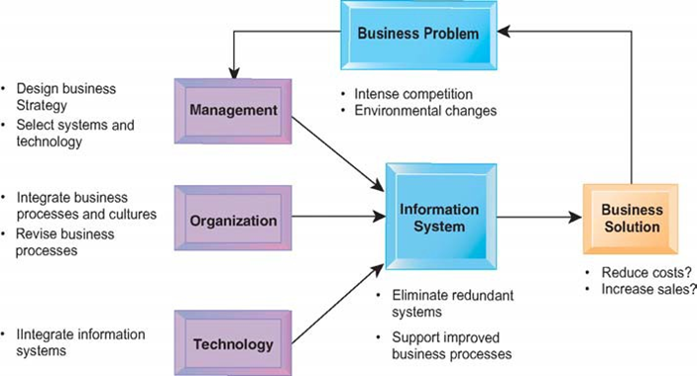
The CIO’s View

Slide 6
Some Issues
Strategic vs. supporting IT
Netflix vs. ELMS
Sociotechnical systems
Proctor & Gamble
Life-cycle systems analysis

Slide 7
“Information”
Wisdom
Knowledge
Information
Data

Slide 8
Information
Data
Knowledge
(individual)
(organization)
(society)
Information
Enterprise Sys
Lifecycle
Internet
Data as Asset
Collaboration
Web
Data Modeling
Institutions
Search Engines
Databases (2)
Professions
User Needs
Databases
Digital Gov
Search Strategy
CMS
Security
Social Networks
Linked Data
Privacy
Data Mining
Filter Bubble
Ethics

Slide 9
Some Examples
University of Maryland
American Airlines
Walmart

Slide 10
Midterm Exam 1 on March 1
70 minutes, 100 points
15 points = 10 minutes!
Only covers sessions 1-8 (and 1 was snow!)
Including readings, homework, class sessions
Practice Exam is available now
Quizzes are also useful cues

Slide 11
Before You Go
On a sheet of paper, answer the following (ungraded) question (no names, please):
What was the muddiest point in today’s class?

