Slide 1

Social Networks
Session 8
INST 301
Introduction to Information Science

Slide 2
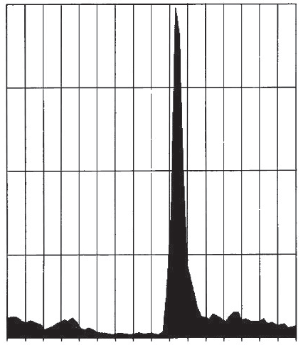
Deaths per Week, United States Army
8,000
6,000
4,000
2,000
Jan Feb Mar Apr May Jun Jul Aug Sept Oct Nov Dec Jan Feb Mar Apr
1918 1919

Slide 3



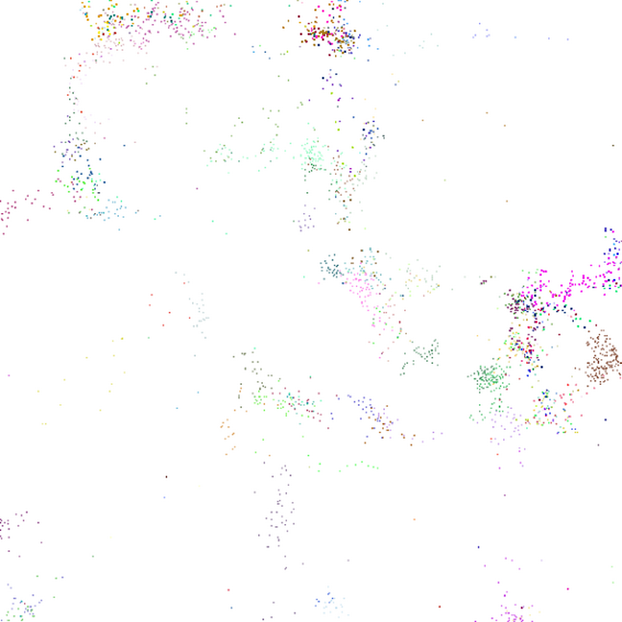

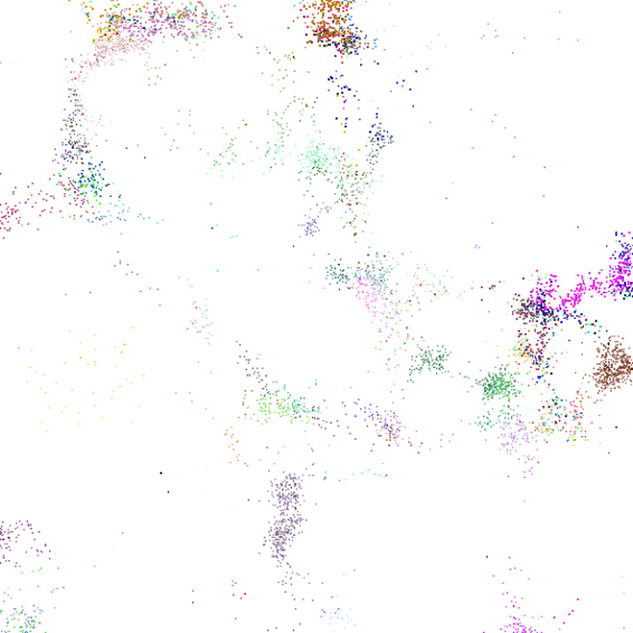





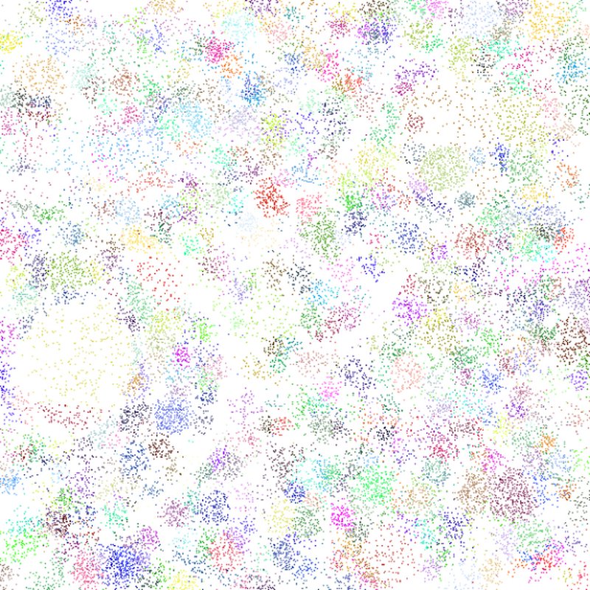
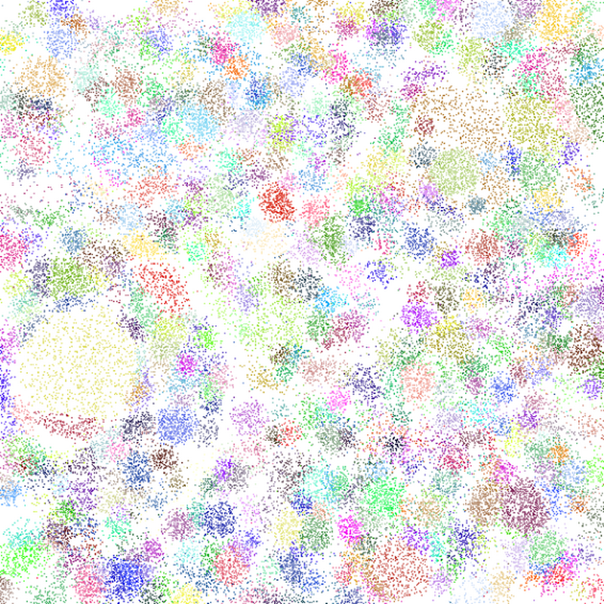
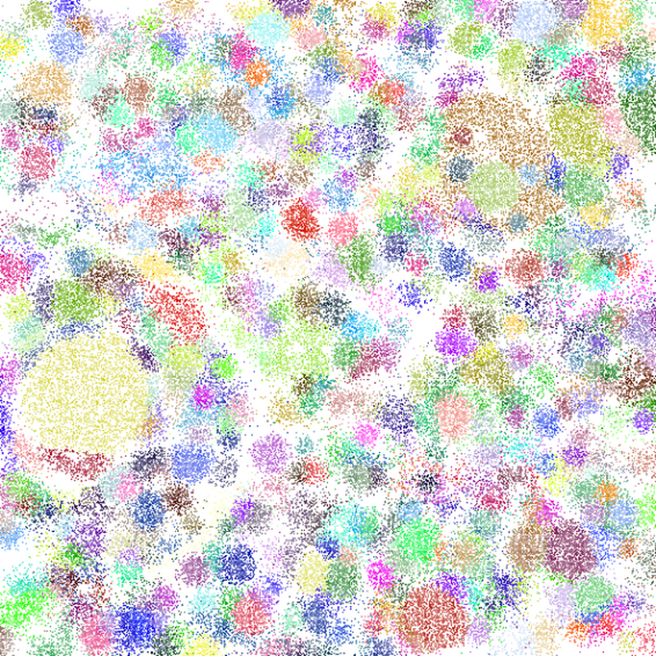
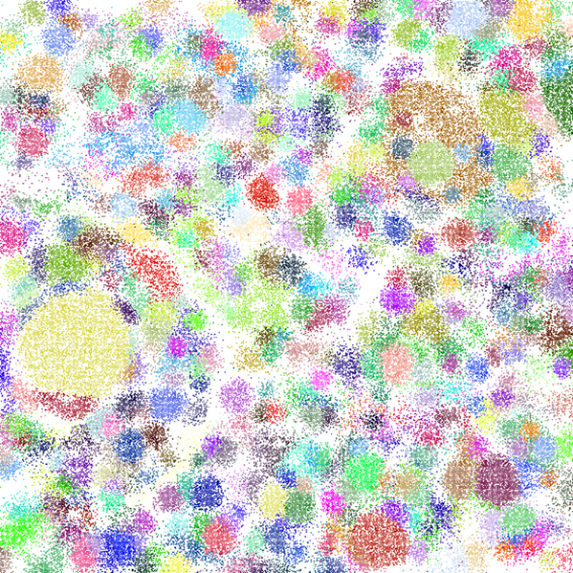
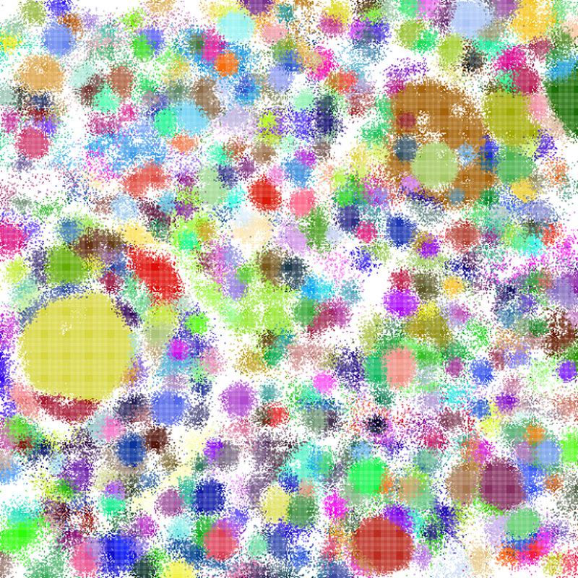
500 randomly chosen users
500 most active users
Day 1
Day 2
Day 3
Day 4
Day 5
Day 6
Day 7
Day 8
Day 1
Day 2
Day 3
Day 4
Day 5
Day 6
Day 7
Day 8
Credit: Jen Golbeck
Notes:
These animated images show the spread of information that starts with either 500 randomly chosen people or the 500 most active people in an internet community. It powerfully shows the way information (or diseases) can spread through networks differently depending on who it starts with.

Slide 4
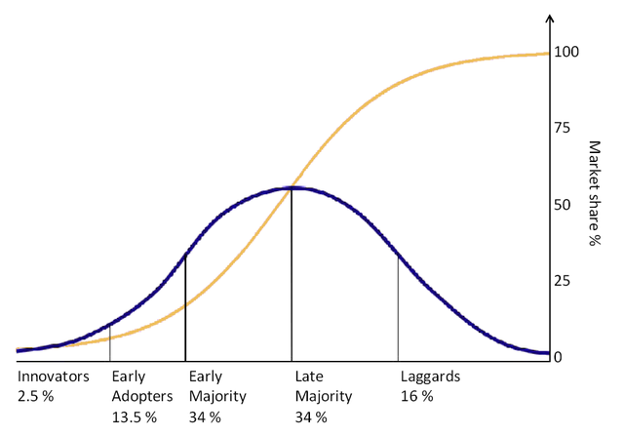
Adoption Curve

Slide 5
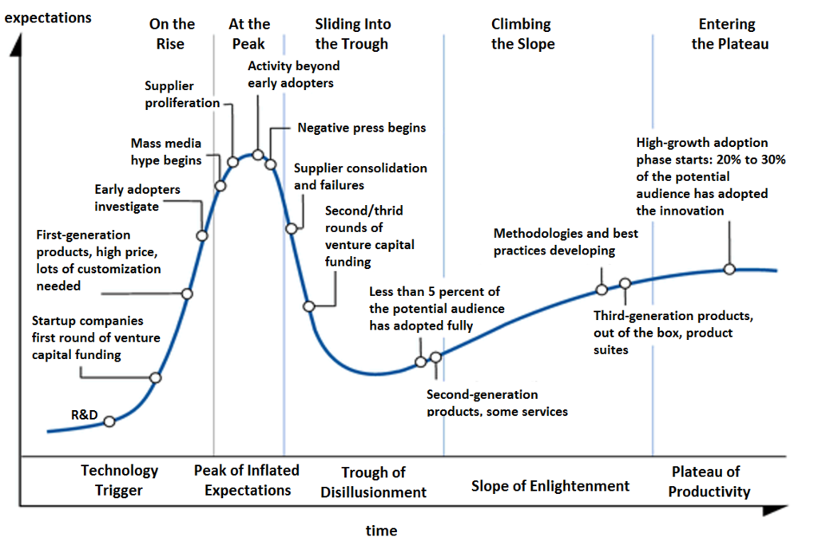
Hype Cycle

Slide 6
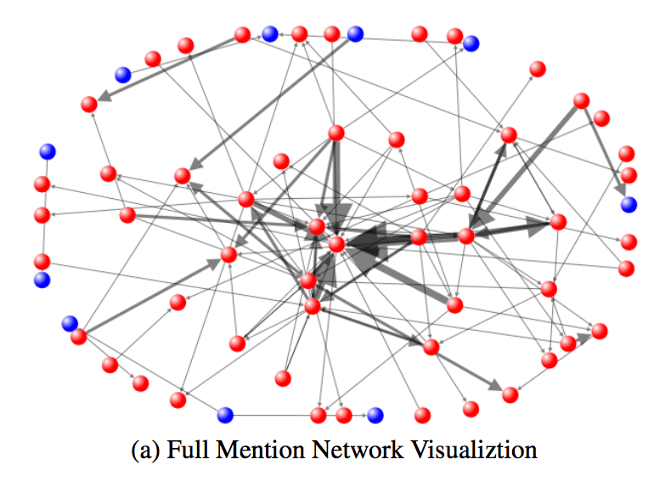
Credit: Jen Golbeck

Slide 7
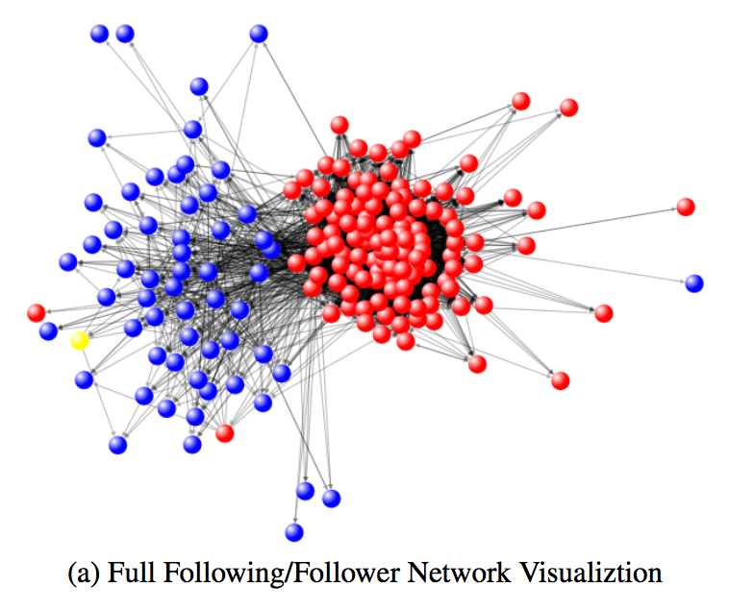
Credit: Jen Golbeck

Slide 8
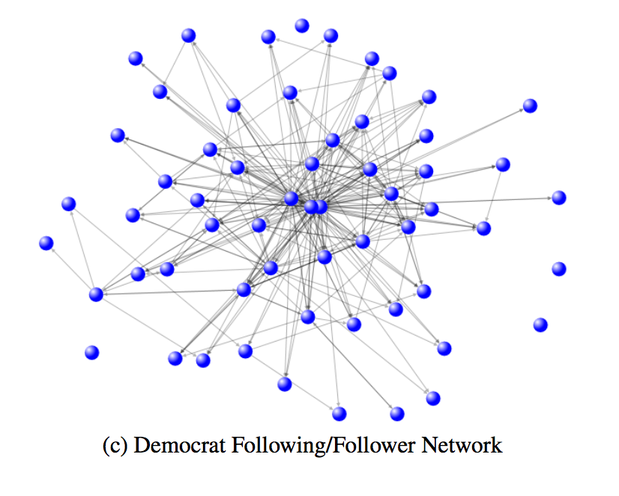
Credit: Jen Golbeck

Slide 9
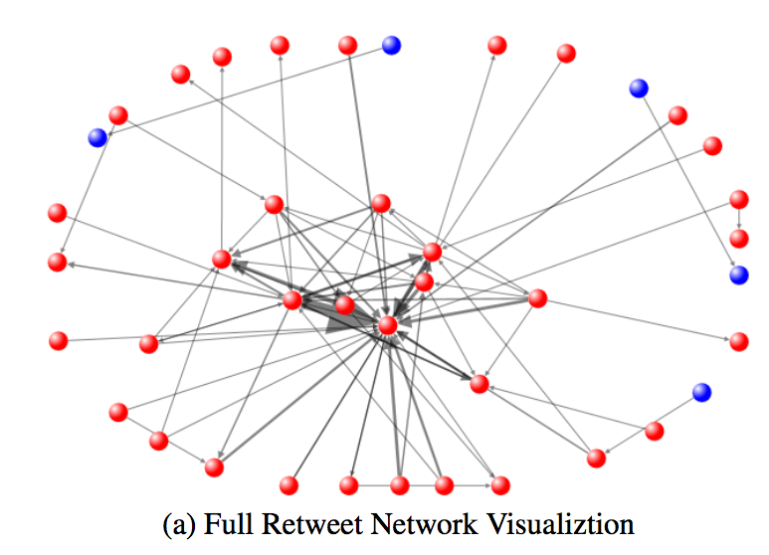
Credit: Jen Golbeck

Slide 10
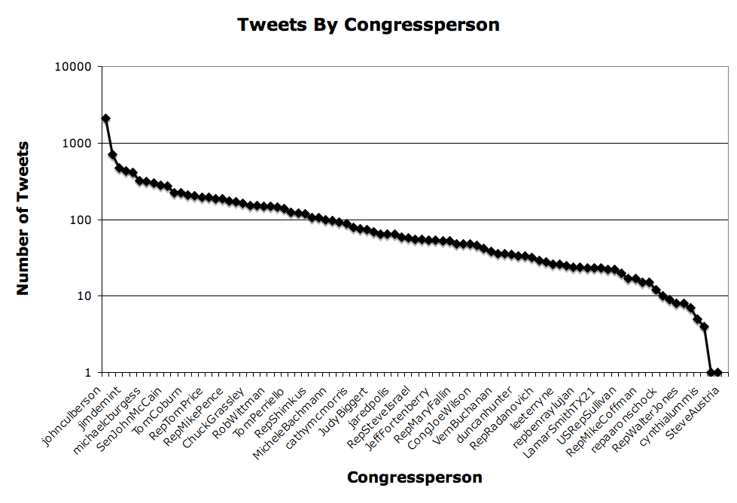
Credit: Jen Golbeck

Slide 11
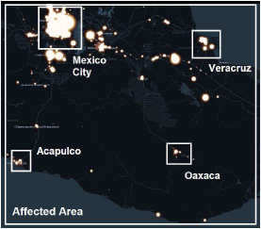
Oaxaca Earthquake
Credit: Vanessa Frias-Martinez

Slide 12
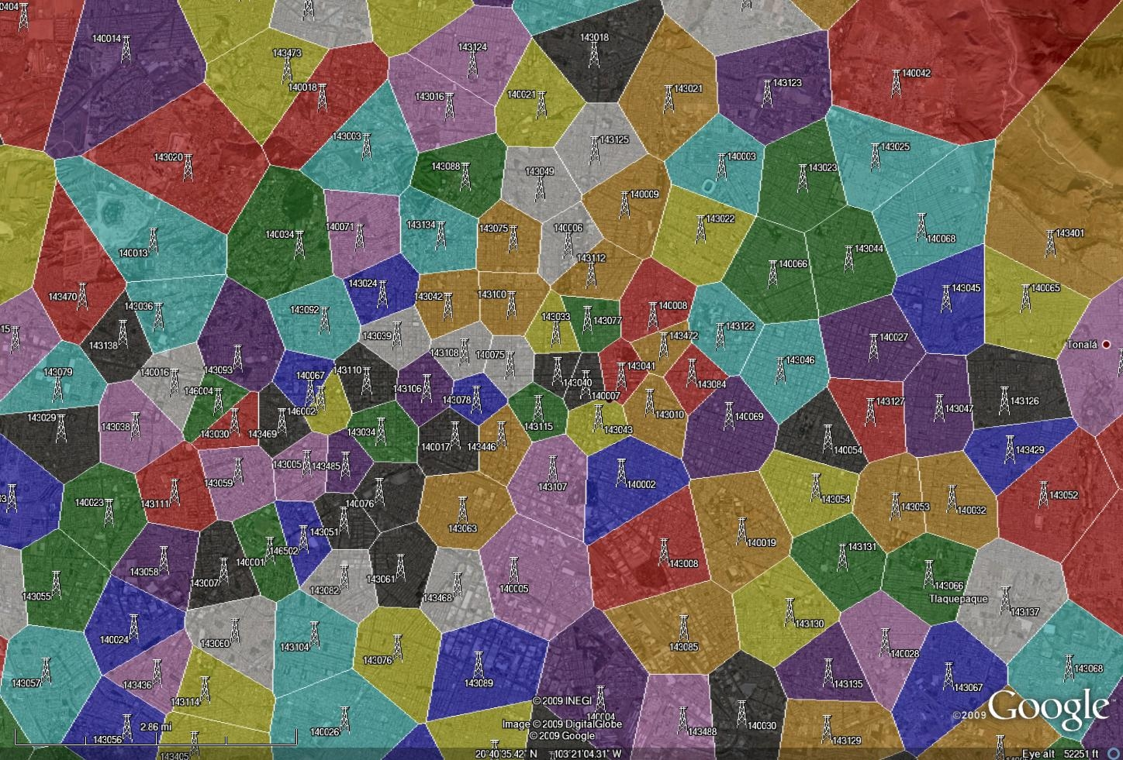
Call Detail Records
Credit: Vanessa Frias-Martinez

Slide 13
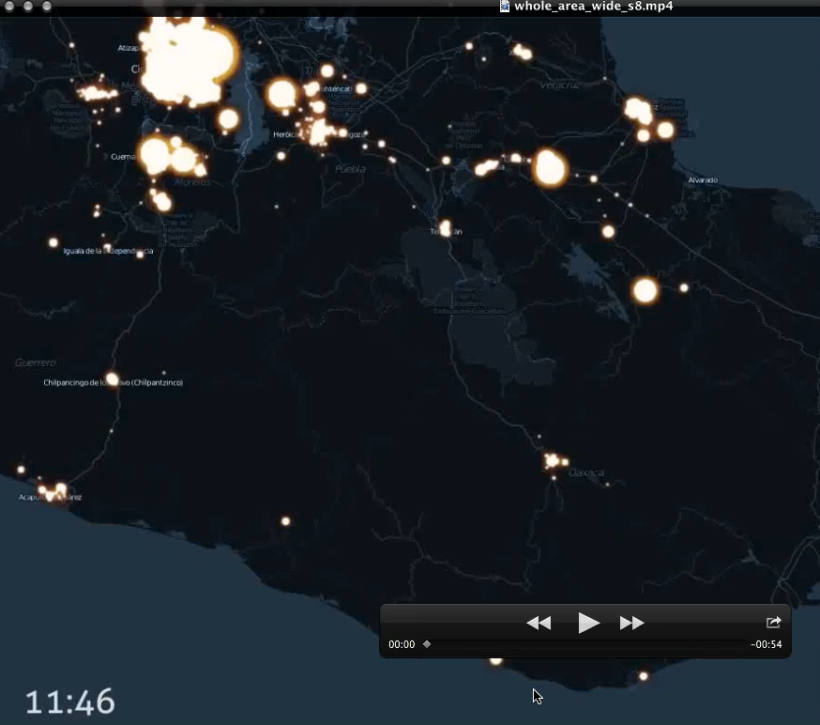
Video
Credit: Vanessa Frias-Martinez

Slide 14
Call Volumes
Compute time series of call volumes
  1-minute resolution
  compare to baseline (normalized difference)
Mexico City
Oaxaca
Credit: Vanessa Frias-Martinez

Slide 15
Social Activity
Mexico City
Credit: Vanessa Frias-Martinez

Slide 16
Call Duration
3pm
Mexico City
Credit: Vanessa Frias-Martinez

Slide 17
Mobility Behavior
Credit: Vanessa Frias-Martinez

Slide 18
Summary
Larger call volumes right after earthquake
Shorter call durations (“check call”)
Longer calls at the end of the day
Highly connected users contact larger number of peers
Larger mobility patterns during earthquake
Credit: Vanessa Frias-Martinez

Slide 19
H1N1 Mexico Timeline
Preflu
Medical Alert
17th April
Closing Schools
27th April
Suspension
1st May
Reopen
6th May
Credit: Vanessa Frias-Martinez

Slide 20
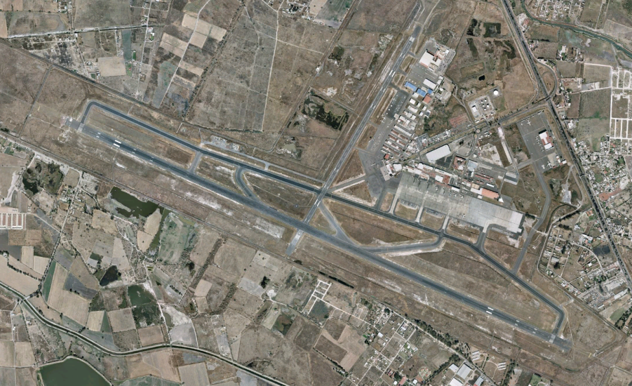
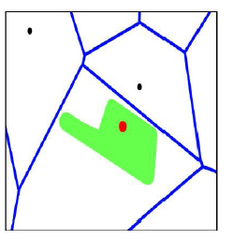
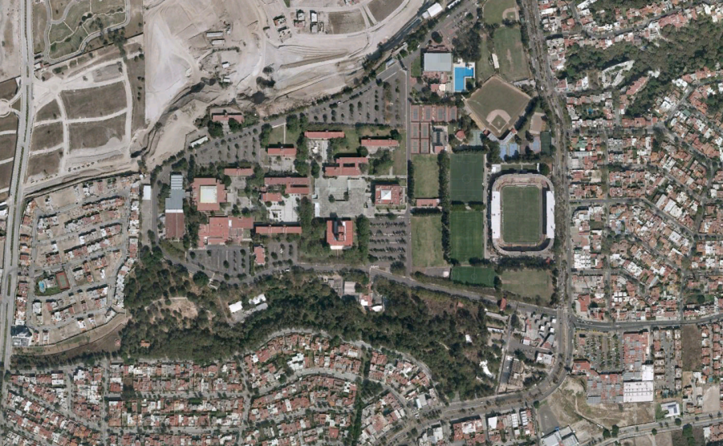
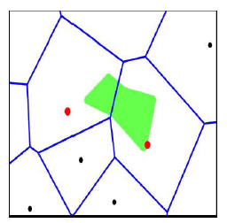
Infrastructure Analysis
Only citizens that DO NOT LIVE in these BTS areas
Credit: Vanessa Frias-Martinez

Slide 21
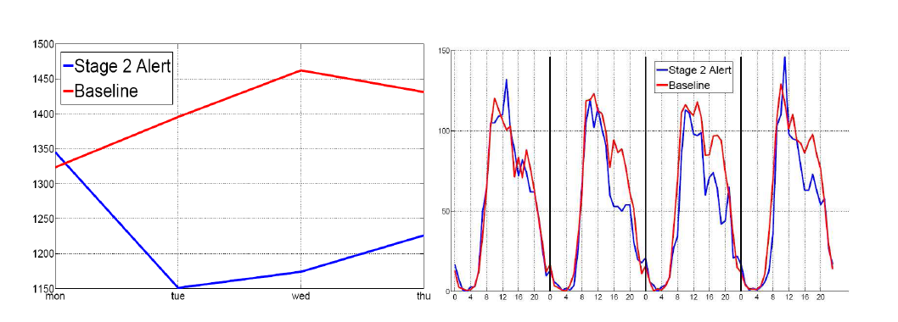
University Campus
Credit: Vanessa Frias-Martinez

Slide 22
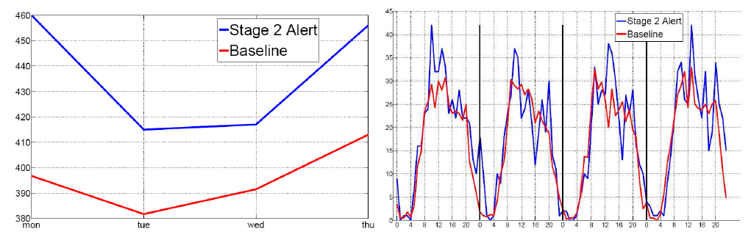
Airport
Credit: Vanessa Frias-Martinez

Slide 23
Evaluating IR Systems
User-centered strategy
  Given several users, and at least 2 retrieval systems
  Have each user try the same task on both systems
  Measure which system works the “best”
System-centered strategy
  Given documents, queries, and relevance judgments
  Try several variations on the retrieval system
  Measure which ranks more good docs near the top

Slide 24
Which is the Best Rank Order?
A.
B.
C.
D.
E.
F.
= relevant document

Slide 25
Precision and Recall
Precision
  How much of what was found is relevant?
  Often of interest, particularly for interactive searching
Recall
  How much of what is relevant was found?
  Particularly important for law, patents, and medicine

Slide 26
Measures of Effectiveness
Retrieved
Relevant

Slide 27
Affective Evaluation
Measure stickiness through frequency of use
  Non-comparative, long-term
Key factors (from cognitive psychology):
  Worst experience
  Best experience
  Most recent experience
Highly variable effectiveness is undesirable
  Bad experiences are particularly memorable

Slide 28
Before You Go
On a sheet of paper, answer the following (ungraded) question (no names, please):
What was the muddiest point in today’s class?

