Slide 1

Search Strategies
Session 7
INST 301
Introduction to Information Science

Slide 2
The Search Engine
Source
Selection
IR System
Query
Formulation
Query
Search
Ranked List
Selection
Indexing
Document
Index
Examination
Document
Acquisition
Collection
Delivery

Slide 3
“The Search”
Source
Selection
IR System
Query
Formulation
Query
Search
Ranked List
Selection
Indexing
Document
Index
Examination
Document
Acquisition
Collection
Delivery

Slide 4
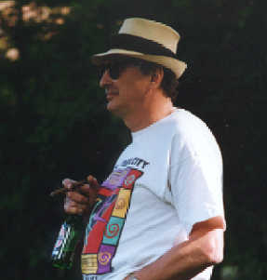


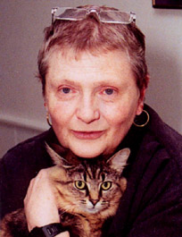
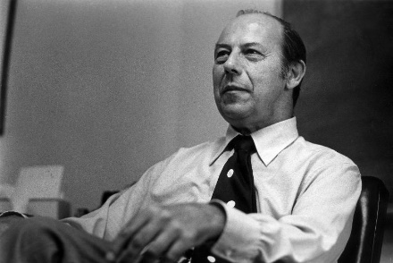
Search
Strategies

Slide 5
Marchionini’s
Factors Affecting Information Seeking
Information seeker
Task
Search system
Domain
Setting
Outcomes

Slide 6
Belkin’s ASK:
Anomalous State of Knowledge
Searchers do not clearly understand
  The problem itself
  What information is needed to solve the problem
The query results from a clarification process
Notes:
8

Slide 7
Bates’ “Berry Picking” Model
A sketch of a searcher… “moving through many actions towards a general goal of satisfactory completion of research related to an information need.”
Q2
Q4
Q3
Q1
Q5
Q0

Slide 8
Dervin’s Sensemaking
Situation
Gap
Action
Notes:
8

Slide 9
Four Levels of Information Needs
RIN₀
Real information needs (RIN)
= visceral need
PIN₀
…
PIN_{m}
Perceived information needs (PIN)
= conscious need
r₀
r₁
r_{n}
Request
= formalized need
q₀
q₁
q₂
q₃
q_{r}
Query
= compromised need
Stefano Mizzaro. (1999) How Many Relevances in Information Retrieval? Interacting With Computers, 10(3), 305-322.

Slide 10
Broder’s Web Query Taxonomy
Informational (~50%)
  Acquire static information (“topical”)
Navigational (~20%)
  Reach a particular site (“known item”)
Transactional (~30%)
  Perform a Web-mediated activity (“service”)
Andrei Broder, SIGIR Forum, Fall 2002

Slide 11
Supporting the Search Process
Source
Selection
Predict
Nominate
Choose
IR System
Query
Formulation
Query
Search
Ranked List
Selection
Query Reformulation
and
Relevance Feedback
Document
Examination
Document
Source
Reselection
Delivery

Slide 12
Two Ways of Searching
Controlled
Vocabulary
Searcher
Free-Text
Searcher
Author
Indexer
Construct query from
terms that may
appear in documents
Write the document
using terms to
convey meaning
Choose appropriate
concept descriptors
Construct query from
available concept
descriptors
Content-Based
Query-Document
Matching
Metadata-Based
Query-Document
Matching
Query Terms
Document Terms
Document Descriptors
Query Descriptors
Retrieval Status Value

Slide 13
Boolean Operators
spacewalk
Apollo
spacewalk
Apollo
Gemini
Gemini
spacewalk AND
Apollo AND
(NOT Gemini)
spacewalk AND
(Apollo OR Gemini)

Slide 14
The Perfect Query Paradox
Every information need has a perfect document ste
  Finding that set is the goal of search
Every document set has a perfect query
  AND every word to get a query for document 1
  Repeat for each document in the set
  OR every document query to get the set query
The problem isn’t the system … it’s the query!
Notes:
14

Slide 15
Pearl Growing
Start with a set of relevant documents
Use them to learn new vocabulary
  Related terms to help broaden the search
  Terms that help to remove unrelated senses
Repeat until you converge on a useful set

Slide 16
Pearl Growing Example
What is the Moon made of?
Query: moon
Initial search reveals:
  Adding “Apollo” might help focus the search
  Rejecting “Greek” might avoid unrelated page
Revised query: +moon -Greek Apollo

Slide 17
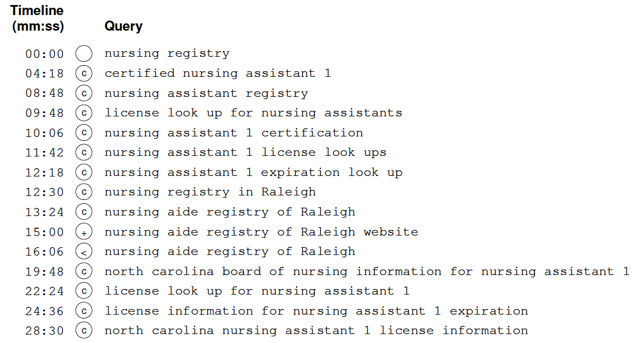
28% of Web Queries are Reformulations
Pass, et al., “A Picture of Search,” 2007

Slide 18
Concept Analysis
Identify facets of your question
  What entities are involved?
  What attributes of those entities are important?
  What attribute values do you seek?
Choose the appropriate search terms
  What terms might an author have used?
    Perhaps by using a thesaurus
  Use initial searches to refine your term choices

Slide 19
Building Blocks
Most Specific Facet
AND
Partial Query
AND
Final Query
Another Facet
Another Facet

Slide 20
Building Blocks Example
What is the history of Apartheid?
Facets?
  Entity: Racial segregation
  Location: South Africa
  Time: Before 1990
Query construction:
  (Apartheid OR segregation) AND (“South Africa” OR Pretoria) AND (history OR review)

Slide 21
Web-specific Strategies
Using outward links
  Find good hubs, follow their links
Using inward links
  Find good authorities, see who links to them
  +url:http://terpconnect.umd.edu/~oard/
URL pruning
  Discover related work, authors, organization, …
  Some servers provide raw directory listings

Slide 22
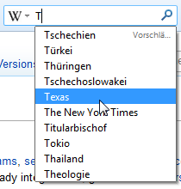
Query Suggestion
Predict what the user might type next
  Learned from behavior of many users
  Can be customized to a user or group
Helps w/typos, limited vocabulary, …
Provides a basis for auto-completion
  Particularly useful in difficult input settings

Slide 23
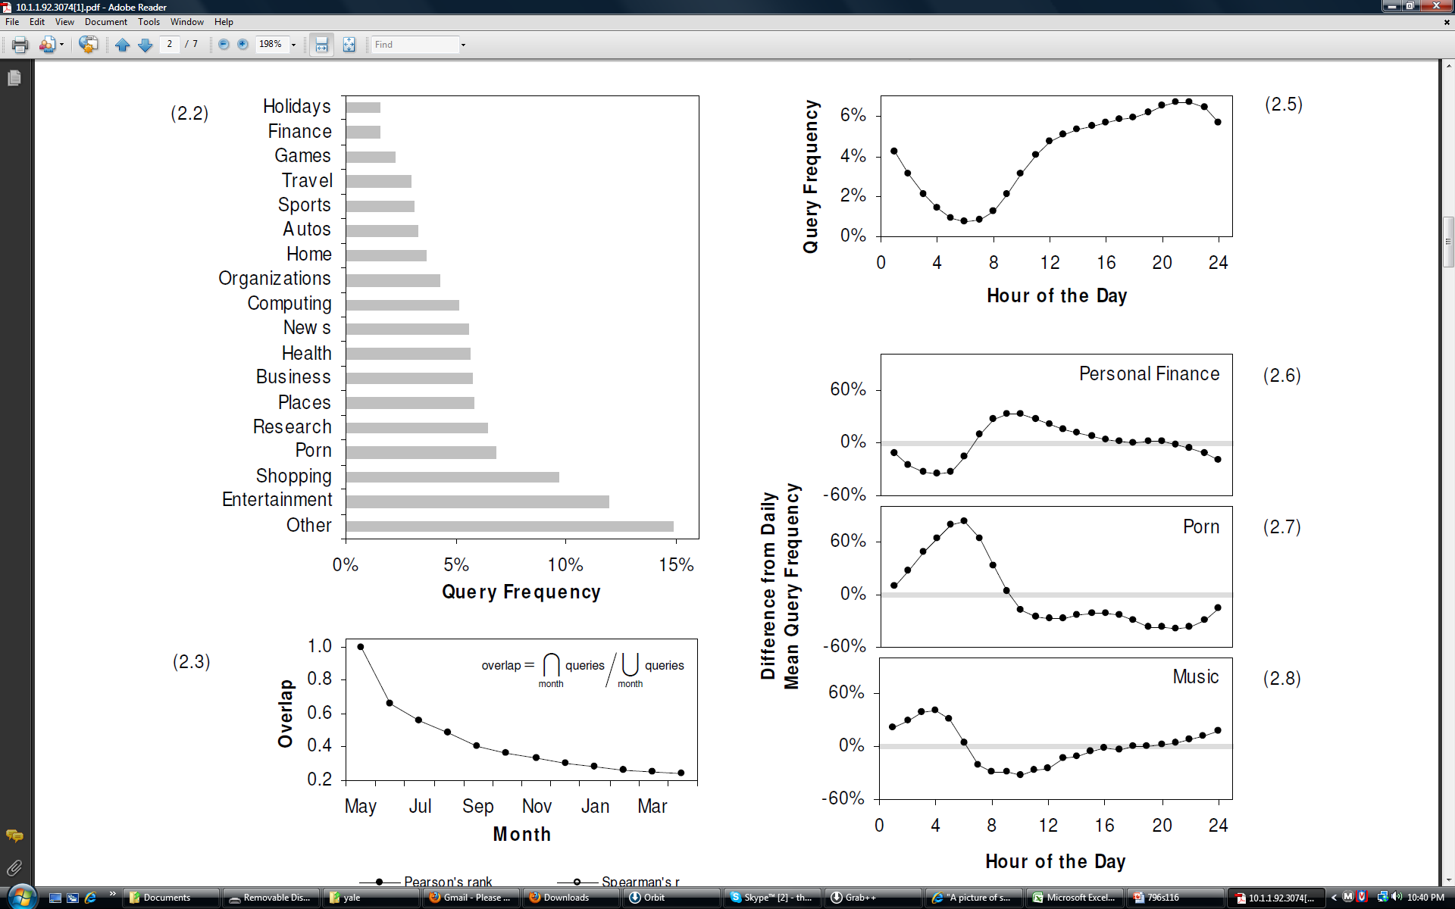
Pass, et al., “A Picture of Search,” 2007

Slide 24
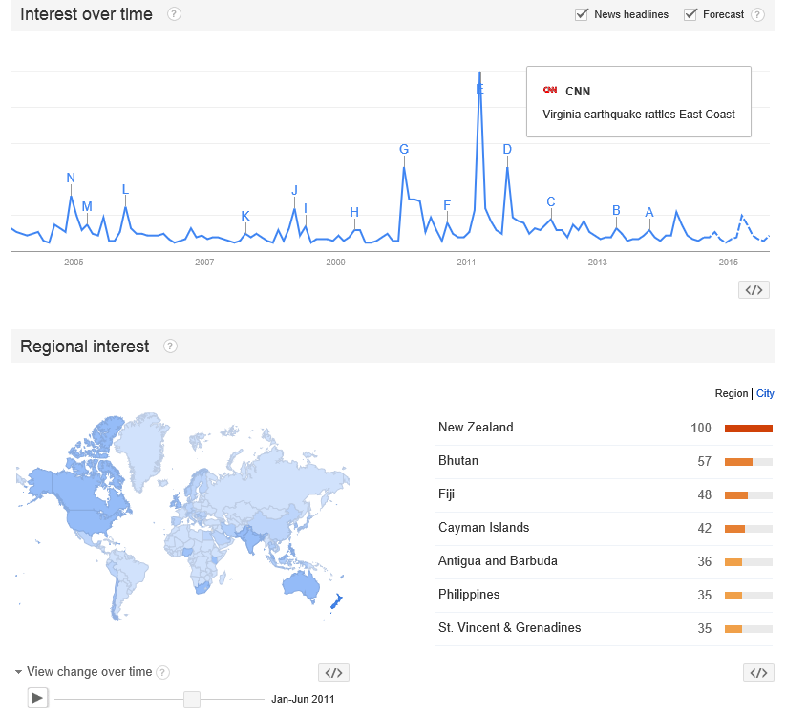
Burstiness
Query: Earthquake
http://www.google.com/trends/

Slide 25
Diversity Ranking
Query ambiguity
  UPS: United Parcel Service
  UPS: Uninterruptible power supply
  UPS: University of Puget Sound
Query aspects
  United Parcel Service: store locations
  United Parcel Service: delivery tracking
  United Parcel Service: stock price

Slide 26
Try Some Searches
Using building blocks:
  Which cities in the former country of Czechoslovakia have pollution problems?
Using pearl growing:
  What event in the early 1900’s is Noel Davis famous for?

Slide 27
Some Good Advice
Human-Computer Interaction
Interactive IR
User in control
  Anticipatable outcomes
  Explainable results
  Browsable content
  Informative feedback
  Easy reversal
Limit working memory load
  Show query context
Support for learning
  Novice and expert alternatives
  Scaffolding
Support human reasoning
  Show actual content
  Depict uncertainty
  Be fast
Use familiar metaphors
  Timelines, ranked lists, maps, …
Some system initiative
  Loosely guide the process
  Expose structure of knowledge
Co-design w/search strategies
Credit: Ben Shneiderman

Slide 28
Evaluation
What can be measured that reflects the searcher’s ability to use a system? (Cleverdon, 1966)
  Coverage of Information
  Form of Presentation
  Effort required/Ease of Use
  Time and Space Efficiency
  Recall
  Precision
Effectiveness

Slide 29
Evaluating IR Systems
User-centered strategy
  Given several users, and at least 2 retrieval systems
  Have each user try the same task on both systems
  Measure which system works the “best”
System-centered strategy
  Given documents, queries, and relevance judgments
  Try several variations on the retrieval system
  Measure which ranks more good docs near the top

Slide 30
Which is the Best Rank Order?
A.
B.
C.
D.
E.
F.
= relevant document

Slide 31
Precision and Recall
Precision
  How much of what was found is relevant?
  Often of interest, particularly for interactive searching
Recall
  How much of what is relevant was found?
  Particularly important for law, patents, and medicine

Slide 32
Measures of Effectiveness
Retrieved
Relevant

Slide 33
Affective Evaluation
Measure stickiness through frequency of use
  Non-comparative, long-term
Key factors (from cognitive psychology):
  Worst experience
  Best experience
  Most recent experience
Highly variable effectiveness is undesirable
  Bad experiences are particularly memorable

Slide 34
Before You Go
On a sheet of paper, answer the following (ungraded) question (no names, please):
What was the muddiest point in today’s class?

