Slide 1
User Needs
Session 6
INST 301
Introduction to Information Science

Slide 2
Muddiest Points
Link types (in, out, back, forward, …)
The TF*IDF formula
Behavior

Slide 3
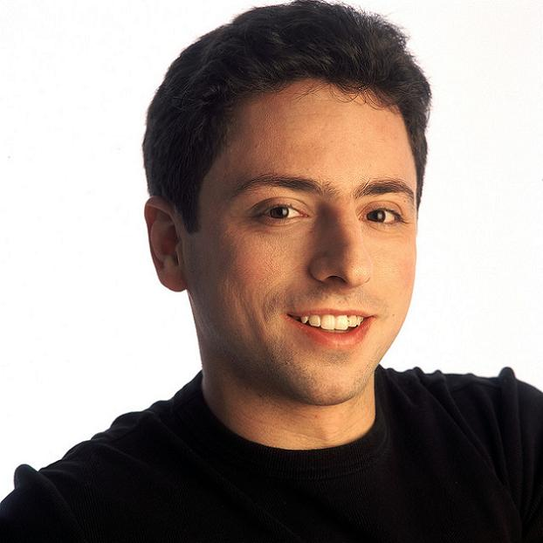
The PageRank Paper

Slide 4
What are Humans Good At?
Sense low level stimuli
Recognize patterns
Reason inductively
Communicate with multiple channels
Apply multiple strategies
Adapt to changes or unexpected events
Notes:
Fuzzy and hard things

Slide 5
What are Computers Good At?
Sense stimuli outside human’s range
Calculate quickly and accurately
Store large quantities and recall accurately
Respond rapidly and consistently
Perform repetitive actions reliably
Work under heavy load for an extended period
Notes:
“Simple and sharply defined things” again paraphrasing George Miller

Slide 6
Synergy
Humans do what they are good at
Computers do what they are good at
Strengths of one cover weakness of the other

Slide 7
Human Senses
Visual
Position/motion, color/contrast, symbols
Auditory
Position/motion, tones/volume, speech
Haptic
Mechanical, thermal, electrical, kinesthethic
Olfactory
Smell, taste
Vestibular

Slide 8
User Characteristics
Perceptual
The five senses
Physical
Anthropomorphic (height, left handed, etc.)
Age (mobility, dexterity, etc.)
Cognitive
Conceptual
Cultural

Slide 9
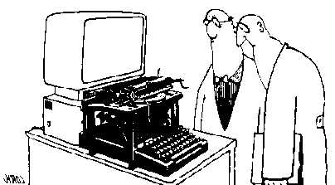
Transfer Effects
People transfer expectations from similar objects
Positive: prior learning applies to new situation
Negative: prior learning conflicts with new situation

Slide 10
Caller: Hello, is this Tech Support?"
Tech: Yes, it is. How may I help you?
Caller: The cup holder on my PC is broken and I am within my warranty period. How do I go about getting that fixed?
Tech: I'm sorry, but did you say a cup holder?
Caller: Yes, it's attached to the front of my computer.
Tech: Please excuse me if I seem a bit stumped, it’s because I am. Did you receive this as part of a promotional, at a trade show? How did you get this cup holder? Does it have any trademark on it?
Caller: It came with my computer, I don't know anything about a promotional. It just has '4X' on it.
At this point the Tech Rep had to mute the call, because he couldn't stand it. The caller had been using the load drawer of the CD-ROM drive as a cup holder, and snapped it off the drive.

Slide 11
Types of User Needs
Informational (30-40% of queries)
What is a quark?
Navigational
Find the home page of United Airlines
Refinding something you have found before
Transactional
Data: What is the weather in Paris?
Shopping: Who sells a Viao Z505RX?
Proprietary: Obtain a journal article

Slide 12
Pass, et al., “A Picture of Search,” 2007

Slide 13
Pass, et al., “A Picture of Search,” 2007

Slide 14
Burstiness Query: Earthquake
http://www.google.com/trends/

Slide 15
Query Statistics
Pass, et al., “A Picture of Search,” 2007

Slide 16
User Needs Exercise
Form teams with diverse expertise
Think about a specific search problem
User needs, user characteristics
Identify needed system capabilities

Slide 17
Multilingual Access to Large Spoken Archives
Douglas W. Oard
University of Maryland, College Park, MD, USA
William Byrne, Martin Franz, Lisa Goodgame, Samuel Gustman, Jan Hajic,
Michael Picheny, Josef Psutka, Bhuvana Ramabhadran, Dagobert Soergel

Slide 18
Who Uses the Collection?
Discipline
Products
History
Linguistics
Journalism
Material culture
Education
Psychology
Political science
Law enforcement
Book
Documentary film
Research paper
CDROM
Study guide
Obituary
Evidence
Personal use
Based on analysis of 280 access requests

Slide 19
Question Types
Content
Person, organization
Place, type of place (e.g., camp, ghetto)
Time, time period
Event, subject
Mode of expression
Language
Displayed artifacts (photographs, objects, …)
Affective reaction (e.g., vivid, moving, …)
Age appropriateness

Slide 20
Observational Studies
Workshop 1 (June)
Workshop 2 (August)
Four searchers
History/Political Science
Holocaust studies
Holocaust studies
Documentary filmmaker
Sequential observation
Rich data collection
Intermediary interaction
Semi-structured interviews
Observational notes
Think-aloud
Screen capture
Four searchers
Ethnography
German Studies
Sociology
High school teacher
Simultaneous observation
Opportunistic data collection
Intermediary interaction
Semi-structured interviews
Observational notes
Focus group discussions

Slide 21
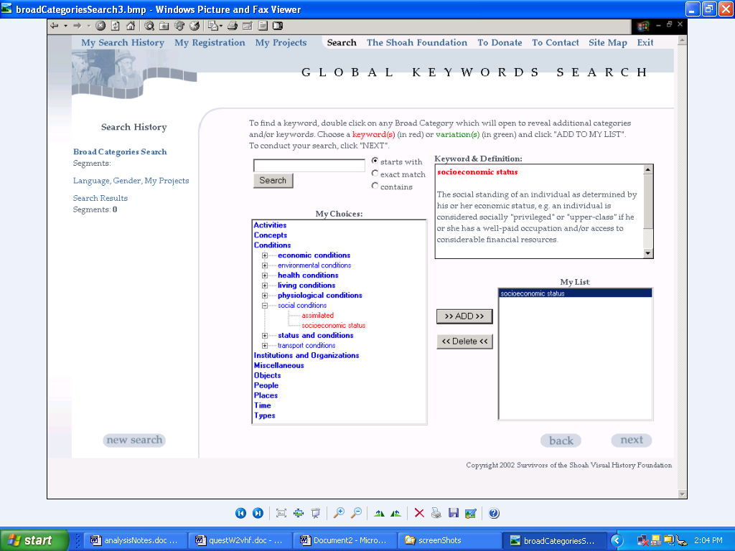
Thesaurus-Based Search

Slide 22
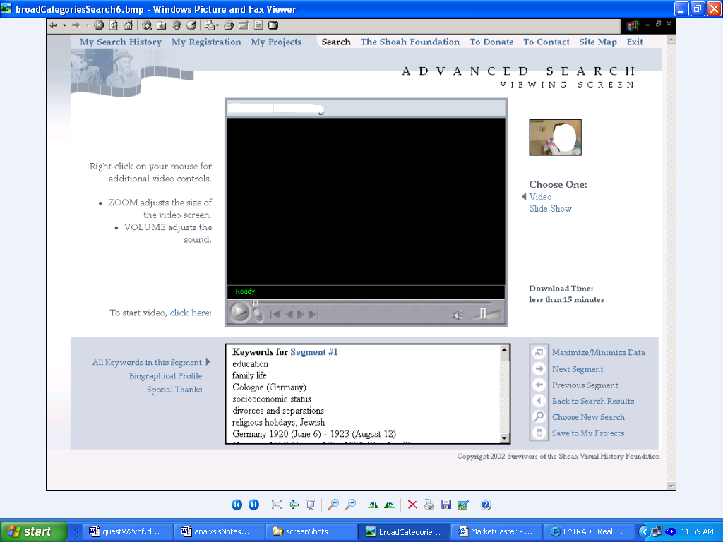
Segment Viewer

Slide 23
Observed Selection Criteria
Topicality (57%)
Judged based on: Person, place, …
Accessibility (23%)
Judged based on: Time to load video
Comprehensibility (14%)
Judged based on: Language, speaking style

Slide 24
Functionality
Needed Function | Boolean Search and Ranked Retrieval (13) Testimony summary (12) Pre-Interview Questionnaire search/viewer (9) Rapid access (7) Related/Alternative search terms (3) Adding multiple search terms at once (2) Keywords linked to segment number for easy access(1) Multi-tasking (1) Searching testimonies by places under ‘Experience Search’ (1) Extensive editing within ‘My Project’ (1)
Desired Function | Temporary saving of selected testimonies (4) Remote access (3) Integrated user tools for note taking (3) Map presentation (2) Reference tool (1) More repositories (1) Introductory video of system tutorial (1) Help (1)

Slide 25
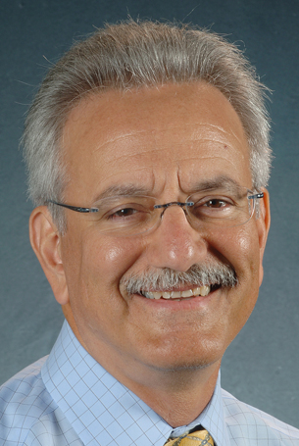
Search Strategies

