Slide 1
Search Engines
Session 5
INST 301
Introduction to Information Science

Slide 2
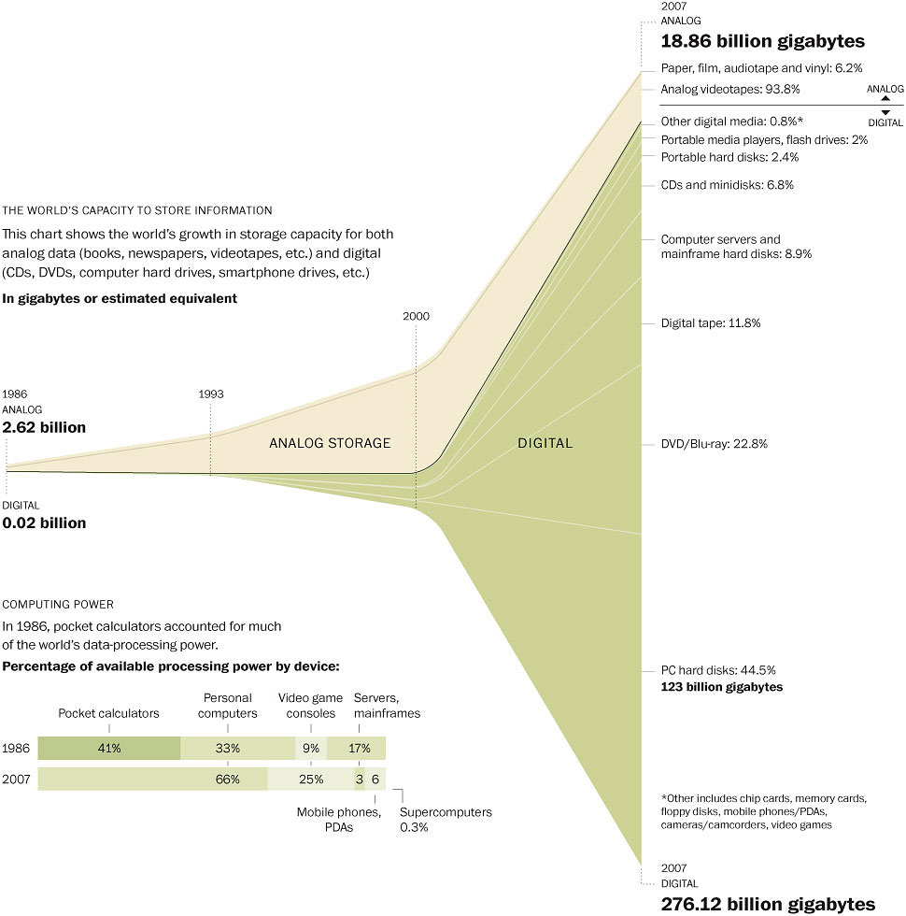
Washington Post (2007)

Slide 3
so what is a
Search Engine?

Slide 4
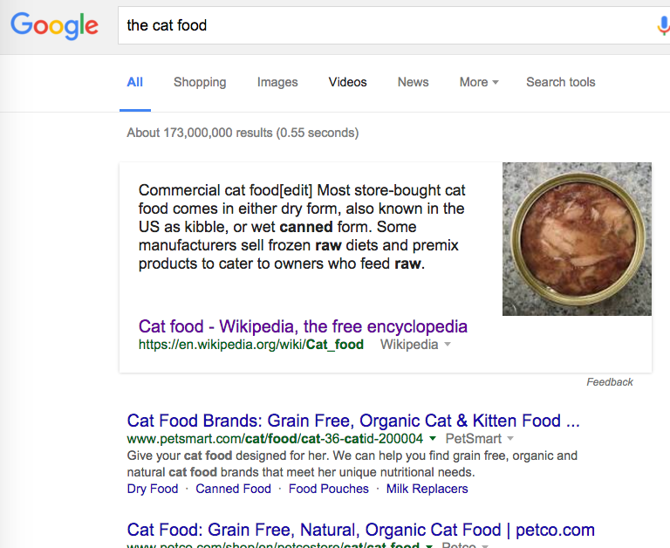
Notes:
What is the first thing that catches you eye in this slide?
-- You all know how to search in google and you all have done that… In this slide, there is something we often skip to notice!!!

Slide 5
Notes:
What is the first thing that catches you eye in this slide?
-- You all know how to search in google and you all have done that… In this slide, there is something we often skip to notice!!!

Slide 6
Query
the cat food
D2
cats eat canned food. the cat food
is not good for dogs.
Natural organic cat food available at petco.com
D1
Notes:
HOW Many Document contain the term -- Document frequency

Slide 7
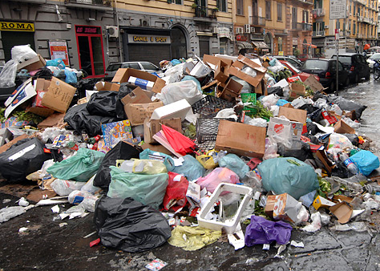
Find all the brown boxes
No Structure and No Index
Notes:
Can you do this in 55 seconds?

Slide 8
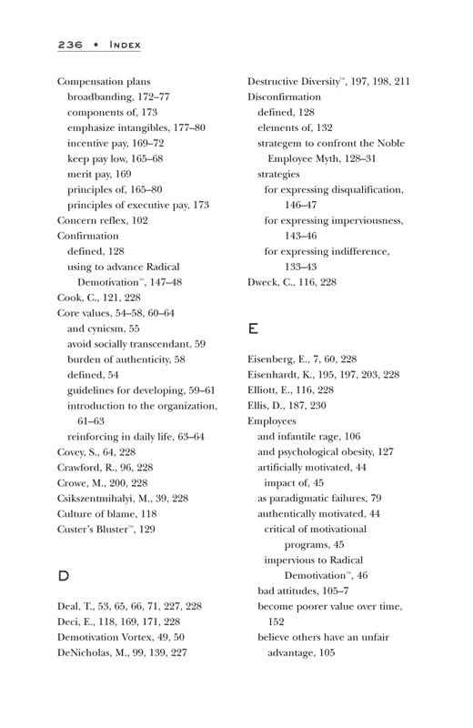
How about here
This is what indexing does
Makes data accessible in a structured format, easily accessible through search.

Slide 9
Building Index
Documents:
1: cats eat canned food. the cat food is not good for dogs.
2: natural organic cat food available at petco.com
Term – Document Index Matrix
TERM | D1 | D2
available | 0 | 1
canned | 1 | 0
cat | 2 | 1
dog | 1 | 0
eat | ? | ?
food | ? | ?
… | … | …
Notes:
Left at !!!!
purposely

Slide 10
Query
the cat food
D2
D3
cats eat canned food. the cat food
is not good for dogs.
Natural organic cat food available at petco.com
the the
the the the the
D1
Some terms are more informative
than others
Notes:
HOW Many Document contain the term -- Document frequency

Slide 11
How Specific is a Term?
TERM (t) | Document Frequency of term t (df_{t} ) | Inverse Document Frequency of term t (idf_{t}) = (N/df_{t} ) | Log of Inverse Document Frequency of term t [log(idf_{t})]
cat | 1 | 1,000,000
petco.com | 100 | 10,000
food | 1000 | 1000
canned | 10,000 | 100
good | 100,000 | 10
the | 1,000,000 | 1

Slide 12
How Specific is a Term?
TERM (t) | Document Frequency of term t (df_{t} ) | Inverse Document Frequency of term t (idf_{t}) = (N/df_{t} ) | Log of Inverse Document Frequency of term t [log(idf_{t})]
cat | 1 | 1,000,000
petco.com | 100 | 10,000
food | 1000 | 1000
canned | 10,000 | 100
good | 100,000 | 10
the | 1,000,000 | 1
Magnitude of increase

Slide 13
How Specific is a Term?
TERM (t) | Document Frequency of term t (df_{t} ) | Inverse Document Frequency of term t (idf_{t}) = (N/df_{t} ) | Log of Inverse Document Frequency of term t [log(idf_{t})]
cat | 1 | 1,000,000 | 6
petco.com | 100 | 10,000 | 4
food | 1000 | 1000 | 3
canned | 10,000 | 100 | 2
good | 100,000 | 10 | 1
the | 1,000,000 | 1 | 0

Slide 14
Putting it all together
To rank, we obtain the weight for each term using tf-idf
The tf-idf weight of a term is the product of its
tf weight and its idf weight
Weight (t) = tf_{t} × log(N /df_{t})
Using the term weights, we obtain the document weight

Slide 15
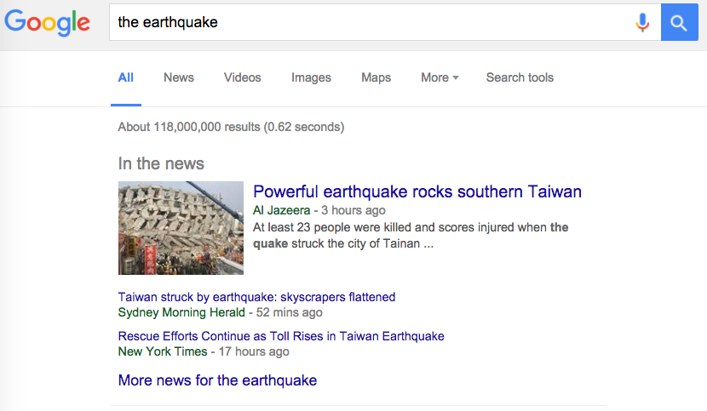
Notes:
Now if we change the query, what is going to happen? , Time ??? How do we know the time?
The other crowd click on it and them we know it is importatnt

Slide 16
Finding based on MetaData or Description
A type of “document expansion”
Terms near links describe content of the target
Works even when you can’t index content
Image retrieval, uncrawled links, …

Slide 17
Ways of Finding Information
Searching content
Characterize documents by the words the contain
Searching behavior
Find similar search patterns
Find items that cause similar reactions
Searching description
Anchor text
Notes:
Now we know there three way to find things on the internet.

Slide 18
Crawling the Web

Slide 19
Web Crawl Challenges
Adversary behavior
“Crawler traps”
Duplicate and near-duplicate content
30-40% of total content
Check if the content is already index
Skip document that do not provide new information
Network instability
Temporary server interruptions
Server and network loads
Dynamic content generation

Slide 20
How does Google PageRank work?
Objective - estimate the importance of a webpage
Inlinks are “good” (like recommendations)
Inlinks from a “good” site are better than inlinks from a “bad” site
P_{a}
P_{x}
P₂
P₁
P_{y}
P_{k}
P_{i}
P_{j}
Notes:
SO what does Page rank do? Any one want to attempt to answer?
Does anyone know what a backline is?
PageRank focusces on
Backlinks or Inlinks : (url:https://terpconnect.umd.edu/~oard/)
Outlinks
Power of Backlinks
The rationale behind it is (i) a page with more incoming links is more important
than a page with less incoming links, (ii) a page with a link from a page which is known to be of high
importance is also important.
What does this mean? And Which type do you think PR belongs?
Behavior correct? More people click on earthquakes at Taiwan, more popular it becomes and more popular it is, more relevant it becomes.
More relevant results, attract more people to use google and more people means more behavior.
This sort of leads to the Monopoy overy search!! Thus google has become a biggest monopoly

Slide 21
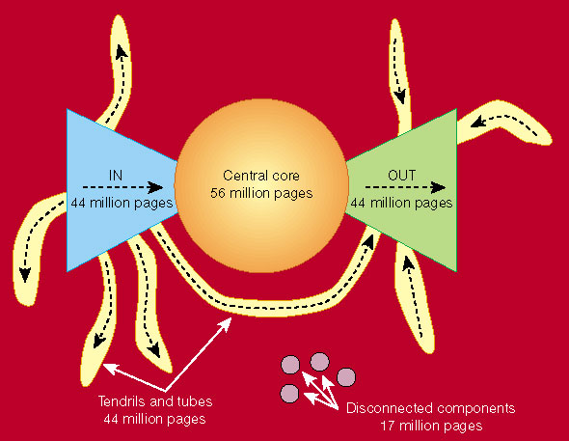
Link Structure of the Web
Nature 405, 113 (11 May 2000) | doi:10.1038/35012155

Slide 22
So,
A Web search engine is an application composed of ;
CRAWLING component
- important to define a search space
INDEXING component
- of importance to developers AND content-centric
SEARCH component
- of importance to the users AND user-centric

Slide 23
Today: The “Search Engine”
Source
Selection
IR System
Query
Formulation
Query
Search
Ranked List
Selection
Indexing
Document
Index
Examination
Document
Acquisition
Collection
Delivery

Slide 24
Next Session: “The Search”
Source
Selection
IR System
Query
Formulation
Query
Search
Ranked List
Selection
Indexing
Document
Index
Examination
Document
Acquisition
Collection
Delivery

Slide 25
Before You Go
Assignment H2
On a sheet of paper, answer the following (ungraded) question (no names, please):
What was the muddiest point in today’s class?

