Slide 1

The Web
Session 4
INST 301
Introduction to Information Science

Slide 2
Outline
Using The Internet
The Web
Creating Web pages

Slide 3
TCP/IP layer architecture
Application
Application
Virtual network service
Transport
Transport
Virtual link for end to end packets
Network
Network
Network
Network
Virtual link for packets
Link
Link
Link
Link
Link
Link
Link for bits
Link for bits
Link for bits

Slide 4
Transmission Control Protocol (TCP)
Built on the network-layer version of UDP
Guarantees delivery all data
  Retransmits missing data
Guarantees data will be delivered in order
  “Buffers” subsequent packets if necessary
No guarantee of delivery time
  Long delays may occur without warning

Slide 5
User Datagram Protocol (UDP)
The Internet’s basic transport service
  Sends every packet immediately
  Passes received packets to the application
No delivery guarantee
  Collisions can result in packet loss
Example: sending clicks on web browser
Notes:
No connection establishment. As we shall discuss in Section 3.5, TCP uses a three-way handshake before it starts to transfer data. UDP just blasts away without any formal preliminaries. Thus UDP does not introduce any delay to establish a connection. This is probably the principle reason why DNS runs over UDP rather than TCP -- DNS would be much slower if it ran over TCP. HTTP uses TCP rather than UDP, since reliability is critical for Web pages with text. But, as we briefly discussed in Section 2.2, the TCP connection establishment delay in HTTP is an important contributor to the "world wide wait".
No connection state. TCP maintains connection state in the end systems. This connection state includes receive and send buffers, congestion control parameters, and sequence and acknowledgment number parameters. We will see in Section 3.5 that this state information is needed to implement TCP's reliable data transfer service and to provide congestion control. UDP, on the other hand, does not maintain connection state and does not track any of these parameters. For this reason, a server devoted to a particular application can typically support many more active clients when the application runs over UDP rather than TCP.
Small segment header overhead. The TCP segment has 20 bytes of header overhead in every segment, whereas UDP only has 8 bytes of overhead.
Unregulated send rate. TCP has a congestion control mechanism that throttles the sender when one or more links between sender and receiver becomes excessively congested. This throttling can have a severe impact on real-time applications, which can tolerate some packet loss but require a minimum send rate. On the other hand, the speed at which UDP sends data is only constrained by the rate at which the application generates data, the capabilities of the source (CPU, clock rate, etc.) and the access bandwidth to the Internet. We should keep in mind, however, that the receiving host does not necessarily receive all the data - when the network is congested, a significant fraction of the UDP-transmitted data could be lost due to router buffer overflow. Thus, the receive rate is limited by network congestion even if the sending rate is not constrained.

Slide 6
File Transfer Program (FTP)
Used to move files between machines
  Upload (put) moves from client to server
  Download (get) moves files from server to client
Both visual and command line interfaces available
Normally requires an account on the server
  Userid “anonymous” provides public access

Slide 7
Hands On: Graphical Secure FTP
Install WinSCP (Windows) or Fetch (Mac)
  In Network at https://terpware.umd.edu/
SFTP to “terpconnect.umd.edu”
Change directory to “/pub/USERID”
Upload or download files
You can see these files at:
http://terpconnect.umd.edu/~USERID/

Slide 8
Virtual Private Networks
a secure private network over the public Internet
Public Internet
Intranet
virtual “leased line”
Intranet

Slide 9
Outline
Using The Internet
The Web
Creating Web pages

Slide 10
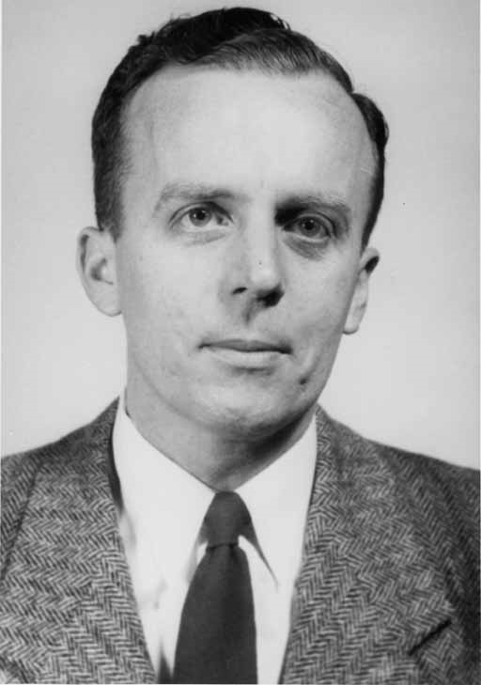
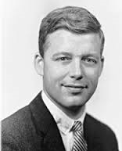
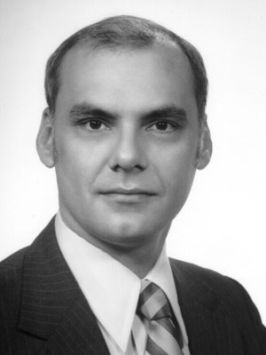
The ARPANET
J.C.R. Licklider
Bob Taylor
Larry Roberts

Slide 11
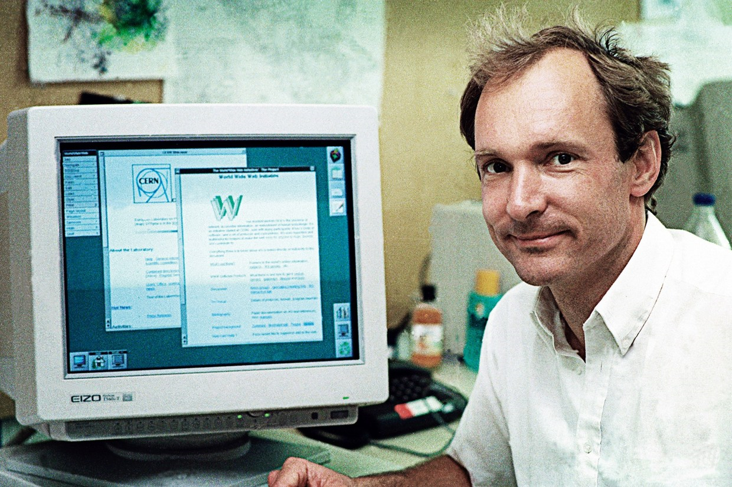
The Web

Slide 12
The World-Wide Web
My Browser
Local copy of
Page requested
Requested Page
Proxy Server
Fetch Page
Remote Sever
Send Request
Internet
Notes:
A server that sits between a client application, such as a Web browser, and a real server. It intercepts all requests to the real server to see if it can fulfill the requests itself. If not, it forwards the request to the real server. Proxy servers have two main purposes:
Improve Performance: Proxy servers can dramatically improve performance for groups of users. This is because it saves the results of all requests for a certain amount of time. Consider the case where both user X and user Y access the World Wide Web through a proxy server. First user X requests a certain Web page, which we'll call Page 1. Sometime later, user Y requests the same page. Instead of forwarding the request to the Web server where Page 1 resides, which can be a time-consuming operation, the proxy server simply returns the Page 1 that it already fetched for user X. Since the proxy server is often on the same network as the user, this is a much faster operation. Real proxy servers support hundreds or thousands of users. The major online services such as Compuserve and America Online, for example, employ an array of proxy servers.
Filter Requests: Proxy servers can also be used to filter requests. For example, a company might use a proxy server to prevent its employees from accessing a specific set of Web sites.

Slide 13
“The Web”
HTML
HTTP
Email
FTP
RTSP
URL
URL
(e.g.,http://www.foo.org/snarf.html)
Web
Server
File System
Internet
communication
protocols
HTML
(data/display)
HTTP
(transfer)

Slide 14
Web Standards
HTML
  How to write and interpret the information
URL
  Where to find it
HTTP
  How to get it
Notes:
Link this to postal service

Slide 15
Uniform Resource Locator (URL)
Uniquely identify Web pages
Domain name
File name
http://www.glue.umd.edu:80/~oard/teaching.html
Protocol
Port
Path

Slide 16
HyperText Markup Language (HTML)
Simple document structure language for Web
Advantages
  Adapts easily to different display capabilities
  Widely available display software (browsers)
Disadvantages
  Does not directly control layout

Slide 17
Outline
Using the Internet
The Web
Creating Web pages

Slide 18
“Hello World” HTML
This is the header
<html>
<head>
<title>Hello World!</title>
</head>
<body>
<p>Hello world! This is my first webpage!</p>
</body>
</html>
This is the actual content of the HTML document

Slide 19
Hands On:
Learning HTML From Examples
Use Internet Explorer to find a page you like
  http://terpconnect.umd.edu/~oard
Right-click and select view souce
  Opens a notepad window with the source
Compare HTML source with the Web page
  Observe how each effect is achieved

Slide 20
Hands On: “Adopt” a Web Page
Modify the HTML source using notepad
  For example, change the page to yours
Save the HTML source somewhere
  In the “File” menu, select “Save As”
  Put the name in quotes (e.g., “test.html”)
FTP it to your ../pub directory on terpconnect
View it
  http://terpconnect.umd.edu/~(yourlogin)/test.html

Slide 21
Tips
Edit files on your own machine
  Upload when you’re happy
Save early, save often!
Reload browser to see changes
File naming
  Don’t use spaces
  Punctuation matters

Slide 22
HTML Editors
Several are available
  Dreamweaver
  Microsoft Word
You may still need to edit the HTML file
  Some editors use browser-specific features
  Some HTML features may be unavailable
  File names may be butchered when you upload
Verbose HTML can make hand-editing difficult

Slide 23
HTML Structure
“Tags” mark structure
  <html>a document</html>
  <ol>an ordered list</ol>
  <i>something in italics</i>
Tag name in angle brackets <>
  Not case sensitive (unlike XML)
Open/Close pairs
  Close tag is sometimes optional (unlike XML)

Slide 24
Logical Structure Tags
Head
  Title
Body
  Headers: <h1> <h2> <h3> <h4> <h5>
  Lists: <ol>, <ul> (can be nested)
  Paragraphs:<p>
  Definitions: <dt><dd>
  Tables: <table> <tr> <td> </td> </tr> </table>
  Role: <cite>, <address>, <strong>, …

Slide 25
Physical Structure Tags
Bold: <b></b>
Italics: <i></i>
Typeface: <font face=“Arial”></font>
Size: <font size=“+1”></font>
Color: <font color=“990000”></font>

Slide 26
(Hyper)Links
index.html
<html>
<head>
<title>Hello World!</title>
</head>
<body>
<p>Hello world! This is my first webpage!</p>
<p>Click <a href="test.html">here</a> for another page.</p>
</body>
</html>
test.html
<html>
<head>
<title>Another page</title>
</head>
<body>
<p>This is another page.</p>
</body>
</html>

Slide 27
Hypertext “Anchors”
Internal anchors: somewhere on the same page
  <a href=“#students”> Students</a>
    Links to: <a name=“students”>Student Information</a>
External anchors: to another page
  <a href=“http://ischool.umd.edu”>iSchool</a>
  <a href=“http://terpconnect.umd.edu/~oard/research.html#email”>email papers</a>
URL may be complete, or relative to current page
  <a href=“video/week2.mp4”>2</a>
File name (in URL) is case sensitive (on Unix servers)
  Protocol and domain name are not case sensitive

Slide 28
Images
<img src=“URL”> or <img src=“path/file”>
  <img src=“http://www.clis.umd.edu/IMAGES/head.gif”>
  ALT: a text string
  ALIGN: position of the image
  WIDTH and HEIGHT: size of the image
Can use as anchor:
  <a href=URL><img src=URL2></a>

Slide 29
Tables
<table>
eenie | mennie | miney
mo | catch | a tiger
by | the | toe
<tr>
<td>
</td>
<td>
</td>
<td>
</td>
</tr>
<tr>
<td>
</td>
<td>
</td>
<td>
</td>
</tr>
<tr>
<td>
</td>
<td>
</td>
<td>
</td>
</tr>
</table>

Slide 30
Table Example
<table align=“center”>
<caption align=“right”>The caption</caption>
< tr align=“LEFT”>
<th> Header1 </th>
<th> Header2</th>
</tr>
<tr><td>first row, first item </td>
<td>first row, second item</td></tr>
< tr><td>second row, first item</td>
<td>second row, second item</td></tr>
</table>
Notes:
Table can basically put all the html into it
Better keep with basic table elements so that you have wider auidence
Use indent to help you to read the table source data

Slide 31
Programming for the Web
JavaScript [Client-side]
  Server embeds a program in HTML
  Browser runs the program when it gets to it
PHP “Common Gateway Interface” [Server-side]
  HTML form sends field values to the server
  Server passes field values to a program
  Program generates a Web page as a response
Ajax
  Server sends browser a generic program to run
  Browser and server programs exchange XML-encoded data

Slide 32
JavaScript
<HTML>
<HEAD>
<TITLE>My first script</TITLE>
</HEAD>
<BODY BGCOLOR=WHITE>
<H1>
<SCRIPT LANGUAGE=JAVASCRIPT TYPE="TEXT/JAVASCRIPT">
document.write("Hello, world!")
</SCRIPT>
</H1>
</BODY></HTML>

Slide 33
What’s a Web Page?
Content
Structure
Appearance
Behavior

Slide 34
Why is There a Web?
Affordable storage
  300,000 words/$ in 1995
Adequate backbone capacity
  25,000 simultaneous transfers in 1995
Adequate “last mile” bandwidth
  1 second/screen in 1995
Display capability
  10% of US population in 1995
Effective search capabilities
  Lycos and Yahoo were started in 1995

Slide 35
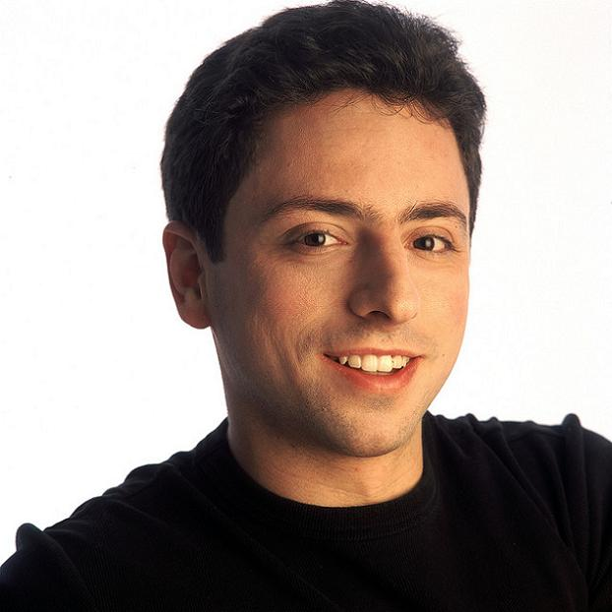
Next Week …

Slide 36
Before You Go
On a sheet of paper, answer the following (ungraded) question (no names, please):
What was the muddiest point in today’s class?

