Slide 1

The Internet
Session 3
INST 301
Introduction to Information Science

Slide 2
Outline
The creation story
What it is
Exploring it
Using it

Slide 3
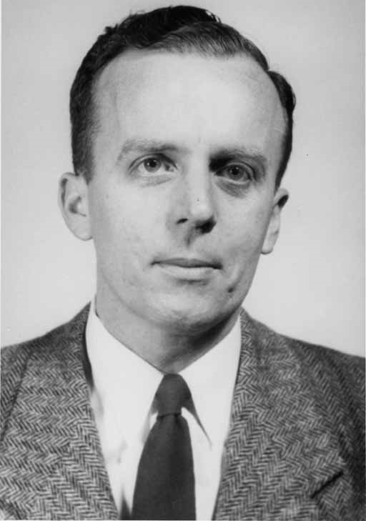
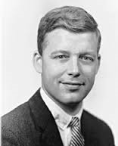
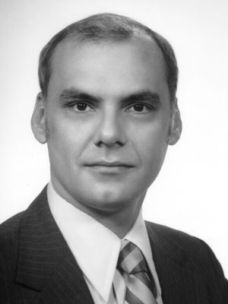
The ARPANET
J.C.R. Licklider
Bob Taylor
Larry Roberts

Slide 4
Outline
The creation story
What it is
Exploring it
Using it

Slide 5
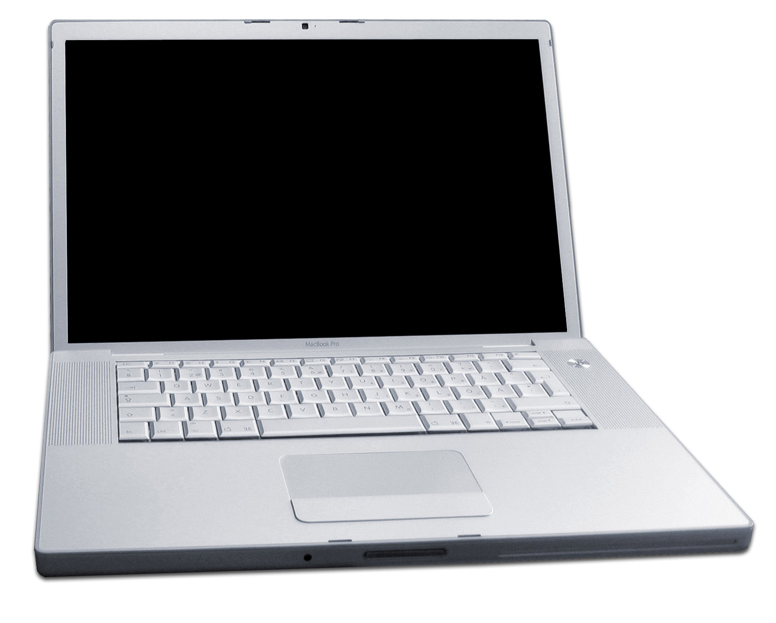
Source: Wikipedia

Slide 6
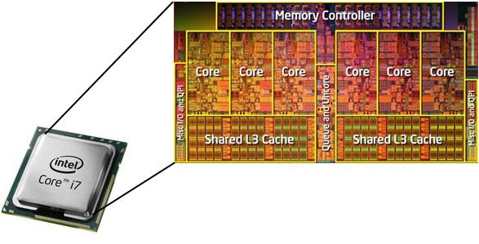
Central Processing Unit (CPU)

Slide 7
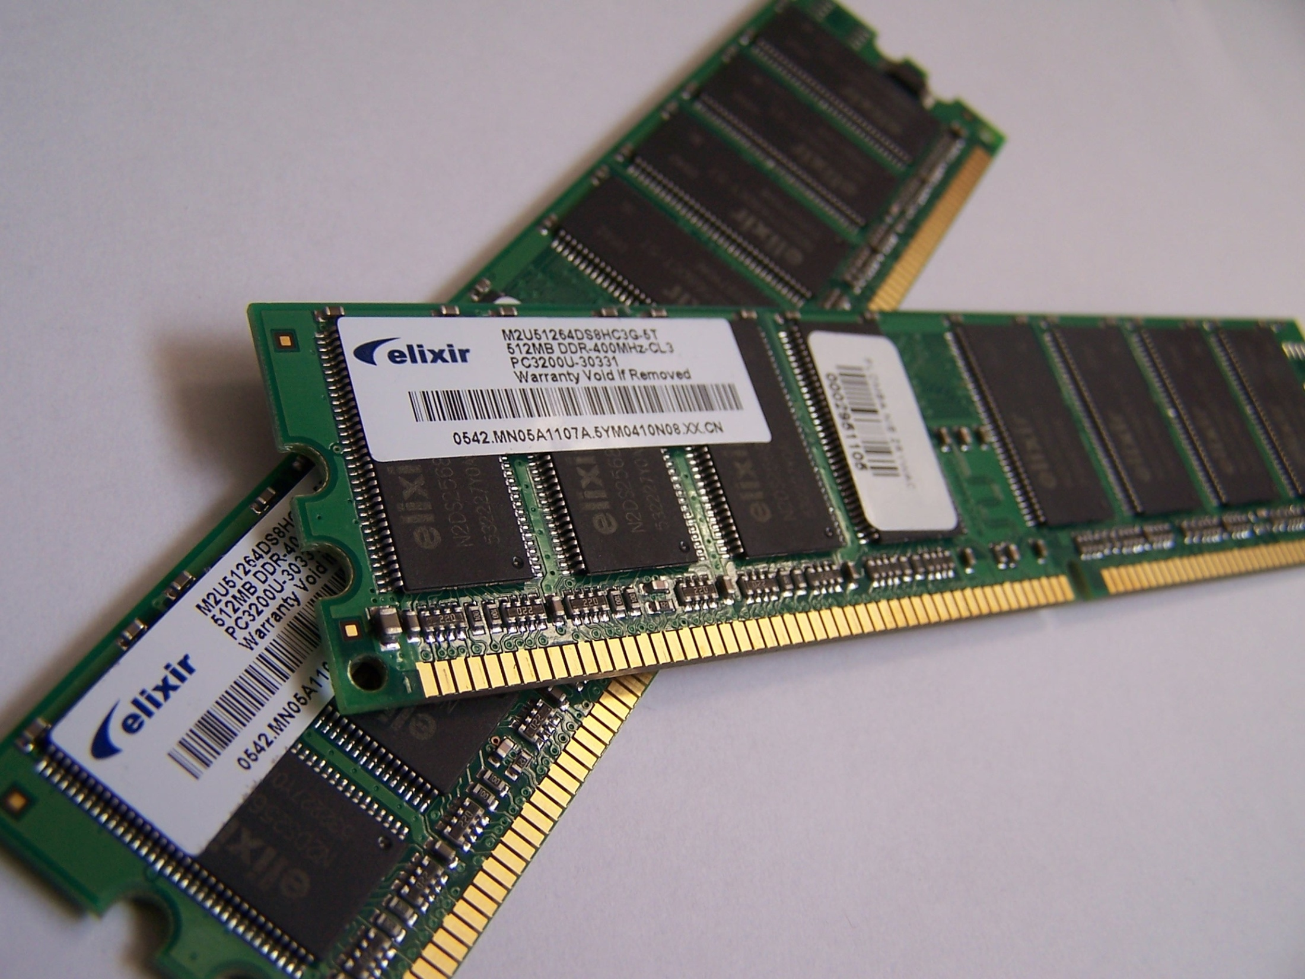
Random Access Memory (RAM)
Source: Wikipedia

Slide 8
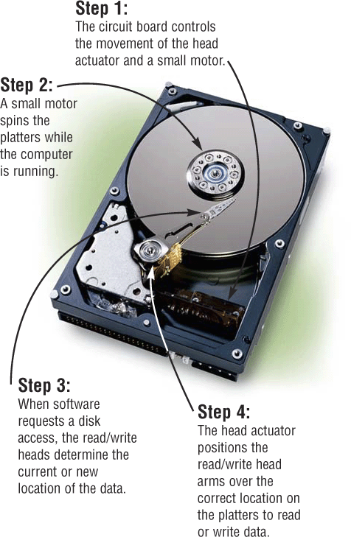
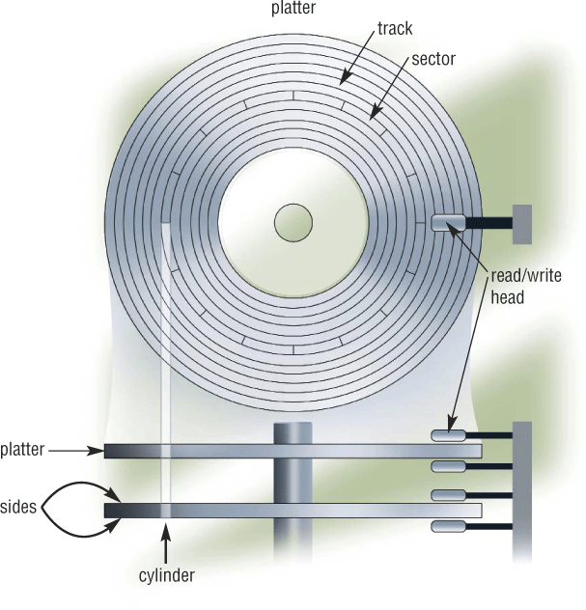
Hard Drive (“Disk”)
Extracted From Shelly Cashman Vermatt’s Discovering Computers 2004

Slide 9
Networks of Networks
Local Area Networks (LAN)
  Connections within a room, or perhaps a building
Wide Area Networks (WAN)
  Provide connections between LANs
Internet
  Collection of WANs across multiple organizations

Slide 10
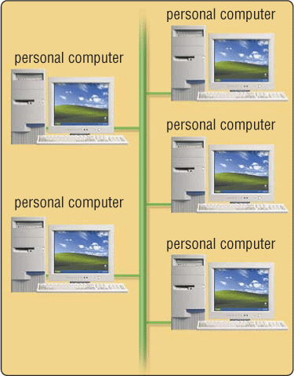
Ethernet
Local Area Network (LAN)
All attach to the same cable
Transmit anytime
  Collision detection
  Automatic retransmission
Inexpensive and flexible
  Easy to add new machines
  Robust to computer failure
Inefficient
  Half the bandwidth is wasted

Slide 11
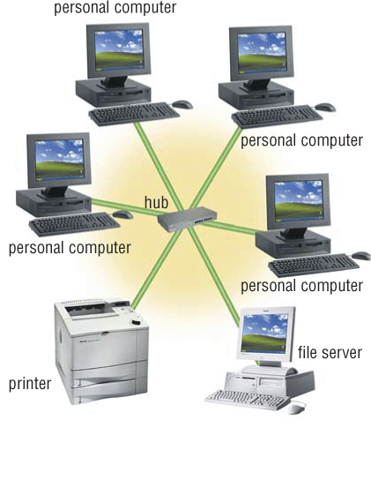
Switched (“Star”) Network
All attach directly to a hub
  Switched Ethernet
  Digital Subscriber Lines (DSL)
Higher cost
  Line from hub to each machine
  Hub must handle every packet
Much higher bandwidth
  No sharing, no collisions

Slide 12
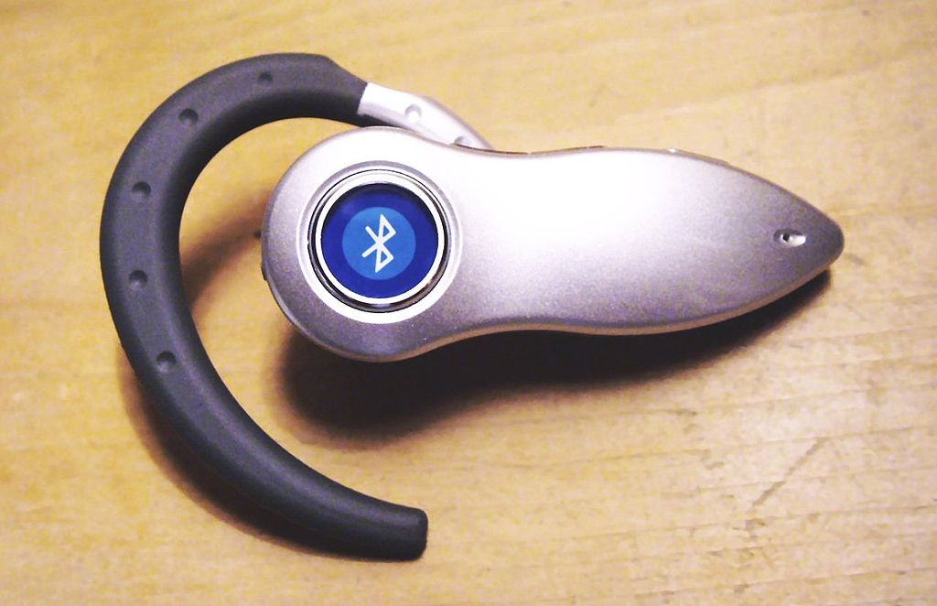
Wireless Networks
WiFi is available in several (“maximum”) speeds
  IEEE 802.11b: 10Mb/s
  IEEE 802.11g: 54Mb/s (required for video)
  IEEE 802.11n: 248Mb/s
  IEEE 802.11ac: 7 Gb/s
“Wireless Data” plans typical speeds:
  3G: At least 200 kb/s
  4G: At least 100 Mb/sec (required for video)
Bluetooth for peer-to-peer short range
  At least 24 kb/s; max range is about 30 feet

Slide 13
An Internet Protocol (IP) Address
Identifies a LAN
54.84.241.99
Identifies a specific device

Slide 14
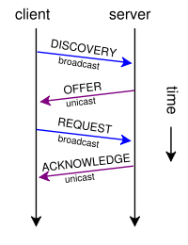
“Leasing” an IP Address
Dynamic Host Configuration Protocol (DHCP)

Slide 15
Routing Tables
IP Prefix | Next Router | Estimated Delay
216.141.xxx.xxx | 120.0.0.0 | 18 ms
216.xxx.xxx.xxx | 121.0.0.0 | 34 ms
101.42.224.xxx | 120.0.0.0 | 21 ms
xxx.xxx.xxx.xxx | 121.0.0.0 | 250 ms
120.0.0.0
45.0.2.10
121.0.0.0
Windows: route print
Mac: netstat -nr

Slide 16
Wide Area Networks
Two key ideas:
  Unshared “point-to-point” links
  Automatic forwarding
Challenge: Routing is complex
  Which paths are possible?
  Which is shortest?
  Which is least busy?

Slide 17
Domain Name Service (DNS)
Domain Names
  Easier to remember than IP addresses
  Written like a postal address: specific-to-general
Each “name server” knows one level of names
  “Top level” name servers know .edu, .com, .mil, …
  .edu name server knows umd, umbc, stanford, …
  .umd.edu name server knows terpconnect, ischool, …
  …

Slide 18
Ports
“Well-known” ports for initial contact
  22 Secure Shell (SSH and SFTP)
  53 Domain Name Service (DNS)
  68 Dynamic Host Configuration Protocol (DHCP)
  80 Hypertext Transfer Protocol (HTTP)
  143 Internet Message Access Protocol (IMAP)
  …
Registered ports for specialized services
  e.g., 8080 may be a user-created HTTP server
Ephemeral ports
  Established as needed for ongoing interactions

Slide 19
Outline
The creation story
What it is
Exploring it
Using it

Slide 20
Hands-on:
Learn About Your IP Address
Find your IP address
  Launch a command shell
  Type “ipconfig /all” (and press enter)
See who “owns” that address
  Use http://remote.12dt.com/
See where in the world it (probably) is
  http://geobytes.com/iplocator/

Slide 21
Hands On: TraceRoute
See how packets get from South Africa to you
  Use http://services.truteq.com/
Look at the same data visually
  http://www.monitis.com/traceroute/
  Alternative: http://visualroute.visualware.com/
    Tested with Firefox (requires Flash and Java)

Slide 22
Outline
The creation story
What it is
Exploring it
Using it

Slide 23
TCP/IP layer architecture
Application
Application
Virtual network service
Transport
Transport
Virtual link for end to end packets
Network
Network
Network
Network
Virtual link for packets
Link
Link
Link
Link
Link
Link
Link for bits
Link for bits
Link for bits

Slide 24
Transmission Control Protocol (TCP)
Built on the network-layer version of UDP
Guarantees delivery all data
  Retransmits missing data
Guarantees data will be delivered in order
  “Buffers” subsequent packets if necessary
No guarantee of delivery time
  Long delays may occur without warning

Slide 25
User Datagram Protocol (UDP)
The Internet’s basic transport service
  Sends every packet immediately
  Passes received packets to the application
No delivery guarantee
  Collisions can result in packet loss
Example: sending clicks on web browser
Notes:
No connection establishment. As we shall discuss in Section 3.5, TCP uses a three-way handshake before it starts to transfer data. UDP just blasts away without any formal preliminaries. Thus UDP does not introduce any delay to establish a connection. This is probably the principle reason why DNS runs over UDP rather than TCP -- DNS would be much slower if it ran over TCP. HTTP uses TCP rather than UDP, since reliability is critical for Web pages with text. But, as we briefly discussed in Section 2.2, the TCP connection establishment delay in HTTP is an important contributor to the "world wide wait".
No connection state. TCP maintains connection state in the end systems. This connection state includes receive and send buffers, congestion control parameters, and sequence and acknowledgment number parameters. We will see in Section 3.5 that this state information is needed to implement TCP's reliable data transfer service and to provide congestion control. UDP, on the other hand, does not maintain connection state and does not track any of these parameters. For this reason, a server devoted to a particular application can typically support many more active clients when the application runs over UDP rather than TCP.
Small segment header overhead. The TCP segment has 20 bytes of header overhead in every segment, whereas UDP only has 8 bytes of overhead.
Unregulated send rate. TCP has a congestion control mechanism that throttles the sender when one or more links between sender and receiver becomes excessively congested. This throttling can have a severe impact on real-time applications, which can tolerate some packet loss but require a minimum send rate. On the other hand, the speed at which UDP sends data is only constrained by the rate at which the application generates data, the capabilities of the source (CPU, clock rate, etc.) and the access bandwidth to the Internet. We should keep in mind, however, that the receiving host does not necessarily receive all the data - when the network is congested, a significant fraction of the UDP-transmitted data could be lost due to router buffer overflow. Thus, the receive rate is limited by network congestion even if the sending rate is not constrained.

Slide 26
File Transfer Program (FTP)
Used to move files between machines
  Upload (put) moves from client to server
  Download (get) moves files from server to client
Both visual and command line interfaces available
Normally requires an account on the server
  Userid “anonymous” provides public access

Slide 27
Hands On: Graphical Secure FTP
Install WinSCP (Windows) or Fetch (Mac)
  In Network at https://terpware.umd.edu/
SFTP to “terpconnect.umd.edu”
Change directory to “/pub/USERID”
Upload or download files
You can see these files at:
http://terpconnect.umd.edu/~USERID/

Slide 28
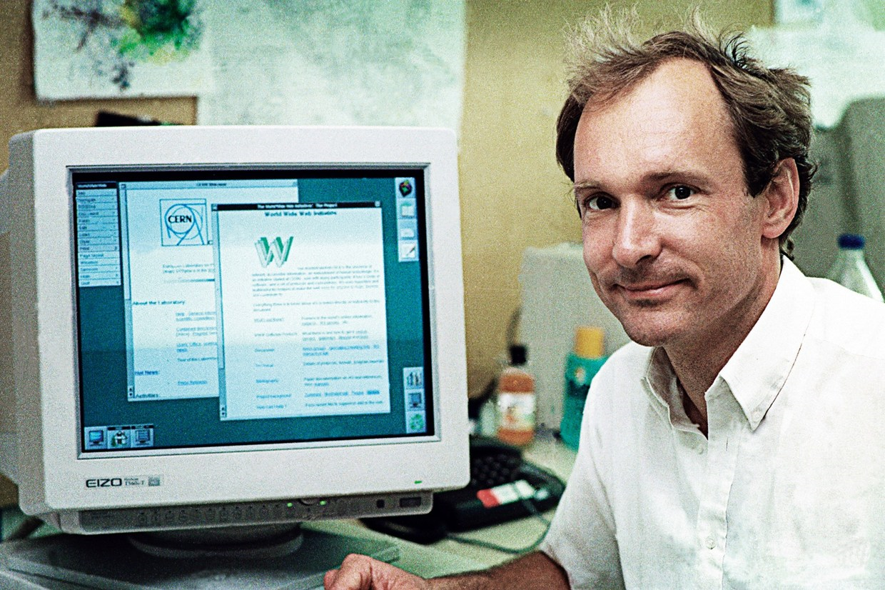
Next: The Web

Slide 29
Before You Go
On a sheet of paper, answer the following (ungraded) question (no names, please):
What was the muddiest point in today’s class?

