Slide 1
The Personalized Search
Session 26
INST 301
Introduction to Information Science
Notes:
A search application that is tailored for each of us. Because what is relevant to you, does not mean it is relevant to me !....

Slide 2
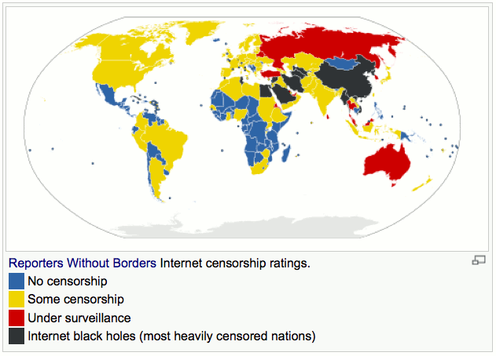
Credits: Wikipedia ; Creative Commons CC0 1.0 Universal Public Domain Dedication

Slide 3
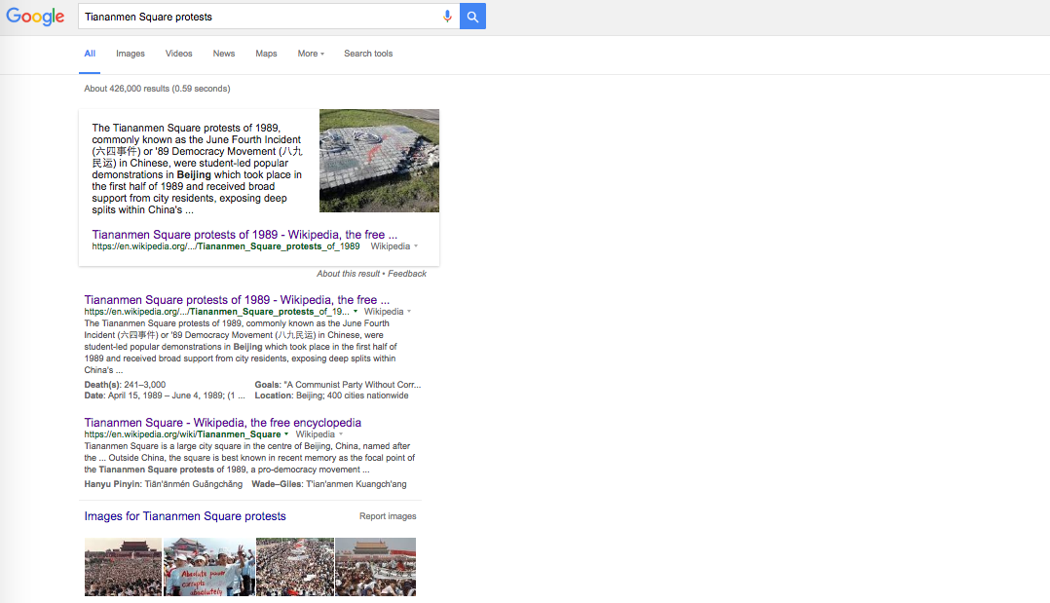
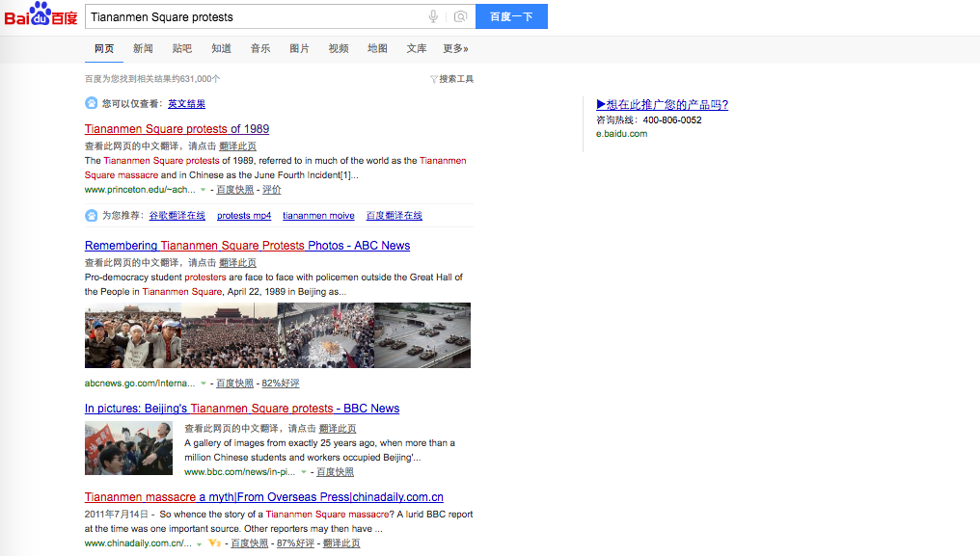
Notes:
-- Content, Behavior and Description.
Location, Time, Relevance (clicks)
Is this giving you a fair view of information?
It is highly and the user is happy. In this example.

Slide 4
Netflix, Amazon,
Google, Facebook,
may-be your refrigerator (in the future)?

Slide 5
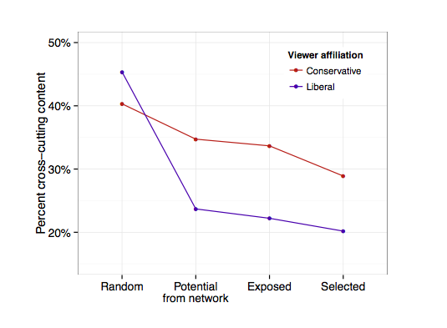
Notes:
Total proportion of hard news links on Facebook if everyone saw a random sample of everything

Slide 6
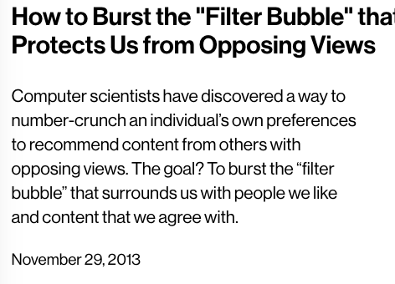
Notes:
-- Google’s search algorithm can easily shift the voting preferences of undecided voters by 20 percent or more—up to 80 percent in some demographic groups—with virtually no one knowing they are being manipulated.
-- Search Engine Manipulation Effect (SEME) turns out to be one of the largest behavioral effects ever discovered.
--
On average, you’re about 6% less likely to see content that the other political side favors. Who you’re friends with matters a good deal more than the algorithm.

Slide 7
Before You Go
P4 and P5
On a sheet of paper, answer the following (ungraded) question (no names, please):
What was the muddiest point in today’s class?

Slide 8
References
https://www.technologyreview.com/s/522111/how-to-burst-the-filter-bubble-that-protects-us-from-opposing-views/
http://www.theguardian.com/commentisfree/2016/apr/19/donald-trump-facebook-election-manipulate-behavior

