Slide 1
Privacy
Session 25
INST 301
Introduction to Information Science

Slide 2
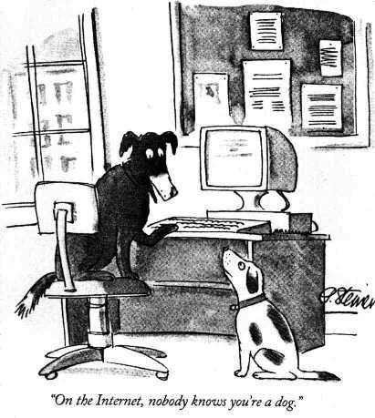

Slide 3
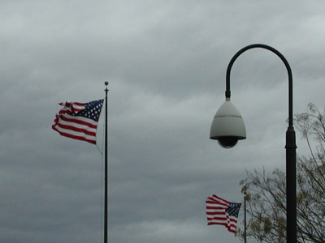
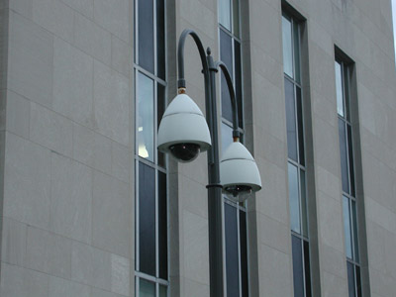
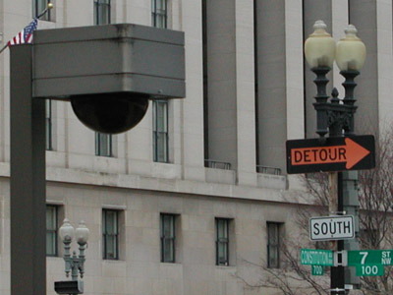
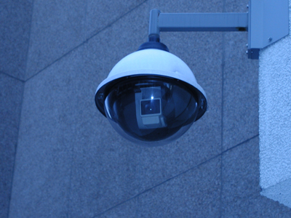
Privacy vs. Anonymity

Slide 4
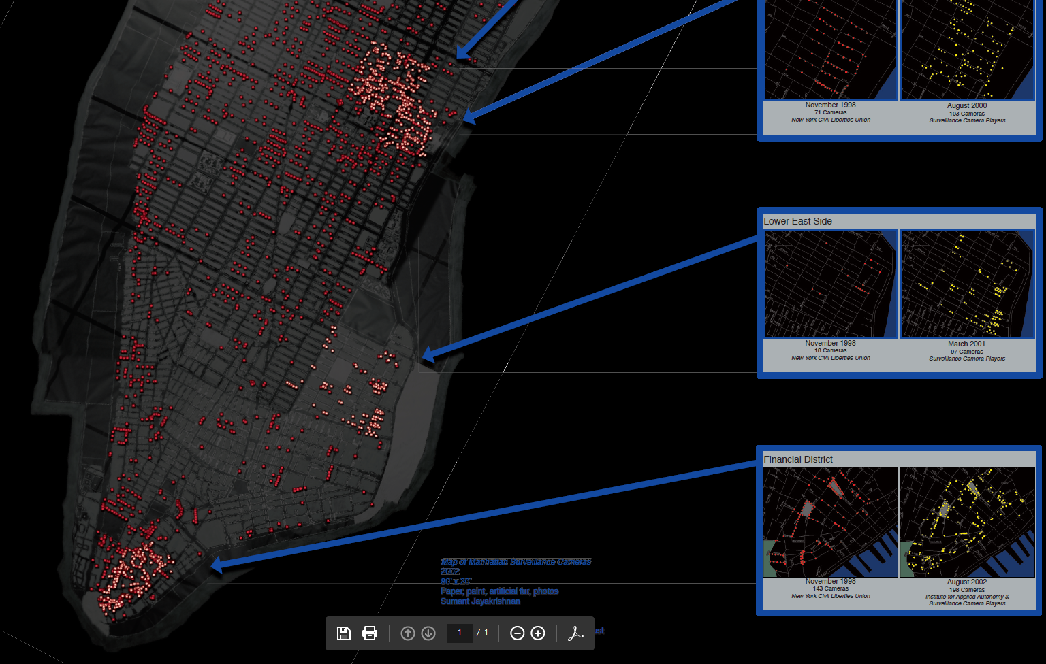
http://www.appliedautonomy.com/isee.html

Slide 5
Ideals in Tension
Whenever a conflict arises between privacy and accountability, people demand the former for themselves and the latter for everybody else.
The Transparent Society by David Brin

Slide 6
Privacy Protection (USA)
Government: Privacy Act of 1974
Applies only to government records
Commercial: Privacy policies
Federal Trade Commission enforcement
Employers: Ownership
Employers own content on services they provide

Slide 7
Obscurity
A lot of information is public record
Previously shielded by “practical obscurity”
Records were hard to access
Digital access changes that
Physical access
Search and data mining

Slide 8
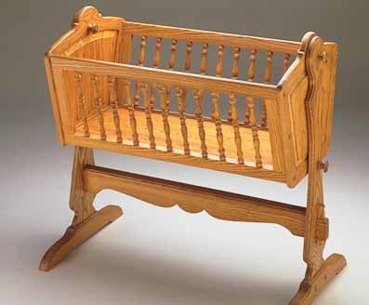
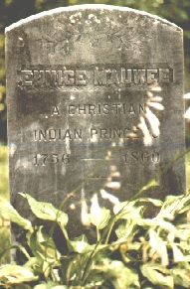
Tracking Before the Web
Governments have information about life events
Birth and death
Marriage and divorce
Licenses (e.g., drivers)
Property and taxes
Business exchange information about transactions
How you commute to work
What cereal you eat
Where you like to go for vacation
What hobbies you have

Slide 9
http://www.whitepages.com/

Slide 10
Online Tracking
Web tracking
Browser data, clickthrough, cookies, …
Packet sniffers
Detect passwords, reconstruct packets, …
Law enforcement
Carnivore (US), RIP (UK), …
National security
FISA (US), SORM (Russia), …

Slide 11
Centralized Surveillance
Proxy server
Set up a Web server and enable proxy function
Configure all browsers to use the proxy server
Store and analyze Web server log files
Firewall
Can monitor all applications, not just the Web

Slide 12
Distributed Tracking Ecosystem
http://wsj.com/wtk

