Slide 1

Information Security
Session 24
INST 301
Introduction to Information Science

Slide 2
Ownership
Who has the right to use a system?
  A server, the data, the Internet?
Who establishes this policy? How?
  What equity considerations are raised?
Can someone else deny access?
  Denial of service attacks
How can denial of service be prevented?
  Who can gain access and what can they do?

Slide 3
Authentication
Used to establish identity
Two types
  Physical (Keys, badges, cardkeys, thumbprints)
  Electronic (Passwords, digital signatures)
Two-factor authentication

Slide 4
Good Passwords
Long enough not to be guessed
  Programs can try every combination of 5 letters
Not in the dictionary
  Programs can try every word in a dictionary
    every proper name, every pair of words, every date, every …
Mix upper case, lower case, numbers
Change it often
Reuse creates risks
  Abuse, multiple compromise

Slide 5
Authentication Attacks
Brute force
Guessing
“Phishing”
Impersonation
Theft

Slide 6
Viruses
Platform dependent
Typically binary
Needs an execution path
  Autoexecution, authorized execution, buffer overflow
Most effective when not previously known
  “Zero-day exploit”

Slide 7
Trojan Horse
Malicious program with undesired capabilities
  Log key strokes and sends them somewhere
  Create a “back door” administrator logon
Spyware: reports information about your activity without your knowledge

Slide 8
Access Control Issues
Protect system administrator access
  Greater potential for damaging acts
  What about nefarious system administrators?
Firewalls
  Prevent unfamiliar packets from passing through
  Protects against application weaknesses

Slide 9
Denial of Service Attacks
Virus
Botnet
  Activate on command
Worm
  Self-replicating

Slide 10
Critical Infrastructure Protection
Telecommunications
Banking and finance
Energy
Transportation
Emergency services
Food and agriculture
Water
Public health
Postal and shipping
Defense industrial base
Hazardous materials
SCADA: Supervisory Control and Data Acquisition

Slide 11
Symmetric Key Encryption
Same key used both for encryption and decryption
key
key
Alice
Bob
Encrypt
Cipher text
Decrypt
Plain text
Plain text
Insecure channel
eavesdropper
eavesdropper
eavesdropper

Slide 12
Asymmetric Key Encryption
Different keys used for encryption and decryption
Bob’s public key
Bob’s private key
Alice
Bob
Encrypt
Cipher text
Decrypt
Plain text
Plain text
Insecure channel
eavesdropper
eavesdropper
eavesdropper

Slide 13
Asymmetric Key Encryption
Key = a large number (> 1024 bits)
  Public key: known by all authorized encoders
  Private key: known only by decoder
One-way mathematical functions
  “Trapdoor functions”
    Like mixing paint (easy to do, hard to undo)
  Large numbers are easy to multiply, hard to factor
Importance of longer keys
  Keys < 256 bits can be cracked in a few hours
  Keys > 1024 bits presently effectively unbreakable

Slide 14
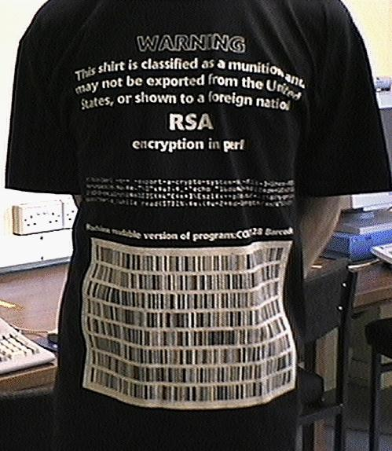
RSA “Public Key” Encryption
Until 1997 – Illegal to show this slide to non-US citizens!
print pack"C*", split/\D+/,
`echo "16iII*o\U@{$/=$z; [(pop,pop,unpack"H*",<>)]} \EsMsKsN0[lN*1lK[d2%Sa2/d0 <X+d*lMLa^*lN%0]dsXx++lMlN /dsM0<J]dsJxp"|dc`

Slide 15
Digital Signatures
Alice “signs” (encrypts) with her private key
  Bob checks (decrypts) with her public key
Bob knows it was from Alice
  Since only Alice knows Alice’s private key
Non-repudiation: Alice can’t deny signing message
  Except by claiming her private key was stolen!
Integrity: Bob can’t change message
  Doesn’t know Alice’s Private Key

Slide 16
Key Management
Pubic announcement of public key
  e.g., append public key to the end of each email
  But I can forge the announcement
Establish a trusted “certificate authority”
  Leverage “web of trust” to authenticate authority
  Register public key with certificate authority

Slide 17
Certificate Authority
Certificate Authority
Bob’s public key
Bob’s public key
Bob’s private key
Alice
Bob
Encrypt
Cipher text
Decrypt
Plain text
Plain text
Insecure channel
eavesdropper
eavesdropper
eavesdropper

Slide 18
What Goes Wrong?
Consider the Risks Digest articles you read
  http://catless.ncl.ac.uk/Risks
Focus on unexpected consequences
Try to articulate the root cause
  Not just the direct cause

Slide 19
Some Practical Tips
Keep anti-virus software current
Keep software updates current
Change default settings
Be wary of anything free

