Slide 1
Information Professions
Session 22
INST 301
Introduction to Information Science

Slide 2
Three Library Competencies
Management
Tech-nical Services
Reference
Service

Slide 3
HathiTrust
Centralized repository for digitized books
Google Books digitization (via owning libraries)
Microsoft book search (ran from 2006-2008)
Internet Archive
Million book project, project Gutenberg, contributions, …
Cooperative digitization
As of August 13, 2010
6,549,680 Total volumes
3,798,116 Book titles
153,311 Serial titles
1,300,896 Public Domain

Slide 4
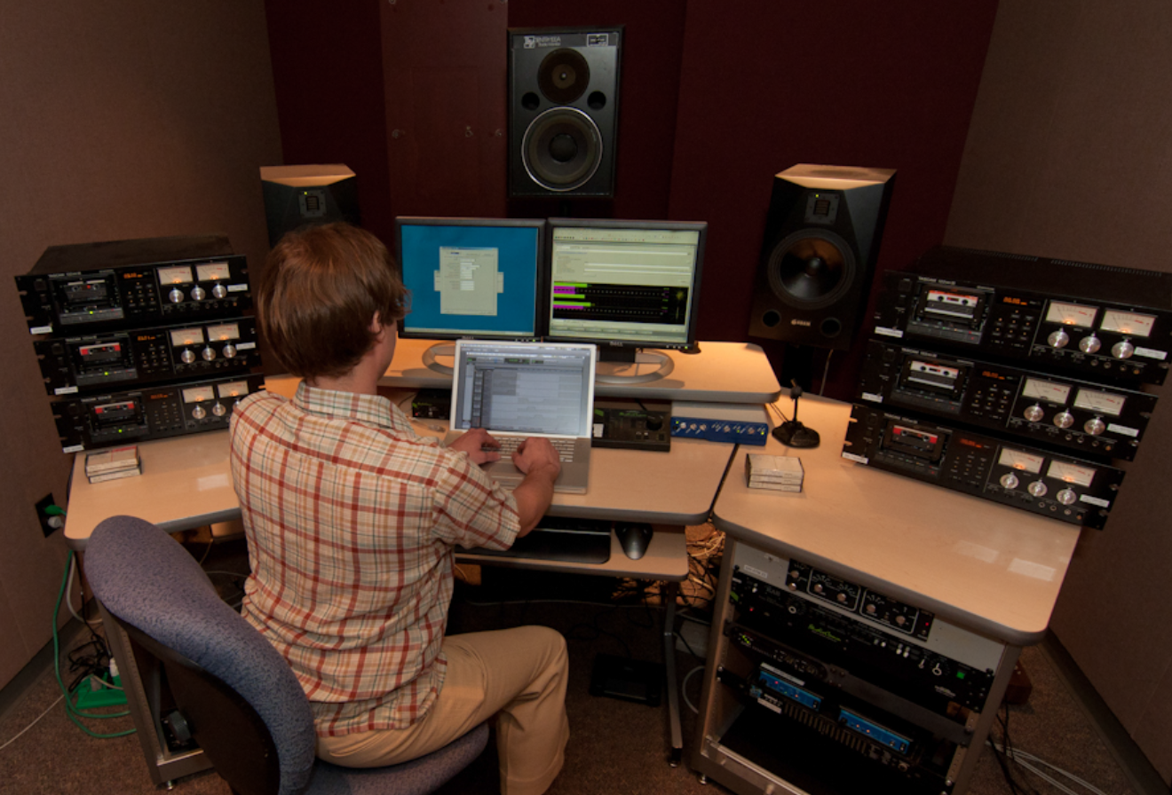
Indiana University Digitization

Slide 5
ITHAKA
JSTOR digitization
Back runs of journals
Recently expanded to books
Portico preservation
Centralized management, originally for journals
Release triggers: discontinuation, loss of access
Also service for books and datasets

Slide 6
Archives
Government
Legal, cultural
Institutional
Liability, institutional memory
Manuscript repositories
Research, preservation

Slide 7
National Archives Records Schedules
Schedule 1. Civilian Personnel Records
Schedule 2. Payrolling and Pay Administration Records
Schedule 3. Procurement, Supply, and Grant Records
Schedule 4. Property Disposal Records
Schedule 5. Budget Preparation, Presentation, and Apportionment Records
Schedule 6. Accountable Officers' Accounts Records
Schedule 7. Expenditure Accounting Records
Schedule 8. Stores, Plant, and Cost Accounting Records
Schedule 9. Travel and Transportation Records
Schedule 10. Motor Vehicle Maintenance and Operations Records
Schedule 11. Space and Maintenance Records
Schedule 12. Communications Records
Schedule 13. Printing, Binding, Duplication, and Distribution Records
Schedule 14. Information Services Records
Schedule 15. Housing Records
Schedule 16. Administrative Management Records
Schedule 17. Cartographic, Aerial Photographic, Architectural, and Engineering Records
Schedule 18. Security and Protective Services Records
Schedule 20. Electronic Records
Schedule 21. Audiovisual Records
Schedule 23. Records Common to Most Offices Within Agencies
Schedule 24. Information Technology Operations and Management Records
Schedule 25. Ethics Program Records
Schedule 26. Temporary Commissions, Boards, Councils and Committees
Schedule 27. Records of the Chief Information Officer

Slide 8
Appraisal
Value
Evidential
Informational
Costs
Storage, arrangement, description, preservation, …
Stakeholder interests
Primary: Institutional needs
Primary: Accountability
Secondary: Other future record users

Slide 9
DACS Principles
Records in archives possess unique characteristics.
The principle of respect des finds is the basis of archival arrangement and description.
Arrangement involves identification of groupings within material.
Description reflects arrangement.
The rules of description apply to all archival materials regardless of form or medium.
The principles of archival description apply equally to records created by corporate bodies, individuals, or families.
Archival descriptions may be presented at varying levels of detail to produce a variety of outputs.
The creators of archival materials, as well as the materials themselves, must be described.

Slide 10
(Single-Level) DACS Elements
Required
Optional
Reference code
Name+location of repository
Title
Date
Extent
Name of creator(s)
Scope and content
Conditions governing access
Languages and scripts
Plus, for “Optimal”
Administrative/biographical history
Access points
System of arrangement
Physical access
Technical access
Conditions for reproduction and use
(other) Finding aids
Custodial history
Immediate source of acquisition
Appraisal, destruction, scheduling
Accruals (anticipated additions)
Existence+location of originals
Existence+location of copies
Related archival materials
Publication note
Notes
Description control

Slide 11
The iSchool Vision
Data, Information, Knowledge
Information
People
Technology
Individuals, Institutions, Society
Tech, Knowledge, Adoption

Slide 12
Why iSchools Emerged
Increased number of research-focused universities
Closure of Library & Information Science (LIS) programs at many highly ranked universities
Internet emergence as a mass phenomenon

Slide 13
Defining an “LIS Program”
In North America, all library science education are Master’s Degree programs
The American Library Association accredits library science Masters programs in USA & Canada
Another organization accredits school library Masters programs
Currently 54 accredited LIS programs in the USA

Slide 14
US Federal R&D Funds to Universities

Slide 15
Library School Closures (post-1945)
Top-100 US Universities
Other US Universities
1962: Carnegie Institute (39)
1978: Oregon (90)
1985: Minnesota (20)
1986: Sothern California (32)
1986: Case Western (53)
1988: Vanderbilt (36)
1990: Chicago (8)
1992: Columbia (7)
1994: Berkeley (2)
1948: William and Mary
1952: NJ College for Women
1983: SUNY Genesco
1984: Mississippi
1985: Ball State
1993: Brigham Young (112)
1994: Northern Illinois
2005: Clark Atlanta
(2010 Shanghai Jiao Tong Academic Ranking of US Universities)

Slide 16
Consequences of the Web
Incremental change
Digital delivery
Commodity Web browser
Transformational change
Free integrated end-user search experience
Unlimited free perfect reproduction
Instantaneous free global communication
Previously unimaginable scale
The great reversal
From scarce information to scarce attention

Slide 17
US LIS Programs in Top-100 Universities
US LIS Program in an iSchool
Other US LIS Programs
UCLA (11)
Washington (14)
Wisconsin-Madison (15)
Michigan (18)
Illinois (19)
Maryland (28)
Texas (29)
UNC Chapel Hill (30)
Rutgers (37)
Pittsburgh (38)
Arizona (45)
Indiana (50)
Florida State (70)
Tennessee (70)
Kentucky (90)
Missouri-Columbia (90)
South Florida (90)
Hawaii (55)
Iowa (55)
Alabama (70)
Louisiana State (70)
SUNY Buffalo (90)
South Carolina (90)
(##)=2010 Academic Ranking of World Universities

Slide 18
US iSchools with No LIS Program
Former LIS programs
Others
UC Berkeley (2)
Carnegie Mellon (39)
Cornell (10)
Colorado-Boulder (24)
Pennsylvania State (31)
UC Irvine (32)
Michigan State (49)
Georgia Tech (55)
Maryland-Baltimore County
(##)=2010 Academic Ranking of World Universities

Slide 19
468 (of 2,200) US Universities offer 900 “Information” Masters Degrees
305 “Information Systems” Programs
IS, Management IS, Computer IS, Geographic IS, IS Management
118 “Information Technology” Programs
IT, IT Management, Business IT, Management of IT
106 “Informatics” Programs
Bioinformatics, Health informatics
98 “Information Science” Programs
Library & IS, Computer & IS, IS, Information Studies
ASIST Task Force on Information Professionals, 2008

Slide 20
iSchools Outside the USA
Europe (19)
Elsewhere (17)
Czech Republic: 1
Denmark: 1
Finland: 1
France: 1
Germany: 2
Ireland: 1
Portugal: 2
Spain: 3
Sweden: 1
United Kingdom: 6
Australia: 3
Canada: 3
China: 3
Israel: 1
Korea: 3
Japan: 1
Singapore: 1
Turkey: 1
Uganda: 1

Slide 21
Maryland’s iSchool Faculty
LIS-Focused
Humanities-Focused
Policy
John Bertot
Ursula Gorham
Paul Jaeger
Youth Experience
June Ahn
Tammy Clegg
Mega Subramaniam
Ann Weeks
Information Organization
Katy Lawley
Archives
Ken Heger
Michael Kurtz
Richard Marciano
Ricky Punzalan
Katie Shilton
Digital Humanities
Kari Kraus

Slide 22
Maryland’s iSchool Faculty
Social Science Focus
Technology-Focused
Communications
Beth St .Jean
Yla Tausczik
Jessica Vitak
Andrea Wiggins
Susan Winter
Information Management
Brian Butler
Vedat Diker
Kanti Srikantaiah
Ping Wang
Kathy Weaver
Human-Computer Interaction
Marshini Chetty
Allison Druin
Niklas Elmqvist
Leah Findlater
Jenny Preece
Human Language Technology
Doug Oard
Social Networks
Vanessa Frias-Martinez
Jen Golbeck

Slide 23
Behind the Numbers
Information policy
Intergenerational design teams
Value-sensitive design
Online communities
Technology adoption

Slide 24
Degree Programs
Bachelor of Science in Informatics (f2f: from 2016)
Master of Library Science (f2f, online)
Libraries
School Libraries
Archives and Records Management
Master of Information Management (f2f, online)
M.S. in Human-Computer Interaction (f2f)
Ph.D. in Information Studies (f2f)

Slide 25
The MLIS Core
LBSC 791
Designing Principled Inquiry
LBSC 631
Achieving
Organizational Excellence
TOP
BACK
LBSC 671
Creating
Information
Infrastructures
LBSC 602
Serving Information Needs
FRONT

Slide 26
The MLS Program
Specializations
School Library
Archives, Records, and Information Management
History and Library Science dual degree program
Government Information Management & Services
Information and Diverse Populations
Curation and Management of Digital Assets
Unspecializations
Thesis option
Individualized Program Plan
Top
Front
Back

Slide 27
Example Research Projects
Diffusion of Technical Innovation
Preserving Virtual Worlds
Public Libraries and the Internet
Kids Team
E-Discovery
International Childrens’ Digital Library
Ethical Design for Named Data Networking

