Slide 1
Information Institutions
Session 21
INST 301
Introduction to Information Science

Slide 2
“Information Institutions”
Schools
Primary, Secondary, Tertiary
Libraries
Public, Academic, School, Special
Archives
Government, Corporate, …
Special collections, Historical societies
Museums
Art, Material culture, Natural history
Search engines
Google, Bing, Baidu, Yandex
“LAM”

Slide 3
A Collection Development Policy
Customer use is the most powerful influence on the Library’s collection. …The other driving force is the Library’s strategic plan.
… selections are made to provide depth and diversity of viewpoints to the existing collection and to build the world-class Western History/Genealogy and African American Research Library collections. …
… The Library provides materials to support each individual’s journey, and does not place a value on one customer’s needs or preferences over another’s. …
Materials for children and teenagers are intended to broaden their vision, support recreational reading …
Denver Public Library, 2012

Slide 4
Access models
Ownership (“just in case”)
Unlimited use for an unlimited period
Right of first sale vs. license restrictions
Subscription
Unlimited (or limited) use for a defined period
Single vs. multiple users
Pay-per-view (“just in time”)

Slide 5
Zipf’s Law

Slide 6
Physical Storage
Segregate by:
Users (e.g., Chemistry library)
Type (e.g., audiovisual materials)
Usage frequency (e.g., offsite storage)
Size (e.g., folios)
Arrange in a way that facilitates access
Topical shelf order (e.g., Dewey Decimal System)
Foster preservation
Environment (temperature, humidity, light)
Access controls (closed stacks, gloves, …)

Slide 7
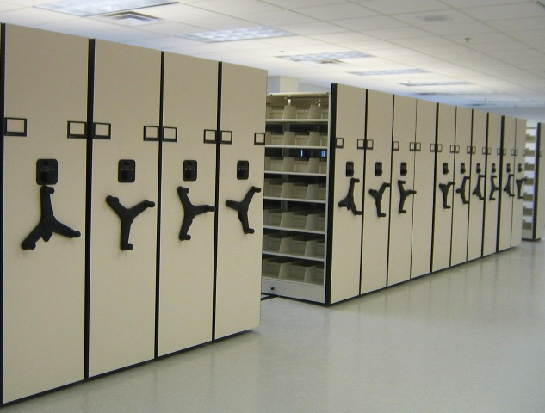
High-Density Shelving
http://www.kmhsystems.com/high-density-storage.html

Slide 8
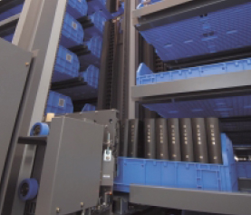
Compact Storage Robot
Kyushu University, Japan

Slide 9
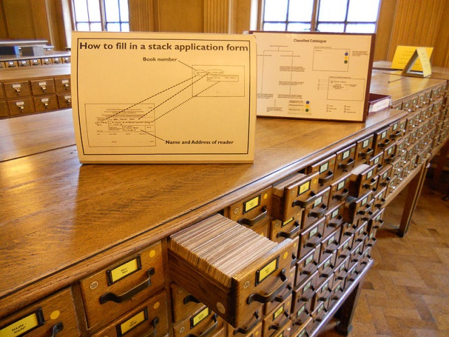
Access Points
Originally designed for card catalogs
One card for every “authorized” access point
Four types “dictionary” catalog access points
Title (uniform titles)
Author (name authority)
Subject (controlled vocabulary)
Series
Other things can serve a similar purpose
Call number (shelf order)
“Keywords” (full-text search)

Slide 10
Library of Congress Subject Headings
Controlled vocabulary for subject access points
Most commonly applied to books and serials
Used when a subject describes ≥20% of the work
Choose the most specific appropriate headings
But if more than 3 subtopics, choose a broader heading

Slide 11
A Framework: FRBR
The Organization
of Information
Third Edition
Paperback
(ISBN 978-1-59…)
Copy 2
(barcode 102343…)

Slide 12
Family of Works
Equivalent
Derivative
Descriptive
Free
Translation
Review
Microform
Reproduction
Edition
Summary
Casebook
Simultaneous
“Publication”
Abridged
Edition
Abstract
Dramatization
Digest
Novelization
Criticism
Screenplay
Copy
Libretto
Revision
Illustrated
Edition
Evaluation
Change of Genre
Exact
Reproduction
Parody
Translation
Expurgated
Edition
Annotated
Edition
Imitation
Variations or Versions
Same Style or
Thematic Content
Facsimile
Arrangement
Commentary
Reprint
Slight
Modification
Adaptation
Original Work - Same Expression
Same Work –
New Expression
New Work
Cataloging Rules Cut-Off Point
RDA for Georgia, 2011
Notes:
12
This picture shows a continuum of the relationships within a family of works as represented in manifestations <click> moving from left to right following this red arrow On the left <click> are those that are equivalent content, that are from the same expression of the same work. Once we introduce a change to the content, like a translation, <click> we have a new expression of the same work - and as we make further changes to the content we move further to the right, farther away from the original work. These are derivative expressions of the same work. Once that derivation crosses the <click> “magic line” of becoming more of the work of another person or corporate body, we consider it a new work, but it is part of the family of related works, even when the content moves on to be only describing <click> a work in the family at the right end of this continuum. Works in a descriptive relationship can also be said to be in a subject relationships, because the subject of those works is another work – as with a commentary on a work.
The ability to inform the user of these related works ties back to the ** collocating and finding functions of a catalog. We need to show users the pathways to related materials. The FRBR model reminds us of these important relationships that we should reflect in our catalogs and resource discovery systems for our users.

Slide 13
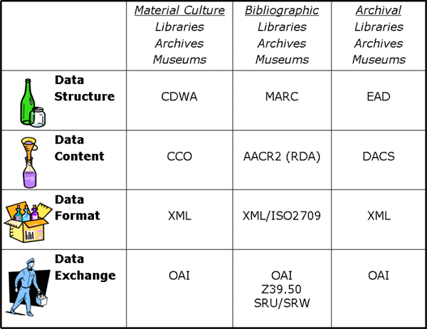
Metadata
Adapted from Elings and Waibel, First Monday, (12)3, 2007

Slide 14
Some Types of “Metadata”
Descriptive
Content, creation process, relationships
Technical
Format, system requirements
Administrative
Acquisition, authentication, access rights
Preservation
Media migration
Usage
Display, derivative works
Not in
Taylor &
Joudrey
Adapted from
Introduction to Metadata,
Getty Information Institute (2000)

Slide 15
Aspects of Metadata
Framework
Functional Requirements for Bibliographic Records (FRBR)
Schema (“Data Fields and Structure”)
Dublin Core
Guidelines (“Data Content and Values”)
Resource Description and Access (RDA)
Library of Congress Subject Headings (LCSH)
Representation (abstract “Data Format”)
Resource Description Framework (RDF)
Serialization (“Data Format”)
RDF in eXtensible Markup Language (RDF/XML)
Adapted from Elings and Waibel, First Monday, (12)3, 2007

Slide 16
Some RDA Elements for Products
Work
ID
Title
Date
etc.
Expression
ID
Form
Date
Language
etc.
Manifestation
ID
Title
Statement of responsibility
Edition
Imprint (place, publisher, date)
Form/extent of carrier
Terms of availability
Mode of access
etc.
Item
ID
Provenance
Location
etc.
RDA for Georgia, 2011
Notes:
16
Remember this slide from the earlier presentation that lists the elements that identify each of the FRBR Group 1 entities.

Slide 17
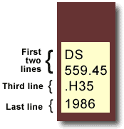
Library of Congress Classification
Book title: Uncensored War: The Media and Vietnam Author: Daniel C. Hallin Call Number: DS559.46 .H35 1986
The first two lines describe the subject of the book. DS559.45 = Vietnamese Conflict
The third line often represents the author's last name. H = Hallin
The last line represents the date of publication.
D History
DS1-937 History of Asia
DS520-560.72 Southeast Asia
DS556-559.93 Vietnam. Annam
DS557-559.9 Vietnamese Conflict
After other initial consonants for the second letter: use number: |  | a 3 | e 4 | i 5 | o 6 | r 7 | u 8 | y 9
For expansion for the letter: use number: |  | a-d 3 | e-h 4 | i-l 5 | m-o 6 | p-s 7 | t-v 8 | w-z 9
http://www.usg.edu/galileo/skills/unit03/libraries03_04.phtml

Slide 18
The World Is Flat (in LCC)
HM846 .F74 2005
H Social sciences
HM Sociology
HM831 Social change – Causes
HM846 Technological Innovations. Technology.
.F74 Cutter number for Friedman, Thomas

Slide 19
The World Is Flat (in Dewey)
303.4833
300 Social science
300 Social sciences, sociology, & anthropology
303 Social processes
303.4 Social change
303.48 Causes of change
303.483 Development of science and technology
303.4833 Communication (Information technology)

Slide 20
LCSH Subdivisions
Topical
Archaeology – Methodology
Form
Archaeology – Fiction
Chronological
Archaeology – History – 18th century
Geographic
Archaeology – Egypt

Slide 21
Inter-Library Loan
Users search “union catalog” to find books
Remote library “ships” it to local library
Often by scanning it, where practical
Someone pays for this (local library or user)
Local library manages circulation
Limited access period
Some “return” mechanism

Slide 22
Weeding (“Library Hygiene”)
Presumes some limited asset
e.g., shelf space, browsing time, …
Anticipated future use
Reshelving and circulation statistics
Historical value
Sufficiency of single copies
Last copy doctrine
Condition
Preservation costs

Slide 23
HathiTrust
Centralized repository for digitized books
Google Books digitization (via owning libraries)
Microsoft book search (ran from 2006-2008)
Internet Archive
Million book project, project Gutenberg, contributions, …
Cooperative digitization
As of August 13, 2010
6,549,680 Total volumes
3,798,116 Book titles
153,311 Serial titles
1,300,896 Public Domain

Slide 24
Archives
Government
Legal, cultural
Institutional
Liability, institutional memory
Manuscript repositories
Research, preservation

Slide 25
Some Sources for Collections
Institutional components
Transferred from records management
Donors
Typically deed of gift specifies terms
Purchase

Slide 26
National Archives Records Schedules
Schedule 1. Civilian Personnel Records
Schedule 2. Payrolling and Pay Administration Records
Schedule 3. Procurement, Supply, and Grant Records
Schedule 4. Property Disposal Records
Schedule 5. Budget Preparation, Presentation, and Apportionment Records
Schedule 6. Accountable Officers' Accounts Records
Schedule 7. Expenditure Accounting Records
Schedule 8. Stores, Plant, and Cost Accounting Records
Schedule 9. Travel and Transportation Records
Schedule 10. Motor Vehicle Maintenance and Operations Records
Schedule 11. Space and Maintenance Records
Schedule 12. Communications Records
Schedule 13. Printing, Binding, Duplication, and Distribution Records
Schedule 14. Information Services Records
Schedule 15. Housing Records
Schedule 16. Administrative Management Records
Schedule 17. Cartographic, Aerial Photographic, Architectural, and Engineering Records
Schedule 18. Security and Protective Services Records
Schedule 20. Electronic Records
Schedule 21. Audiovisual Records
Schedule 23. Records Common to Most Offices Within Agencies
Schedule 24. Information Technology Operations and Management Records
Schedule 25. Ethics Program Records
Schedule 26. Temporary Commissions, Boards, Councils and Committees
Schedule 27. Records of the Chief Information Officer

Slide 27
Appraisal
Value
Evidential
Informational
Costs
Storage, arrangement, description, preservation, …
Stakeholder interests
Primary: Institutional needs
Primary: Accountability
Secondary: Other future record users

Slide 28
DACS Principles
Records in archives possess unique characteristics.
The principle of respect des finds is the basis of archival arrangement and description.
Arrangement involves identification of groupings within material.
Description reflects arrangement.
The rules of description apply to all archival materials regardless of form or medium.
The principles of archival description apply equally to records created by corporate bodies, individuals, or families.
Archival descriptions may be presented at varying levels of detail to produce a variety of outputs.
The creators of archival materials, as well as the materials themselves, must be described.

Slide 29
(Single-Level) DACS Elements
Required
Optional
Reference code
Name+location of repository
Title
Date
Extent
Name of creator(s)
Scope and content
Conditions governing access
Languages and scripts
Plus, for “Optimal”
Administrative/biographical history
Access points
System of arrangement
Physical access
Technical access
Conditions for reproduction and use
(other) Finding aids
Custodial history
Immediate source of acquisition
Appraisal, destruction, scheduling
Accruals (anticipated additions)
Existence+location of originals
Existence+location of copies
Related archival materials
Publication note
Notes
Description control

Slide 30
Deaccessioning
Space limits
Policy changes
Technology changes

Slide 31
Threats to Physical Collections
Organic decay
Intentional actions
Pilferage and vandalism
Official acts
Disasters
Natural disasters
Flood, tornado, earthquake, …
Accidents
Fire, sprinkler malfunction, …
Armed conflict

Slide 32
Organic Decay
Rag paper: 300-2,000 years
Acidic paper: 25-50 years
Acetate film: 40 years
Nitrate film: 40-1-00 years
ISO 11799:2003
Image Permanence Institute, 2012

Slide 33
Digital Preservation
Preservation of born-digital materials
Preserving appearance and interpretability
Preserving behavior
Digitization for preservation
Scanning (of paper, of microfilm)
Audio digitization
Video digitization
Volumetric imaging
Digital holography, computational tomography

Slide 34
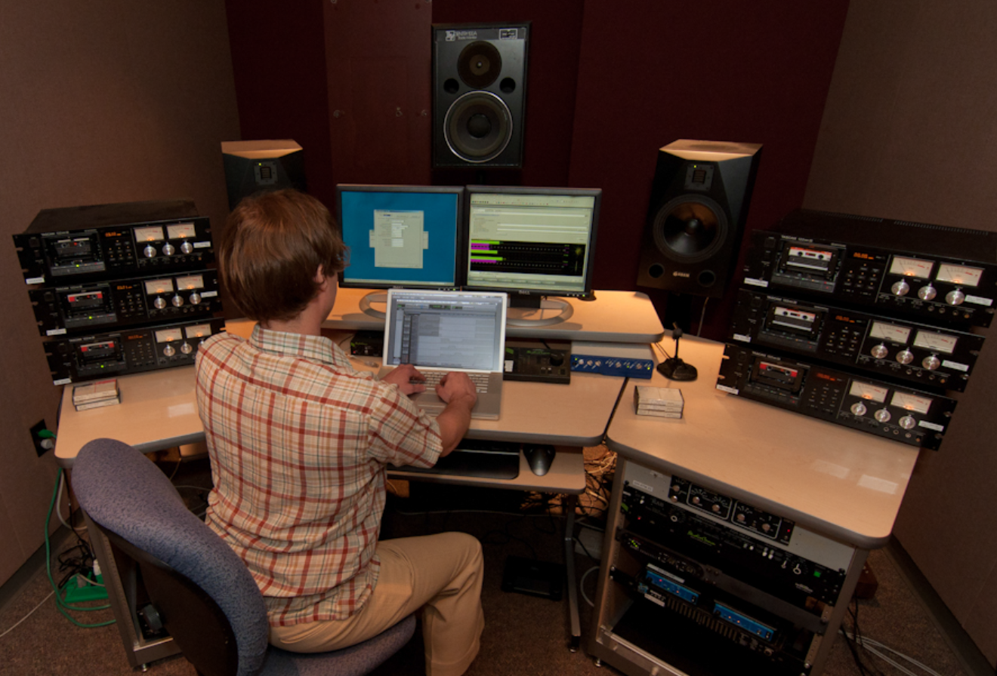
Indiana University Digitization

Slide 35
Preserving Behavior
Word processors
Formatting, track changes, undo deleted text
Spreadsheets
Formulas, visualizations
Databases
Queries, forms, derived values
Computer-Assisted Design (CAD)
Display, modification, manufacturing
Software
Simulation, games, embedded systems, …

Slide 36
Behavior Preservation Strategies
Format migration
For example, convert Word Perfect to PDF
Emulation
Allows running old software on newer systems

Slide 37
ITHAKA
JSTOR digitization
Back runs of journals
Recently expanded to books
Portico preservation
Centralized management, originally for journals
Release triggers: discontinuation, loss of access
Also service for books and datasets

