Slide 1
Collaboration Support
Session 20
INST 301
Introduction to Information Science

Slide 2
Global Software Teams
Barriers
Solutions
Geographic distance
Temporal distance
Linguistic & cultural distance
Fear and trust
Organizational structure
Process
Infrastructure
Project Architecture
Cultural ambassadors
Configuration management
Face to face kickoffs
Modularity
Well defined interfaces
Effective handoffs
Win-win strategies

Slide 3
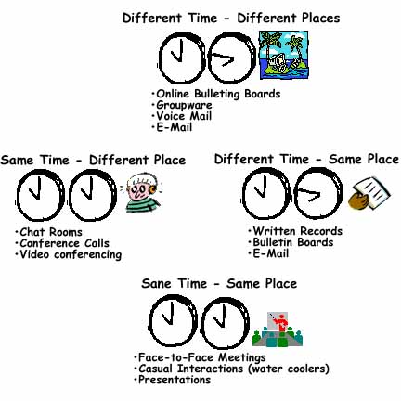
http://www.fullcirc.com/community/diffmodes.htm

Slide 4
CSCW
Work
Grounded in the study of work processes
Cooperative
Assumes a shared objective, task
Computer-supported

Slide 5
Example
Google Docs
http://docs.google.com

Slide 6
Key Issues in CSCW
Shared information space
Group awareness
Coordination
Concurrency control
Multi-user interfaces
Heterogeneous environments

Slide 7
Online Patient Support Groups
Online support group participants include 28% of adult Internet users (34 million) in 2001
Slide borrowed from Derek Hansen

Slide 8
Core Attributes
Shared goal, interest, need, or activity
Some members engage in repeated, active participation
Access to shared resources
And policies manage the access to those resources.
Reciprocity of information, support and services
Shared context
Social conventions, language, protocols, …
(Preece 2001)

Slide 9
Usability & Sociability
Support evolving community
Design Usability
Interaction dialog
Navigation
Registration forms
Feedback
Representations of users
Message format
Archives
Support tools
Design sociability
Policies for:
Membership
Codes of conduct
Security
Privacy
Copyright
Free speech
Moderators
Assess community needs
Preece 2000

Slide 10
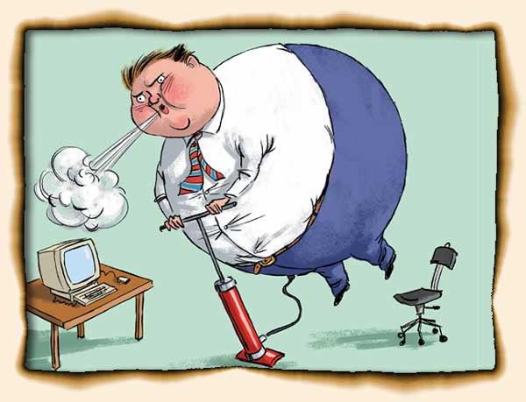
Roles
Lurkers
Dominators
Linkers, pollinators
Flamers
Newbies
Polly Annas
http://www.fullcirc.com/community/memberroles.htm
http://redwing.hutman.net/%7Emreed/
Slide borrowed from Nancy Atkinson

Slide 11
Design Strategies of Successful Communities
Define and articulate your PURPOSE
Build flexible, extensible gathering PLACES
Create meaningful and evolving member PROFILES
Design for a range of ROLES (newcomers, leaders …)
Develop a strong LEADERSHIP program
Encourage appropriate ETIQUETTE
Promote cyclic EVENTS
Integrate the RITUALS of community life
Facilitate member-run SUBGROUPS
http://www.peachpit.com/articles/printerfriendly.aspx?p=21189 (Kim 2001)

Slide 12
Community Question Answering

Slide 13
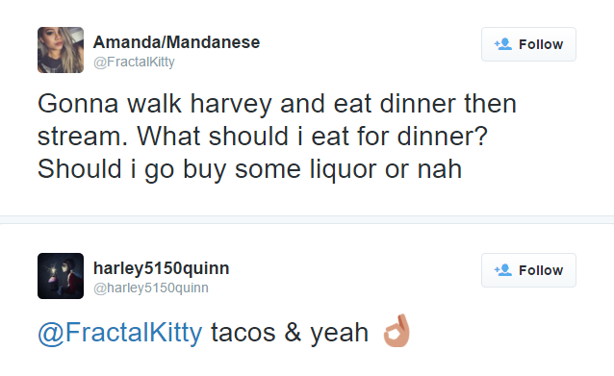
Yahoo! Community Question Answering
TREC LiveQA
No
Is Question?
Yes
(twitter.com)
Title
TW-A
TW-Q
Title + Body
(Indri BM25)
Question
Reply
(Indri BM25)
(Online retrieval)
(Jaccard similarity with Title)
(Answer)
(Answer)
https://answers.yahoo.com/question/index?qid=20150901082719AAkidKn

Slide 14
The Project
P1: Teams and topics announced tonight
P2: Technology
P3: Social Issues
P4: Analysis
P5: Presentation

