Slide 1
Data, Information and Knowledge (and the delayed Introduction!)
Session 2
INST 301
Introduction to Information Science

Slide 2
Outline
The Third Wave
Data / Information / Knowledge
All the usual stuff (syllabus, grading, …)
Information Science major

Slide 3
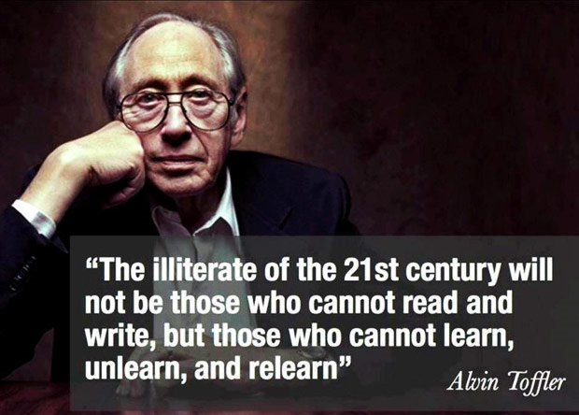
What is a Futurist?

Slide 4
Outline
The Third Wave
Data / Information / Knowledge
All the usual stuff (syllabus, grading, …)
Information Science major

Slide 5
“Information”
Wisdom
Knowledge
Information
Data

Slide 6
Information Hierarchy
Data
Raw “facts”
Information
Contextualized facts
Knowledge
Actionable contextualized facts
Wisdom
Judgmental choices among possible actions

Slide 7
An Example
Data
98.6º F, 99.5º F, 100.3º F, 101º F, …
Information
Hourly body temperature: 98.6º F, 99.5º F, 100.3º F, 101º F, …
Knowledge
If you have a temperature above 100º F, you most likely have a fever
Wisdom
If you don’t feel well, go see a doctor

Slide 8
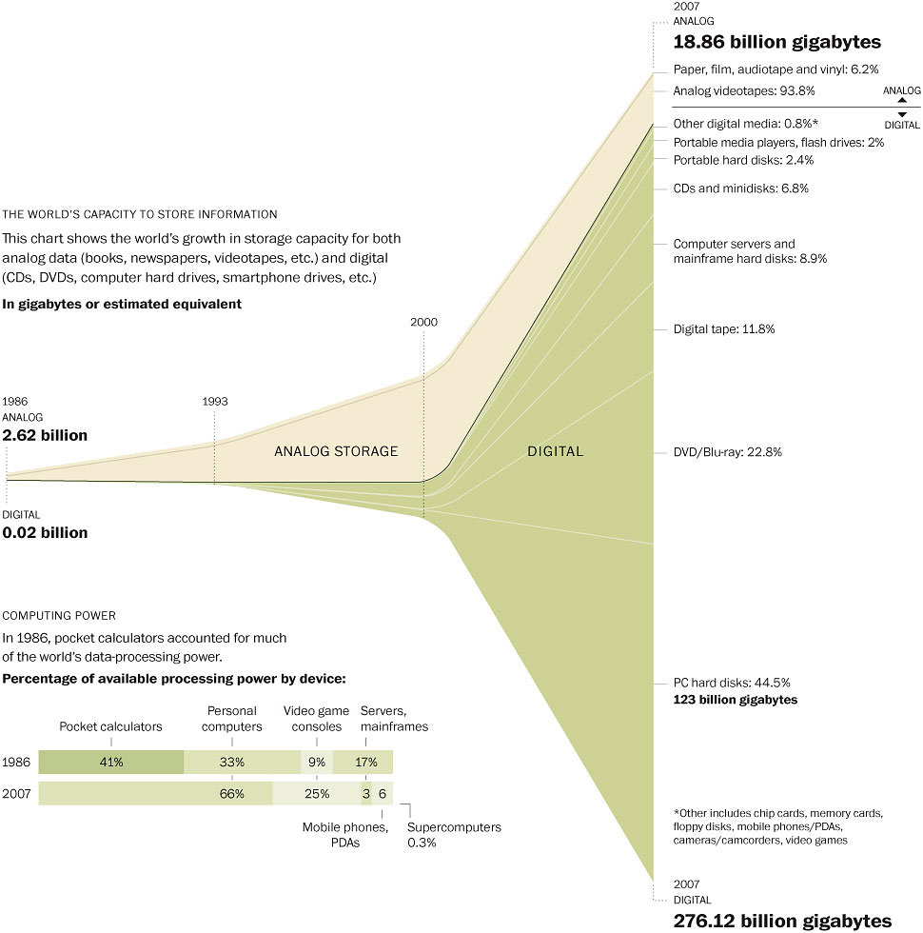
Washington Post (2007)

Slide 9
Outline
The Third Wave
Data / Information / Knowledge
All the usual stuff (syllabus, grading, …)
Information Science major

Slide 10
Course Description
Introduction of information and knowledge management systems and their use by organizations.
Concepts underlying
database,
information retrieval, and
knowledge management systems will be discussed.
Focus on
the processes of becoming informed and
the products which result from those processes, as well as
the innovative approaches to information problem solving within an organization.

Slide 11
Information
Data
Knowledge
(individual)
(organization)
(society)
Information
Enterprise Sys
Lifecycle
Internet
Data as Asset
Collaboration
Web
Data Modeling
Institutions
Search Engines
Databases (2)
Professions
User Needs
Databases
Digital Gov
Search Strategy
CMS
Security
Social Networks
Linked Data
Privacy
Data Mining
Filter Bubble
Ethics

Slide 12
Some “Subtexts”
The nature of innovation
The interplay of technology and society
The role of technical competence
Different ways of knowing and doing

Slide 13
Approach
Readings (done before class)
Acquire background
Can be consulted later as a source for details
Class sessions
Develop conceptual structure
Homework, Project
Gain hands-on experience
Quizzes, exams
Focus effort, measure progress

Slide 14
Structure
Classes start promptly at 2 PM
End promptly at 3:15
Bring your devices and use them
But stay focused on the class discussion
Quiz at start of class on Tuesday
Exceptions: today; exam days
Homework due at start of class each Thursday
Exception: this week
Team project during Module 3
Three “open book” exams

Slide 15
Grading
60% for individual work
11 quizzes @ 2% each for your best 10
3 exams @ 20% each for your best 2
20% for group work
Same grade for everyone in a project team
20% your choice (individual or group)
8 assignments @ 4% each (but capped at 20%)
No curve!
90-100: some sort of A, 80-89: some sort of B, …

Slide 16
The Fine Print
Group work is encouraged on homework
But you must personally write what you turn in
Deadlines are firm and sharp
Allowances for individual circumstances are already included in the grading computation
Academic integrity is a serious matter
No group work during the exams or quiz!es
Scrupulously respect time limits

Slide 17
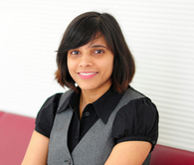
Contact Information
Doug Oard:
Office: AVW 3126 (or, by arrangement, HBK 2118F)
Office Hours: Wednesdays 10-10:55 AM
I’m also usually happy to stay after class
Email: oard@umd.edu (answered within 24 hours)
Indicate if you do not want my answer sent to the class
Jyothi Vinjumur
Office: AVW 3126
Office Hours: Mondays 4-5 PM
Email: jyothikv@umd.edu (answered within 24 hours)

Slide 18
A Personal Approach to Learning
Work ahead, so that you are never behind
Find new questions everywhere
Then find the answers somewhere
Enrich your practical skills relentlessly
Pick topics you want to learn more about

Slide 19
Our Next Reading

Slide 20
Outline
The Third Wave
Data / Information / Knowledge
All the usual stuff (syllabus, grading, …)
Information Science major

Slide 21
“Information Science”
People
Information
Technology
Notes:
There will be a single major – Information Science. But then 3-4 concentrations with the first to be Data Science. The others have not been figured out fully although one may be along the Developer lines (tech) and one along Project manager or Entrepreneur (people). Concentrations do not need state approval to be altered like majors and programs, so they can be more adaptable to the changing fields.

Slide 22
B.S. in Information Science
Data Science
Web-Enabled Databases
Data Mining
Visualization
Decision Support
Data
Science
Concentration
Information Organization
Web Programming
Statistical Analysis
User Needs Analysis
Integrative Capstone
Introduction to Information Science
Internet Infrastructure
Data
Modeling
User Experience Design
Teams & Organizations
Core
Elementary
Statistics
Pre-Calculus
Mathematics
Programming for non-CS Majors
Introduction to Psychology
Prerequisites
Other
Stuff
Notes:
The required 10 courses for all BSIS students, no matter their concentration.

Slide 23
Before You Go
Please complete the ungraded survey

