Slide 1
Knowledge Lifecycle
Session 18
INST 301
Introduction to Information Science

Slide 2
Wisdom
Knowledge
Information
Data

Slide 3
Information Hierarchy
Data
Raw “facts”
Information
Contextualized facts
Knowledge
Actionable contextualized facts
Wisdom
Judgmental choices among possible actions

Slide 4
Knowledge
“Knowledge is a fluid mix of framed experience, values, contextual information, and expert insight that provides a framework for evaluating and incorporating new experiences and information. It originates and is applied in the minds of knowers. In organizations, it often becomes embedded not only in documents or repositories but also in organizational routines, processes, practices, and norms.”
Davenport, Thomas A. and Lawrence Prusak
Working Knowledge: How Organizations Manage What
They Know, Boston, Mass., Harvard Business School
Press, 1998.

Slide 5
Two Types of Knowledge
Explicit knowledge refers to what has been codified, structured or semi-structured, recorded and is accessible.
2. Tacit knowledge refers to the knowledge that resides in an individual’s mind. It is the “know-how” and experience of the staff member that is vital to the organization.

Slide 6
Internal Sources of Tacit Knowledge
Information repositories
Subject Matter Expert (SME) directories
Apprenticeships
Mentoring
Communities of practice
“After action” and project milestone reviews
Strategic staffing
Recruiting, retention, developmental assignments
Oral history program

Slide 7
A Broader View
Internal
External
Knowledge | - Colleagues - Meetings | - Contacts - Networking
Information | - Intranet - CMS | - Libraries - Search engines
Data | -Databases -Data mining | - Market research

Slide 8
Knowledge Conversion
To
Tacit
Explicit
Tacit
Socialization
Externalization
From
Explicit
Internalization
Combination
Ikujiro Nonaka and Hirotaka Takeuchi, The Knowledge Creating Company, New York, Oxford University Press, 1995.

Slide 9
Knowledge Management
“Knowledge Management deals with the systematic process of identifying, capturing, organizing and disseminating/sharing explicit and tacit knowledge that add value within an organization”
“A broad process of locating, organizing, transferring and using information and expertise within an organization.”

Slide 10
Information Management
Data becomes information when its creator adds meaning
Information is created when data is:
Contextualized
Categorized
Calculated
Corrected
Condensed
Knowledge Management
Information becomes knowledge through human transformation
Transformation happens through:
Comparison
Consequences
Connections
Conversations
Working Knowledge, 1998
T. Davenport & L. Prusak

Slide 11
Why We Don’t Share: People
People don’t know what they know; don’t know that what they know may be valuable to others; and don’t know who wants to know what they know
People don’t have trusting relationships with others
People don’t have time to share
People don’t care about sharing
People are afraid to share (knowledge is power; fear of negative consequences)
People don’t ask
People work for people who don’t share
(Source: Michael J.Novak)

Slide 12
Why We Don’t Share: Organization
Stovepipes
Not invented here
Focus on explicit rather than tacit knowledge
Intra-organizational competition
“Knowledge is power”
Lack of systematic, holistic approach to managing the organization
(Source: Michael J.Novak)

Slide 13
Why We Don’t Share: Process
No formal process for sharing
Informal sharing processes not supported by management
Knowledge sharing viewed as “overhead” or “support;”
As opposed to “value adding” or “value creating”
No coherent approach to process management
Process management focuses on individual processes
As opposed to the overall organization
(Source: Michael J.Novak)

Slide 14
Why We Don’t Share: Technology
Obsolete systems
Multiple, incompatible systems
Systems not user-friendly
Systems not accessible
Systems not maintained, improved, updated
Lack of training on use of systems
(Source: Michael J.Novak)

Slide 15
Implementing KM
Making Knowledge Visible
Who knows what
Taxonomy of expertise
Yellow Pages
Competence
Building “Knowledge-Intensiveness”
Training, face to face contacts
Competence centers
Community of practices
Management of knowledge process
Networking
Building Knowledge Infrastructure
Common communication infrastructure
Access to external/internal
information/knowledge sources
Use of Modern methods and tools
Developing a Knowledge Culture
Values and culture
Rewarding
Sharing/exchange of knowledge
Shared mindsets and visions
Trust on each other
From an article by Marianne Broadbent

Slide 16
Physical Arrangement
My organization attempts to locate employees and groups who need to share information in the same physical space.
When employees who need to share information are scattered in different locations, their ability to share is facilitated through frequent face-to-face meetings or other means.
My organization’s office designs and layouts encourage information sharing.
Documents, posters, videos and other physical dispersal mechanisms are used to facilitate information use and sharing.
We attempt to distribute value-added information to dispersed workers rather than raw data.
Source: Davenport, Thomas H. and Lawrence Prusak, Information Ecology: Mastering the Information
and Knowledge Environment, Harvard Business School Press, (1997) pp. 175-192.

Slide 17
Communities of Practice
Are made up of volunteers – no one forces them to join
While they may learn and work together, they don’t produce community deliverables or meet deadlines
They are distinguished by what brings them together
May have stated goals but these may be very broad and general
Members tend to be like each other with same types of jobs and/or skills
These communities last as long as members want them to last

Slide 18
Life Cycle of the Community (Wenger)
Planning
Start-Up
Growth
Sustainment
Closure

Slide 19
COLLECTING
CONNECTING
Databases (external & internal)
Codify useful information
Content architecture
Information service support
(HARVEST)
Learning communities
Directories
Groupware
Response teams
Culture of collaboration
Knowledge maps
(HARNESS)
Exploit
Openness to new ideas
Spaces (physical & virtual)
Groupware
Meetings
Brainstorming
Scenario analysis
(HYPOTHESIZE)
Selection of items for alerting (“push”)
Data mining and text mining
(HUNT)
Explore
From Knowledge Management for the Information Professional, Edited by T. Kanti Srikantaiah and Michael E.D. Koenig. Information Today, Medford, N.J. (2000)

Slide 20
Competitive Intelligence
Definition
systematic and ethical program for gathering, analyzing, and managing external information that can affect your company's plans, decisions, and operations...Specifically, it is the legal collection and analysis of information regarding the capabilities, vulnerabilities, and intentions of business competitors, conducted buy using information databases and other “open sources” and through ethical inquiry (http://www.scip.org/ci).

Slide 21
Knowledge Mapping
A knowledge map graphically displays, among other things, staff skills and competencies, business processes, products, customers and information repositories in an organization emphasizing relationships.
A knowledge map provides an assessment of knowledge creation, knowledge capture, knowledge transfer and knowledge sharing in an organization identifying gaps and assisting in developing appropriate knowledge management policies and practices.
Knowledge maps point to people, documents, databases, and practices.

Slide 22
Srikantaiah’s Knowledge Management Model
External and internally available
knowledge
(reach is vast)
People (internal staff & outside experts)
Knowledge (richness in content)
Explicit Knowledge
Asset
(Explicit Tacit
Tacit Knowledge
Asset
Tacit Tacit
Face to face conversation
Formal
Informal
Telephone Conversations
Formal
Informal
Video Conferences
Individual Knowledge
Top Management Support
Outside experts
Mentoring
Coaching
Study Tours
Client Knowledge
Email
Other
Commercial print publications
Internal records (business records, archives)
Sound recordings, video recordings,
graphic material, etc.
Data Warehouse
Internal databases (text, numerical)
External databases (text, numerical)
Email
Intranet
Internet
Best practices
Self study material
Newsletters
Groupware
Other
Knowledge
Infrastructure
and Types
Knowledge
Mentoring
Twining arrangements
Benchmarking
Study tours
Training and personal
Development
Budget allocation
Information technology
Customer knowledge
Top management support
People as assets (social capital: culture, trust, knowledge behavior & human capital issues)

Slide 23
Knowledge Audits
What knowledge to people have access to?
How is knowledge acquired in the organization?
How is knowledge acquired from outside sources?
How is knowledge transferred in the organization?
Is knowledge power, or is sharing knowledge power?
What technology is used to manage knowledge?

Slide 24
Data Collection and Analysius
How will the data be collected?
Questionnaire
Focus group interviews
Personal interviews
How will the data be analyzed?
Manually
Using databases and spread sheets
Using specialist data analysis tools
Source: Henczel; The Information Audit: A Practical Guide

Slide 25
Typical Knowledge Audit Questions
What precisely, is the nature of the knowledge resources to be dealt with in the project?
What information do people need to do their jobs?
What is the function of the information?
Who holds that knowledge now? Who needs it? When?
How can that peocess be made substantially more effective?
(Source: Martin Dillon)

Slide 26
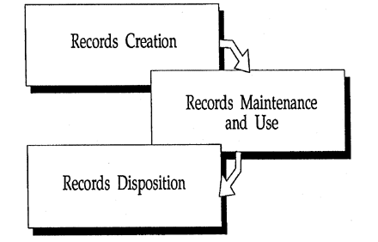
National Archives Records Life Cycle
National Archives and Records Administration (2000)

Slide 27
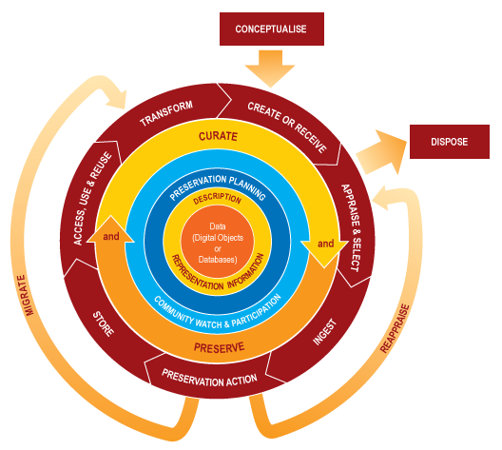
DCC Digital Curation Life Cycle

Slide 28
A Scientific Information Lifecycle
Alberto Pepe, AAHEP4 Summit (2010)

Slide 29
Some Good Advice
Capture tacit knowledge and make it explicit
Identify and nurture communities of practice
Find and disseminate best practices
Develop locators of both experts and expertise
Implement enterprise portals as gateways to corporate knowledge
Have clear taxonomies for major knowledge domains
Build robust data warehousing and business intelligence architectures
Focus on knowledge about the customer
Assure that corporate culture rewards knowledge sharing
Focus the enterprise on learning
Source: Ramon Barquin

Slide 30
Some Websites
http://www.skyrme.com
http://www.acm.org
http://www.ibm.com
http://www.kikm.org
http://www.scip.org
http://www.sla.org
http://www.sveiby.com
http://www.tfpl.com
http:/ /cpsquare.org
http://www.eknowledgecenter.com
http://www.icasit.org
http://www.knowledgeboard.com
http://www.uts.edu.au
http://www.KMPro.com
http://www.apqc.org
http://www.worldbank.org
http://www.kmresource.com
http://www.brint.com
http://www.cio.com
http://www.kmci.org
http://www.orgnet.com
http://www.km4dev.org
http://www.kmnetwork.com
https://www.youtube.com/watch?v=6pIFUOav2xE

