Slide 1
Data Mining
Session 17
INST 301
Introduction to Information Science

Slide 2
Agenda
Visualization
Data mining
Supervised machine learning

Slide 3
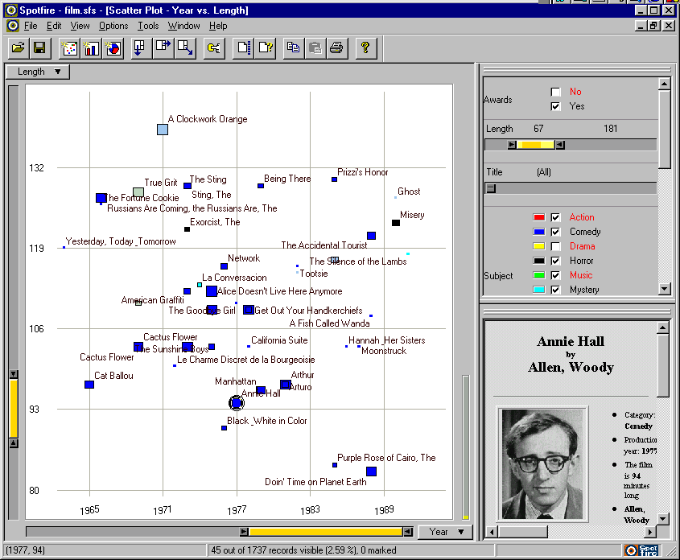
Starfield Visualization
Notes:
21

Slide 4
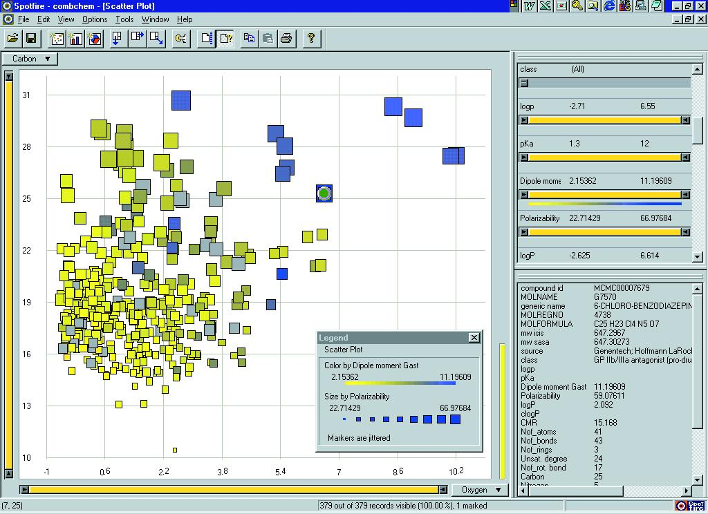

Slide 5
Constructing Starfield Displays
Two attributes determine the position
Can be dynamically selected from a list
Numeric position attributes work best
Date, length, rating, …
Other attributes can affect the display
Displayed as color, size, shape, orientation, …
Each point can represent a cluster
Interactively specified using “dynamic queries”
Notes:
22

Slide 6
Projection
Depict many numeric attributes in 2 dimensions
While preserving important spatial relationships
Typically based on the vector space model
Which has about 100,000 numeric attributes!
Approximates multidimensional scaling
Heuristics approaches are reasonably fast
Often visualized as a starfield
But the dimensions lack any particular meaning
Notes:
23

Slide 7
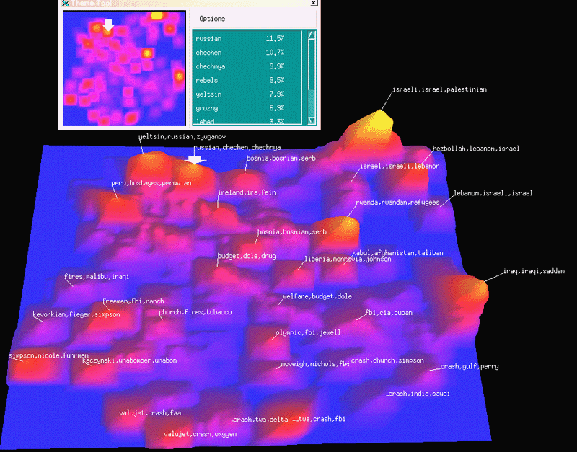

Slide 8
Contour Map Display
Display a cluster density as terrain elevation
Fit a smooth opaque surface to the data
Visualize in three dimensions
Project two 2-D and allow manipulation
Use stereo glasses to create a virtual “fishtank”
Create an immersive virtual reality experience
Mead mounted stereo monitors and head tracking
“Cave” with wall projection and body tracking
Notes:
24

Slide 9
Cluster Formation
Based on inter-document similarity
Computed using the cosine measure, for example
Heuristic methods can be fairly efficient
Pick any document as the first cluster “seed”
Add the most similar document to each cluster
Adding the same document will join two clusters
Check to see if each cluster should be split
Does it contain two or more fairly coherent groups?
Lots of variations on this have been tried
Notes:
20

Slide 10
Agenda
Visualization
Data mining
Supervised machine learning

Slide 11
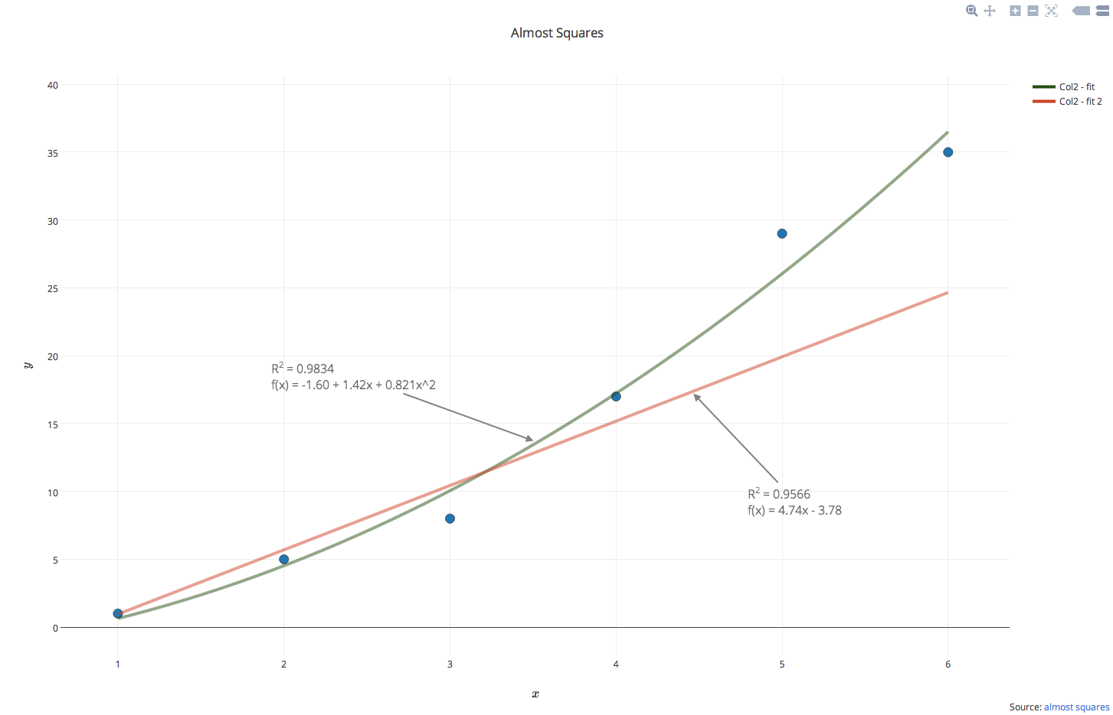
Curve Fitting

Slide 13
Text Data Mining

Slide 14
Agenda
Visualization
Data mining
Supervised machine learning

Slide 15
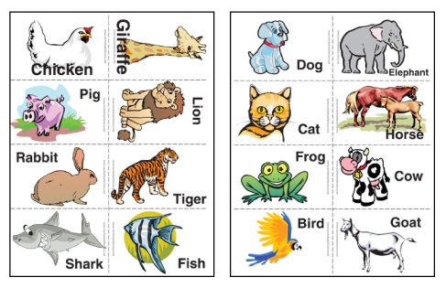
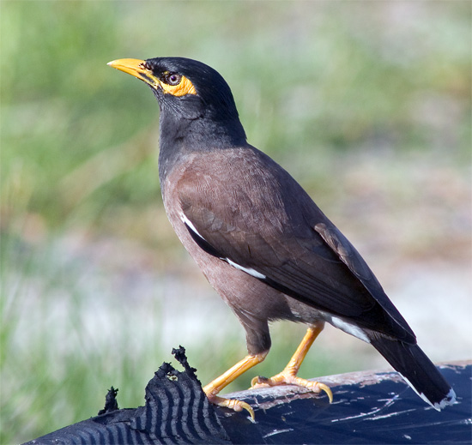

Slide 16
Cute Mynah Bird Tricks
Make scanned documents into e-text
Make speech into e-text
Make English e-text into Hindi e-text
Make long e-text into short e-text
Make e-text into hypertext
Make e-text into metadata
Make email into org charts
Make pictures into captions
…

Slide 18
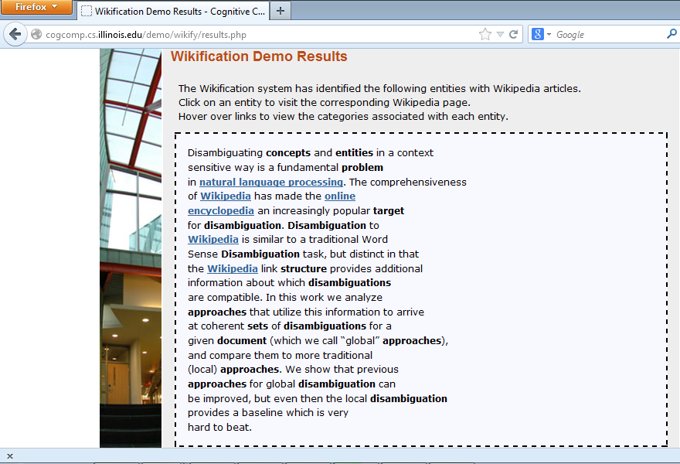
http://cogcomp.cs.illinois.edu/demo/wikify/?id=25

Slide 19
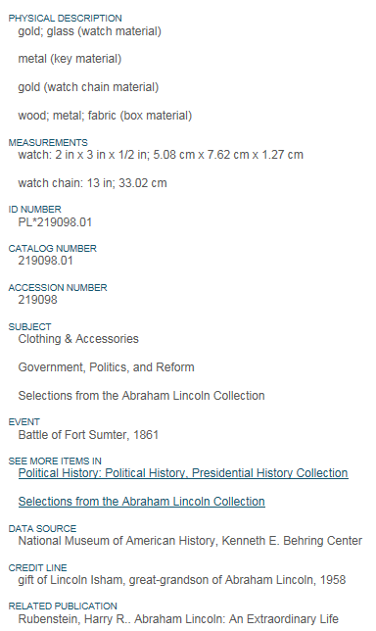
http://americanhistory.si.edu/collections/search/object/nmah_516567

Slide 20
Lincoln’s English gold watch was purchased in the 1850s from George Chatterton, a Springfield, Illinois, jeweler. Lincoln was not considered to be outwardly vain, but the fine gold watch was a conspicuous symbol of his success as a lawyer. The watch movement and case, as was often typical of the time, were produced separately. The movement was made in Liverpool, where a large watch industry manufactured watches of all grades. An unidentified American shop made the case. The Lincoln watch has one of the best grade movements made in England and can, if in good order, keep time to within a few seconds a day. The 18K case is of the best quality made in the US. A Hidden Message Just as news reached Washington that Confederate forces had fired on Fort Sumter on April 12, 1861, watchmaker Jonathan Dillon was repairing Abraham Lincoln's timepiece. Caught up in …

Slide 21
NEIL A. ARMSTRONG
INTERVIEWED BY DR. STEPHEN E. AMBROSE AND DR. DOUGLAS BRINKLEY
HOUSTON, TEXAS – 19 SEPTEMBER 2001
ARMSTRONG: I'd always said to colleagues and friends that one day I'd go back to the university. I've done a little teaching before. There were a lot of opportunities, but the University of Cincinnati invited me to go there as a faculty member and pretty much gave me carte blanche to do what I wanted to do. I spent nearly a decade there teaching engineering. I really enjoyed it. I love to teach. I love the kids, only they were smarter than I was, which made it a challenge. But I found the governance unexpectedly difficult, and I was poorly prepared and trained to handle some of the aspects, not the teaching, but just the—universities operate differently than the world I came from, and after doing it—and actually, I stayed in that job longer than any job I'd ever had up to that point, but I decided it was time for me to go on and try some other things.
AMBROSE: Well, dealing with administrators and then dealing with your colleagues, I know—but Dwight Eisenhower was convinced to take the presidency of Columbia [University, New York, New York] by Tom Watson when he retired as chief of staff in 1948, and he once told me, he said, "You know, I thought there was a lot of red tape in the army, then I became a college president." He said, "I thought we used to have awful arguments in there about who to put into what position." Have you ever been with a bunch of deans when they're talking about—
ARMSTRONG: Yes. And, you know, there's a lot of constituencies, all with different perspectives, and it's quite a challenge.
http://wikipedia-miner.cms.waikato.ac.nz/demos/annotate/

Slide 22
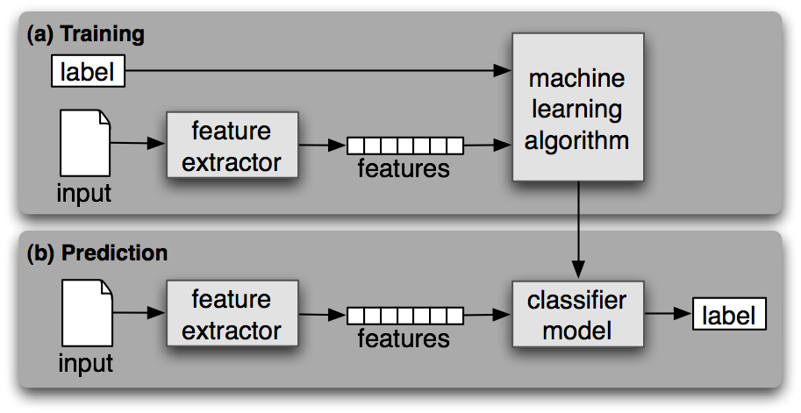
Supervised Machine Learning
Steven Bird et al., Natural Language Processing, 2006

Slide 23
Gender Classification Example
>>> classifier.show_most_informative_features(5) Most Informative Features
last_letter = 'a' female : male = 38.3 : 1.0 last_letter = 'k' male : female = 31.4 : 1.0 last_letter = 'f' male : female = 15.3 : 1.0 last_letter = 'p' male : female = 10.6 : 1.0 last_letter = 'w' male : female = 10.6 : 1.0
>>> for (tag, guess, name) in sorted(errors): print 'correct=%-8s guess=%-8s name=%-30s'
correct=female guess=male name=Cindelyn ... correct=female guess=male name=Katheryn correct=female guess=male name=Kathryn ... correct=male guess=female name=Aldrich ... correct=male guess=female name=Mitch ... correct=male guess=female name=Rich ...
NLTK Naïve Bayes

Slide 24
Some Supervised Learning Methods
Support Vector Machine
High accuracy
k-Nearest-Neighbor
Naturally accommodates multi-class problems
Decision Tree (a form of Rule Induction)
Explainable (at least near the top of the tree)
Maximum Entropy
Accommodates correlated features

Slide 25
Rule Induction
Automatically derived Boolean profiles
(Hopefully) effective and easily explained
Specificity from the “perfect query”
AND terms in a document, OR the documents
Generality from a bias favoring short profiles
e.g., penalize rules with more Boolean operators
Balanced by rewards for precision, recall, …
Notes:
21

Slide 26
Statistical Classification
Represent documents as vectors
e.g., based on TF, IDF, Length
Build a statistical model for each label
e.g., a “vector space”
Use that model to label new instances
e.g., by largest inner product
Notes:
25

Slide 27
The k-Nearest-Neighbor Classifier

Slide 28
Linear Separators
Which of the linear separators is optimal?
Original from Ray Mooney

Slide 29
Maximum Margin Classification
Implies that only “support vectors” matter; other training examples are ignorable.
Original from Ray Mooney

Slide 30
Supervised Learning Limitations
Rare events
It can’t learn what it has never seen!
Overfitting
Too much memorization, not enough generalization
Unrepresentative training data
Reported evaluations are often very optimistic
It doesn’t know what it doesn’t know
So it always guesses some answer
Unbalanced “class frequency”
Consider this when deciding what’s good enough

