Slide 1

Linked Open Data
Session 16
INST 301
Introduction to Information Science

Slide 2
Named Entity Recognition
Machine learning techniques can find:
  Location in the text of a reference to an entity
  Extent of that reference (i.e., which characters)
  Type of the entity (person, location, ...)
Two types of features are useful
  Orthography (e.g., paired capitalization)
  Trigger words (e.g., Mr., Professor, said, …)

Slide 3
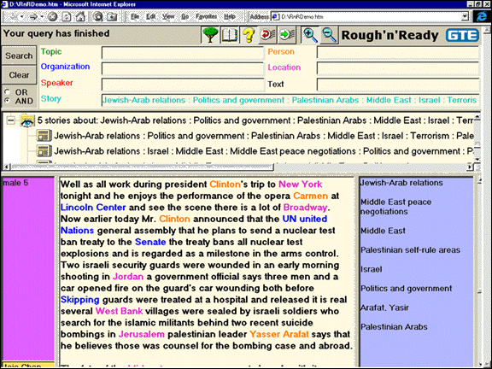

Slide 4
Reference Chaining
Variant forms of person names
  Nicknames, common forms of reference
Variant forms of other references
  Acronyms, abbreviations
Within-document co-reference resolution
  Named, nominal, pronominal

Slide 5
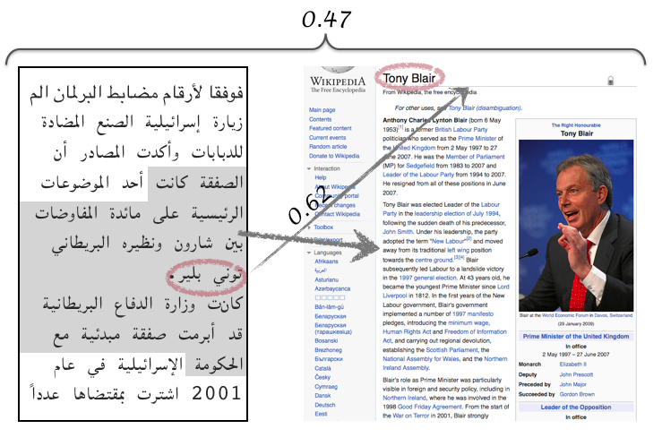
Cross-Document Entity Linking

Slide 6
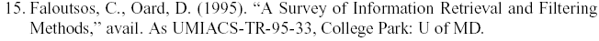
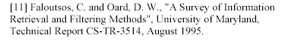
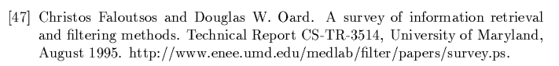
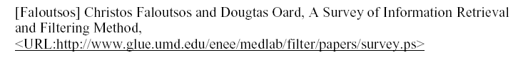
Example: Bibliographic References

Slide 7
Microformats
microformat
URL
<div class="h-card">
<p><img class="u-photo" href="/me.png" alt="" /></p>
<p class="p-name"> <a href="u-url"
href="http://waterpigs.co.uk">Barnaby Walters</a> </p>
</div>
plain-text
http://microformats.org/

Slide 8
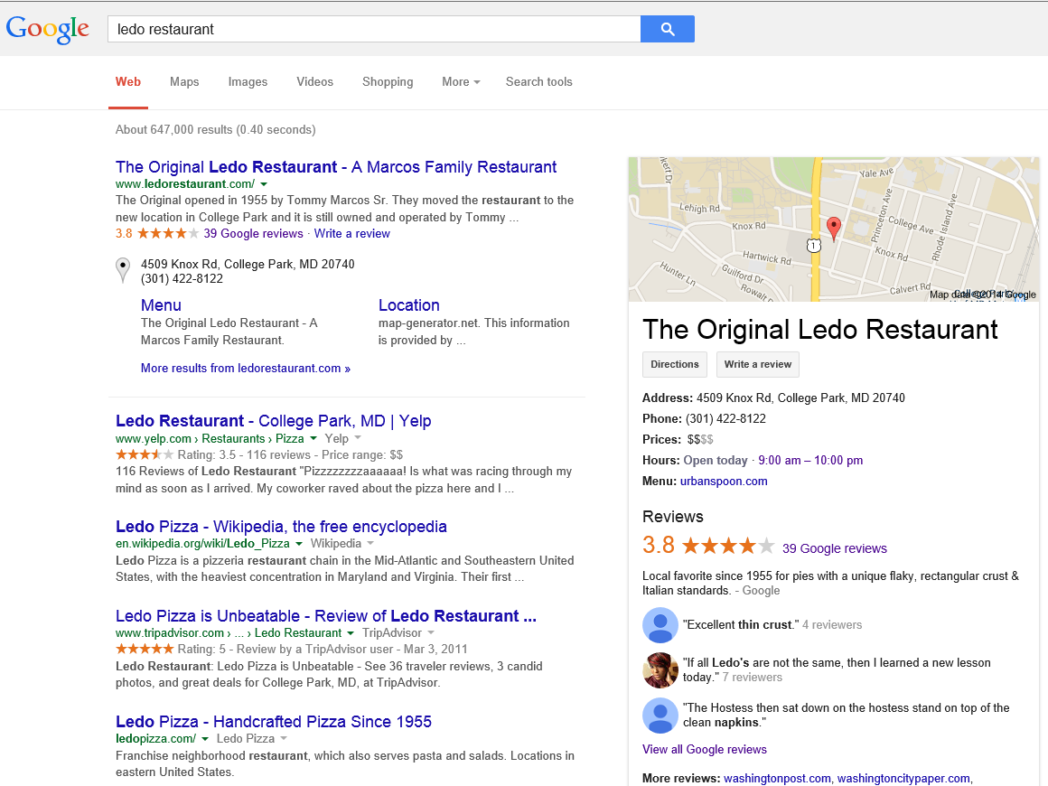

Slide 9
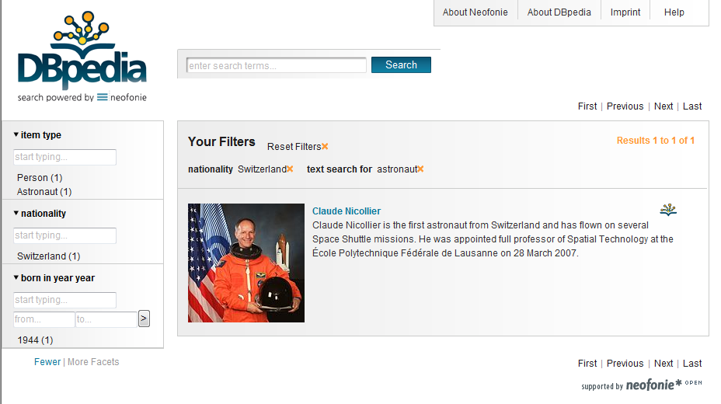
Semantic Search

Slide 10
Web Ontology Language (OWL)
<owl:Class rdf:about="http://dbpedia.org/ontology/Astronaut">
<rdfs:label xml:lang="en">astronaut</rdfs:label>
<rdfs:label xml:lang="de">Astronaut</rdfs:label>
<rdfs:label xml:lang="fr">astronaute</rdfs:label>
<rdfs:subClassOf
rdf:resource="http://dbpedia.org/ontology/Person">
</rdfs:subClassOf>
</owl:Class>

Slide 11






Knowledge-Base Population
When Lisa's mother Marge Simpson went to a weekend getaway at Rancho Relaxo, …
After two years in the academic quagmire of Springfield Elementary, Lisa finally has a teacher that she connects with. But she soon learns that the problem with being middle-class is that …
Springfield
Bottomless Pete, Nature’s
Cruelest Mistake
per:cities_of_residence
per:alternate_names
Marge Simpson
Homer Simpson
per:spouse
Springfield Elementary
per:children
per:children
per:schools_attended
Lisa Simpson
Bart Simpson
Paul McNamee et al, HLTCOE Participation at TAC 2012: Entity Linking and Cold Start Knowledge Base Construction
http://www.nist.gov/tac/publications/2012/papers.html

Slide 12
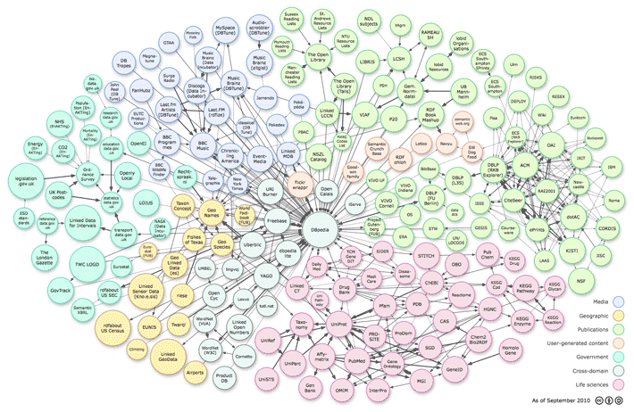
Linked Open Data

Slide 13
