Slide 1

Content Management Systems
Session 15
INST 301
Introduction to Information Science

Slide 2
Putting the Pieces Together
Browser
Web Server
Database
HTML
SQL Query
CGI
HTML
Results

Slide 3
Why Database-Generated Pages?
Remote access to a database
  Client does not need the database software
Serve rapidly changing information
  e.g., Airline reservation systems
Provide multiple “access points”
  By subject, by date, by author, …
Record user responses in the database

Slide 4
Why Content Management Systems?
Separation of content and appearance
Separation of roles
Standardization of common “design patterns”
  Login and password recovery
  Headlines and drill-down
  Site map
  Search
  Shopping cart

Slide 5
Content Management Systems
WordPress
  http://wordpress.org
Joomla
  http://www.joomla.org
Drupal
  https://drupal.org

Slide 6
Roles
Information architecture design
Task assignment
Content generation and modification
Approval for “publication”
Publication
Error correction
Tracking task progress

Slide 7
Client Hardware
(PC)
Interface
Design
Web Browser
(IE, Firefox)
Client-side Programming
(JavaScript)
Interaction
Design
Interchange Language
(HTML, XML)
Server-side Programming
(PHP)
Business
rules
Database
(MySQL)
Server Hardware
(PC, Unix)

Slide 8
Content Management System Structure
Database stores the content
  And access control data and parameters
Server scripting controls the user experience
  PHP reads database, generates HTML
HTML conveys the user experience
User-side scripting enhances interactivity
  JavaScript may be used for form validation

Slide 9
“Site Blueprint”
Main
Homepage
Teaching
Research
Other
Activities
LBSC 690
Ph.D.
Students
IR
Colloquium
INFM 718R
Publications
TREC
Doctoral
Seminar
Projects

Slide 10
Grid Layouts
Navigation Bar
Navigation Bar
Content
Content
Navigation Bar
Related Links
Navigation Bar
Content
Content

Slide 11
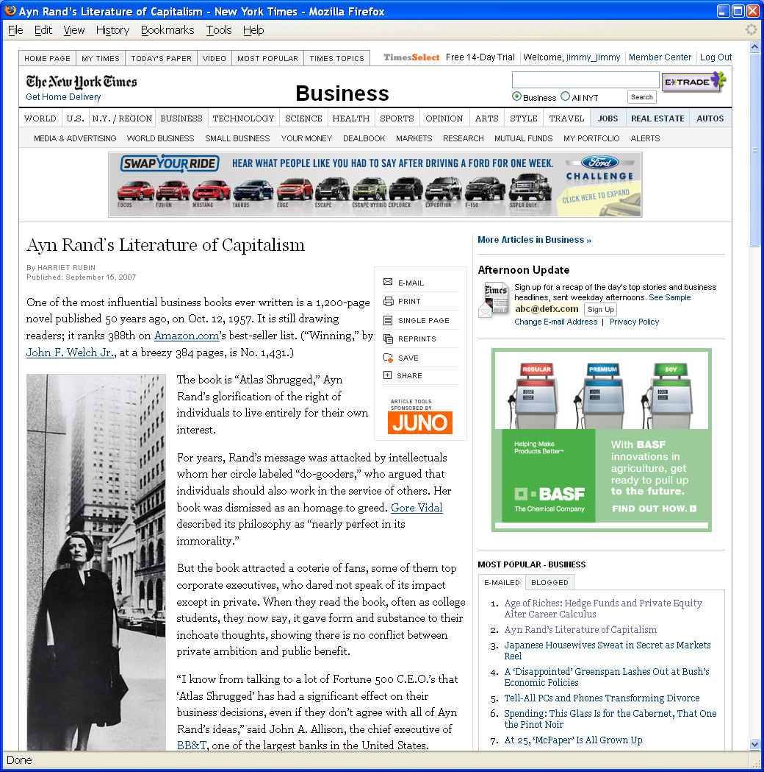
Grid Layout: NY Times

Slide 12
Grid Layout: NY Times
Navigation
Banner Ad
Another Ad
Content
Popular
Articles

Slide 13
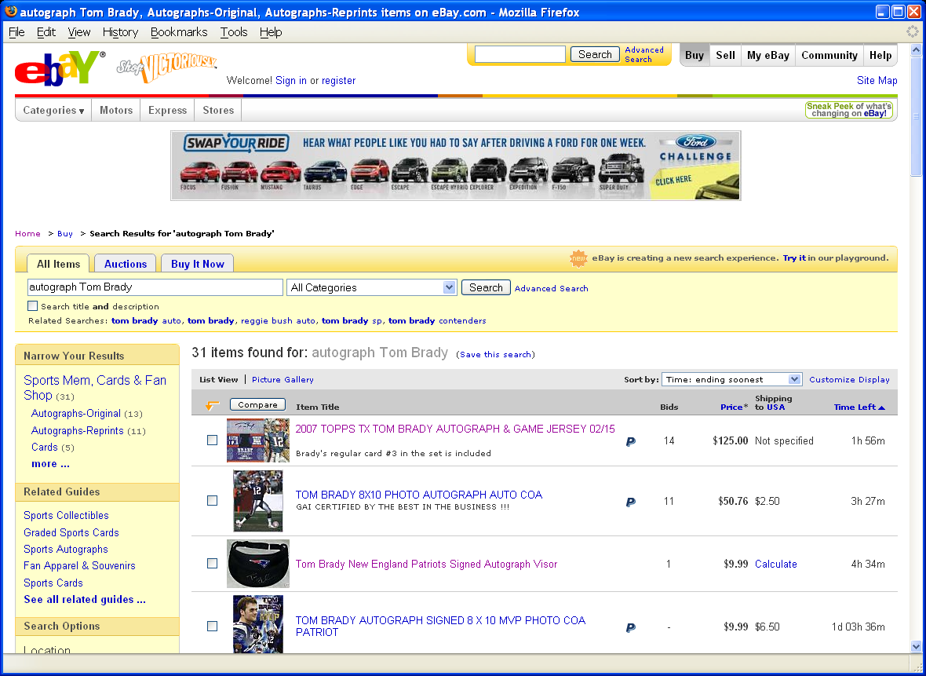
Grid Layout: ebay

Slide 14
Grid Layout: ebay
Navigation
Banner Ad
Navigation
Related
Search Results

Slide 15
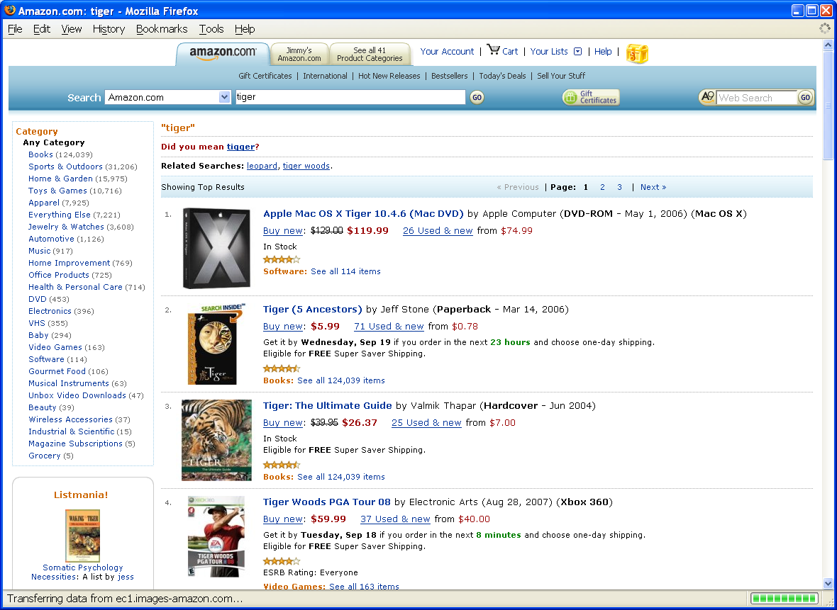
Grid Layout: Amazon

Slide 16
Grid Layout: Amazon
Navigation
Navigation
Related
Search Results

Slide 17
Drupal Structure
Front end
  The Web site
Back end
  Where the Web site is defined

Slide 18
Drupal Structure
Regions
  Header, left sidebar, content, right sidebar, footer
  Structure->Blocks->Demonstrate Blocks Region
Blocks
  Navigation, login, Drupal, help, content, search
  Optional: who’s online, recent comments, …
Menus
  Main, navigation, user

Slide 19
Drupal Content (“Nodes”)
Basic Page
Article
  By default allows comments
Blog entry
Forum topic

Slide 20
Optional Drupal Modules
Aggregator
Blog
Forum
Book
Contact form
Poll
Search
Statistics
Trigger
Translation

Slide 21
Some Downloadable Modules
Content Construction Kit
Views
OpenLayer
Dynamic Display Block
Embedded Media
Image Cache
Calendar
Share

Slide 22
Installing Drupal
Download and install XAMPP
  Add c:\xampp\mysql\bin to your path
Download and install Drupal
  Configure for local use (“first time user guide”)
  Ignore SMTP error messages
Configure your site
  Add some “splash page” content
  Set user permissions

Slide 23
Drupal’s Use of MySQL
USE drupal;
SHOW TABLES;
SELECT * FROM users;
SELECT * FROM nodes;
SELECT * FROM node_revisions;

Slide 24
Ajax Applications
Google Maps
  http://maps.google.com
Google Suggest
  http://www.google.com/webhp?complete=1&hl=en
Sajax Tables
  http://labs.revision10.com/?p=5
Sajax
  http://www.modernmethod.com/sajax/

Slide 25
